Slide 1

CS 1674: Neural Networks
PhD. Nils Murrugarra-Llerena
nem177@pitt.edu

Slide 2
Outline
Motivation Neural Networks
Perceptron
Activation Functions
Training a Neural Network
  Weight Initialization
  Forward Propagation
  Loss Function
  Regularization
  Gradient Descent
  Backpropagation
Notes:
Add labs in slides [x]
See Slides UPC: https://drive.google.com/drive/u/5/folders/1mgUmU5HHiAvGctnixFs2AyI-yhmPe_gM
Missing material from CS2770? [x]
Review Sandra Avila course (Find interactive animations / material) [ … ]
See Slides
Neural Networks
Adicionar link a videos (fin)
Deep Learning
CNN Architectures
Transfer Learning
##
Animations
CNN explainer: https://poloclub.github.io/cnn-explainer/
2D vis: https://adamharley.com/nn_vis/cnn/2d.html
Feature Visualization: https://distill.pub/2017/feature-visualization/
See inspiration slide from Neural Networks [ Prof. Sandra Avila ]
##
TensorFlow PlayGround (Neural Networks): https://playground.tensorflow.org/#activation=sigmoid&batchSize=10&dataset=gauss&regDataset=reg-plane&learningRate=0.03&regularizationRate=0&noise=0&networkShape=1&seed=0.35802&showTestData=false&discretize=false&percTrainData=50&x=true&y=true&xTimesY=false&xSquared=false&ySquared=false&cosX=false&sinX=false&cosY=false&sinY=false&collectStats=false&problem=classification&initZero=false&hideText=false
Neural Network Visualization: https://adamharley.com/nn_vis/mlp/2d.html
Add Videos (Slide 66) - https://docs.google.com/presentation/d/1dP5C_q3MCPKEW12np0zTipIE3otErBDKaXKSxdGNElQ/edit?slide=id.ga40fee7c02_0_556#slide=id.ga40fee7c02_0_556
Backpropagation proof: https://dustinstansbury.github.io/theclevermachine/derivation-backpropagation
Animation Slide 77 - https://docs.google.com/presentation/d/1Fgirul2xaI09Su0TYajt5IEEBJdcywsDDcfeV8yL2iw/edit?slide=id.g1589d442ea7_0_1619#slide=id.g1589d442ea7_0_1619
Gradient Descent animation: http://ruder.io/optimizing-gradient-descent/
Review Stanford CV-DL course
Add AhaSlides Activities

Slide 3
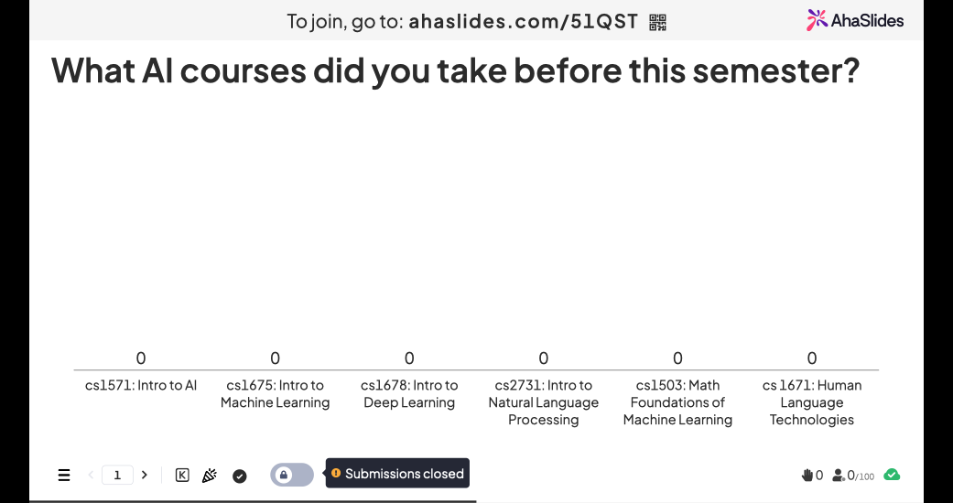

Slide 4
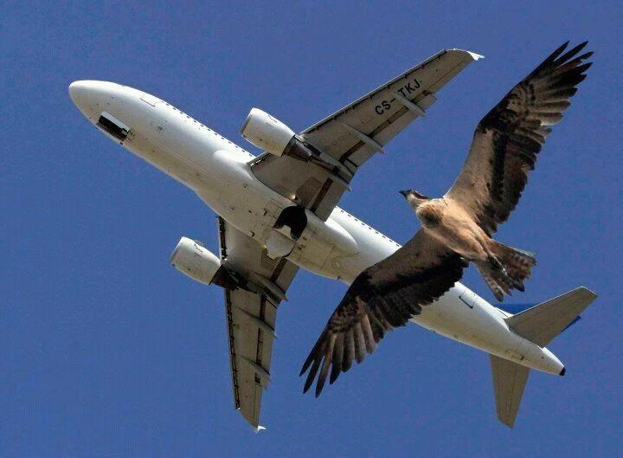
Many inventions were inspired by Nature ...
4
Birds inspired us to fly
https://i.pinimg.com/736x/18/4a/cc/184accf6b4d7980d2c2e8090ff295cd7--animal-tracks-friends.jpg
Slide Credit: Prof. Sandra Avila - UNICAMP

Slide 5
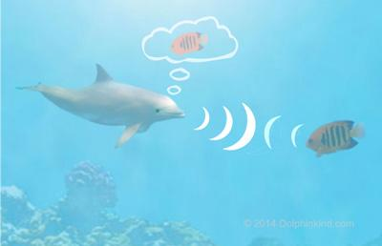
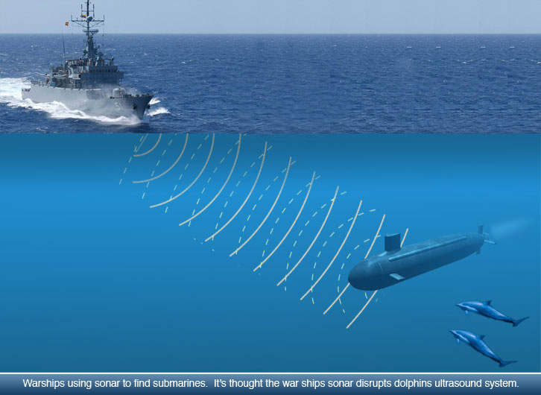
Many inventions were inspired by Nature ...
5
Dolphins inspired sonar development
http://www.dolphinkind.com/images/dolphin_echolocation.jpg
https://sites.google.com/site/echolocationkawproject/_/rsrc/1459209762464/sonars/image.jpeg
Slide Credit: Prof. Sandra Avila - UNICAMP

Slide 6
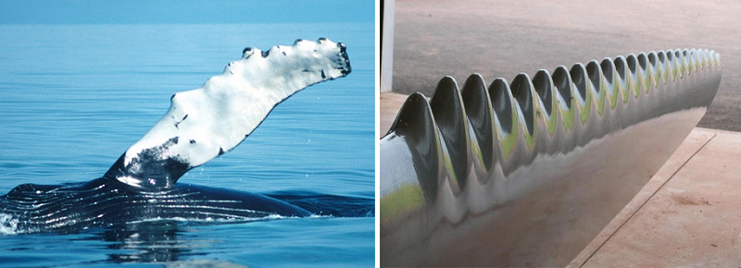
Many inventions were inspired by Nature ...
6
Humpback whales inspired wind turbines
https://images.app.goo.gl/7muFj7RTQLLRDYdh9
Slide Credit: Prof. Sandra Avila - UNICAMP

Slide 7
It seems logical to look at the
brain’s architecture for inspiration on
how to build an intelligent machine.
7
Slide Credit: Prof. Sandra Avila - UNICAMP
Notes:
This is the key idea that inspired Artificial Neural Networks (ANNs). However, although planes were inspired by birds, they don’t have to flap their wings. Similarly, ANNs have gradually become quite different from their biological cousins.

Slide 8

8
ILSVRC 2012 — Image Classification task
Rank | Name | Error Rate (%) | Description
1 | University of Toronto |  | Deep Learning
2 | University of Tokyo | 26.2 | Hand‐crafted features and learning models
3 | University of Oxford | 26.9
4 | Xerox/INRIA | 27.0
Object recognition over 1,000,000 images and 1,000 categories (2 GPU)
“ImageNet classification with deep convolutional neural networks”. NIPS, 2012.
Slide Credit: Prof. Sandra Avila - UNICAMP
8

Slide 9
9
ILSVRC 2012 — Image Classification task
Rank | Name | Error Rate (%) | Description
1 | University of Toronto | 15.3 | Deep Learning
2 | University of Tokyo | 26.2 | Hand‐crafted features and learning models
3 | University of Oxford | 26.9
4 | Xerox/INRIA | 27.0
Object recognition over 1,000,000 images and 1,000 categories (2 GPU)
“ImageNet classification with deep convolutional neural networks”. NIPS, 2012.
Slide Credit: Prof. Sandra Avila - UNICAMP
9

Slide 10
10
26.1%
Classification error
15.3%
11.2%
Human: 5.0%
6.7%
3.6%
3.0%
2.3%
2011 2012 2013 2014 2015 2016 2017
ILSVRC year
“ImageNet classification with deep convolutional neural networks”. NIPS, 2012.
Slide Credit: Prof. Sandra Avila - UNICAMP
10

Slide 11
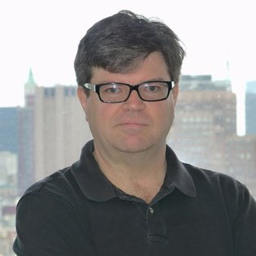
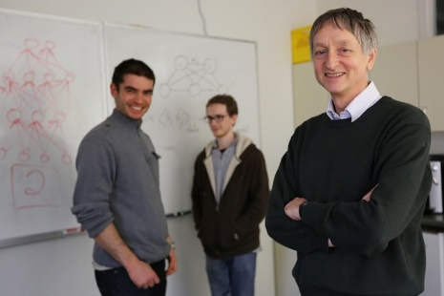
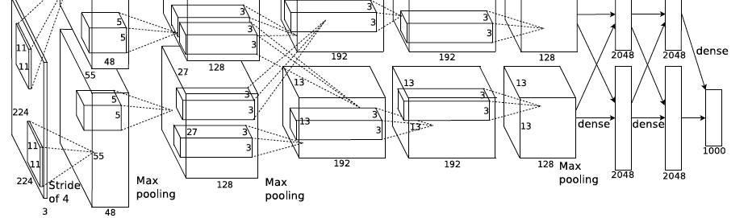
ImageNet Challenge 2012
AlexNet: Similar framework to LeCun’98 but:
  Bigger model (7 hidden layers, 650,000 units, 60,000,000 params)
  More data (10⁶ vs. 10³ images)
  GPU implementation (50x speedup over CPU)
    Trained on two GPUs for a week
  Better regularization for training (DropOut)
A. Krizhevsky, I. Sutskever, and G. Hinton, ImageNet Classification with Deep Convolutional Neural Networks, NIPS 2012
Adapted from Lana Lazebnik
Notes:
Two-GPU architecture

Slide 12
Will this wave die out like the previous ones did?
12

Slide 13
From Biological to Artificial Neurons
13
There is now a huge quantity of data available to train neural networks.
Computing power now makes it possible to train large neural networks in a reasonable amount of time.
The training algorithms have been improved.
ANNs seem to have entered a virtuous circle of funding and progress.
Slide Credit: Prof. Sandra Avila - UNICAMP

Slide 14
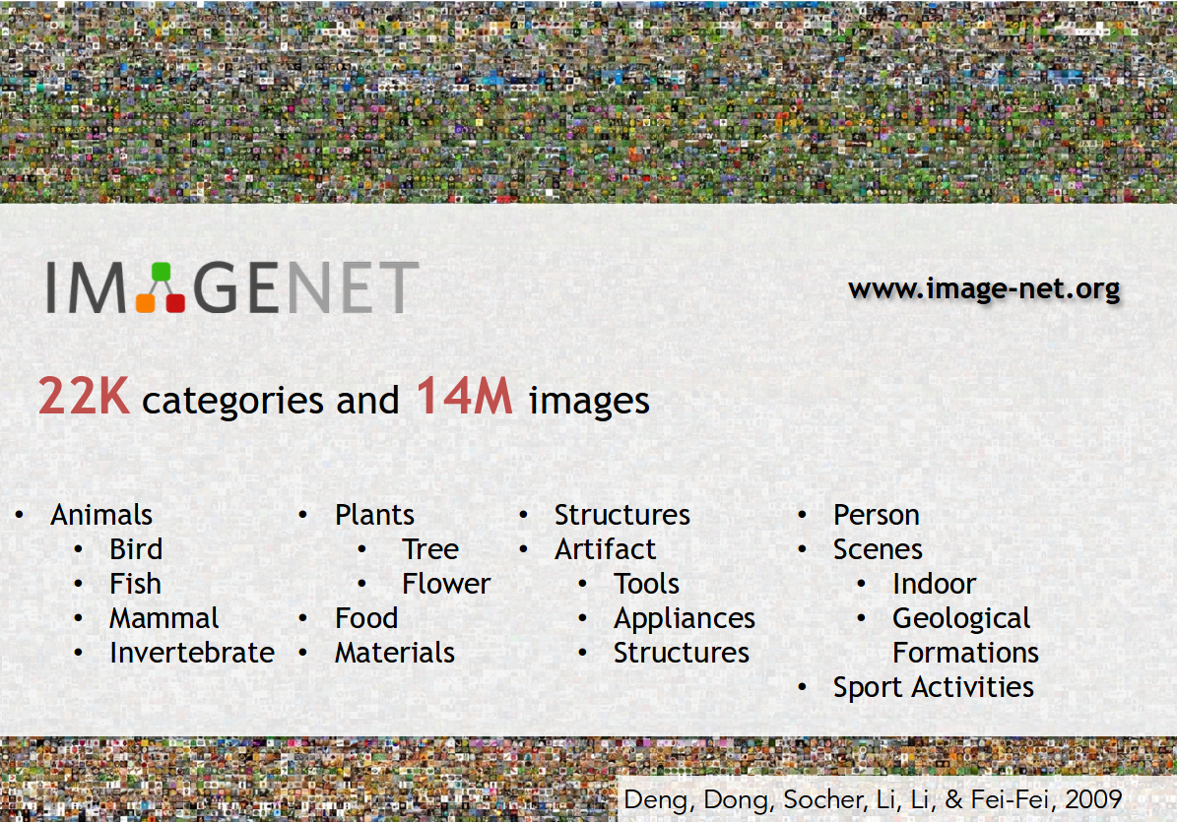
14

Slide 15
From Biological to Artificial Neurons
15
There is now a huge quantity of data available to train neural networks.
Computing power now makes it possible to train large neural networks in a reasonable amount of time.
The training algorithms have been improved.
ANNs seem to have entered a virtuous circle of funding and progress.
Slide Credit: Prof. Sandra Avila - UNICAMP

Slide 16
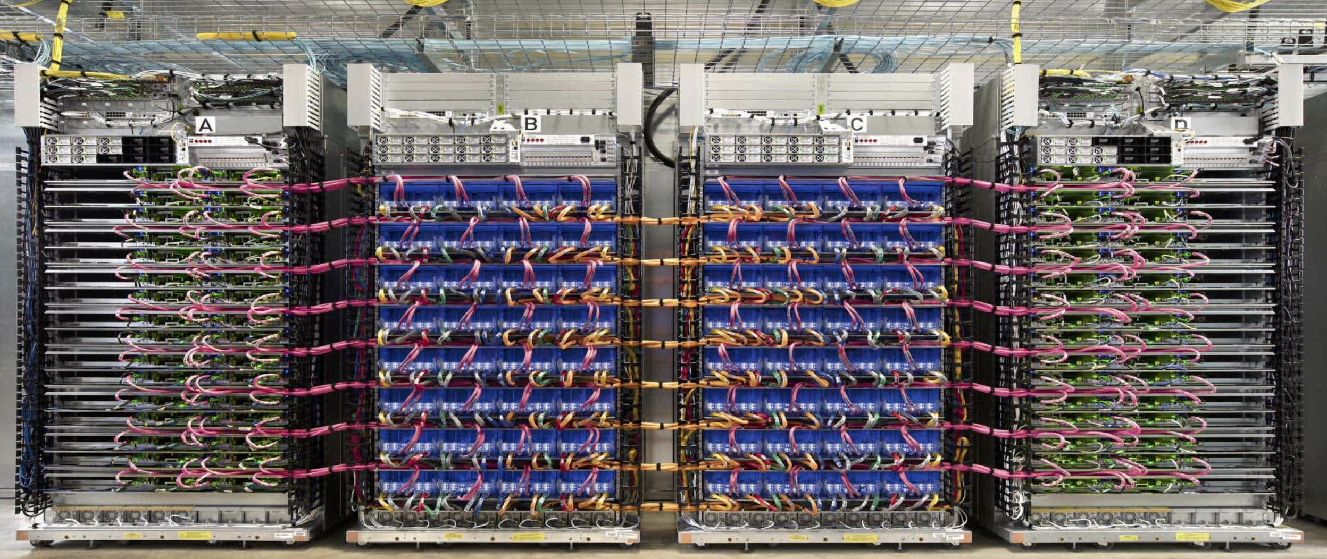
16
http://www.tomshardware.com/news/google-automl-aritifical-intelligence-ai,34533.html

Slide 17

Lab 6: Pytorch
Duration: 20 min
Notes:
[Content]
Section 1
1.1 Creating Tensors [For Class]
1.2. Operations in Pytorch [For Class]
1.3: Manipulating Tensors in Pytorch [Extra]
Section 2
Autograd [For Class]
[Exercises]
Coding Exercise 1.1 [Extra]
Coding Exercise 1.2 [For Class]
Coding Exercise 1.3 [Extra]

Slide 18
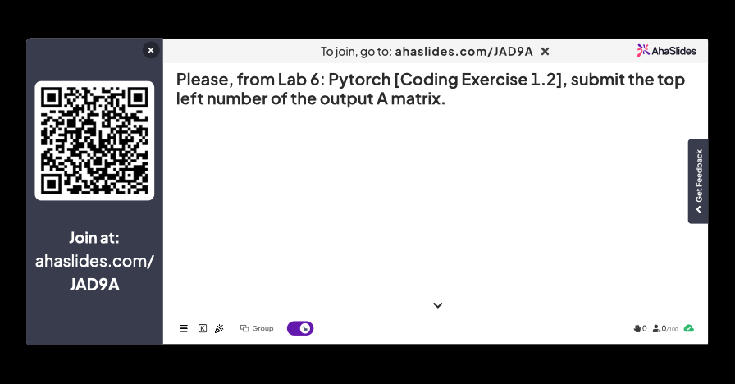

Slide 19
Assignment 6: Pytorch

Slide 20
From Biological to Artificial Neurons
20
There is now a huge quantity of data available to train neural networks.
Computing power now makes it possible to train large neural networks in a reasonable amount of time.
The training algorithms have been improved.
ANNs seem to have entered a virtuous circle of funding and progress.
Slide Credit: Prof. Sandra Avila - UNICAMP

Slide 21
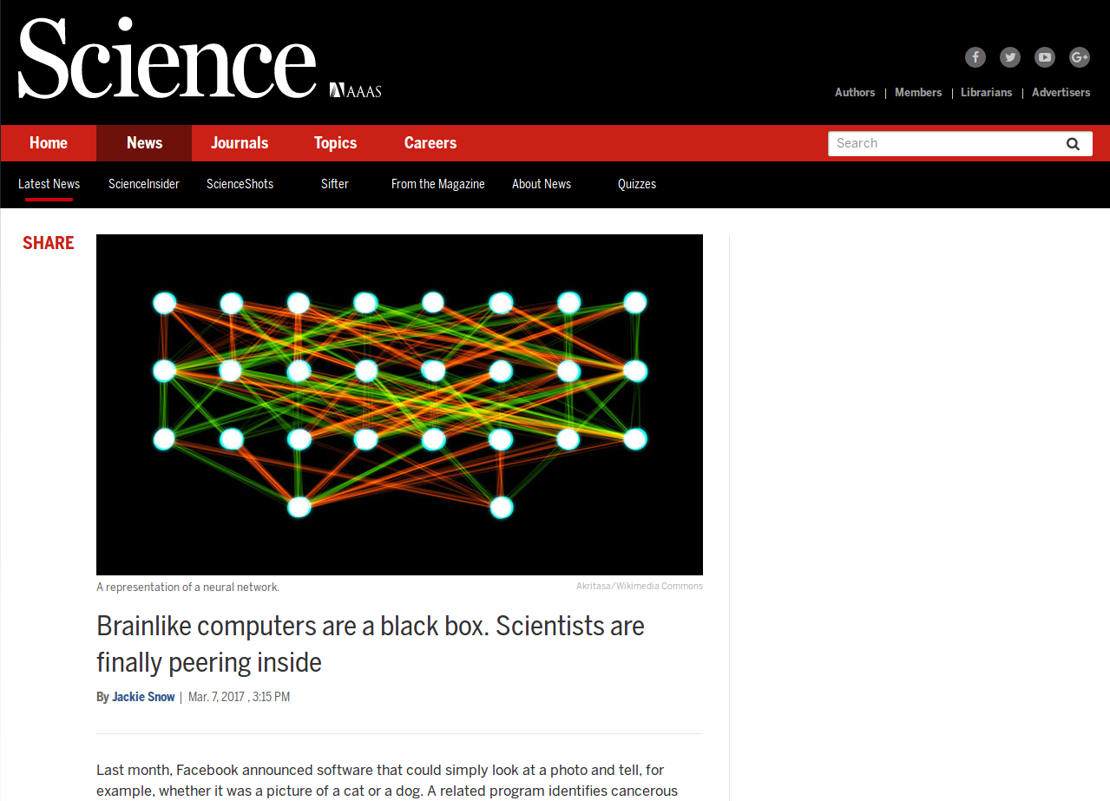
21
http://www.sciencemag.org/news/2017/03/brainlike-computers-are-black-box-scientists-are-finally-peering-inside

Slide 22
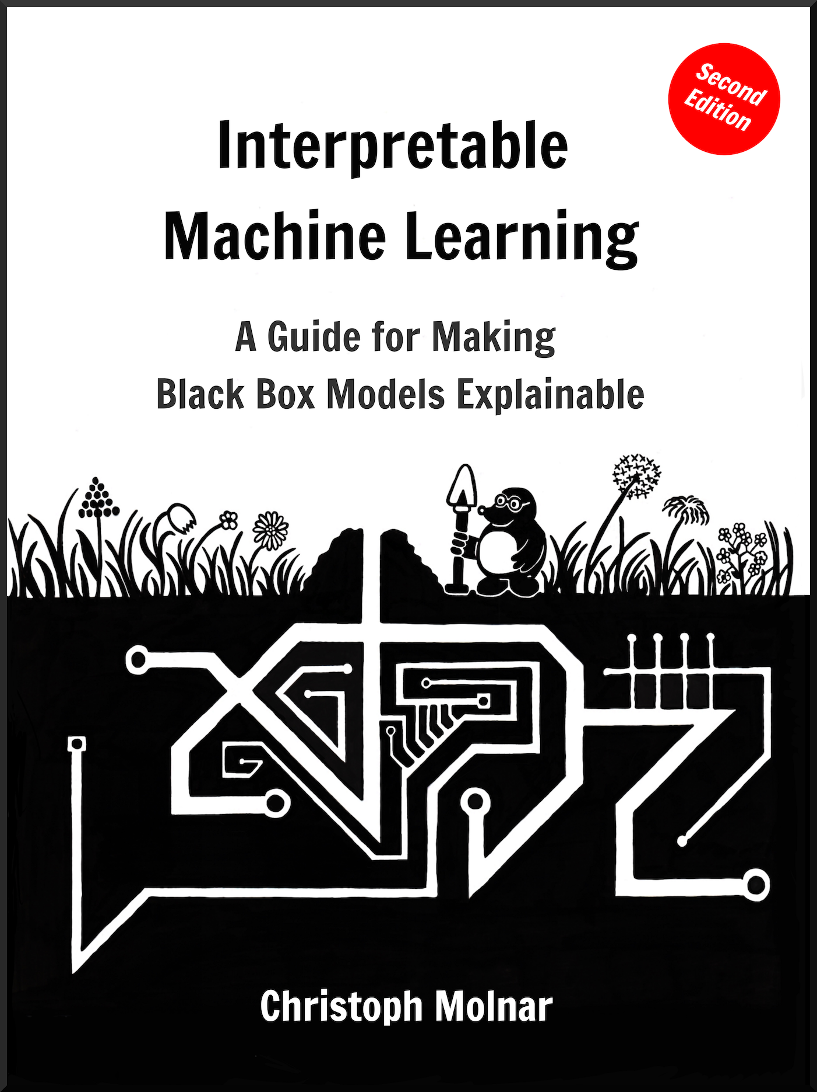
22
“Interpretable Machine Learning”, 2022 https://christophm.github.io/interpretable-ml-book Chap. 10 Neural Network Interpretation
Slide Credit: Prof. Sandra Avila - UNICAMP

Slide 23
From Biological to Artificial Neurons
23
There is now a huge quantity of data available to train neural networks.
Computing power now makes it possible to train large neural networks in a reasonable amount of time.
The training algorithms have been improved.
ANNs seem to have entered a virtuous circle of funding and progress.
Slide Credit: Prof. Sandra Avila - UNICAMP

Slide 24
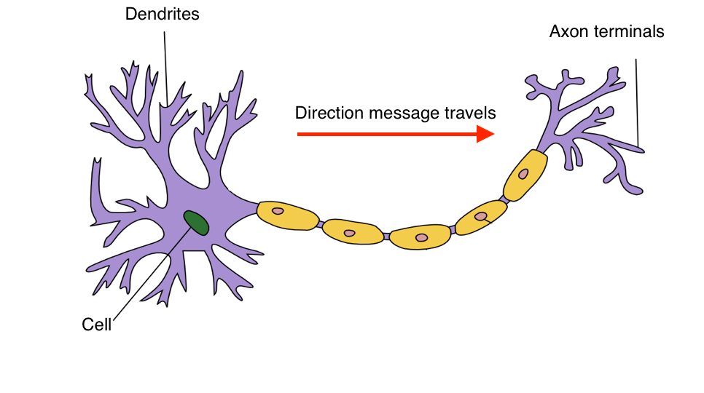
Biological Neurons
http://www.jeremyjordan.me/content/images/2017/06/Neuron_Hand-tuned.png
Signal
Slide Credit: Prof. Sandra Avila - UNICAMP

Slide 25


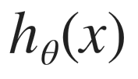
Biological Neurons - Analogy
x₁
𝜃₁
⠇
𝜃_{n}
x_{n}
Slide Credit: Prof. Sandra Avila - UNICAMP

Slide 26
The Perceptron
26
Invented in 1957 by Frank Rosenblatt.
It is based on a Linear Threshold Unit (LTU):
  The inputs and output are now numbers and each input connection is associated with a weight.
The LTU computes a weighted sum of its inputs then it applies a step function to that sum and outputs the result.
Slide Credit: Prof. Sandra Avila - UNICAMP

Slide 27
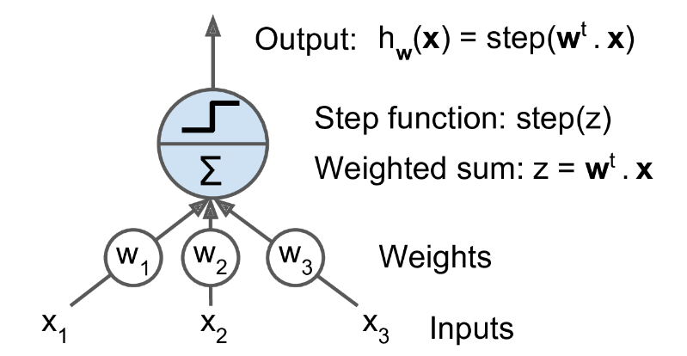
The Perceptron
27
Linear Threshold Unit
Slide Credit: Prof. Sandra Avila - UNICAMP

Slide 28
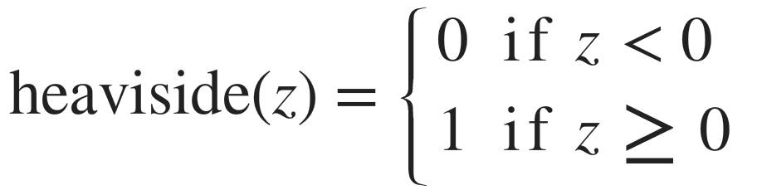
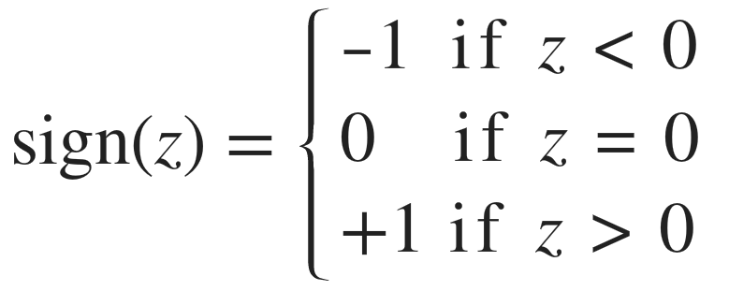
The Perceptron
28
Linear Threshold Unit
Slide Credit: Prof. Sandra Avila - UNICAMP

Slide 29
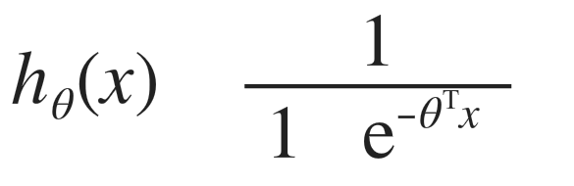
Neuron Model: Logistic Unit
29
=
Inputs
+
Logistic
function
Output
x₁
𝜃₁
x₂
𝜃₂
𝜃₃
x₃
Slide Credit: Prof. Sandra Avila - UNICAMP

Slide 30
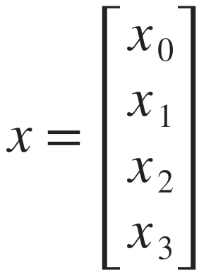
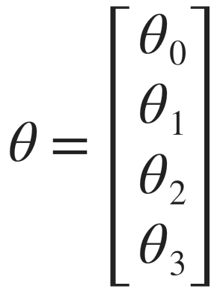
Neuron Model: Logistic Unit
30
weights
x₀
𝜃₀
x₁
𝜃₁
x₂
𝜃₂
Output
𝜃₃
x₃
=
Sigmoid (Logistic) activation function
+
Inputs
Slide Credit: Prof. Sandra Avila - UNICAMP

Slide 31

TensorFlow PlayGround

Slide 32
[Example] Simple Example: AND
32
1
0.5
0
g(z)
x₁, x₂ ∈ {0,1}
y = x₁ AND x₂
z
+1
-30
x₁ x₂
+20
x₁
0 0 g(-30) ≈ 0
0 1 g(-10) ≈ 0
1 0 g(-10) ≈ 0
1 1 g(10) ≈ 1
g(-30) ≈ 0
g(-10) ≈ 0
+20
g(-10) ≈ 0
x₂
g(10) ≈ 1
= g(-30 + 20x₁ + 20x₂)
Slide Credit: Prof. Sandra Avila - UNICAMP

Slide 33
[Example] Simple Example: OR
1
0.5
0
g(z)
x₁, x₂ ∈ {0,1}
y = x₁ OR x₂
z
+1
-10
x₁ x₂
+20
x₁
0 0 g(-30) ≈ 0
0 1 g(-10) ≈ 0
1 0 g(-10) ≈ 0
1 1 g(10) ≈ 1
g(-10) ≈ 0
g(10) ≈ 1
g(10) ≈ 1
g(30) ≈ 1
+20
x₂
= g(-10 + 20x₁ + 20x₂)
Slide Credit: Prof. Sandra Avila - UNICAMP

Slide 34
Multi-class Classification?

Slide 35
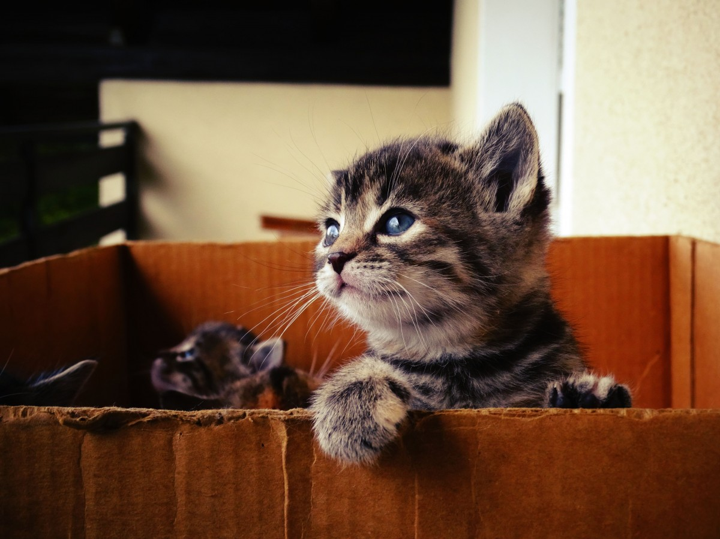
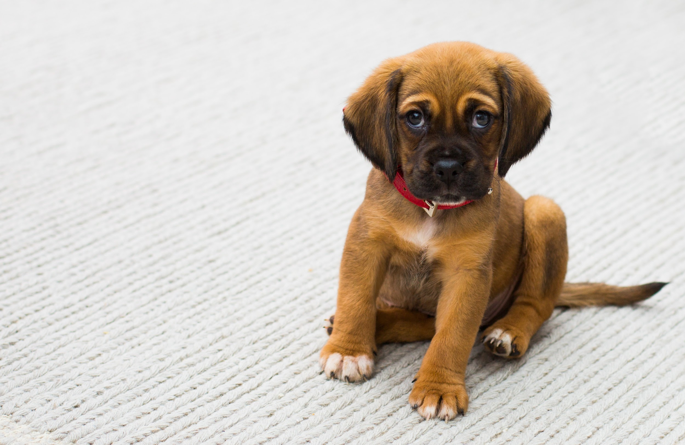

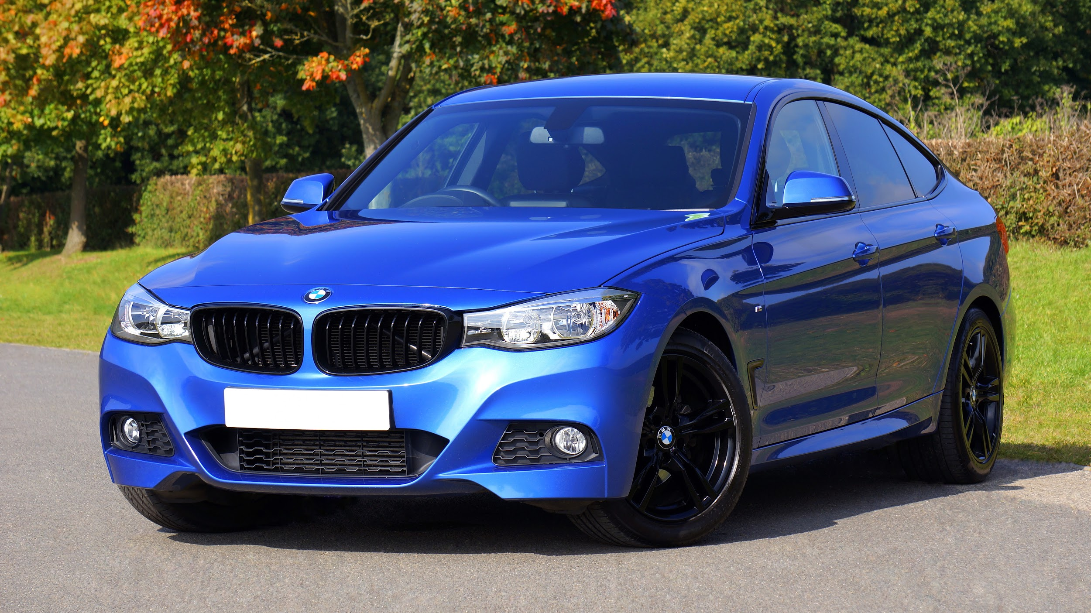
Multi-class Classification
Cat
Dog
Frog
Car
cat?
dog?
frog?
car?
Slide Credit: Prof. Sandra Avila - UNICAMP

Slide 36
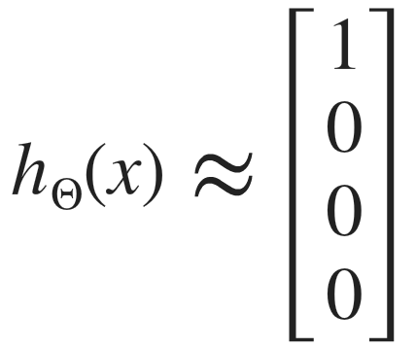
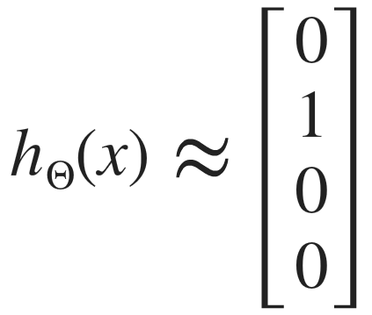
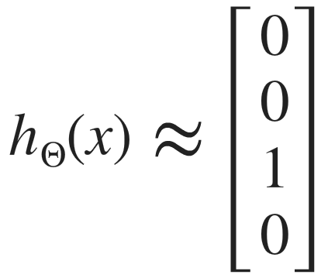
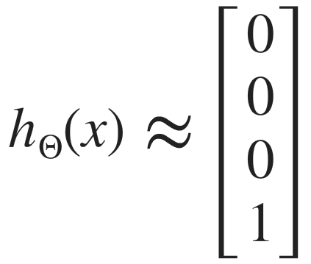
Cat
Dog
Frog
Car
cat?
dog?
frog?
car?
Want , , ,
when cat
when dog
when frog
when car

Slide 37
Softmax Classification
The output layer is typically modified by replacing the individual activation functions by a shared softmax function.
cat?
dog?
frog?
car?
Slide Credit: Prof. Sandra Avila - UNICAMP

Slide 38
Softmax Classification
The output layer is typically modified by replacing the individual activation functions by a shared softmax function.
cat?
dog?
frog?
car?
Softmax
Slide Credit: Prof. Sandra Avila - UNICAMP

Slide 39
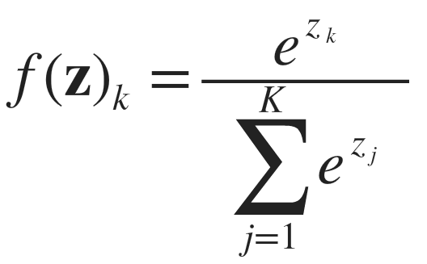
Softmax Classification
The output layer is typically modified by replacing the individual activation functions by a shared softmax function.
Softmax
Slide Credit: Prof. Sandra Avila - UNICAMP

Slide 40
Softmax Classification
Softmax
Cat
Dog
Frog
Car
5.1
3.2
-1.7
-2.0
164.0
24.5
0.18
0.13
0.87
0.13
0.00
0.00
Slide Credit: Prof. Sandra Avila - UNICAMP

Slide 41
How do we decide whether the neuron should fire or not?
Slide Credit: Prof. Sandra Avila - UNICAMP

Slide 42
We decided to add “activation functions”
for this purpose.
Slide Credit: Prof. Sandra Avila - UNICAMP
Notes:
To check the Y value produced by a neuron and decide whether outside connections should consider this neuron as “fired” or not. Or rather let’s say — “activated” or not.

Slide 43
Step Function
Its output is 1 (activated) when value > 0 (threshold) and outputs a 0 (not activated) otherwise.
1
0.5
0
z
Slide Credit: Prof. Sandra Avila - UNICAMP

Slide 44
Step Function: Problem?
Binary classifier (“yes” or “no”, activate or not activate). A Step function could do that for you!
Multi classifier (class1, class2, class3, etc). What will happen if more than 1 neuron is “activated”?
Slide Credit: Prof. Sandra Avila - UNICAMP

Slide 45
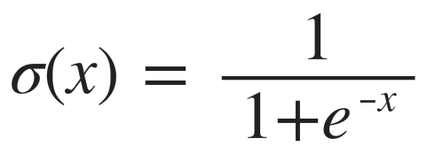
Sigmoid Function
The output of the activation function is always going to be in range (0,1).
It is nonlinear in nature.
1
0.5
0
x
Slide Credit: Prof. Sandra Avila - UNICAMP

Slide 46
Sigmoid Function
The output of the activation function is always going to be in range (0,1).
It is nonlinear in nature.
1
0.5
0
x
Combinations of this function are also nonlinear! Great!!
Slide Credit: Prof. Sandra Avila - UNICAMP

Slide 47
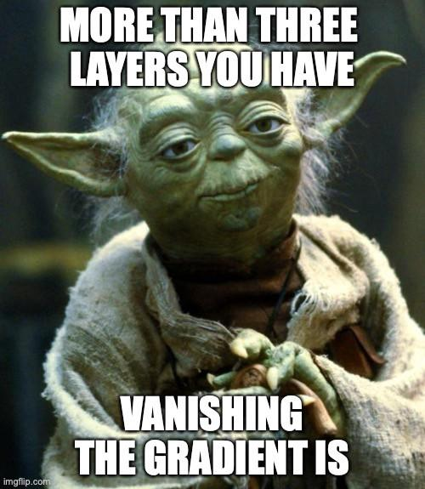
Sigmoid Function: Problem?
Towards either end of the sigmoid function, the 𝜎(x) values tend to respond very less to changes in x.
The problem of “vanishing gradients”.
  Cannot make significant change because of the extremely small value.
Slide Credit: Prof. Sandra Avila - UNICAMP

Slide 48
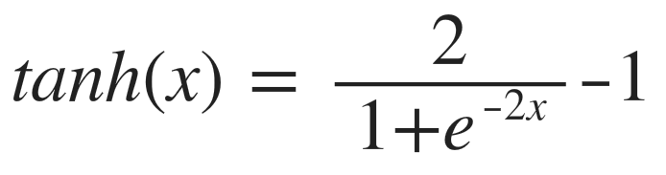
Tanh Function
The output of the activation function is always going to be in range (-1,1).
It is nonlinear in nature.
Combinations of this function are also nonlinear! Great!!
1
0
-1
x
Slide Credit: Prof. Sandra Avila - UNICAMP

Slide 49
Tanh Function: Problem?
Like sigmoid, tanh also has the vanishing gradient problem.
Slide Credit: Prof. Sandra Avila - UNICAMP

Slide 50
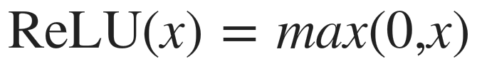
ReLU (Rectified Linear Unit) Function
20
10
0
It gives an output x if x is positive and 0 otherwise. The range is [0, inf).
It is nonlinear in nature. Combinations of this function are also nonlinear!
Sparsity of the activation!
x
Slide Credit: Prof. Sandra Avila - UNICAMP
Notes:
Another point that I would like to discuss here is the sparsity of the activation. Imagine a big neural network with a lot of neurons. Using a sigmoid or tanh will cause almost all neurons to fire in an analog way ( remember? ). That means almost all activations will be processed to describe the output of a network. In other words the activation is dense. This is costly. We would ideally want a few neurons in the network to not activate and thereby making the activations sparse and efficient.
ReLu give us this benefit.

Slide 51
ReLU Function: Problem?
Because of the horizontal line in ReLU (for negative x), the gradient can go towards 0.
“Dying ReLU problem”: several neurons can just die and not respond making a substantial part of the network passive.
Slide Credit: Prof. Sandra Avila - UNICAMP

Slide 52

Leaky ReLU Function
20
10
0
It gives an output x if x is positive
and 0 otherwise. The range is [0, inf).
(Leaky) ReLU is less computationally expensive than tanh and sigmoid because it involves simpler mathematical operations.
x
Slide Credit: Prof. Sandra Avila - UNICAMP

Slide 53
Ok! Which One Do We Use?
If you don’t know the nature of the function you are trying to learn, start with ReLU.
You can use your own custom functions too!
Slide Credit: Prof. Sandra Avila - UNICAMP

Slide 54
Neural Network
54
Layer 1 = Input layer
Layer 2 = Hidden layer
Layer 3 = Output layer
x₁
a₁
⁽²⁾
x₂
a₂
⁽²⁾
x₃
a₃
⁽²⁾
Layer 1
Layer 2
Layer 3
Slide Credit: Prof. Sandra Avila - UNICAMP

Slide 55
Neural Network
55
bias unit
Layer 1 = Input layer
Layer 2 = Hidden layer
Layer 3 = Output layer
x₀
a₀
⁽²⁾
x₁
a₁
⁽²⁾
x₂
a₂
⁽²⁾
x₃
a₃
⁽²⁾
Layer 1
Layer 2
Layer 3
Slide Credit: Prof. Sandra Avila - UNICAMP

Slide 56
Neural Network
56
^{(j)}
a_{i}
“activation” of unit i in layer j
^{(j)}
𝚯
matrix of weights controlling function mapping from layer j to layer j + 1
x₀
a₀
⁽²⁾
x₁
a₁
⁽²⁾
x₂
a₂
a₁
⁽²⁾
⁽³⁾
x₃
a₃
⁽²⁾
Layer 1
Layer 2
Layer 3
Slide Credit: Prof. Sandra Avila - UNICAMP

Slide 57
57
x₁
⁽²⁾
^{(j)}
a₁
a_{i}
“activation” of unit i in layer j
^{(j)}
x₂
a₂
⁽²⁾
⁽³⁾
𝚯
a₁
matrix of weights controlling function mapping from layer j to layer j + 1
x₃
a₃
⁽²⁾
Slide Credit: Prof. Sandra Avila - UNICAMP

Slide 58
58
x₁
a₁
^{(j)}
⁽²⁾
a_{i}
“activation” of unit i in layer j
^{(j)}
x₂
a₂
⁽³⁾
⁽²⁾
a₁
𝚯
matrix of weights controlling function mapping from layer j to layer j + 1
x₃
a₃
⁽²⁾
Slide Credit: Prof. Sandra Avila - UNICAMP

Slide 59
59
x₁
a₁
^{(j)}
⁽²⁾
a_{i}
“activation” of unit i in layer j
^{(j)}
x₂
a₂
⁽³⁾
⁽²⁾
a₁
𝚯
matrix of weights controlling function mapping from layer j to layer j + 1
x₃
a₃
⁽²⁾
Slide Credit: Prof. Sandra Avila - UNICAMP

Slide 60
60
x₁
a₁
^{(j)}
⁽²⁾
a_{i}
“activation” of unit i in layer j
⁽³⁾
^{(j)}
x₂
a₂
⁽²⁾
a₁
𝚯
matrix of weights controlling function mapping from layer j to layer j + 1
x₃
a₃
⁽²⁾
Slide Credit: Prof. Sandra Avila - UNICAMP

Slide 61
x₁
a₁
⁽²⁾
a_{i}
^{(j)}
“activation” of unit i in layer j
x₂
a₂
^{(j)}
⁽²⁾
⁽³⁾
𝚯
a₁
matrix of weights controlling function mapping from layer j to layer j + 1
x₃
⁽²⁾
a₃

Slide 62
62
x₁
⁽²⁾
^{(j)}
a₁
a_{i}
“activation” of unit i in layer j
⁽²⁾
^{(j)}
x₂
a₂
⁽³⁾
𝚯
a₁
matrix of weights controlling function mapping from layer j to layer j + 1
x₃
⁽²⁾
a₃
Feedforward Neural Network
(forward propagating)

Slide 63
Neural Network Intuition
63
Layer 1
Layer 2
Layer 3
Layer 4
Complexity
Slide Credit: Prof. Sandra Avila - UNICAMP

Slide 64
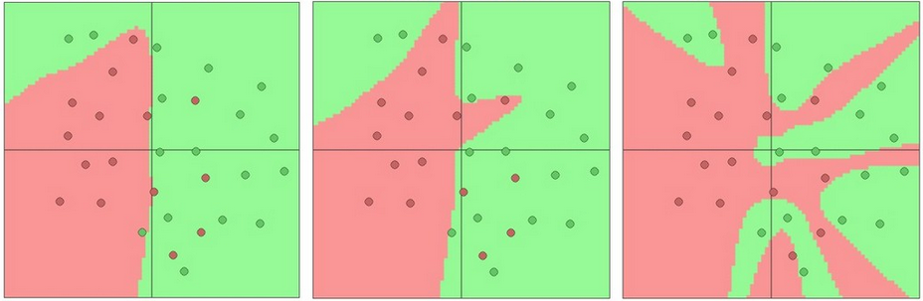
Neural Network Intuition
64
Toy 2d classification with 2-layer neural network
http://cs.stanford.edu/people/karpathy/convnetjs/demo/classify2d.html
http://cs231n.github.io/assets/nn1/layer_sizes.jpeg
3 hidden neurons
6 hidden neurons
20 hidden neurons
Slide Credit: Prof. Sandra Avila - UNICAMP

Slide 65
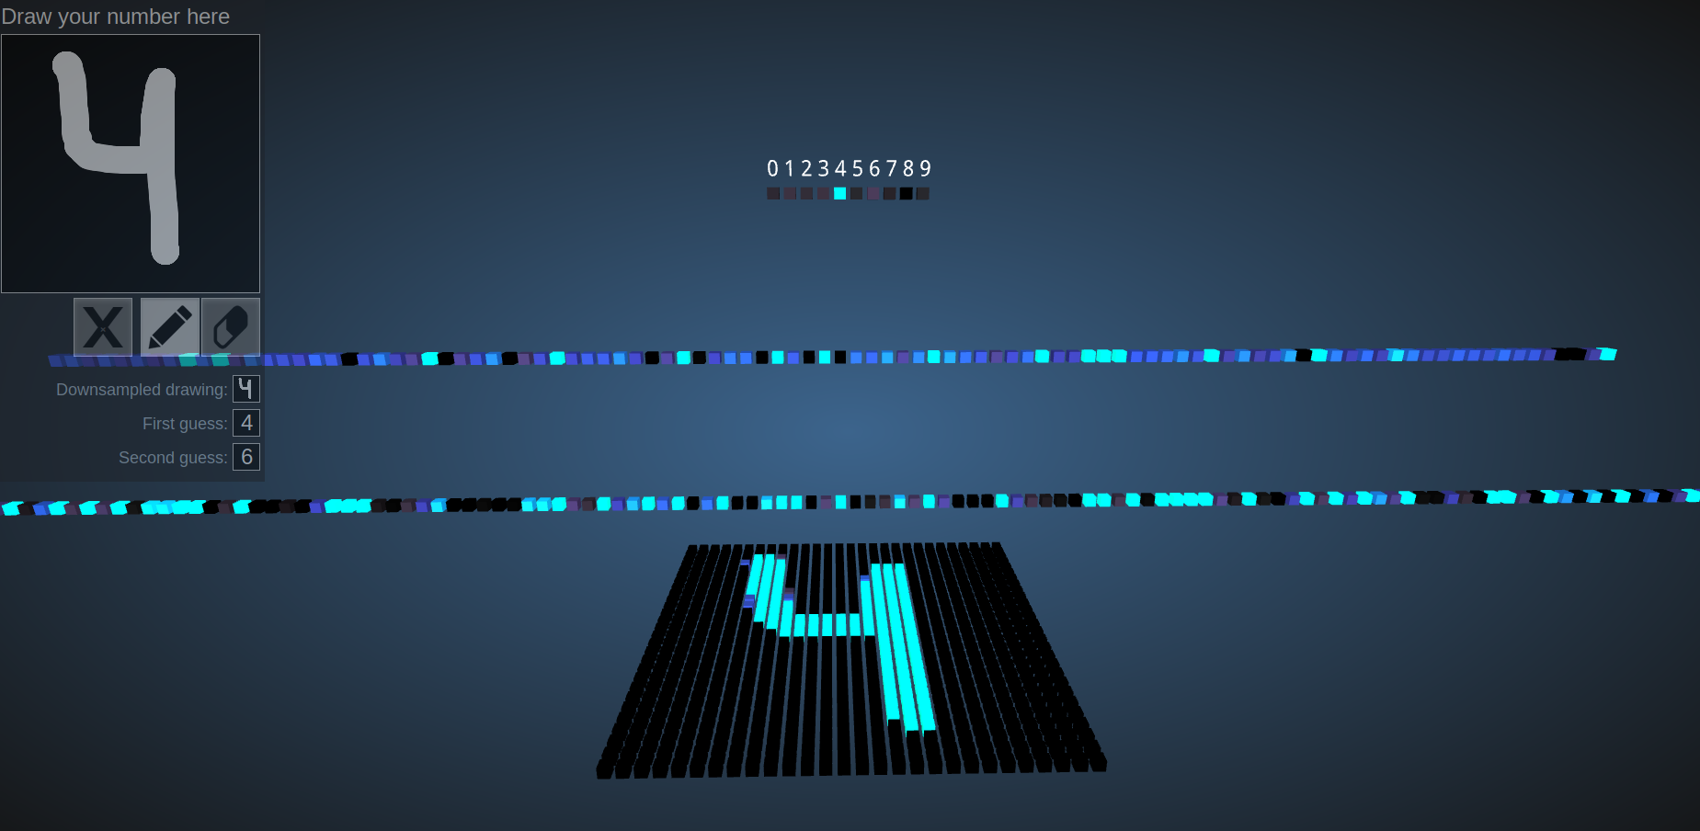
https://adamharley.com/nn_vis/mlp/2d.html

Slide 66
Training a Neural Network

Slide 67
Training a Neural Network
The first thing we need to do is to “select” an architecture.
Input units: dimensionality of the problem (features x)
Output units: Number of classes
Hidden units (per layer)
Slide Credit: Prof. Sandra Avila - UNICAMP

Slide 68
Training a Neural Network
Hidden units (per layer):
  Usually, the more, the better
  Good start: a number close to the number of input
  Default: 1 hidden layer. If you have >1 hidden layer, then it is interesting that you have the same number of units in every hidden layer.
Slide Credit: Prof. Sandra Avila - UNICAMP

Slide 69
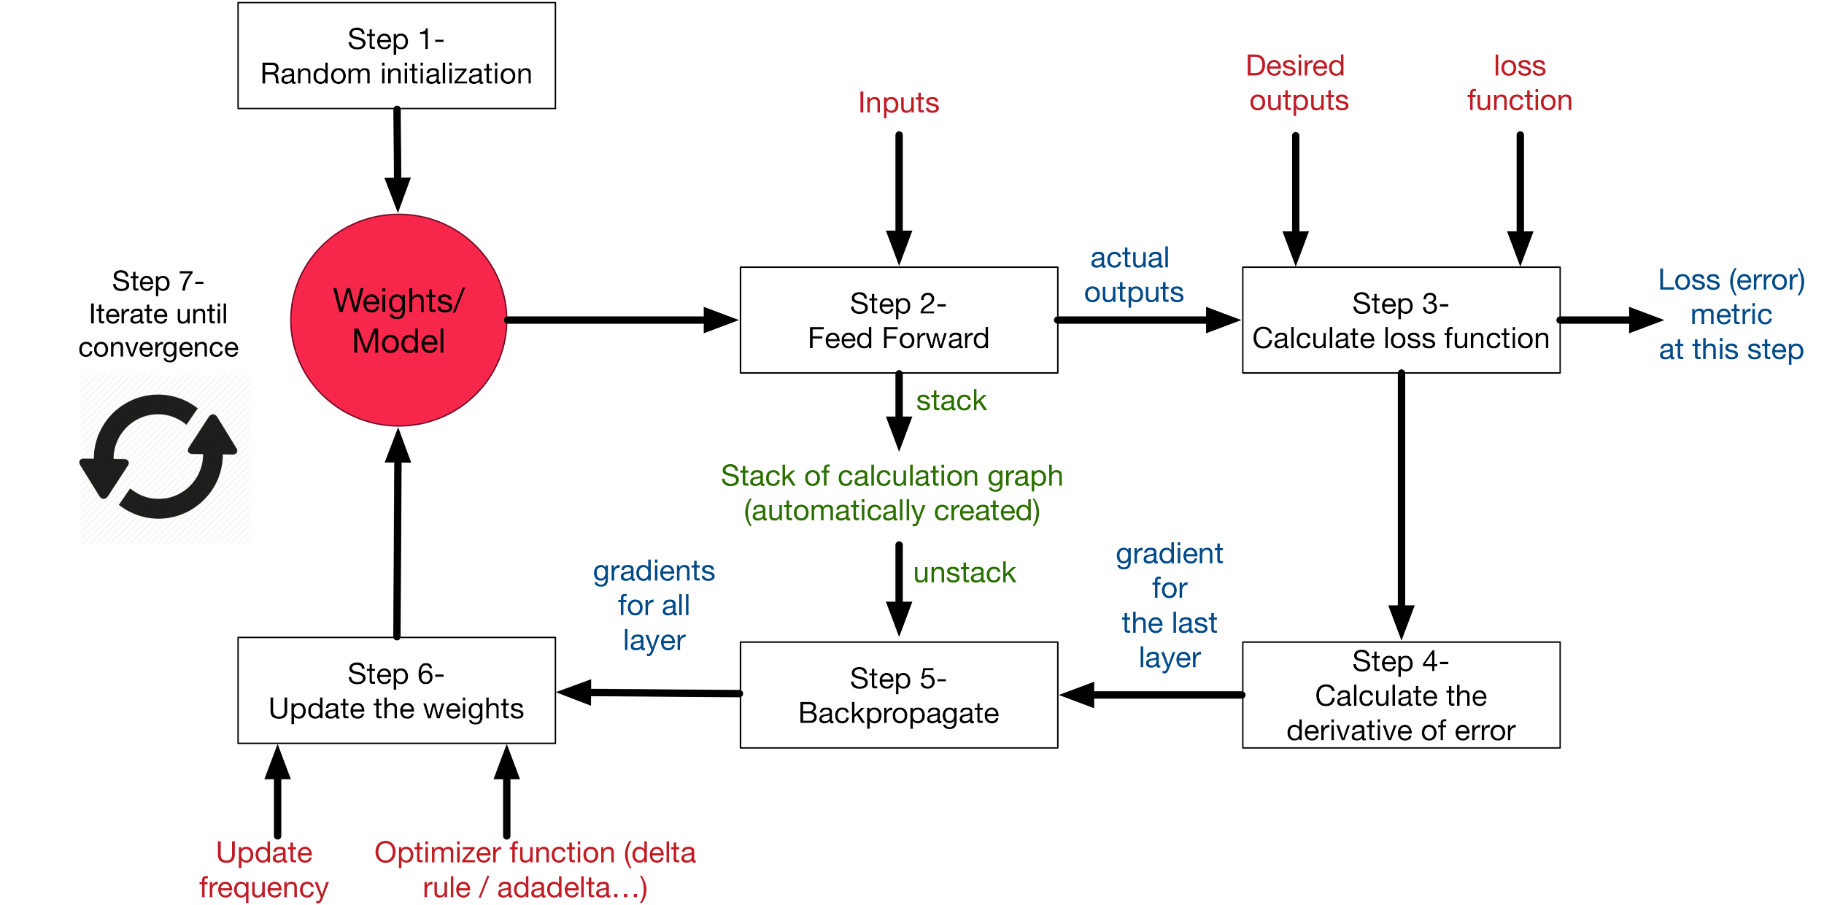
Training a Neural Network

Slide 70
Training a Neural Network
Slide Credit: Prof. Sandra Avila - UNICAMP

Slide 71
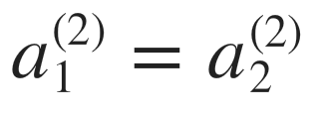
Zero Initialization
Symmetric Weights
1
1
x₁
⁽²⁾
⁽³⁾
a₁
a₁
x₂
⁽²⁾
a₂
After each update, parameters corresponding to inputs going into each of two hidden units are identical.
Slide Credit: Prof. Sandra Avila - UNICAMP

Slide 72
Symmetric Breaking
We must initialize 𝚯 to a random value in [-𝜀, 𝜀] (i.e. [-𝜀 ≤ 𝚯 ≤ 𝜀])
Slide Credit: Prof. Sandra Avila - UNICAMP

Slide 73
Today’s Initialization
Xavier initialization [Glorot & Bengio, 2010]: “Understanding the difficulty of training deep feedforward neural networks”, http://proceedings.mlr.press/v9/glorot10a/glorot10a.pdf
𝚯 = np.random.randn(n)*sqrt(2.0/n)
He initialization [He et al., 2015]: “Delving Deep into Rectifiers: Surpassing Human-Level Performance on ImageNet Classification” https://arxiv.org/pdf/1502.01852
Slide Credit: Prof. Sandra Avila - UNICAMP

Slide 74
Today’s Initialization
Xavier initialization [Glorot & Bengio, 2010]:
n = input + output
He initialization [He et al., 2015]:
n = input
𝚯 = np.random.randn(n)*sqrt(2.0/n)
Slide Credit: Prof. Sandra Avila - UNICAMP
Notes:
https://medium.com/@piyushkashyap045/mastering-weight-initialization-in-neural-networks-a-beginners-guide-6066403140e9

Slide 75
Training a Neural Network
Slide Credit: Prof. Sandra Avila - UNICAMP

Slide 76
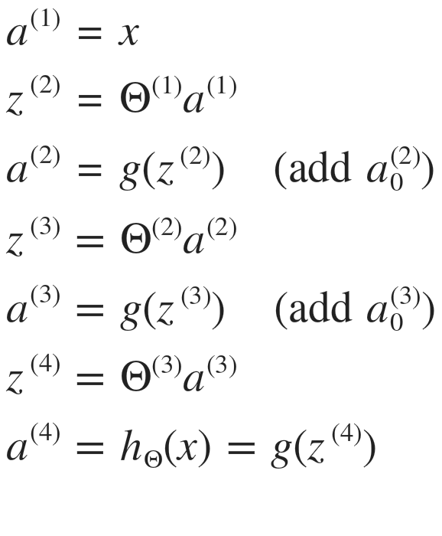
Forward Propagation
Given one training example (x, y):
Slide Credit: Prof. Sandra Avila - UNICAMP

Slide 77
Training a Neural Network
Slide Credit: Prof. Sandra Avila - UNICAMP

Slide 78
Training a Neural Network
Slide Credit: Prof. Sandra Avila - UNICAMP

Slide 79
[Loss Function ] How do we train deep neural networks?
The goal is to find such a set of weights that allow the activations/outputs to match the desired output: f(𝚯, x_{i}) ~ y_{i}
Unfortunately, no closed-form solution for weights 𝚯, but we can express our objective.
We want to minimize a loss function (a function of the weights in the network), we’ll do so iteratively.
For now, let’s simplify and assume there’s a single layer of weights in the network.

Slide 80
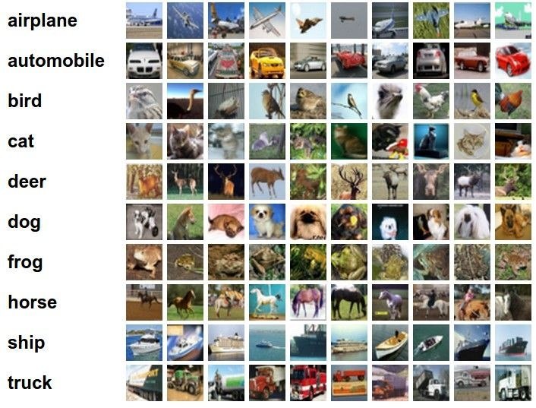
Classification goal
Example dataset: CIFAR-10
10 labels
50,000 training images each image is 32x32x3
10,000 test images
Andrej Karpathy

Slide 81

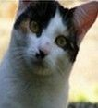
Classification scores
𝚯
𝚯
image
parameters
f(x,𝚯)
10 numbers, indicating class scores
[32x32x3]
array of numbers 0...1 (3072 numbers total)
Andrej Karpathy

Slide 82
Linear classifier
𝚯
𝚯
3072x1
(+b)
10x1
10x1
10x3072
10 numbers, indicating class scores
[32x32x3]
array of numbers 0...1
parameters, or “weights”
Andrej Karpathy

Slide 83
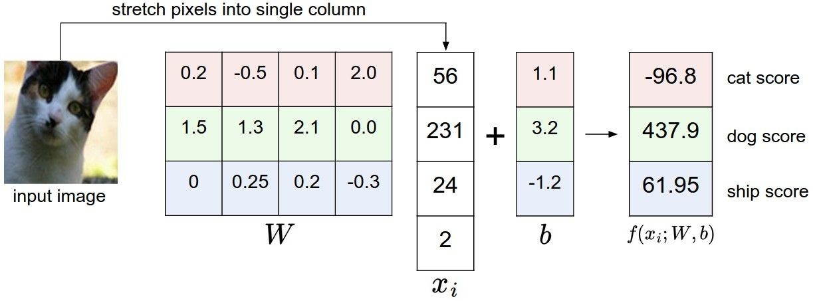
Linear classifier
Example with an image with 4 pixels, and 3 classes (cat/dog/ship)
𝚯
;𝚯,b)
Andrej Karpathy

Slide 84

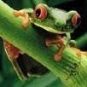
Linear classifier
Going forward: Loss function/Optimization
TODO:
1. Define a loss function that quantifies our unhappiness with the scores across the training data.
cat car frog
3.2
5.1
-1.7
1.3
4.9
2.0
2.2
2.5
-3.1
2. Come up with a way of efficiently finding the parameters that minimize the loss function (optimization)
Andrej Karpathy

Slide 85
Linear classifier
Suppose: 3 training examples, 3 classes. With some 𝚯. The scores
f(x,𝚯)= 𝚯x
are:
cat car frog
3.2
5.1
-1.7
1.3
4.9
2.0
2.2
2.5
-3.1
Adapted from Andrej Karpathy

Slide 86





Linear classifier: Hinge loss
Hinge loss:
Given an example
Suppose: 3 training examples, 3 classes. With some W the scores
f(x,𝚯)= 𝚯x
are:
where where
is the image and
is the (integer) label,
and using the shorthand for the scores vector:
f(x,𝚯)
the loss has the form:
cat car frog
3.2
5.1
-1.7
1.3
4.9
2.0
2.2
2.5
-3.1
Want: s_{yi} >= s_{j} + 1, for j != y_{i}
i.e. s_{j} – s_{yi} + 1 <= 0
If true, loss is 0
If false, loss is magnitude of violation
Adapted from Andrej Karpathy

Slide 87
Linear classifier: Hinge loss
Hinge loss:
Given an example
Suppose: 3 training examples, 3 classes. With some W the scores
f(x,𝚯)= 𝚯x
are:
where where
is the image and
is the (integer) label,
and using the shorthand for the scores vector:
the loss has the form:
f(x,𝚯)
cat car frog | 3.2 5.1 -1.7 | 1.3 2.2 4.9 2.5 2.0 -3.1
Losses: | 2.9
= max(0, 5.1 - 3.2 + 1)
+max(0, -1.7 - 3.2 + 1)
= max(0, 2.9) + max(0, -3.9)
= 2.9 + 0
= 2.9
Adapted from Andrej Karpathy

Slide 88
Linear classifier: Hinge loss
Hinge loss:
Given an example
Suppose: 3 training examples, 3 classes. With some W the scores
is the image and
is the (integer) label,
f(x,𝚯)= 𝚯x
where where
are:
and using the shorthand for the scores vector:
the loss has the form:
f(x,𝚯)
cat 3.2 car 5.1 frog -1.7 | 1.3 4.9 2.0 | 2.2 2.5 -3.1
Losses: 2.9 | 0
= max(0, 1.3 - 4.9 + 1)
+max(0, 2.0 - 4.9 + 1)
= max(0, -2.6) + max(0, -1.9)
= 0 + 0
= 0
Adapted from Andrej Karpathy

Slide 89
Linear classifier: Hinge loss
Hinge loss:
Given an example
Suppose: 3 training examples, 3 classes. With some W the scores
f(x,𝚯)= 𝚯x
are:
where where
is the image and
is the (integer) label,
and using the shorthand for the scores vector:
the loss has the form:
f(x,𝚯)
cat car frog | 3.2 5.1 -1.7 | 1.3 4.9 2.0 | 2.2 2.5 -3.1
Losses: | 2.9 | 0 | 12.9
= max(0, 2.2 - (-3.1) + 1)
+max(0, 2.5 - (-3.1) + 1)
= max(0, 5.3 + 1) + max(0, 5.6 + 1)
= 6.3 + 6.6
= 12.9
Adapted from Andrej Karpathy

Slide 90

Linear classifier: Hinge loss
Hinge loss:
Given an example
Suppose: 3 training examples, 3 classes. With some W the scores
f(x,𝚯)= 𝚯x
are:
where where
is the image and
is the (integer) label,
and using the shorthand for the scores vector:
f(x,𝚯)
the loss has the form:
cat car frog
and the full training loss is the mean over all examples in the training data:
3.2
5.1
-1.7
1.3
4.9
2.0
2.2
2.5
-3.1
L = (2.9 + 0 + 12.9)/3
= 15.8 / 3 = 5.3
Lecture 3 - 12
Losses:
2.9
0
12.9
Adapted from Andrej Karpathy

Slide 91
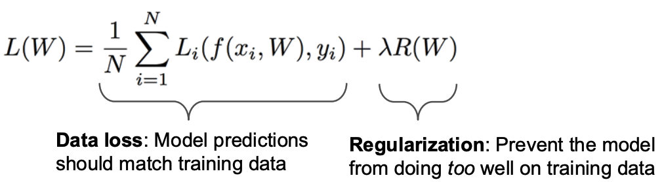
Linear classifier: Hinge loss
𝚯)
𝚯x
;𝚯
;𝚯
𝚯
𝚯
Adapted from Andrej Karpathy

Slide 92
Linear classifier: Regularization
𝚯
𝚯
𝚯
Slide Credit: https://cs231n.stanford.edu/

Slide 93
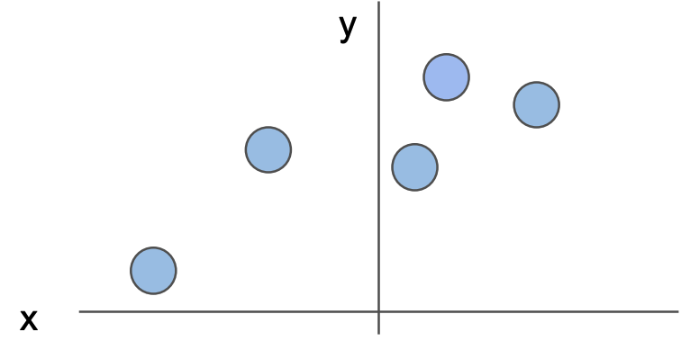
Linear classifier: Regularization Intuition
Slide Credit: https://cs231n.stanford.edu/

Slide 94
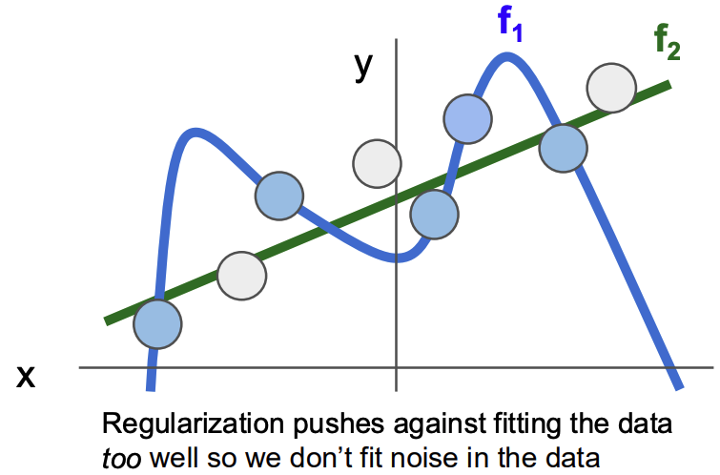
Linear classifier: Regularization – Prefer simpler models
Slide Credit: https://cs231n.stanford.edu/

Slide 95

Linear classifier: Regularization – Overfitting
Slide Credit: Prof. Sandra Avila - UNICAMP

Slide 96
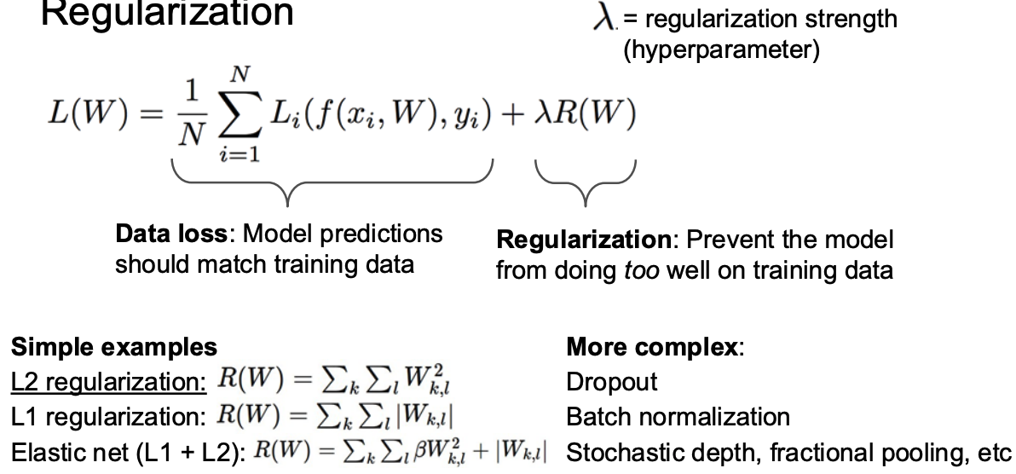
Linear classifier: Regularization
𝚯
𝚯
𝚯
Slide Credit: https://cs231n.stanford.edu/

Slide 97
Linear classifier: Regularization
𝚯
𝚯
𝚯
Why Regularization?
Express preferences over weights
Make the model simple so it works on test data
Improve optimization by adding curvature
Slide Credit: https://cs231n.stanford.edu/

Slide 98
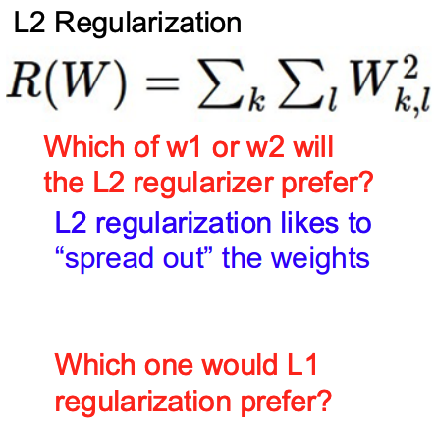
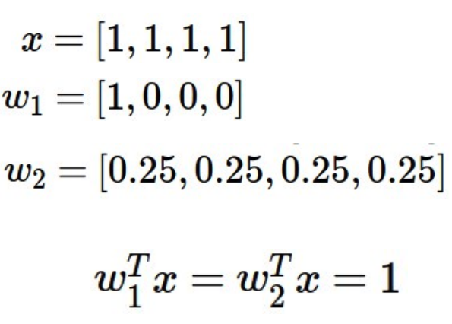
Linear classifier: Regularization – Express Preferences
Slide Credit: https://cs231n.stanford.edu/

Slide 99


Linear classifier: Hinge loss
λ = regularization strength (hyperparameter)
Weight Regularization
In common use: L2 regularization L1 regularization
Dropout (will see later)
Adapted from Andrej Karpathy

Slide 100


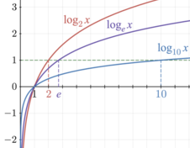

Another loss: Softmax (cross-entropy)
scores = unnormalized log probabilities of the classes
where
cat car frog
3.2
5.1
-1.7
Want to maximize the log likelihood, or (for a loss function) to minimize the negative log likelihood of the correct class:
maximize
Adapted from Andrej Karpathy
minimize

Slide 101

Another loss: Softmax (cross-entropy)
unnormalized probabilities
cat car frog
3.2 5.1 -1.7 | exp
0.13
0.87
0.00
24.5
164.0
0.18
L_i = -log(0.13)
= 0.89
normalize
unnormalized log probabilities
probabilities
Adapted from Andrej Karpathy
Notes:
Exp(3.2) = 24.5
Exp(5.1) = 164
Exp(-0.17) = 0.18

Slide 102
Training a Neural Network
Slide Credit: Prof. Sandra Avila - UNICAMP

Slide 103

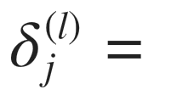


Gradient Computation: Backpropagation Algorithm
Intuition: “error” of node j in layer l.
For each output unit (layer L = 4)
Slide Credit: Prof. Sandra Avila - UNICAMP

Slide 104

Gradient Computation: Backpropagation Algorithm
Intuition: “error” of node j in layer l.
For each output unit (layer L = 4)
Vectorizing it, we have:
Slide Credit: Prof. Sandra Avila - UNICAMP

Slide 105


Slide 106



How to minimize the loss function?
Andrej Karpathy

Slide 107


How to minimize the loss function?
In 1-dimension, the derivative of a function is:
f: loss function
x: weights 𝚯
h: small value
In multiple dimensions, the gradient is the vector of (partial derivatives):
Adapted from Andrej Karpathy, definition/equation from https://en.wikipedia.org/wiki/Gradient

Slide 108
Computing the gradient numerically
current 𝚯:
gradient d𝚯:
[0.34,
-1.11,
0.78,
0.12,
0.55,
2.81,
-3.1,
-1.5,
0.33,…]
loss 1.25347
[?,
?,
?,
?,
?,
?,
?,
?,
?,…]
Andrej Karpathy

Slide 109
Computing the gradient numerically
current 𝚯:
𝚯 + h (first dim):
gradient d𝚯:
[0.34,
-1.11,
0.78,
0.12,
0.55,
2.81,
-3.1,
-1.5,
0.33,…]
loss 1.25347
[0.34 + 0.0001,
-1.11,
0.78,
0.12,
0.55,
2.81,
-3.1,
-1.5,
0.33,…]
loss 1.25322
[?,
?,
?,
?,
?,
?,
?,
?,
?,…]
Andrej Karpathy

Slide 110
current 𝚯:
110
Computing the gradient numerically
𝚯 + h (first dim):
gradient d𝚯:
[0.34,
-1.11,
0.78,
0.12,
0.55,
2.81,
-3.1,
-1.5,
0.33,…]
loss 1.25347
[0.34 + 0.0001,
-1.11,
0.78,
0.12,
0.55,
2.81,
-3.1,
-1.5,
0.33,…]
loss 1.25322
[-2.5,
?,
?,
?,
?,
?,
?,
(1.25322 - 1.25347)/0.0001
= -2.5
?,
?,…]
Andrej Karpathy

Slide 111
Computing the gradient numerically
current 𝚯:
𝚯 + h (second dim):
gradient d𝚯:
[0.34,
-1.11,
0.78,
0.12,
0.55,
2.81,
-3.1,
-1.5,
0.33,…]
loss 1.25347
[0.34,
-1.11 + 0.0001,
0.78,
0.12,
0.55,
2.81,
-3.1,
-1.5,
0.33,…]
loss 1.25353
[-2.5,
?,
?,
?,
?,
?,
?,
?,
?,…]
Andrej Karpathy

Slide 112
current 𝚯:
112
Computing the gradient numerically
𝚯 + h (second dim):
gradient d𝚯:
[0.34,
-1.11,
0.78,
0.12,
0.55,
2.81,
-3.1,
-1.5,
0.33,…]
loss 1.25347
[0.34,
-1.11 + 0.0001,
0.78,
0.12,
0.55,
2.81,
-3.1,
-1.5,
0.33,…]
loss 1.25353
[-2.5,
0.6,
?,
?,
?,
?,
?,
?,
(1.25353 - 1.25347)/0.0001
= 0.6
?,…]
Andrej Karpathy

Slide 113
Computing the gradient numerically
current 𝚯:
𝚯 + h (third dim):
gradient d𝚯:
[0.34,
-1.11,
0.78,
0.12,
0.55,
2.81,
-3.1,
-1.5,
0.33,…]
loss 1.25347
[0.34,
-1.11,
0.78 + 0.0001,
0.12,
0.55,
2.81,
-3.1,
-1.5,
0.33,…]
loss 1.25347
[-2.5,
0.6,
?,
?,
?,
?,
?,
?,
?,…]
Andrej Karpathy

Slide 114



The loss is just a function of 𝚯:
Computing the gradient analytically
want
Andrej Karpathy

Slide 115

The loss is just a function of 𝚯:
Computing the gradient analytically
want
Calculus
= ...
Andrej Karpathy

Slide 116
Computing the gradient analytically
current 𝚯:
gradient d𝚯:
[0.34,
-1.11,
0.78,
0.12,
0.55,
2.81,
-3.1,
-1.5,
0.33,…]
loss 1.25347
[-2.5,
0.6,
0,
0.2,
0.7,
-0.5,
1.1,
1.3,
-2.1,…]
d𝚯 = ...
(some function of data and 𝚯)
Andrej Karpathy

Slide 117
Computing the gradient analytically
f(x, 𝚯) = dot(𝚯, x) = 𝚯1*x1 + 𝚯2*x2 + … + 𝚯D*xD
d f(x, 𝚯) / d 𝚯i = ?
d f(x, 𝚯) / d 𝚯1 = x1
d f(x, 𝚯) / d 𝚯2 = x2
…
Gradient of f(x, 𝚯) wrt 𝚯 is [x1 x2 … xD] i.e. x

Slide 118

Loss gradients
Different notations:
i.e. how does the loss change as a function of the weights
We want to change weights in a way that makes the loss decrease as fast as possible

Slide 119

Gradient descent
We’ll update weights
Move in direction opposite to gradient:
L
Time
Learning rate
𝚯₂
original 𝚯
𝚯₁
negative gradient direction
Figure from Andrej Karpathy

Slide 120

Gradient descent
Iteratively subtract the gradient with respect to the model parameters (𝚯)
I.e. we’re moving in a direction opposite to the gradient of the loss
I.e. we’re moving towards smaller loss

Slide 121
Lab 7: Gradient Descent
Duration: 10 min
Notes:
[Content]
Section 0: Intro [Extra]
Section 1: Pytorch Autograd [Extra]
1.1 Forward Propagation [Extra]
1.2 Backward Propagation [Extra]
Section 2: Pytorch Neural Net Module [For Class]
2.1 Training Loop in Pytorch [For Class]
[Exercises]
Coding Exercise 1.1: Building a Computational Graph [Extra]
Coding Exercise 2.1: Training Loop [For Class]

Slide 122


Slide 123
How to compute the loss/gradient?
In classic gradient descent, we compute the gradient from the loss for all training examples
Mini-batch gradient descent: Only use some of the data for each gradient update, cycle through training examples multiple times
  Each time we’ve cycled through all of them once is called an ‘epoch’
  Allows faster training (e.g. on GPUs), parallelization
  Some benefits for learning due to randomness

Slide 124


Learning rate selection
The effects of step size (or “learning rate”)
https://www.deeplearning.ai/ai-notes/optimization/
Andrej Karpathy

Slide 125
Training a Neural Network
Slide Credit: Prof. Sandra Avila - UNICAMP

Slide 126
Gradient descent in multi-layer nets
We’ll update weights
Move in direction opposite to gradient:
How to update the weights at all layers?
  Answer: backpropagation of error from higher layers to lower layers

Slide 127
Backpropagation: Graphic example
First calculate error of output units and use this to change the top layer of weights.
output
k
j
i
Calculate how to
update weights into j
(update at end of iter)
w⁽²⁾
hidden
w⁽¹⁾
input
Adapted from Ray Mooney, equations from Chris Bishop

Slide 128
Backpropagation: Graphic example
Next calculate error for hidden units based on errors on the output units it feeds into.
output
k
j
i
hidden
input
Adapted from Ray Mooney, equations from Chris Bishop

Slide 129
Backpropagation: Graphic example
Finally update bottom layer of weights based on errors calculated for hidden units.
output
k
j
i
Update weights into i
hidden
input
Adapted from Ray Mooney, equations from Chris Bishop

Slide 130
Backpropagation
A Simple Example

Slide 131
Backpropagation: A Simple Example
f(x, y, z) = (x + y)z
e.g., x = -2, y = 5, z = -4
Andrej Karpathy
Slide Credit: Prof. Sandra Avila - UNICAMP

Slide 132
Backpropagation: A Simple Example
f(x, y, z) = (x + y)z
e.g., x = -2, y = 5, z = -4
x -2
+
q 3
5
f -12
y
*
-4
z
Andrej Karpathy
Slide Credit: Prof. Sandra Avila - UNICAMP

Slide 133



Backpropagation: A Simple Example
f(x, y, z) = (x + y)z
e.g., x = -2, y = 5, z = -4
x -2
+
q 3
5
f -12
y
*
-4
z
Want:
Andrej Karpathy
Slide Credit: Prof. Sandra Avila - UNICAMP

Slide 134

Backpropagation: A Simple Example
f(x, y, z) = (x + y)z
e.g., x = -2, y = 5, z = -4
x -2
+
q 3
5
f -12
y
*
-4
z
Want:
Andrej Karpathy
Slide Credit: Prof. Sandra Avila - UNICAMP

Slide 135
Backpropagation: A Simple Example
f(x, y, z) = (x + y)z
e.g., x = -2, y = 5, z = -4
x -2
+
q 3
5
f -12
y
*
1
-4
z
Want:
Andrej Karpathy
Slide Credit: Prof. Sandra Avila - UNICAMP

Slide 136

Backpropagation: A Simple Example
f(x, y, z) = (x + y)z
e.g., x = -2, y = 5, z = -4
x -2
+
q 3
5
f -12
y
*
1
-4
z
Want:
Andrej Karpathy
Slide Credit: Prof. Sandra Avila - UNICAMP

Slide 137
Backpropagation: A Simple Example
f(x, y, z) = (x + y)z
e.g., x = -2, y = 5, z = -4
x -2
+
q 3
5
f -12
y
*
1
-4
z
3
Want:
Andrej Karpathy
Slide Credit: Prof. Sandra Avila - UNICAMP

Slide 138

Backpropagation: A Simple Example
f(x, y, z) = (x + y)z
e.g., x = -2, y = 5, z = -4
x -2
+
q 3
5
f -12
y
*
1
-4
z
3
Want:
Andrej Karpathy
Slide Credit: Prof. Sandra Avila - UNICAMP

Slide 139
Backpropagation: A Simple Example
f(x, y, z) = (x + y)z
e.g., x = -2, y = 5, z = -4
x -2
+
q 3
5
f -12
y
-4
*
1
-4
z
3
Want:
Andrej Karpathy
Slide Credit: Prof. Sandra Avila - UNICAMP

Slide 140

Backpropagation: A Simple Example
f(x, y, z) = (x + y)z
e.g., x = -2, y = 5, z = -4
x -2
+
q 3
5
f -12
y
-4
*
1
-4
z
3
Want:
Andrej Karpathy
Slide Credit: Prof. Sandra Avila - UNICAMP

Slide 141

Backpropagation: A Simple Example
f(x, y, z) = (x + y)z
e.g., x = -2, y = 5, z = -4
x -2
+
q 3
5
f -12
y
-4
*
1
-4
z
3
Chain rule
Want:
Andrej Karpathy
Slide Credit: Prof. Sandra Avila - UNICAMP

Slide 142
Backpropagation: A Simple Example
f(x, y, z) = (x + y)z
e.g., x = -2, y = 5, z = -4
x -2
+
q 3
5
f -12
y
-4
-4
*
1
-4
z
3
Chain rule
Want:
Andrej Karpathy
Slide Credit: Prof. Sandra Avila - UNICAMP

Slide 143
Backpropagation: A Simple Example
f(x, y, z) = (x + y)z
e.g., x = -2, y = 5, z = -4
x -2
+
q 3
5
f -12
y
-4
-4
*
1
-4
z
3
Chain rule
Want:
-4 x 1 = -4
Andrej Karpathy
Slide Credit: Prof. Sandra Avila - UNICAMP

Slide 144

Backpropagation: A Simple Example
f(x, y, z) = (x + y)z
e.g., x = -2, y = 5, z = -4
x -2
+
q 3
5
f -12
y
-4
-4
*
1
-4
z
3
Want:
Andrej Karpathy
Slide Credit: Prof. Sandra Avila - UNICAMP

Slide 145
Backpropagation: A Simple Example
f(x, y, z) = (x + y)z
e.g., x = -2, y = 5, z = -4
x -2
-4
q 3
+
5
f -12
y
-4
-4
*
1
-4
z
3
Want:
Andrej Karpathy
Slide Credit: Prof. Sandra Avila - UNICAMP

Slide 146
x
f
z
y
Andrej Karpathy
Slide Credit: Prof. Sandra Avila - UNICAMP

Slide 147


x
“local gradient”
f
z
y
Andrej Karpathy
Slide Credit: Prof. Sandra Avila - UNICAMP

Slide 148

x
“local gradient”
f
z
gradients
y
Andrej Karpathy
Slide Credit: Prof. Sandra Avila - UNICAMP

Slide 149

x
“local gradient”
f
z
gradients
y
Andrej Karpathy
Slide Credit: Prof. Sandra Avila - UNICAMP

Slide 150

x
“local gradient”
f
z
gradients
y
Andrej Karpathy
Slide Credit: Prof. Sandra Avila - UNICAMP

Slide 151
x
“local gradient”
f
z
gradients
y
Andrej Karpathy
Slide Credit: Prof. Sandra Avila - UNICAMP

Slide 152
Training a Neural Network
Slide Credit: Prof. Sandra Avila - UNICAMP

Slide 153




Gradient Descent
L_{i}
Want :
repeat {
}
Slide Credit: Prof. Sandra Avila - UNICAMP

Slide 154
Training a Neural Network
Slide Credit: Prof. Sandra Avila - UNICAMP

Slide 155
Assignment 6: Data Loaders

Slide 156
[Extra] Lab 8: Regularization
Section 1

Slide 157
Additional Resources

Slide 158


Neural Networks (3Blue1Brown)

Slide 159
Neural Networks Demystified (in Python)
159

Slide 160

“A friendly introduction to Neural Networks” https://youtu.be/BR9h47Jtqyw

Slide 161

Neural Networks Demystified (in Python)
https://youtu.be/Vfzm1-cfLuc

Slide 162
Summary
We use deep neural networks because of their strong performance in practice
Training deep neural nets
  We need an objective function that measures and guides us towards good performance
  We need a way to minimize the loss function: stochastic gradient descent
  We need backpropagation to propagate error from end of net towards all layers and change weights at those layers
Practices for preventing overfitting
  Regularization

