Slide 1

CS 441: Discrete Structures for Computer Science
PhD. Nils Murrugarra-Llerena
nem177@pitt.edu

Slide 2
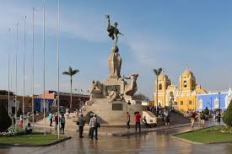
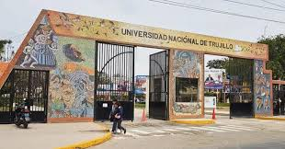

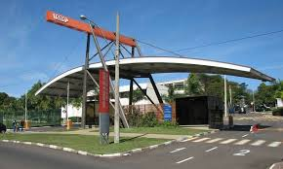


Who am I?
B.S. Computer Science at National University of Trujillo
M.S. in Computer Science at University of São Paulo in AI

Slide 3



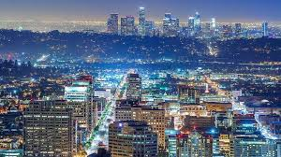

Who am I?
PhD in Computer Science at University of Pittsburgh in Computer Vision
Research scientist at Snap Inc.

Slide 4
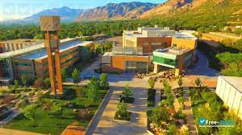

Who am I?
Assistant professor at Weber State University
Teaching Assistant Professor at University of Pittsburgh
[Students’ presentations]
Name, hobbies, and mention one thing that you expect to learn in this course ☺

Slide 5
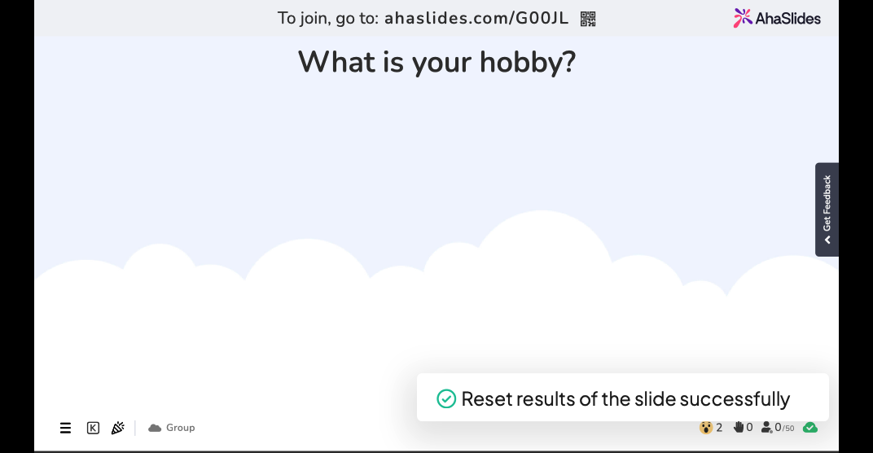

Slide 6
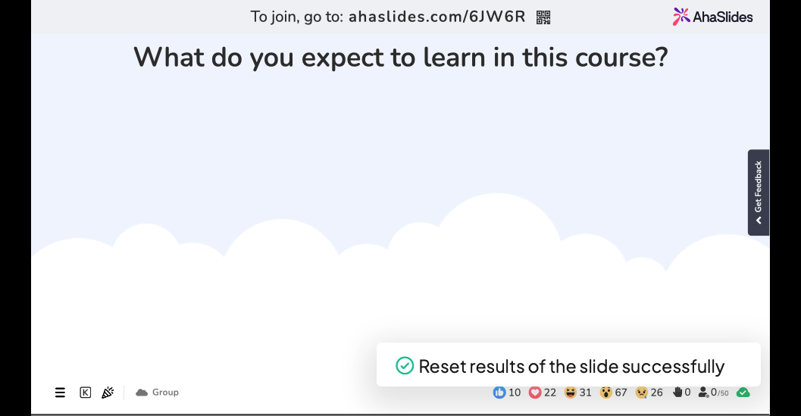

Slide 7
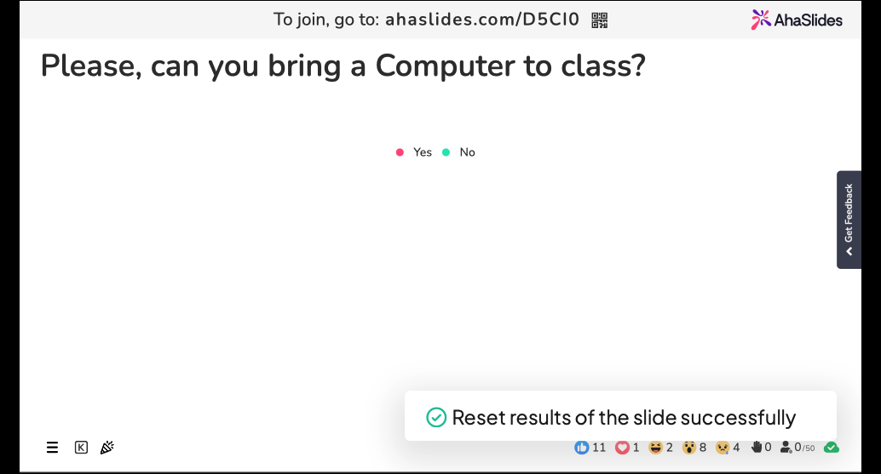

Slide 8
Syllabus
Syllabus

Slide 9

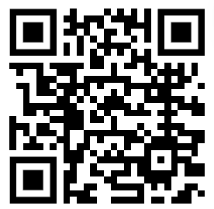
Course intro: Syllabus
Contact Information
  Prof. Nils Murrugarra
  nem177@pitt.edu
  Please, add prefix “[CS 441]” in all emails.
  Website: https://nineil.github.io/courses/fall25_cs441/
Lectures:
  [Section A] Mon/Wed: 1:00pm - 2:15pm @ SENSQ 5502
  [Section B] Mon/Wed: 3:00pm - 4:15pm @ IS 404
Office hours:
  TBD (Please, fill this form). Inputs will be considered with my other courses, and my own schedule

Slide 10
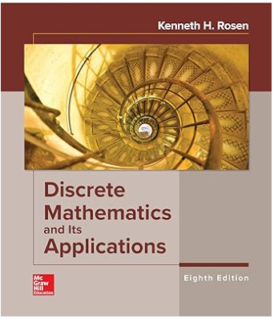
Course intro: Textbook
Discrete Mathematics and its Applications
Edition: 8th
By Kenneth Rosen
ISBN: 1260091996
Year: 2018

Slide 11
Course intro: What to expect?
Material is based on previous iterations of CS 441: Discrete Structures for Computer Science.
Exams mainly cover this material
We will do around 11 to 13 assignments

Slide 12

Course intro: What to expect?
There will be a lot of work!
However, you will learn a lot :). Please, ask
questions in class and use office hours
as needed.
I would like to help you much as possible.

Slide 13
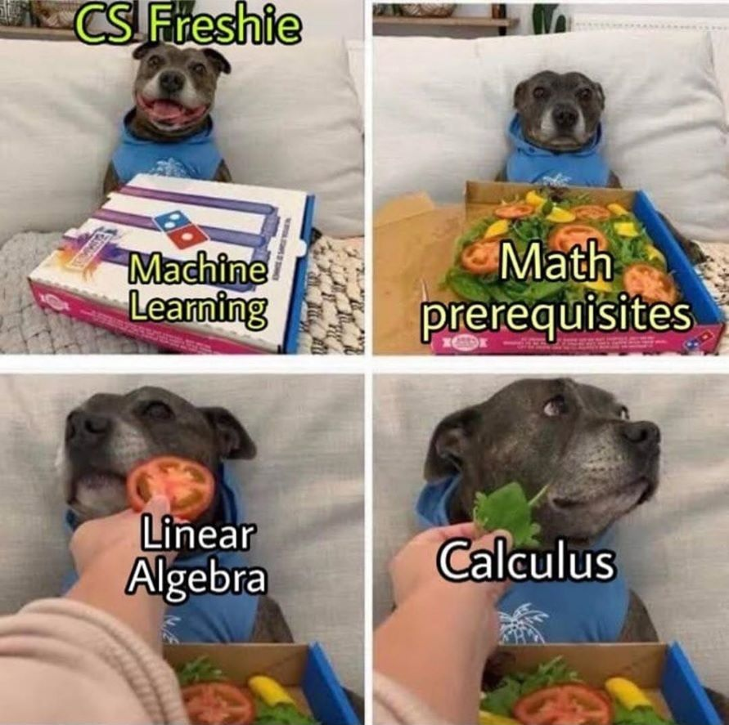
Course intro: What to expect?
H/T Kirk Pruhs

Slide 14
Review Syllabus
Canvas Link:
Section A
Section B

Slide 15

Questions?

Slide 16
Course overview
What is discrete mathematics?
Why is a math course part of the computer science curriculum?
Will I really ever use this stuff again?
How to succeed in this course?

Slide 17
What is discrete mathematics?
Discrete mathematics is the study of distinct objects or structures and their relationships to one another
For example:
  How many ways can a valid password be chosen?
  Can traffic flow between two computers in a network?
  How can we transform messages to hide their contents?
  How do we parse a given sequence of commands?
By contrast, continuous mathematics (e.g., calculus) studies objects and relationships that vary continuously
  e.g., position, velocity, and acceleration of a projectile
Notes:
https://www.youtube.com/watch?v=1FfX2xW3104&ab_channel=freeCodeCamp.org
https://www.youtube.com/watch?v=bOCHTHkBoAs&ab_channel=Fireship
Start
Floating Point Numbers
Set Theory
Complexity Theory
Statistics
https://www.youtube.com/watch?v=q4L-wUF3yig&ab_channel=DidaskoGroup
https://www.youtube.com/watch?v=oJhAPsy9hBU&ab_channel=Intermation → Example Traffic lights (conditions)
##
https://www.youtube.com/watch?v=iF0I2SPk5JU&ab_channel=Sahil%26Sarra

Slide 18
Why study discrete math?
Reason 1: Computers do not process continuous data
Sampling and
discretization
Analog (continuous) input
Digital (discrete) output
Notes:
Home experiment: record voice at different sampling rates
Also related to Reimann sums for those calculus folks out there

Slide 19
Why study discrete math?
Reason 2: Computers aren’t actually all that smart, they are just deterministic functions that map discrete inputs to discrete outputs
Example: Does a given bit string contain an odd number of 1s?
1
No
Yes
0
0
Read
1
…
0
1
1
1
0
1
0
1
Notes:
Church-Turing thesis

Slide 20
Why study discrete math?
In general: Discrete mathematics allows us to better understand computers and algorithms
function fib(int n)
int first = 0;
int second = 1;
int tmp;
for(i = 1 to n)
tmp = first + second;
first = second;
second = tmp;
end for
return first;
function fib(int n)
if(n == 0 || n == 1)
return 1;
else
return fib(n-1) + fib(n-2);

Slide 21
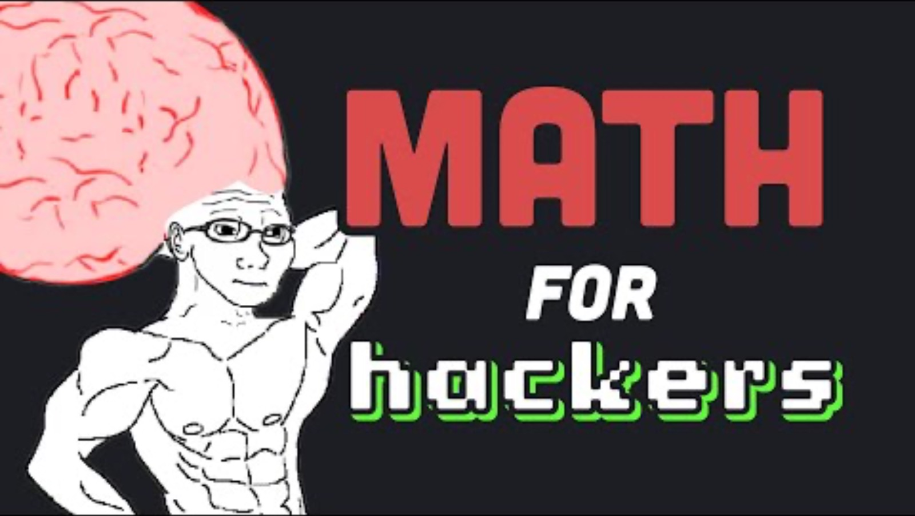
Activity: Why study discrete math?
Start: 0:00
Floating Point Numbers: 2:33
https://www.online-python.com/
Set Theory: 4:14
Complexity Theory: 6:24
Statistics: 7:06

Slide 22
Tentative Syllabus
Logic and proofs
Sets
Functions
Algorithms and analysis
Integers, modular arithmetic, cryptography
Induction
Relations
Are these topics really useful?

Slide 23
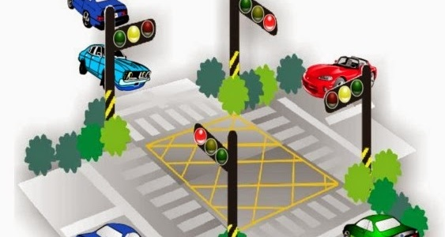
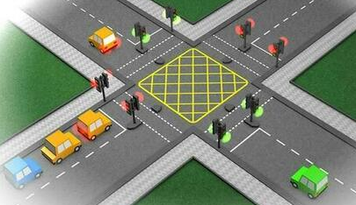
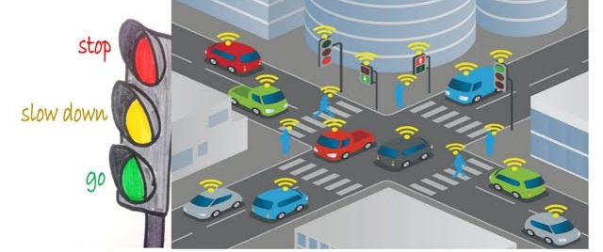
Logic and proofs
Notes:
https://plc.home.blog/2014/05/17/mitsubishi-plc-ladder-control-traffic-lights/
https://www.google.com/imgres?imgurl=https%3A%2F%2Fi.ytimg.com%2Fvi%2F2EAEC0MLyFA%2Fsddefault.jpg&tbnid=Hxd45Q4nfb8VaM&vet=10CAwQ1JoKKARqFwoTCNjTzcnAiI8DFQAAAAAdAAAAABAf..i&imgrefurl=https%3A%2F%2Fwww.youtube.com%2Fwatch%3Fv%3D2EAEC0MLyFA&docid=jH3vIMp6kyY7AM&w=640&h=480&itg=1&q=logic%20for%20driving%20traffic%20lights&ved=0CAwQ1JoKKARqFwoTCNjTzcnAiI8DFQAAAAAdAAAAABAf

Slide 24
Logic and proofs
grant(X, projector) :- role(X, presenter), located(X, 104)
located(adam, 104)
role(adam, presenter)
=> ?grant(adam, projector)
=> true
function fib(int n)
int first = 0;
int second = 1;
int tmp;
for(i = 1 to n)
tmp = first + second;
first = second;
second = tmp;
end for
return first;
Automated reasoning, AI, security
exp()
+
3.1415
Algorithm and
protocol analysis
*
4
Parsing
expressions
Verifying data structures
and hardware
3
2

Slide 25
Sets
… and give us a means of reasoning about the relationships between objects → Database Operations
Sets define collections of objects…

Slide 26
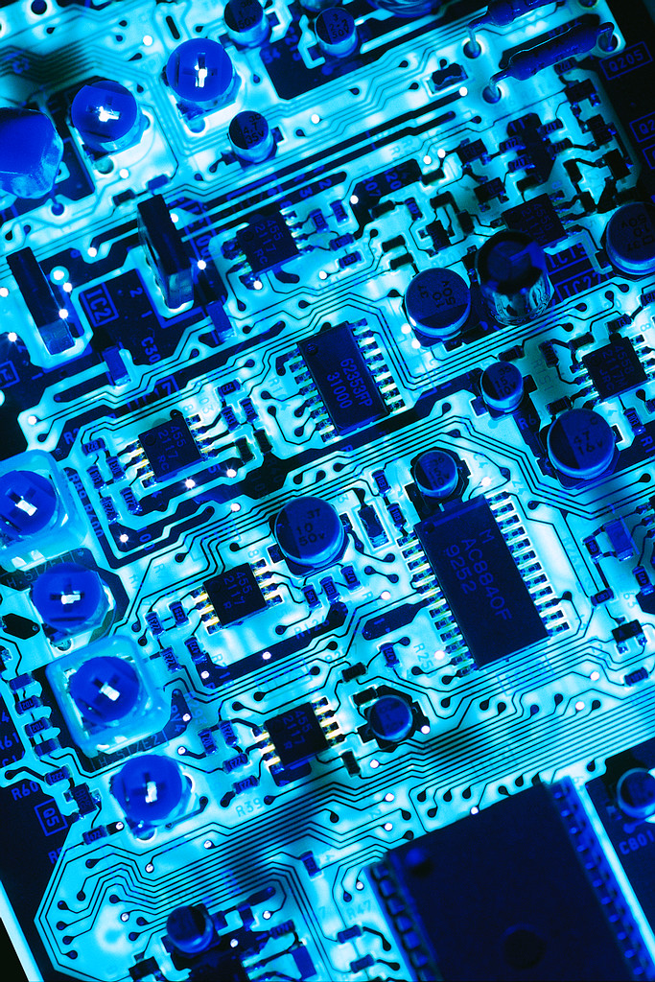
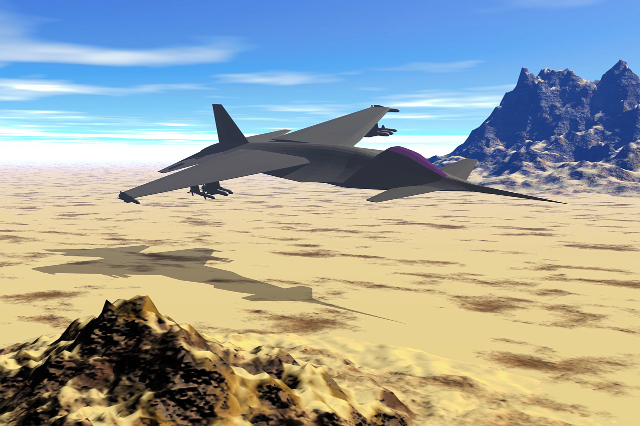
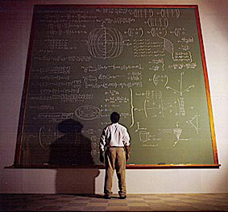
Functions
Hardware design
Theory of computation
Computer graphics
Notes:
Hardware Design – Logical Operations
Computer Graphics – Matrix Operations

Slide 27


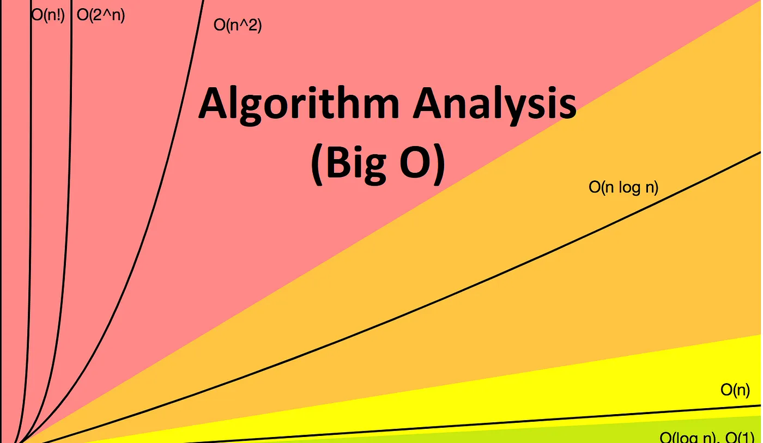
Algorithms and analysis
… and algorithm analysis helps us determine which approaches scale best
Studying algorithms helps us write better code…

Slide 28
Integers and Modular Arithmetic
ATTACK AT DAWN
0111 0101 0110 1011
+
0101 1001 1110 0001
01 20 20 01 03 11 01 20 04 01 23 14
1100 1111 0100 1100
C = P+ 5 (mod 26)
Binary arithmetic and
bitwise operations
06 25 25 06 08 16 06 25 09 06 02 19
FYYFIPFZJFCU
Cryptography

Slide 29

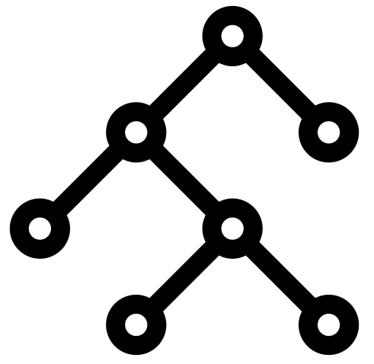
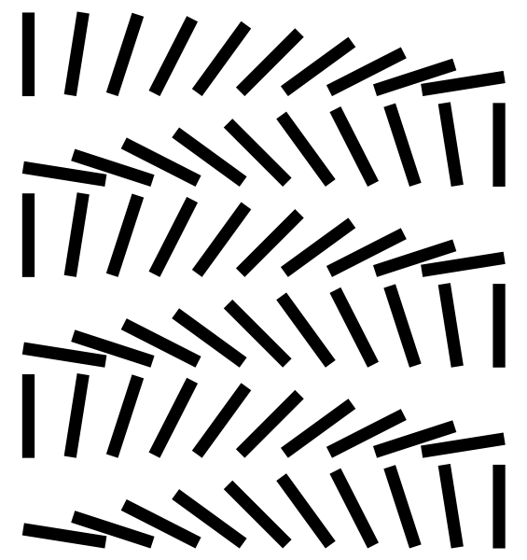
Induction
Induction is a proof technique that helps us reason about infinite objects (e.g. recursion)…
… and processes…
… and data structures!

Slide 30

Relations
How to climb a stair?
Notes:
Steps?
Right / Left foot?

Slide 31

Relations
Name | Age | Phone
Alice | 19 | 555-1234
Danielle | 33 | 555-5353
Zach | 27 | 555-3217
Charlie | 21 | 555-2335
Relational databases
DHTs, DNS,
name services
Route
planning

Slide 32
Syllabus, redux
Logic and proofs
Sets
Functions
Algorithms and analysis
Integers, modular arithmetic, cryptography
Induction
Relations
Are these topics really useful?
Yes

Slide 33
Mastering discrete mathematics requires practice!
Succeeding in this class requires practicing the skills that we will acquire, thinking critically, and asking questions
  We are practicing clear and precise communication in the language of mathematics and logic—be specific!
Keys to success:
  Attend class and take notes
  Do your homework
  Work extra problems when you’re unsure
    Solutions to odd-numbered exercises are provided in textbook
  Go to your recitation every week
  Take advantage of office hours

Slide 34
What should I do now?
Check your Canvas notification settings
Read the chapter for next lecture
Decide if you need Inclusive Access, and opt out if not
Watch for a Gradescope invitation, where you’ll submit recitation and homework assignments
Email me if you have any special circumstances that you may need accommodated

Slide 35
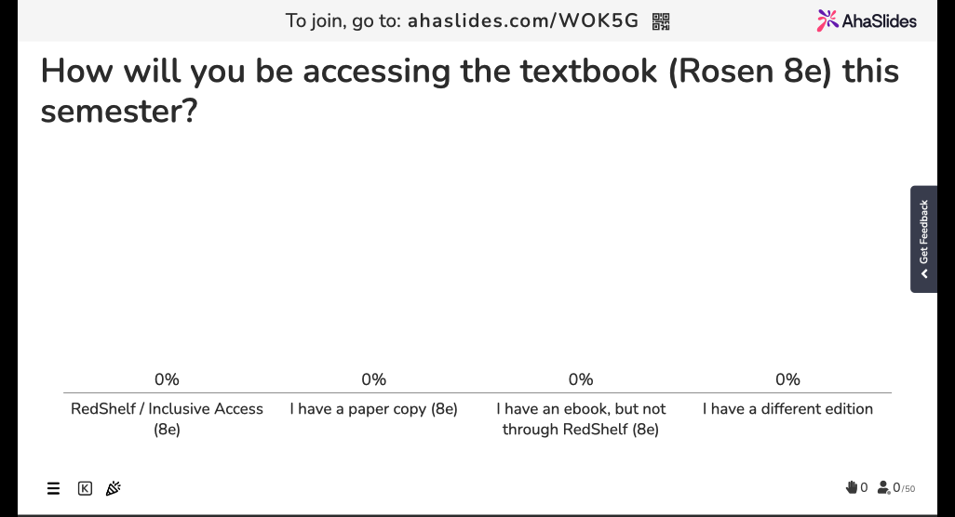

Slide 36
Final thoughts
Our goal is to prepare you to be stronger computer scientists by:
  Exploring the formal foundations of computer science
  Developing critical thinking skills
  Articulating ties between theory and practice
Next: Propositional logic (Sec 1.1)

