Slide 1

CS 441: Propositional Logic
PhD. Nils Murrugarra-Llerena
nem177@pitt.edu

Slide 2
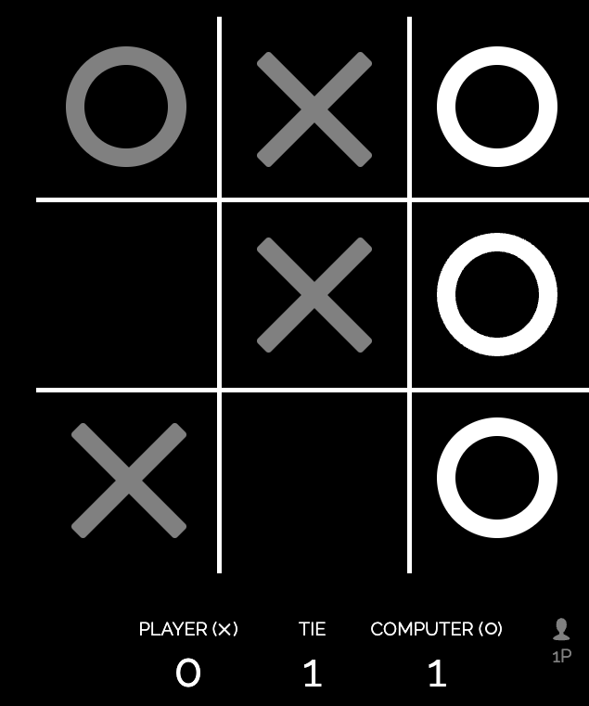
Motivation: Propositional Logic
Let’s play Tic-Tac-Toe
https://playtictactoe.org/
What is our strategy?
Notes:
What is our strategy?
* Form a line AND
* Avoid the computer to form a line
Which scenarios previous situations are True or False?
Movie: War Game, tic tac toe

Slide 3

Today’s Topic: Propositional Logic
What is a proposition?
Logical connectives and truth tables
Translating between English and propositional logic
Notes:
This is the LANGUAGE. There are other logics, better at some things, but this one is standard.
Learning objective is to learn to communicate in this particular language. Use these skills in other languages/models later.

Slide 4
Logic is the basis of all mathematical and analytical reasoning
Given a collection of known truths, logic allows us to deduce new truths
Example
Base facts:
  If it is raining, I will not go outside
  If I am inside, Lisa will stay home
  Lisa and I always play video games if we are together during the weekend
  Today is a rainy Saturday
Conclusion: Lisa and I will play video games today
Logic allows us to advance mathematics through an iterative process of conjecture and proof

Slide 5
Propositional logic is a very simple logic
Definition: A proposition is a precise statement that is either true or false, but not both.
Examples:
  2 + 2 = 4 (true)
  All dogs have 3 legs (false)
  x² < 0 (false)
  Washington, D.C. is the capital of the USA (true)

Slide 6
Not all statements are propositions
Eliana is cool
  “Cool” is a subjective term.
x³ < 0
  True if x < 0, false otherwise.
Springfield is the capital
  True in Illinois, false in Massachusetts.

Slide 7
We can use logical connectives to build complex propositions
We will discuss the following logical connectives:
  ¬ (not)
  ∧ (conjunction / and)
  ∨ (disjunction / or)
  ⊕ (exclusive disjunction / xor)
  → (implication)
  ↔ (biconditional)

Slide 8
Negation
The negation of a proposition is true iff the proposition is false
What we want
to know
What we know
One row for each possible value of “what we know”
p | ¬p
T | F
F | T
The truth table for negation
(I’ll sometimes use ⊤ and ⊥)

Slide 9
Negation Examples
Negate the following propositions
  Today is Monday
    Today is not Monday
  21 * 2 = 42
    21 * 2 ≠ 42
What is the truth value of the following propositions
  ¬(9 is a prime number)
    true
  ¬(Pittsburgh is in Pennsylvania)
    false

Slide 10
Conjunction
The conjunction of two propositions is true iff both propositions are true
p | q | p ∧ q
T | T | T
T | F | F
F | T | F
F | F | F
The truth table for conjunction
2² = 4 rows since we know both p and q!

Slide 11
Disjunction
The disjunction of two propositions is true iff at least one proposition is true
p | q | p ∨ q
T | T | T
T | F | T
F | T | T
F | F | F
The truth table for disjunction

Slide 12
Conjunction and disjunction examples
This symbol means “is defined as”
or “is equivalent to”
(sometimes seen as ≜)
Let:
  p ≡ x² ≥ 0
  q ≡ A lion weighs less than a mouse
  r ≡ 10 < 7
  s ≡ Pittsburgh is located in Pennsylvania
What are the truth values of these expressions:
  p ∧ q
  p ∧ s
  p ∨ q
  q ∨ r
True
False
False
True
False
True
True
False

Slide 13
In-class Activities
Activity 1: Let p ≡ 2+2=5, q ≡ eagles can fly, r ≡ 1=1. Determine the value for each of the following:
  p ∧ q
  ¬p ∨ q
  p ∨ (q ∧ r)
  (p ∨ q) ∧ (¬r ∨ ¬p)
Steps:
Introduce to a classmate
Work in pairs on the exercise
Submit answers
Notes:
p = False
q = True
r = True
p ∧ q --> False
¬p ∨ q --> True
p ∨ (q ∧ r) --> False ∨ True --> True
(p ∨ q) ∧ (¬r ∨ ¬p) --> True ∧ True --> True

Slide 14
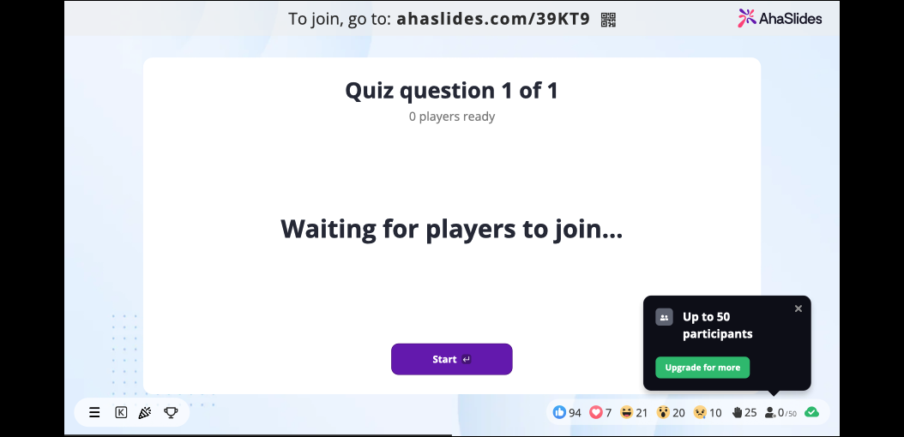

Slide 15
Exclusive or (XOR)
The exclusive or of two propositions is true iff exactly one proposition is true
p | q | p ⊕ q
T | T | F
T | F | T
F | T | T
F | F | F
The truth table for exclusive or
Note: Exclusive or is typically used to natural language to identify choices. For example, “You may have a soup or salad with your entree.”
Notes:
Natural language is often imprecise!
Discuss importance of being precise in specifications

Slide 16
Implication
The implication p → q is false if p is true, and q is false; p → q is true otherwise
Terminology
  p is called the hypothesis
  q is called the conclusion
p | q | p → q
T | T | T
T | F | F
F | T | T
F | F | T
The truth table for implication

Slide 17
Implication (cont.)
The implication p → q can be read in a number of (equivalent) ways:
  If p then q
  p only if q
  p is sufficient for q
  q whenever p
Notes:
Whenver is such as an if

Slide 18
Implication examples
Let:
  p ≡ Jane gets a 100% on her final exam
  q ≡ Jane gets an A on her final exam
What are the truth values of these implications:
  p → q
  q → p
true
false

Slide 19
Other conditional statements
Given an implication p → q:
  q → p is its converse
  ¬q → ¬p is its contrapositive
  ¬p → ¬q is its inverse
Why might this
be useful?
Note: An implication and its contrapositive always have the same truth value
Notes:
Why: Maybe easier to prove…

Slide 20
Biconditional
The biconditional p ↔ q is true if and only if p and q assume the same truth value
p | q | p ↔ q
T | T | T
T | F | F
F | T | F
F | F | T
The truth table for the biconditional
Note: The biconditional statement p ↔ q is often read as “p if and only if q” or “p is a necessary and sufficient condition for q.”

Slide 21
Truth tables can also be made for more complex expressions
Example: What is the truth table for (p ∧ q) → ¬r?
Subexpressions of
“what we want to know”
What we want to know
p | q | r | p ∧ q | ¬r | (p ∧ q) → ¬r
T | T | T | T | F | F
T | T | F | T | T | T
T | F | T | F | F | T
T | F | F | F | T | T
F | T | T | F | F | T
F | T | F | F | T | T
F | F | T | F | F | T
F | F | F | F | T | T
2³ = 8 rows
Notes:
Note that we need 2^3 = 8 rows since we have 3 variables

Slide 22
Like mathematical operators, logical operators are assigned precedence levels
Negation
  ¬q ∨ r means (¬q) ∨ r, not ¬(q ∨ r)
Conjunction
Disjunction
  q ∧ r ∨ s means (q ∧ r) ∨ s, not q ∧ (r ∨ s)
Implication
  q ∧ r → s means (q ∧ r) → s, not q ∧ (r → s)
Biconditional
In general, we will use parentheses to disambiguate and to override precedence rules.
Notes:
ChangeMe

Slide 23
In-class Activities
Activity 2: Show that an implication p → q and its contrapositive ¬q → ¬p always have the same value [app.mural]
  Hint: Construct two truth tables
Activity 3: Construct the truth table for the compound proposition p ∧ (¬q ∨ r) → r [app.mural]
Steps:
Introduce to a classmate
Work in pairs on the exercise
Volunteers to share answers

Slide 24



English sentences can often be translated into propositional sentences
But why would we do that?
Reasoning about law
Philosophy and epistemology
Verifying complex system specifications

Slide 25
Example #1
Example: You can see an R-rated movie only if you are over 17 or you are accompanied by your legal guardian.
Let:
  r ≡ “You can see an R-rated movie”
  o ≡ “You are over 17”
  a ≡ “You are accompanied by your legal guardian”
Translation: r → (o ∨ a)
Find logical connectives
Translate fragments
Create logical expression

Slide 26
Example #2
Example: You can have free coffee if you are a senior citizen and it is a Tuesday
Let:
  c ≡ “You can have free coffee”
  s ≡ “You are a senior citizen”
  t ≡ “It is a Tuesday”
Translation: (s ∧ t) → c

Slide 27
Example #3
Example: If you are under 17 and are not accompanied by your legal guardian, then you cannot see the R-rated movie.
Let:
  r ≡ “You can see the R-rated movie”
  u ≡ “You are under 17”
  a ≡ “You are accompanied by your legal guardian”
Translation: (u ∧ ¬a) → ¬r
Note: The above translation is the contrapositive of the translation from example 1!
Notes:
r → (o v a)
[Contrapositive] p→ q = ~q → ~p
~(o v a) → ~r
(~o ^ ~a) → ~r

Slide 28
Logic also helps us understand bitwise operations
Computers represent data as sequences of bits
  e.g., 0101 1101 1010 1111
Bitwise logical operations are often used to manipulate these data
If we treat 1 as true and 0 as false, our logic truth tables tell us how to carry out bitwise logical operations

Slide 29
Bitwise logic examples
1010 1110
1010 1110
∧
∨
1110 1010
1110 1010
1010 1010
1110 1110
1010 1110
⊕
1110 1010
0100 0100

Slide 30
In-class Activities
Activity 4: Translate the following sentences
  Translate the following English sentence into propositional logic.
  "You get a free salad only if you order off of the extended menu and it is a Wednesday”. ​Use the following propositions:
  s≡"You get a free salad"
  x≡"You order off of the extended menu"
  w≡"It is a Wednesday”
  "If it is raining and today is Saturday, then I will either play video games or watch a movie”. Use the following propositions:
  r≡"It is raining"
  s≡"Today is Saturday"
  g≡"I will play video games"
  m≡"I will watch a movie"
Steps:
Introduce to a classmate
Work in pairs on the exercise
Volunteers to share answers

Slide 31


Slide 32
In-class Activities
Activity 5: Solve the following bitwise problems
1011 1000
1011 1000
⊕
1010 0110
∧
1010 0110
Steps:
Introduce to a classmate
Work in pairs on the exercise
Volunteers to share answers
Notes:
Activity 5: 00011110 10100000

Slide 33
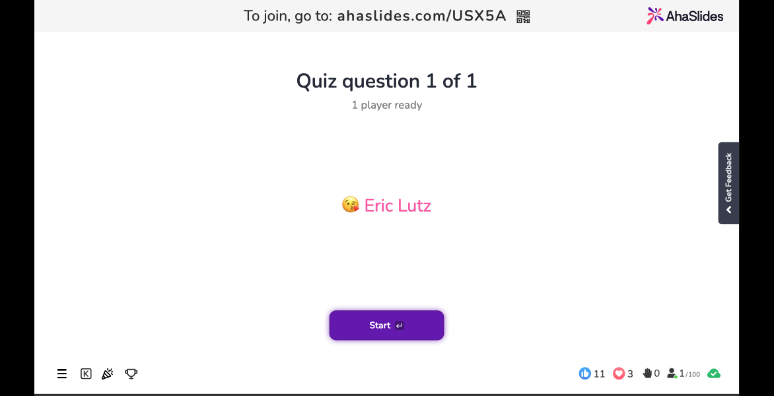

Slide 34
Final Thoughts
Propositional logic is a simple logic that allows us to reason about a variety of concepts
In recitation:
  More examples and practice problems
  Be sure to attend!
Next:
  Logic puzzles and propositional equivalence
  Please read sections 1.2 and 1.3
    In general: do the assigned reading!

