Slide 1

CS 441: Nested Quantifiers
PhD. Nils Murrugarra-Llerena
nem177@pitt.edu

Slide 2
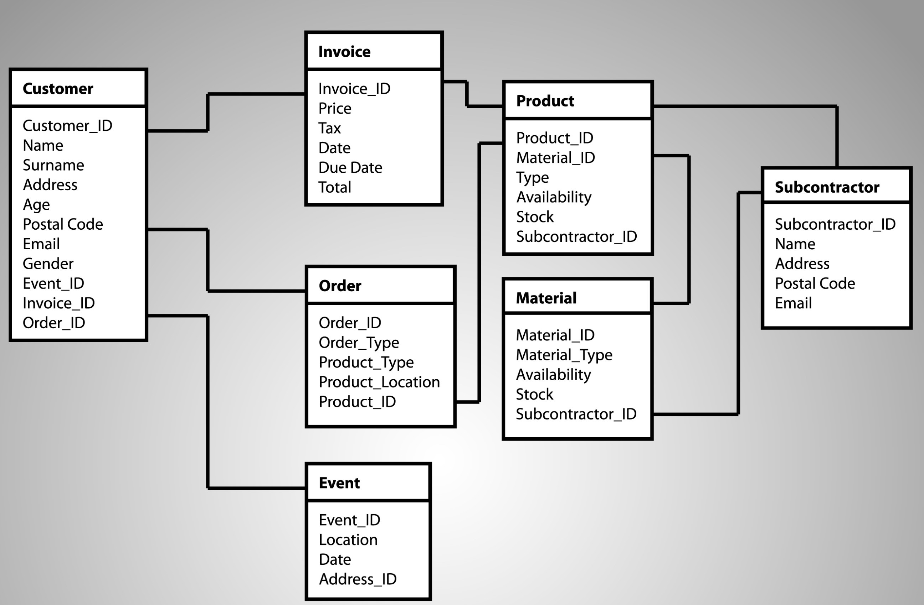

[Motivation] Nested quantifiers
E-commerce Website Developer
Imagine you're the lead developer for an e-commerce website. You need to write a program that checks the inventory and shipping status for customer orders. Your task is to confirm if the following statement is true:
"For every customer, there is a product they have ordered that is currently in stock."
Source: Gemini
Notes:
Source: Gemini
[Act 1]
Let's define our predicates and variables:
C(x): x is a customer.
P(y): y is a product.
O(x,y): Customer x has ordered product y.
S(y): Product y is currently in stock.
Using these, we can translate the English sentence into a precise logical statement:
∀x(C(x)→∃y(P(y)∧O(x,y)∧S(y)))
Database Queries: In SQL, this logical statement would translate into a query with a subquery or a JOIN operation, showcasing its direct application in managing relational databases.

Slide 3

Today’s topics
Predicates
Quantifiers
Logical equivalences in predicate logic
Translations using quantifiers

Slide 4
Nested quantifiers???
Many times, we need the ability to nest one quantifier within the scope of another quantifier
Example: All integers have an additive inverse. That is, for any integer x, we can choose an integer y such that the sum of x and y is zero.
There is no way to express this statement using only a single quantifier!
  ∀x ∃y (x + y = 0)

Slide 5
Deciphering nested quantifiers isn’t as scary as it looks…
… if you remember to read from left to right!
  ∀x ∃y ∀z [(x + y)×z = 0]
For all x…
… there exists a y such that…
… for all z…
And think about scope of variables like with programming!
… (x + y)× z = 0

Slide 6
A few more examples…
This is the commutative law for addition!
  ∀x ∀y (x + y = y + x)
  For all integers x and for all integers y, x + y = y + x
∀x ∀y ∀z [(x+y)+z = x+(y+z)]
  For all integers x, for all integers y, and for all integers z, (x+y)+z = x+(y+z)
∃x ∀y (x × y = 0)
  There exists an x such that for all y, x × y = 0
This is the associative law for addition!

Slide 7
Since we always read from left to right, the order of quantifiers matters!
Clearly true! Just set y = -x
  Consider: ∀x ∃y (x + y = 0)
    Every integer has an additive inverse
  Transpose: ∃y ∀x (x + y = 0)
    There exists some integer y such that when added to any other integer x, the sum of x and y is 0
Not true…
Remember: When reading from left to right, later quantifiers are within the scope of earlier ones

Slide 8
Many mathematical statements can be translated into logical statements with nested quantifiers
Translating mathematical expressions is often easier than translating English statements!
Steps:
  Rewrite statement to make quantification and logical operators more explicit
  Determine the order in which quantifiers should appear
  Generate logical expression

Slide 9
Let’s try a translation…
Universal quantifier
Statement: Every real number except zero has a multiplicative inverse
x × y = 1
Singular—suggestive of an existential quantifier
∀x
2
1
Rewrite: For every real number x, if x ≠ 0, then there exists a real number y such that x × y = 1.
… ∃y (x × y = 1)
(x ≠ 0) → …
3
Translation: ∀x [(x ≠ 0) → ∃y (x × y = 1)] OR
∀x ∃y [(x ≠ 0) → (x × y = 1)]

Slide 10
More examples…
Statement: The product of any two negative integers is always positive
  For any integer x and any integer y, if x < 0 and y < 0, then x × y > 0
  ∀x ∀y [(x < 0 ∧ y < 0) → (x × y > 0)]
Statement: For any real number a, it is possible to choose real numbers b and c such that a² + b² = c²
  For any real number a, there exist real numbers b and c such that a² + b² = c²
  ∀a ∃b ∃c (a² + b² = c²)

Slide 11
Translating quantified statements to English is as easy as reading a sentence!
Let:
  C(x) ≡ x is enrolled in CS441
  P(x) ≡ x has an iPhone
  F(x, y) ≡ x and y are friends
  Domain of x and y is “all students”
Statement: ∀x [C(x) → P(x) ∨ (∃y (F(x,y) ∧ P(y))]
For every student x…
… if x is enrolled in CS441, then…
… x has an iPhone…
… or there exists another student y such that…
… x and y are friends…
… and y has an iPhone.
Every CS 441 student has an iPhone or a friend with an iPhone.

Slide 12
Translate the following expressions into English
Let:
  O(x,y) ≡ x is older than y
  F(x,y) ≡ x and y are friends
  The domain for variables x and y is “all students”
Statement: ∃x ∀y O(x,y)
  There exists a student x, such that for all students y, x is older than y.
  Alternatively: There exists an oldest student.
Statement: ∃x ∃y [F(x,y) ∧ ∀z [(y≠z) → ¬F(x,z)]]
  There exists two students x and y such that x and y are friends and for all students z, if z ≠ y, then x and z are not friends.
  Alternatively: There exists a student with only one friend ☹
Notes:
Well-ordering principle

Slide 13
In-class Activities
Activity 1: Solve the E-commerce Website Developer activity. [miro]
Activity 2: Translate the following mathematical statement into predicate logic: Every even number is a multiple of 2. Assume that the predicate E(x) means “x is even.” (Domains: All integers) [miro]
  Hint: What does “x is a multiple of 2” mean algebraically? Try not to use “mod.”
Activity 3: Translate the following expressions into English. Assume that C(x) means “x has a car”, F(x,y) means “x and y are friends”, and S(x) means “x is a student.” (Domains: All people) [miro]
  ∀x (S(x) → C(x) ∨ ∃y [F(x,y) ∧ C(y)])
  ∀x ∃y ∃z [C(x) ∨ (F(x,y) ∧ C(y)) ∨ (F(x,y) ∧ F(y,z) ∧ C(z))]
Steps:
Introduce to a classmate
Work in pairs on the exercise
Submit answers on miro
Volunteers to share answers
Notes:
Submit P1 and P2a on TH
Problem 2: For all numbers x, if x is even there exists a y such that x = 2y
[Act 1]

Slide 14
Translating from English to a logical expression with nested quantifiers is a little bit more work…
Steps:
  If necessary, rewrite the sentence to make quantifiers and logical operations more explicit
  Create propositional functions to express the concepts in the sentence
  State the domains of the variables in each propositional function
  Determine the order of quantifiers
  Generate logical expression

Slide 15
Let’s try an example…
Universal quantifier
Statement: Every student has asked at least one professor a question.
Rewrite: For every person x, if x is a student, then there exists a professor whom x has asked a question.
Let:
  S(x) ≡ x is a student
  P(x) ≡ x is a professor
  Q(x,y) ≡ x has asked y a question
Translation: ∀x (S(x) → ∃y [P(y) ∧ Q(x,y)])
Existential quantifier
1
2
3
Domains for x and y are “all people”
4
5
Notes:
Domain is people

Slide 16
Translate the following from English
Statement: There is a man who has tasted every type of beer.
Rewrite: There exists a person x such that x is a man and for all types of drink y, if y is a beer then x has tasted y.
Let:
  M(x) ≡ x is a man
  B(x) ≡ x is a beer
  T(x,y) ≡ x has tasted y
Translation: ∃x (M(x) ∧ ∀y [B(y) → T(x,y)])
1
3
Domain: all people
2
Domain: all drinks
Domains: x = all people, y = all drinks
4
5

Slide 17
Negating expression with nested quantifiers is actually pretty straightforward…
… you just repeatedly apply DeMorgan’s laws!
¬[∃x (M(x) ∧ ∀y [B(y) → T(x,y)])]
≡ ∀x ¬(M(x) ∧ ∀y [B(y) → T(x,y)])
≡ ∀x (¬M(x) ∨ ¬∀y [B(y) → T(x,y)])
≡ ∀x (¬M(x) ∨ ∃y ¬[B(y) → T(x,y)])
≡ ∀x (¬M(x) ∨ ∃y ¬[¬B(y) ∨ T(x,y)])
≡ ∀x (¬M(x) ∨ ∃y [B(y) ∧ ¬T(x,y)])
≡ ∀x (M(x) → ∃y [B(y) ∧ ¬T(x,y)])
a → b ≡ ¬a ∨ b
In English: For all people x, if x is a man, then there exists some type beer that x has not tasted.
Alternatively: No man has tasted every type of beer.

Slide 18
A few stumbling blocks…
Whether the negation sign is on the inside or the outside of a quantified statement makes a big difference!
Example: Let T(x) ≡ “x is tall”. Consider the following:
  ¬∀x T(x)
    “It is not the case that all people are tall.”
  ∀x ¬T(x)
    “For all people x, it is not the case that x is tall.”
  Note: ¬∀x T(x) = ∃x ¬T(x) ≠ ∀x ¬T(x)
Recall: When we push negation into a quantifier, DeMorgan’s law says that we need to switch the quantifier!

Slide 19
A few stumbling blocks…
Let: C(x) ≡ “x is enrolled in CS441”
S(x) ≡ “x is smart.”
Question: The following two statements look the same, what’s the difference?
  ∃x [C(x) ∧ S(x)]
  ∃x [C(x) → S(x)]
Subtle note: The second statement is true if there exists one person not in CS441, because F→F is True or F→T is True.
There is a smart student in CS441.
There exists a student x such that if x is in CS441, then x is smart.
Notes:
A few stumbling blocks = Algunos obstáculos
Analyze of truth table of C(x) → S(x) is equiv to ~C(x) v S(x)
###
Options for ∃x [C(x) → S(x)] to be True
Op 1: Find C(x) = True and S(x) = True
Op 2: Find C(x) = False (Remember C(x) → S(x) is equiv to ~C(x) v S(x) )

Slide 20
Negate ∀x (S(x) → ∃y [P(y) ∧ Q(x,y)])
¬∀x (S(x) → ∃y [P(y) ∧ Q(x,y)])
≡ ∃x ¬(S(x) → ∃y [P(y) ∧ Q(x,y)])
≡ ∃x ¬(¬S(x) ∨ ∃y [P(y) ∧ Q(x,y)])
≡ ∃x (S(x) ∧ ¬∃y [P(y) ∧ Q(x,y)])
≡ ∃x (S(x) ∧ ∀y ¬[P(y) ∧ Q(x,y)])
≡ ∃x (S(x) ∧ ∀y [¬P(y) ∨ ¬Q(x,y)])
≡ ∃x (S(x) ∧ ∀y [P(y) → ¬Q(x,y)])
In English: There exists a student x such that for all people y, if y is a professor then x has not asked y a question.
Alternatively: There exists a student that has never asked any professor a question.

Slide 21
In-class Activities
Activity 4: Translate the following English sentences into predicate logic. [miro]
  Every student has at least one friend that is dating a Steelers fan.
  If a person is a parent and a man, then they are the father of some child.
Activity 5: Negate the results from Problem 3 and translate the negated expressions back into English. [miro]
Steps:
Introduce to a classmate
Work in pairs on the exercise
Submit answers on miro
Volunteers to share answers

Slide 22
Final Thoughts
Quantifiers can be nested
  Nested quantifiers are read left to right
  Order is important!
  Translation and negation work the same as they did before!
Next lecture:
  Rules of inference
  Please read sections 1.6–1.7

