Slide 1

CS 441: Informal Proofs
PhD. Nils Murrugarra-Llerena
nem177@pitt.edu

Slide 2
[Motivation] Informal Proofs
Proving an Algorithm's Output is Always Even
The claim is:
For any integer n, the output y will always be an even number.
Consider the following algorithm that takes an integer n as input:
Start with an integer n.
Multiply it by 2.
Add 6 to the result.
The final output is y.
Source: Gemini
Notes:
Source: Gemini

Slide 3

Today's topics
Proof techniques
  How can I prove an implication is true?
  What forms can an informal proof take?
Proof strategies
  Which proof techniques should I try?
  How do I find a proof without trying every proof technique?

Slide 4
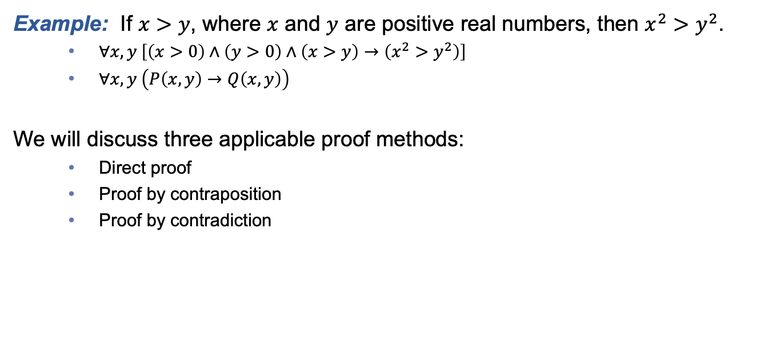
Mathematical theorems are often stated in the form of an implication
Example: If $x>y$, where $x$ and $y$ are positive real numbers, then $x^{2}>y^{2}$.
  $∀x,y \left[\left(x>0\right)∧\left(y>0\right)∧\left(x>y\right)→\left(x^{2}>y^{2}\right)\right]$
  $∀x,y \left(P\left(x,y\right)→Q\left(x,y\right)\right)$
We will discuss three applicable proof methods:
  Direct proof
  Proof by contraposition
  Proof by contradiction

Slide 5
Direct proof
In a direct proof, we prove p → q by showing that if p is true, then q must necessarily be true
Example: Prove that if n is an odd integer, then n³ is an odd integer.
Proof:
  Assume that n is odd. That is n = (2k + 1) for some integer k.
  So, n³ = (2k+1)³ = (4k² + 4k + 1)(2k+1) = 8k³ + 12k² + 6k + 1
  We can factor the above to get 2(4k³ + 6k² + 3k) + 1
  Since the above quantity is one more than even number, we know that n³ is odd. ☐
Notes:
Note that we’re using existential instantiation here by claiming n to be an odd number. We’re not assuming n=7, but rather n=2k+1.

Slide 6
Direct proofs are not always the easiest way to prove a given conjecture.
In this case, we can try proof by contraposition
How does this work?
  Recall that p → q ≡ ¬q → ¬p
  Therefore, a proof of ¬q → ¬p is also a proof of p → q
Proof by contraposition is an indirect proof technique since we don’t prove p → q directly.
Let’s take a look at an example…

Slide 7
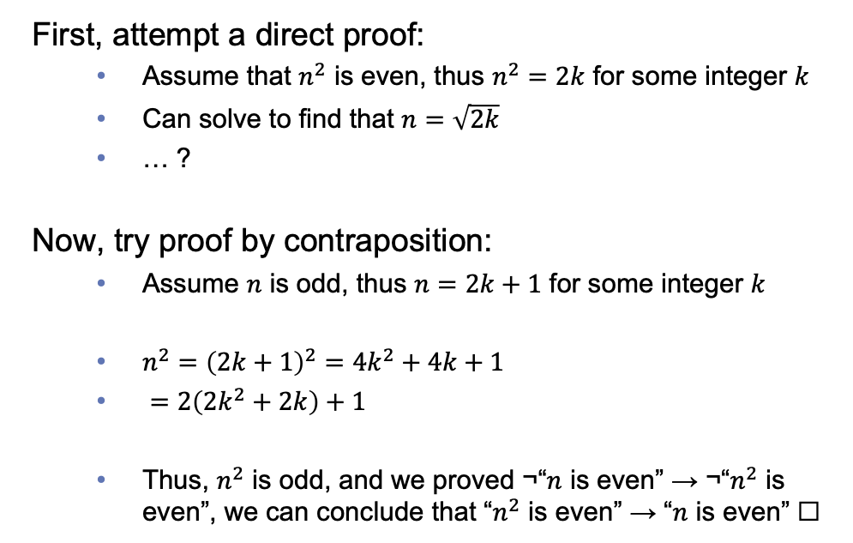
Prove: If n is an integer and n² is even, then n is even.
First, attempt a direct proof:
  Assume that $n^{2}$ is even, thus $n^{2}=2k$ for some integer $k$
  Can solve to find that $n=\sqrt{2k}$
  … ?
Now, try proof by contraposition:
  Assume $n$ is odd, thus $n=2k+1$ for some integer $k$
  $n^{2}={\left(2k+1\right)}^{2}=4k^{2}+4k+1$
  $=2\left(2k^{2}+2k\right)+1$
  Thus, $n^{2}$ is odd, and we proved ¬“$n$ is even” → ¬“$n^{2}$ is even”, we can conclude that “$n^{2}$ is even” → “$n$ is even” ☐
p
q
¬ q
¬ p

Slide 8
Proof by contradiction
Given a conditional p → q, the only way to reject this claim is to prove that p ∧ ¬q is true.
In a proof by contradiction we:
  Assume that p ∧ ¬q is true
  Proceed with the proof
  If this assumption leads us to a contradiction, we can conclude that p → q is true
Notes:
p -->q = ~p v q
[Neg]
~(~p v q)
p ^ ~q

Slide 9
Prove: If n is an integer and 3n + 2 is odd, then n is odd.
q
Proof:
  Assume the negation, that 3n + 2 is odd, n is even (i.e., n = 2k)
  3n + 2 = 3(2k) + 2 = 6k + 2 = 2(3k + 1)
  The above statement tells us that 3n + 2 is even, which is a contradiction of our assumption that 3n + 2 is odd.
  Therefore, we have shown that if 3n + 2 is odd, then n is also odd. ☐
Note: If we prove this by contraposition, we use a lot of the same mechanics/algebra!
  But the line of argumentation is different
We can also use proof by contradiction in cases where were the theorem to be proved is not of the form p → q
p
p
¬ q

Slide 10
Prove: At least 10 of any 64 dates fall on the same day of the week
Proof:
  Let p ≡ “At least 10 of any 64 dates fall on the same day of the week”
  Assume ¬p is true, that is “64 dates can be chosen such that at most 9 fall on the same day of the week”
  When choosing dates, since there are 7 days in a week, at most 7 × 9 = 63 dates can be chosen in total
  This is a contradiction of the statement that we can chose 64 dates
  Therefore, the assumption is false, and we can conclude that at least 10 of any 64 dates fall on the same day of the week. ☐
This proof is an example of the pigeonhole principle, which we will study during our combinatorics unit.

Slide 11

In-class Activities
Notes:
Proof method

Slide 12
In-class Activities
Activity 1: Prove our motivational example [miro]
Activity 2: Prove the following claims
  Use a direct proof to show that the square of an even number is an even number. [miro]
    Note that we proved the converse earlier, so this will prove it is an “if and only if” relationship
  Use proof by contraposition to show that if n is an integer and n³ + 5 is odd, then n is even. [miro]
Steps:
Introduce to a classmate
Work in pairs on the exercise
Submit answers on miro
Volunteers to share answers
Notes:
Proof method
2a and 2b (optional)

Slide 13
The scientific process is not always straightforward…
Gather evidence, prove lemmas
Prove theorem
Conjecture
Notes:
As we look at more proof techniques, let’s keep in mind the bigger picture

Slide 14



The scientific process is not always straightforward…
Proof strategies help us…
Effectively use all of the tools at our disposal
Organize our problem solving approach
Develop a coherent plan of attack

Slide 15
Types of proof strategy
Today we’ll discuss four types of strategy:
  Forward reasoning
  Backward reasoning
  Searching for counterexamples
  Adapting existing proofs

Slide 16
Sometimes forward reasoning doesn’t work
In these cases, it is often helpful to reason backwards, starting with the goal that we want to prove.
Example: Prove that given two distinct positive real numbers x and y, the arithmetic mean of x and y is always greater than the geometric mean of x and y.
Sanity check: Let x=8 and y=4. (8+4)/2 = 6. √(8 × 4) = √(32) ≅ 5.66. 6 > 5.66 ✔
(x + y)/2
√(xy)

Slide 17
Prove that (x+y)/2 > √(xy) for all distinct pairs of positive real numbers x and y.
Proof:
(x + y)/2 > √(xy)
(x + y)²/4 > xy
(x + y)² > 4xy
x² + 2xy + y² > 4xy
x² - 2xy + y² > 0
(x – y)² > 0
(x – y) > 0
x > y
Since (x – y)² > 0 whenever x ≠ y, the final inequality is true. Since all of these inequalities are equivalent, it follows that (x + y)/2 > √(xy). ☐

Slide 18
Other times, searching for a counterexample is helpful
Proof by counterexample is helpful if:
  Proof attempts repeatedly fail
  The conjecture to be proven looks “funny”
Example: Prove that every positive integer is the sum of two squares.
Counterexample:
3 is not the sum of two squares, so the claim is false. ☐
This seems suspicious to me, since other factorizations (e.g., prime factorizations) can be complex.

Slide 19
These four proof strategies are just a start!
A great tool for programmers AND logicians!
When trying to prove a new conjecture, a good “meta strategy” is to:
  If possible, try to reuse an existing proof (analogy!)
  If the conjecture looks fishy, check for a counterexample
  Attempt a “real” proof
    Apply the forward reasoning strategy
    Or, apply the backward reasoning strategy
    Possibly alternate between forward and backward reasoning
Unfortunately, not every proof can be solved using this nice little meta strategy…
In fact, there are many, many proof strategies out there, and NONE of them can be guaranteed to find a proof!
Notes:
Mention recreational books, and logical impossibility theorems

Slide 20
Final Thoughts
Proving theorems is not always straightforward
Having several proof techniques at your disposal will make a huge difference in your success rate!
  And use proof strategies to organize yourself
Next lecture:
  More proof techniques
  Please read section 1.8

