Slide 1

CS 1674/2074: Intro to Computer Vision
PhD. Nils Murrugarra-Llerena
nem177@pitt.edu

Slide 2
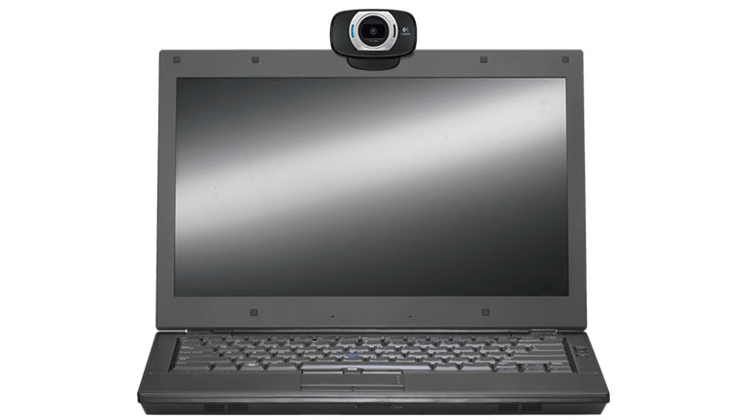
What is Computer Vision?
Done?
"We see with our brains, not with our eyes“ (Oliver Sacks and others)
Adapted from Kristen Grauman

Slide 3
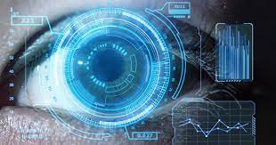
What is Computer Vision?
Automatic understanding of images and video
  Algorithms and representations to allow a machine to recognize objects, people, scenes, and activities
  Algorithms to mine, search, and interact with visual data
  Computing properties and navigating within the 3D world using visual data
  Generating realistic synthetic visual data
Adapted from Kristen Grauman

Slide 4
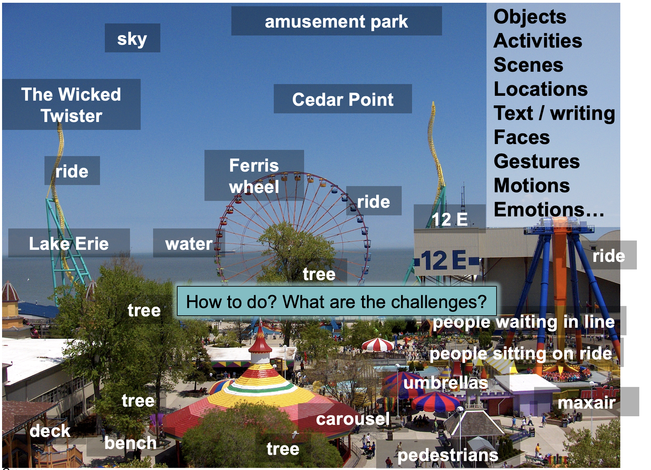
What is Computer Vision?
Kristen Grauman
Notes:
4

Slide 5
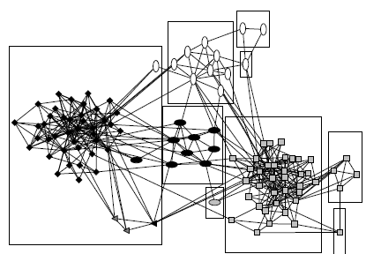
Understanding: Visual search, organization
3
?
2
1
Query
Image or video archives
Relevant content
Kristen Grauman

Slide 6
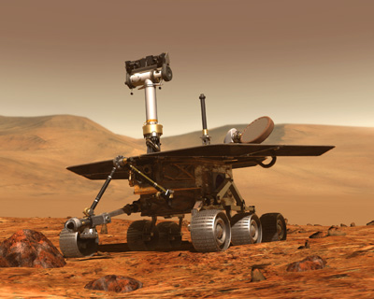
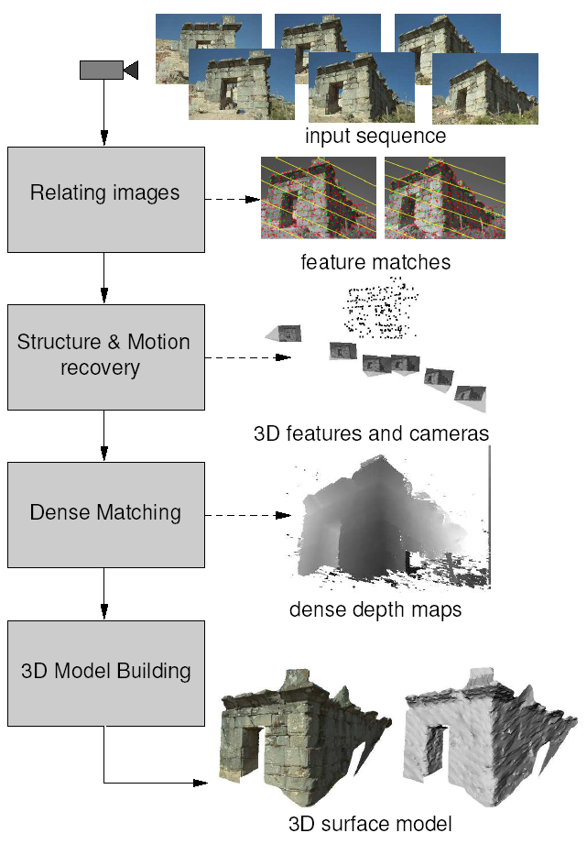
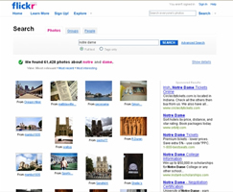
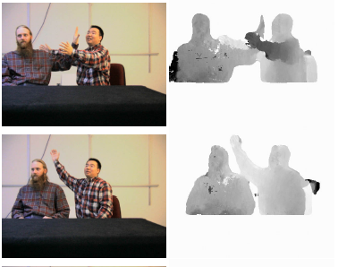
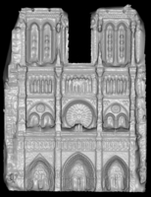
Understanding: Measurement
Multi-view stereo for
community photo collections
Real-time stereo
Structure from motion
NASA Mars Rover
Pollefeys et al.
Goesele et al.
Slide credit: L. Lazebnik

Slide 7
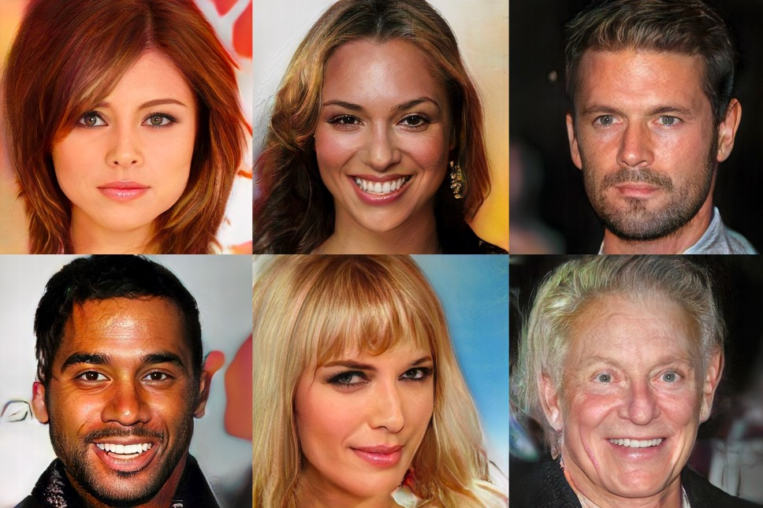
Understanding: Generation
Karras et al., “Progressive Growing of GANs for Improved Quality, Stability, and Variation”, ICLR 2018

Slide 8
Understanding: Related Disciplines
Artificial intelligence
Machine learning
Graphics
Computer vision
Image processing
Cognitive science
Algorithms
Kristen Grauman

Slide 9

Understanding: Vision and graphics
Images
Vision
Model
Graphics
Inverse problems: analysis and synthesis.
Kristen Grauman

Slide 10
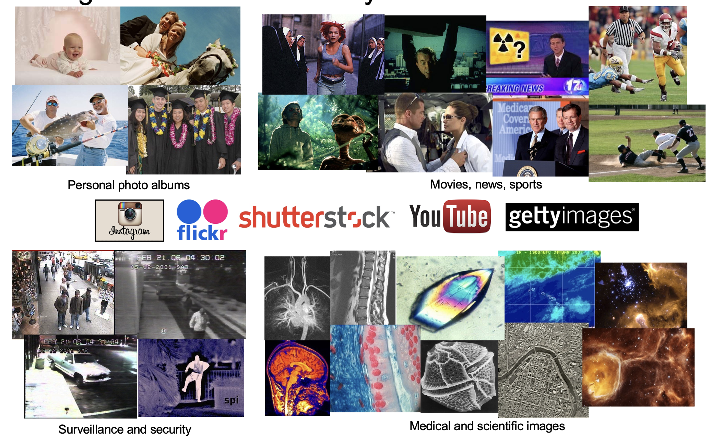
Why Vision?
Images and video are everywhere!
144k hours uploaded to YouTube daily
4.5 mil photos uploaded to Flickr daily
10 bil images indexed by Google
Adapted from Lana Lazebnik

Slide 11
Why Vision?
As image sources multiply, so do applications
  Relieve humans of boring, easy tasks
  Perception for robotics / autonomous agents
  Organize and give access to visual content
  Description of content for the visually impaired
  Human-computer interaction
  Fun applications (e.g. art styles to my photos)
Adapted from Kristen Grauman

Slide 12
Current Computer Vision Topics: From CVPR, ICCV, and ECCV
CVPR = IEEE/CVF Conference on Computer Vision and Pattern Recognition
ICCV = IEEE/CVF International Conference on Computer Vision
ECCV = European Conference on Computer Vision

Slide 13
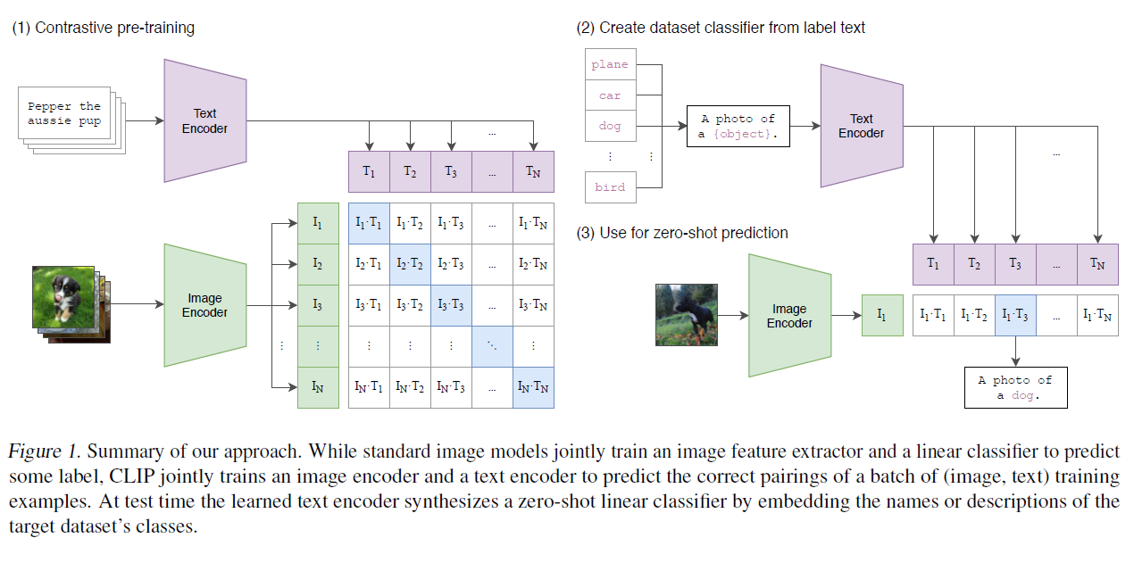
Image-text alignment
Radford et al. "Learning Transferable Visual Models From Natural Language Supervision." ICML 2021.

Slide 14
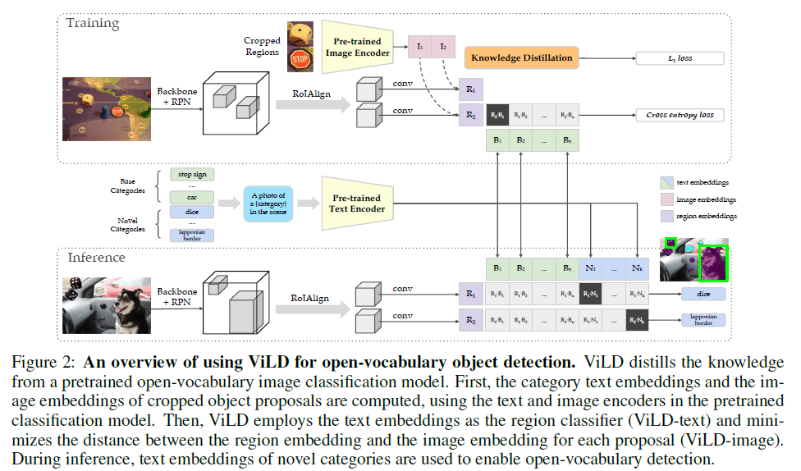
Open-vocabulary object detection
Gu et al. "Open-vocabulary Object Detection via Vision and Language Knowledge Distillation." ICLR 2021.

Slide 15
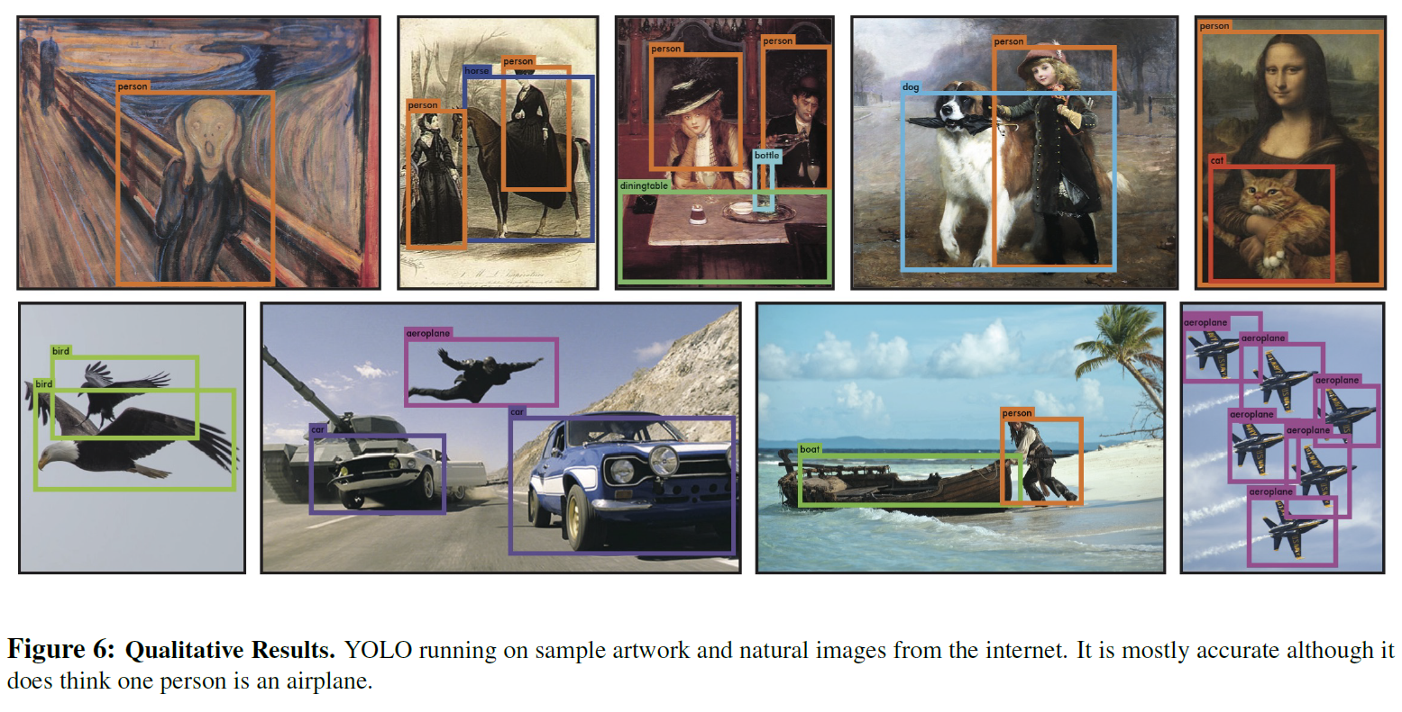
How to recognize objects in new modalities
Redmon et al., CVPR 2016

Slide 16
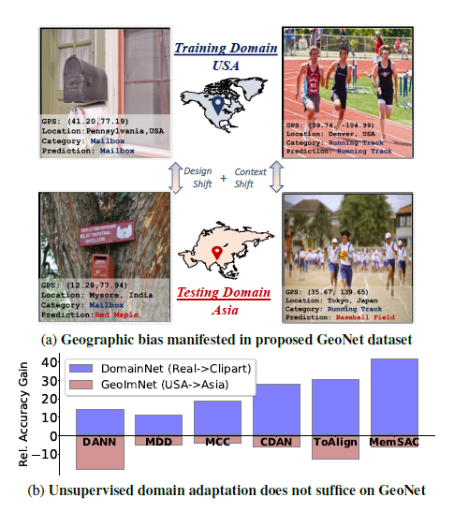
How to use models across countries
Kalluri et al. "GeoNet: Benchmarking Unsupervised Adaptation across Geographies." CVPR 2023.

Slide 17
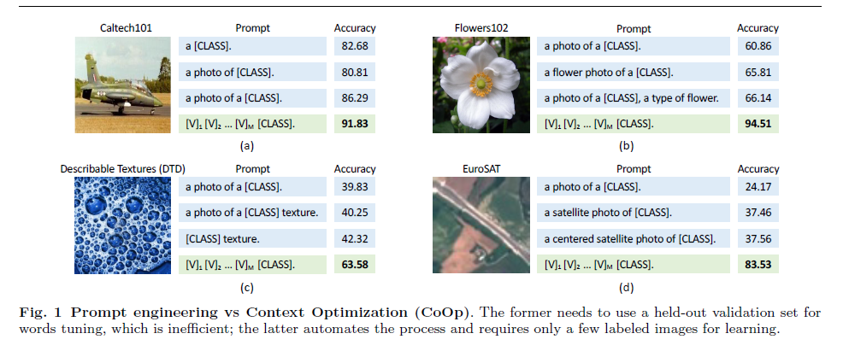
How to query vision-language models
Zhou et al. "Learning to Prompt for Vision-Language Models." IJCV 2022.

Slide 18
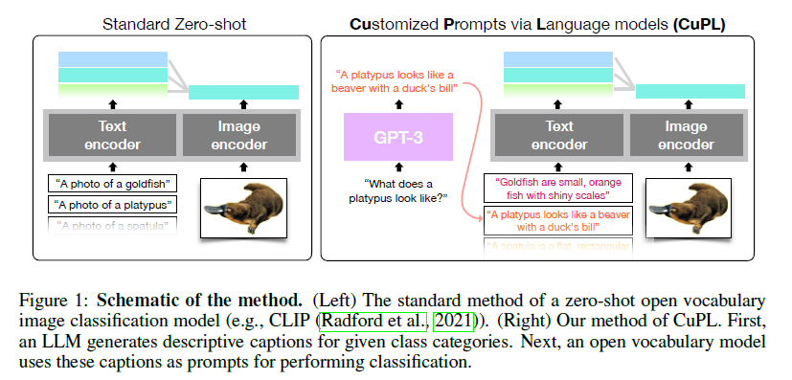
How to query vision-language models
Pratt et al. "What does a platypus look like? Generating customized prompts for zero-shot image classification." ICCV 2023.

Slide 19
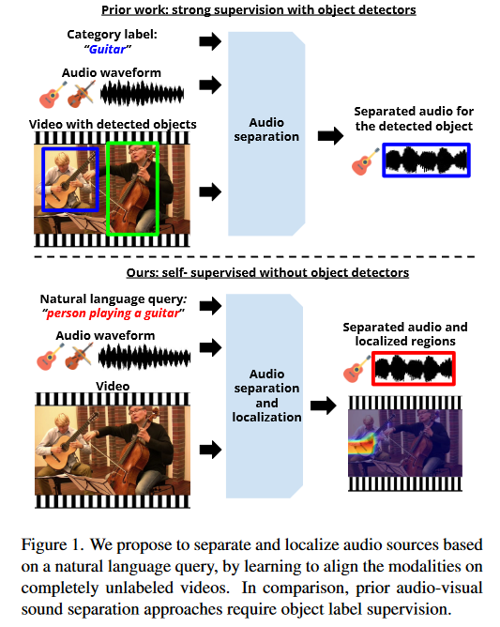
How to integrate modalities (audio)
Tan et al. "Language-Guided Audio-Visual Source Separation via Trimodal Consistency." CVPR 2023.

Slide 20
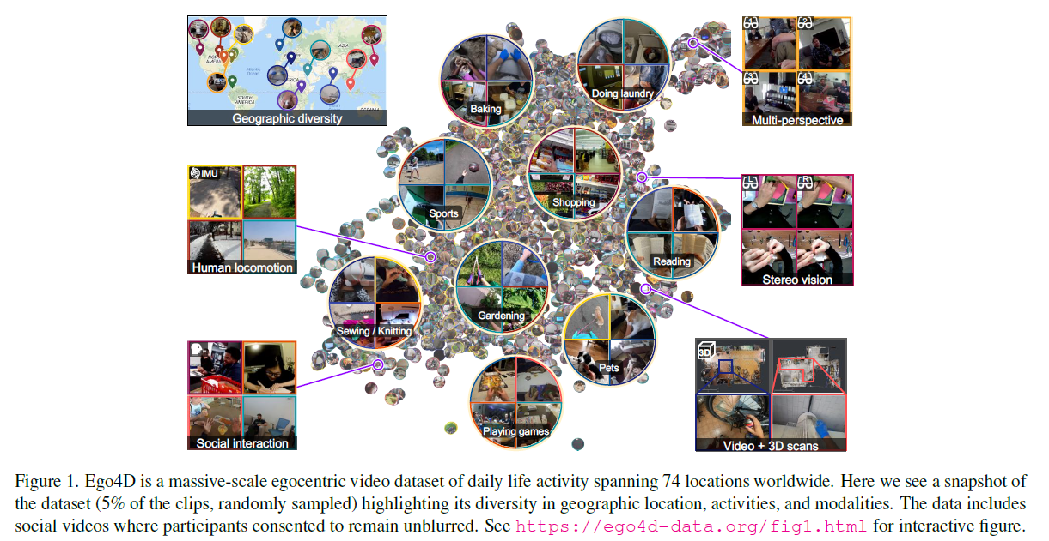
How to represent everyday activities
Grauman et al. "Ego4D: Around the World in 3,000 Hours of Egocentric Video." CVPR 2022.

Slide 21
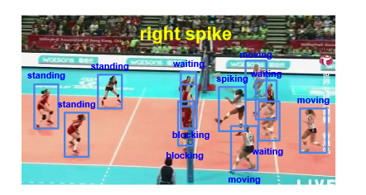
How to understand activities and intents
Bagautdinov et al., CVPR 2017

Slide 22
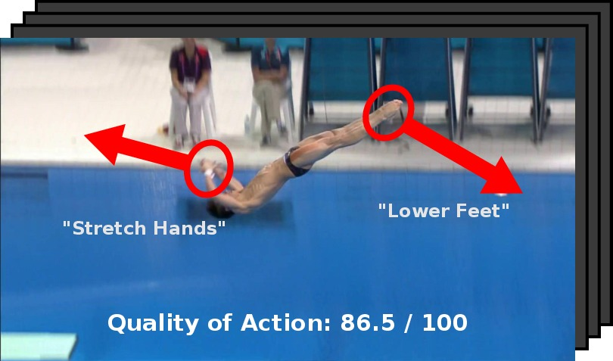
How to grade how well an activity is performed
Pirsiavash et al., ECCV 2014

Slide 23
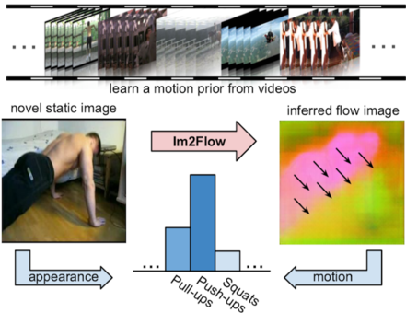
How to imagine motion in static images
Gao et al., CVPR 2018

Slide 24
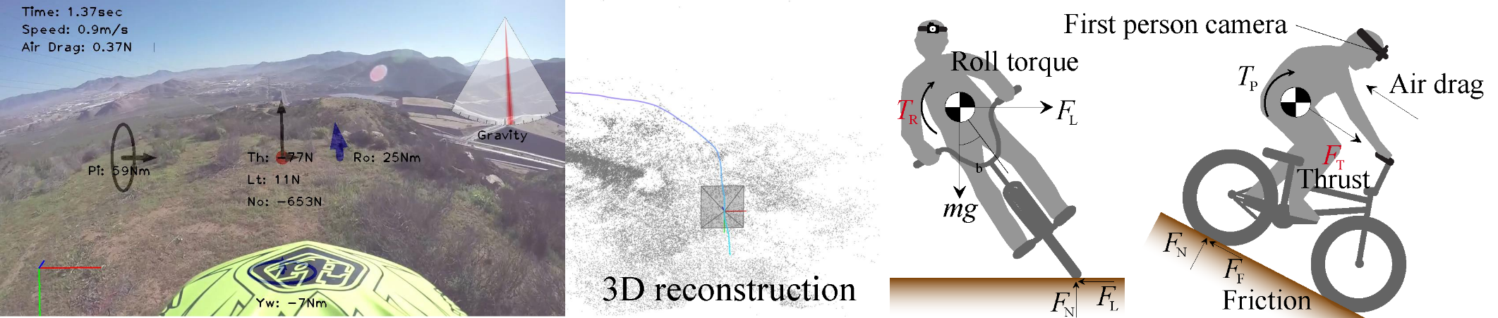
How to decode physics from video
Park et al., CVPR 2016

Slide 25
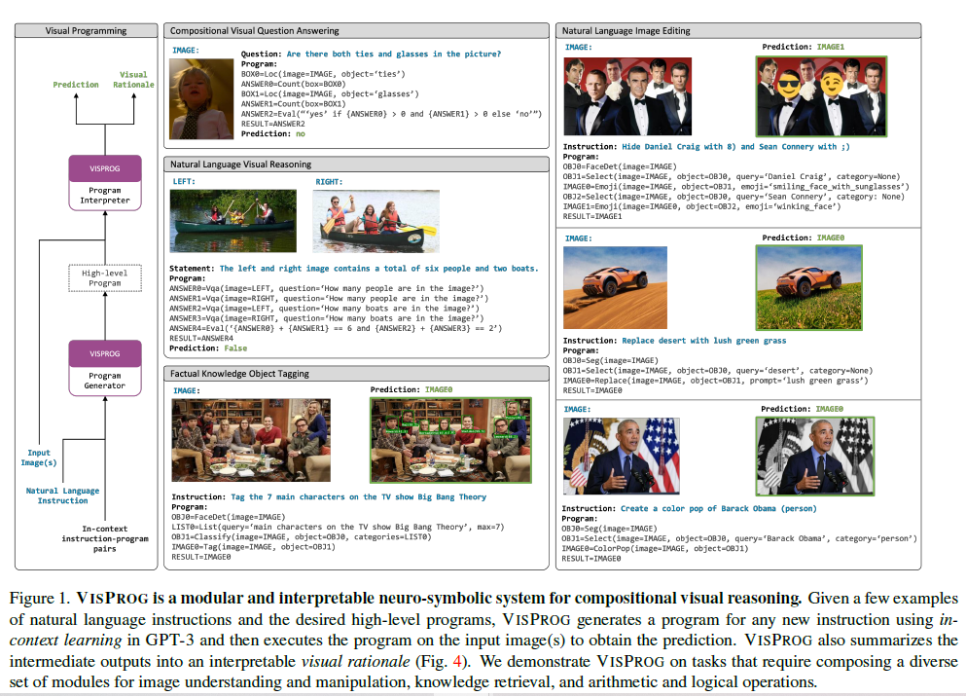
How to perform high-level reasoning
Gupta and Kembhavi. "Visual Programming: Compositional visual reasoning without training." CVPR 2023.

Slide 26
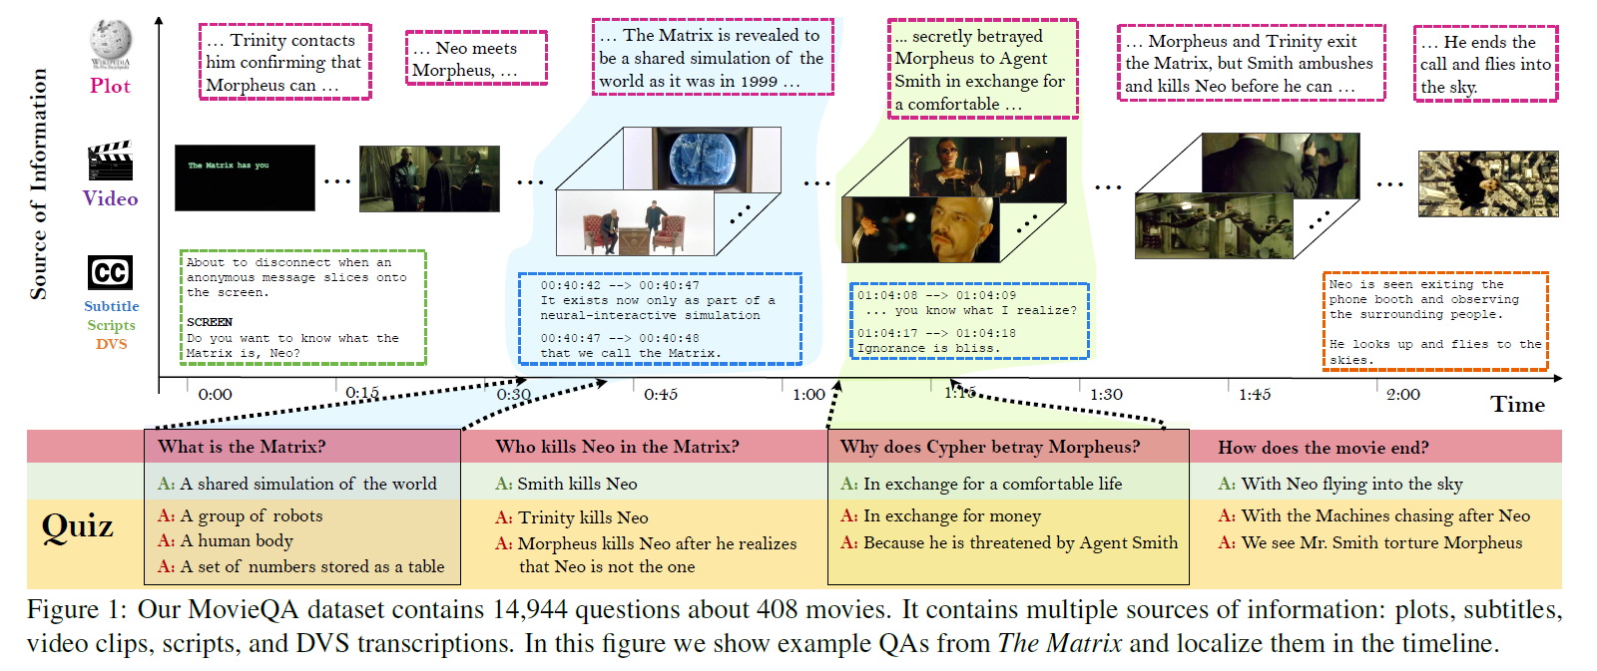
How to understand stories in film
Tapaswi et al., CVPR 2016

Slide 27
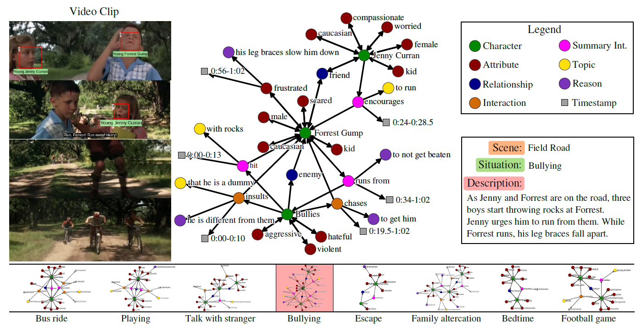
How to understand roles in film
Vicol et al., CVPR 2018

Slide 28
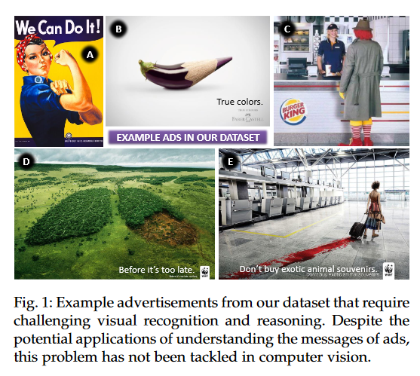
How to understand media persuasion
Ye et al. "Interpreting the Rhetoric of Visual Advertisements." TPAMI 2019.

Slide 29



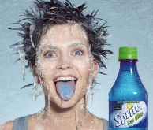

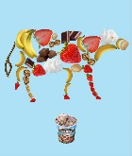


Automatic Understanding of Image and Video Advertisements
Zaeem Hussain, Mingda Zhang, Xiaozhong Zhang, Keren Ye, Christopher Thomas,
Zuha Agha, Nathan Ong, Adriana Kovashka
University of Pittsburgh
Understanding advertisements is more challenging than simply recognizing physical content from images, as ads employ a variety of strategies to persuade viewers.
Here are some sample annotations in our dataset.
What’s being advertised in this image?
Symbolism
Atypical Objects
Culture/Memes
Cars, automobiles
What sentiments are provoked in the viewer?
Amused, Creative, Impressed, Youthful, Conscious
We collect an advertisement dataset containing 64,832 images and 3,477 videos, each annotated by 3-5 human workers from Amazon Mechanical Turk.
What strategies are used to persuade viewer?
Image | Topic | 204,340 | Strategy | 20,000
 | Sentiment | 102,340 | Symbol | 64,131
 | Q+A Pair | 202,090 | Slogan | 11,130
Symbolism, Contrast, Straightforward, Transferred qualities
What should the viewer do, and why should they do this?
Video | Topic | 17,345 | Fun/Exciting | 15,380
 | Sentiment | 17,345 | English? | 17,374
 | Q+A Pair | 17,345 | Effective | 16,721
I should buy Volkswagen because it can hold a big bear.
I should buy VW SUV because it can fit anything and everything in it.
I should buy this car because it can hold everything I need.
More information available at http://cs.pitt.edu/~kovashka/ads
Hussein et al., CVPR 2017

Slide 30
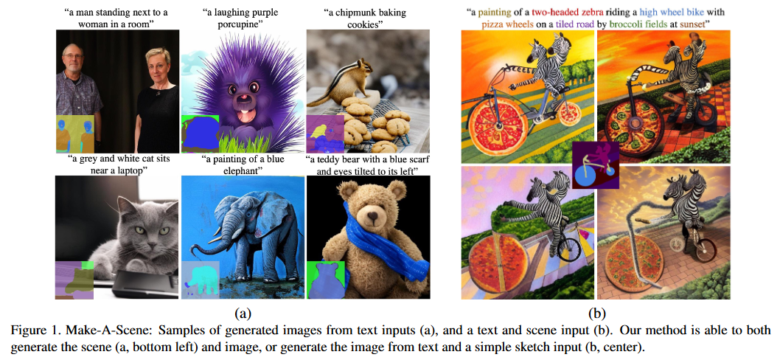
How to generate arbitrary content
Gafni et al. "Make-A-Scene: Scene-Based Text-to-Image Generation with Human Priors.” ECCV 2022.

Slide 31
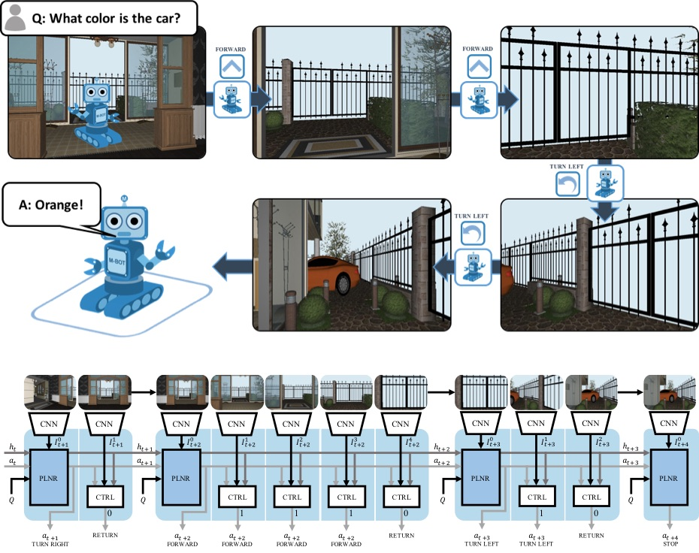
How to reason and act
Das et al., CVPR 2018

Slide 32
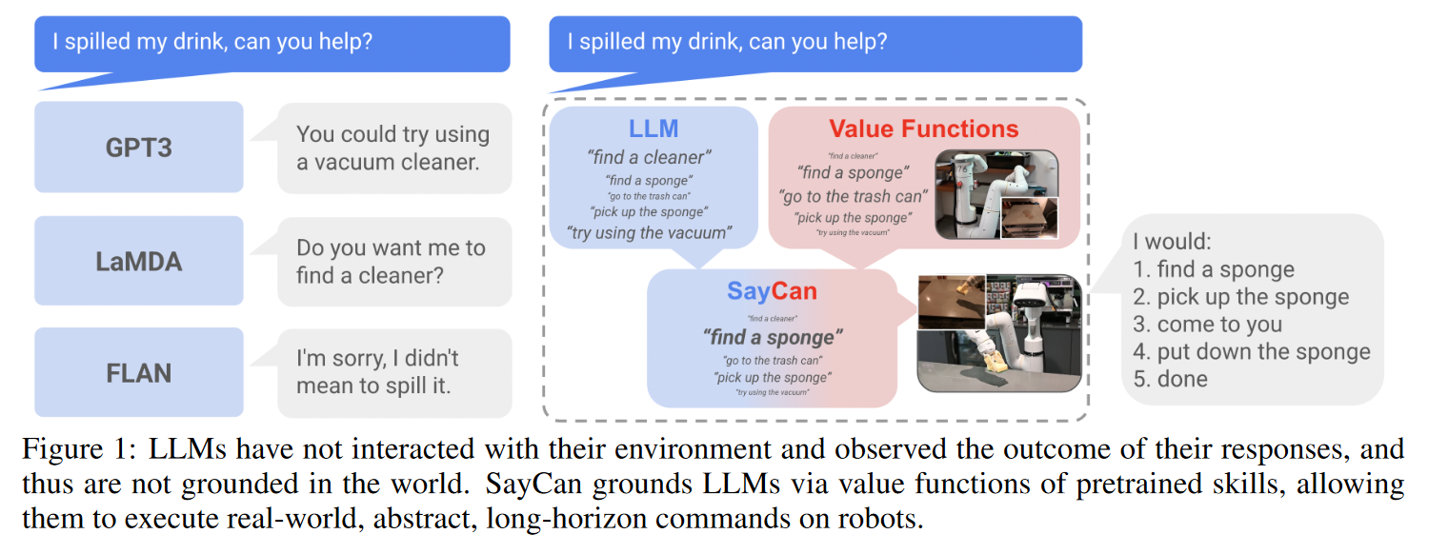
How to use language models for robotics tasks
Ahn et al. "Do As I Can, Not As I Say: Grounding Language in Robotic Affordances." CoRL 2023.

Slide 33
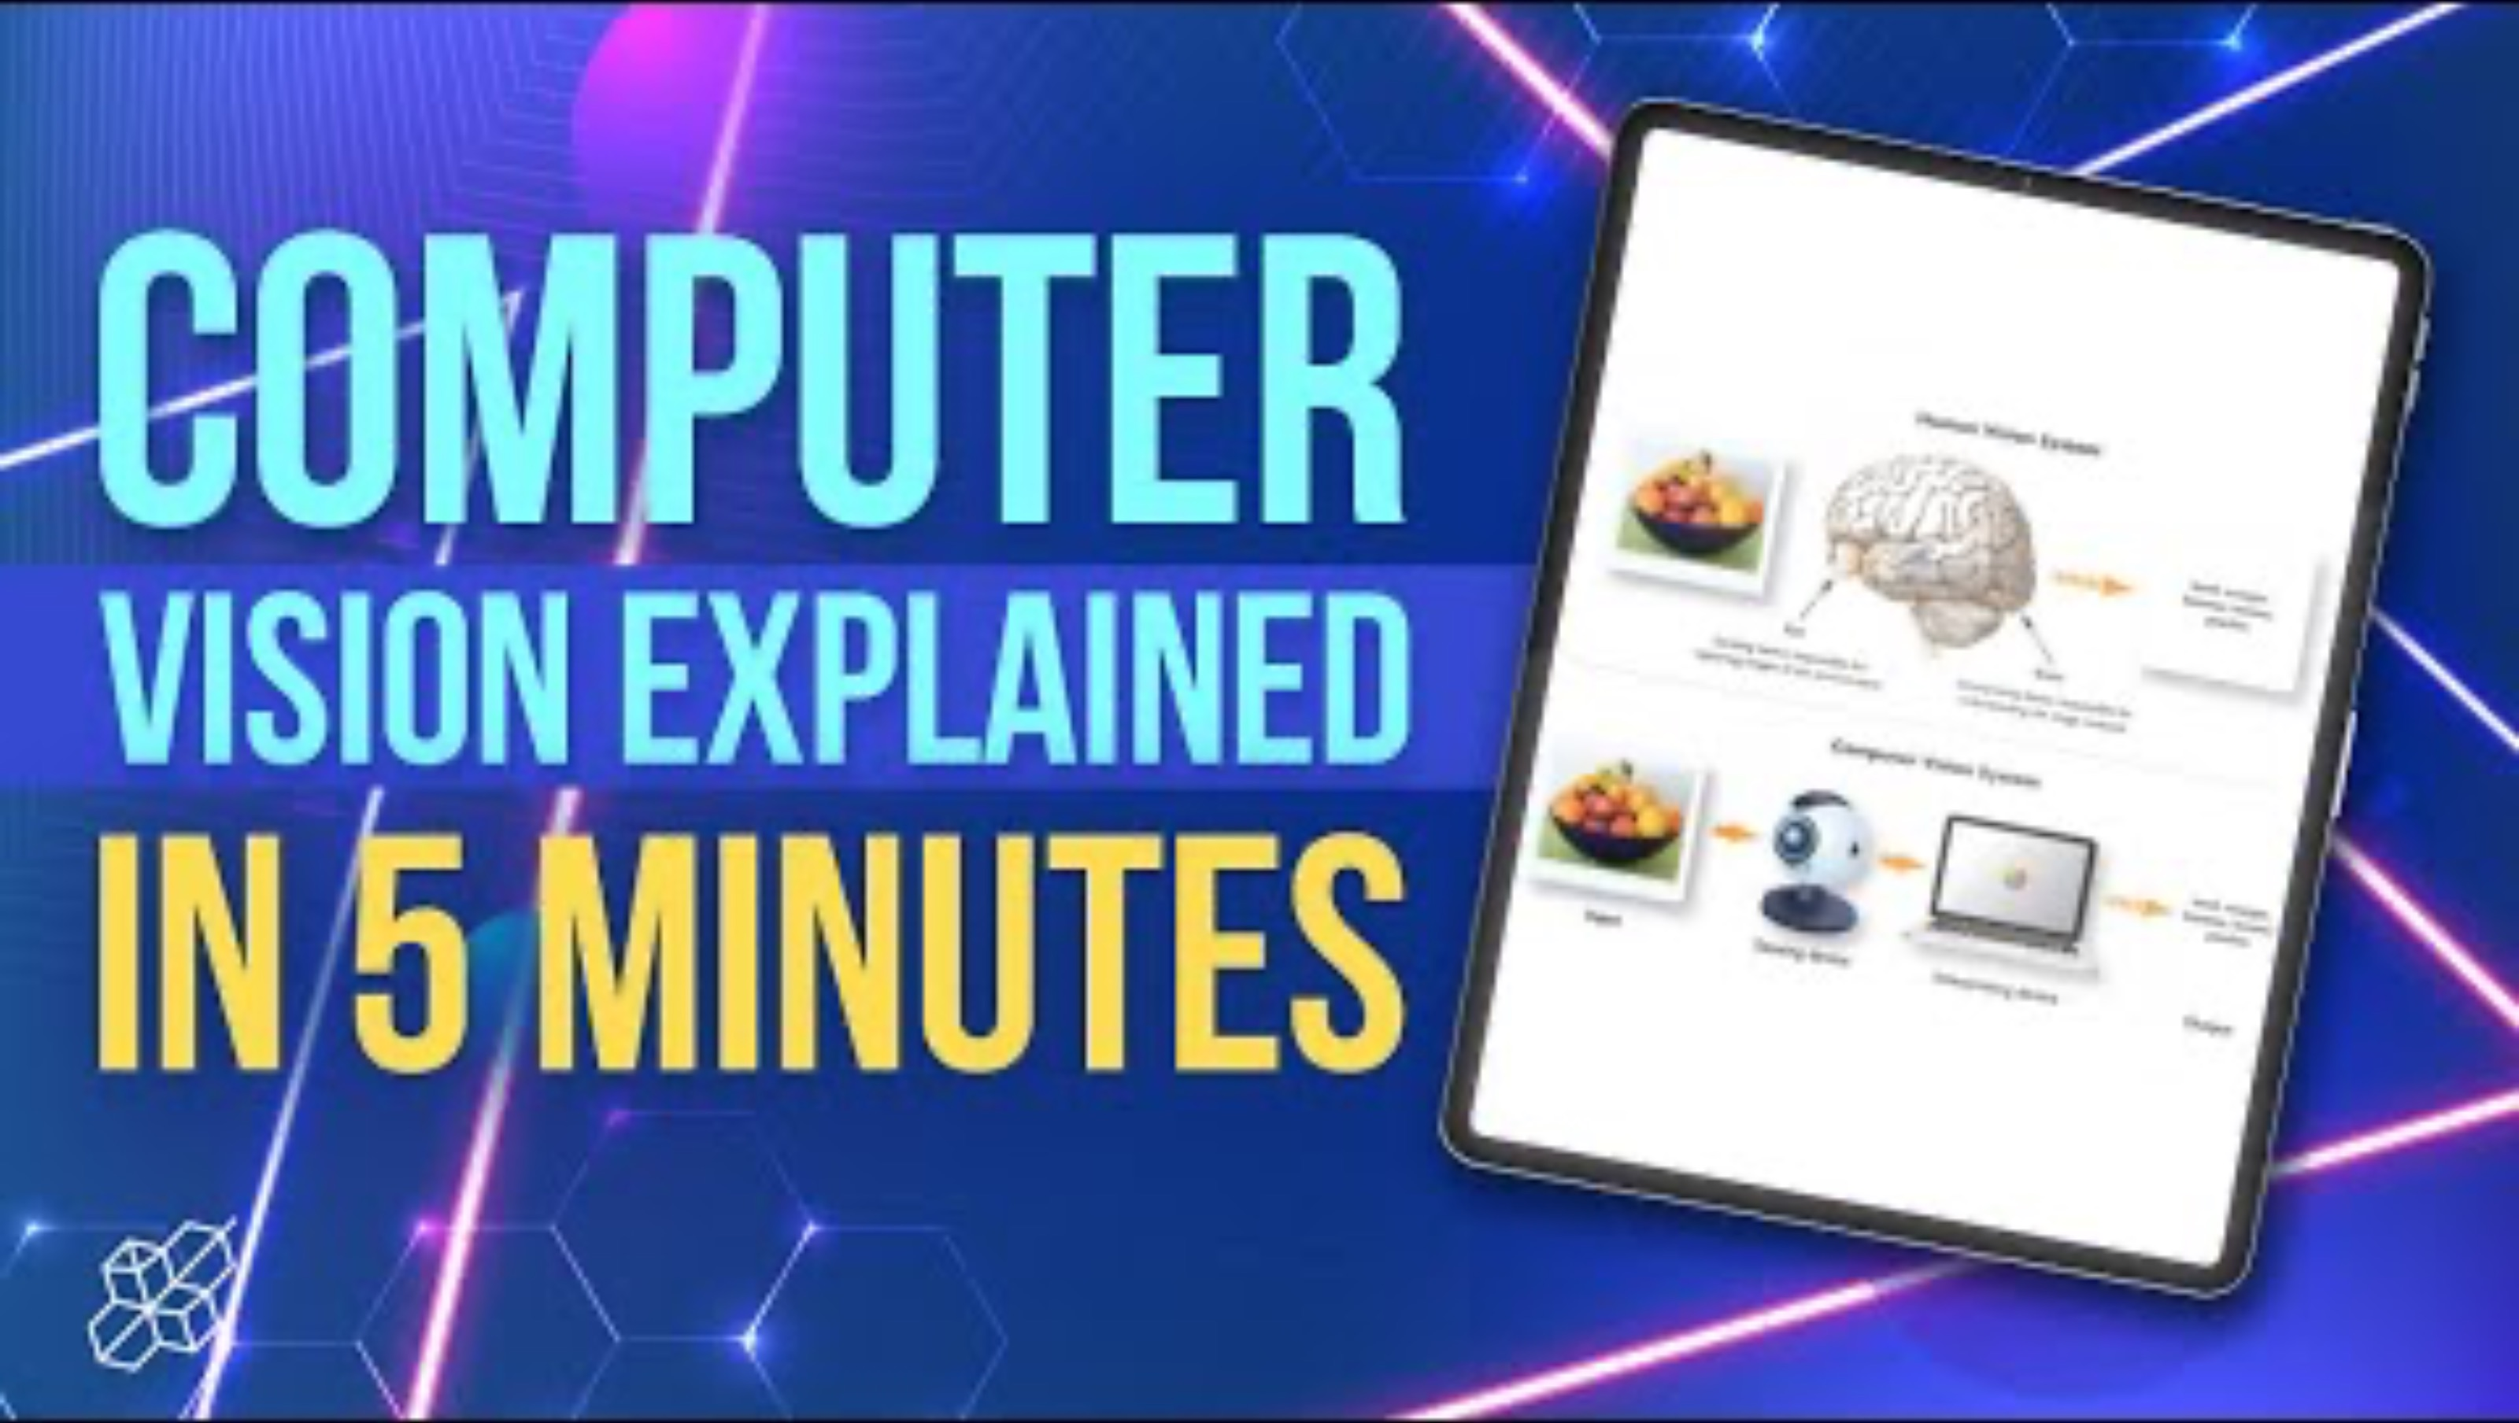
Computer Vision: Summary
Notes:
Until minute 4:31
https://www.youtube.com/watch?v=puB-4LuRNys&ab_channel=AISciences

Slide 34
Overview of topics

Slide 35
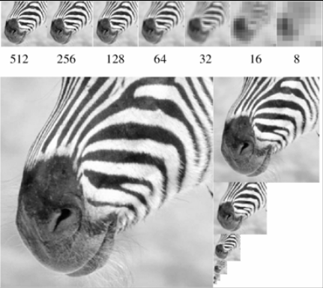
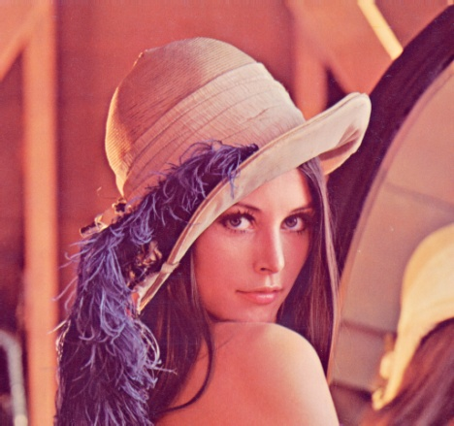
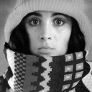

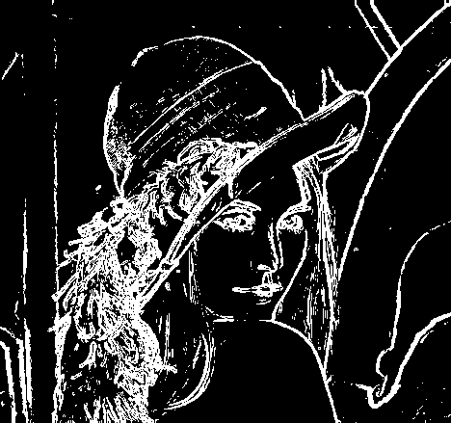
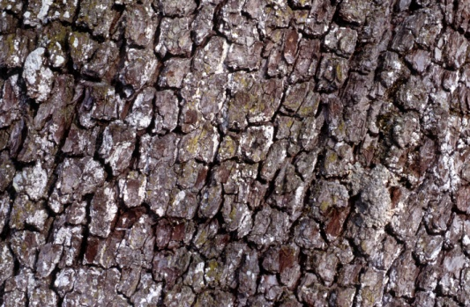

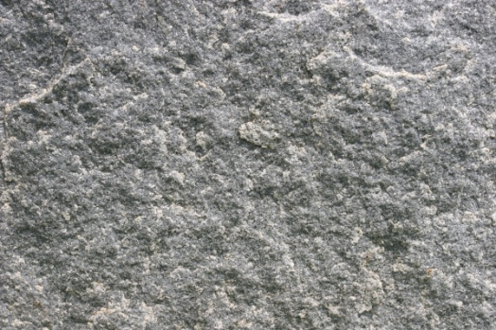

Features and Filters
Describing and transforming textures, colors, edges
Kristen Grauman

Slide 36
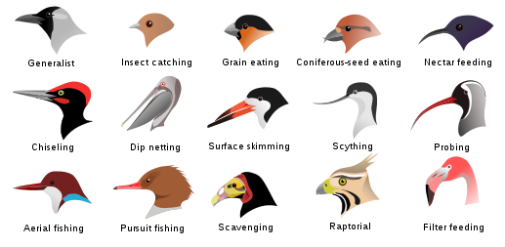
Image Categorization
Fine-grained recognition
Visipedia Project
Slide credit: D. Hoiem

Slide 37
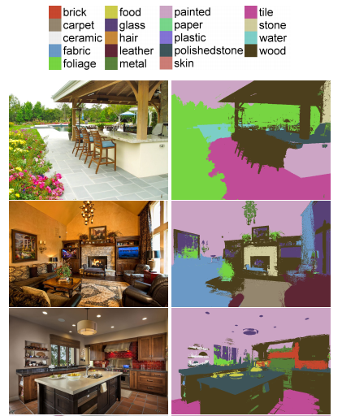
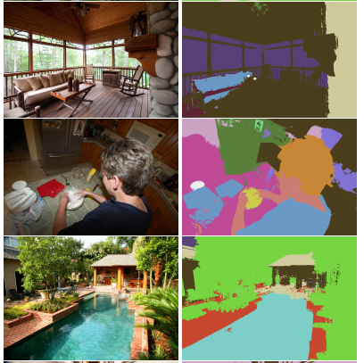
Image Categorization
Material recognition
[Bell et al. CVPR 2015]
Slide credit: D. Hoiem

Slide 38
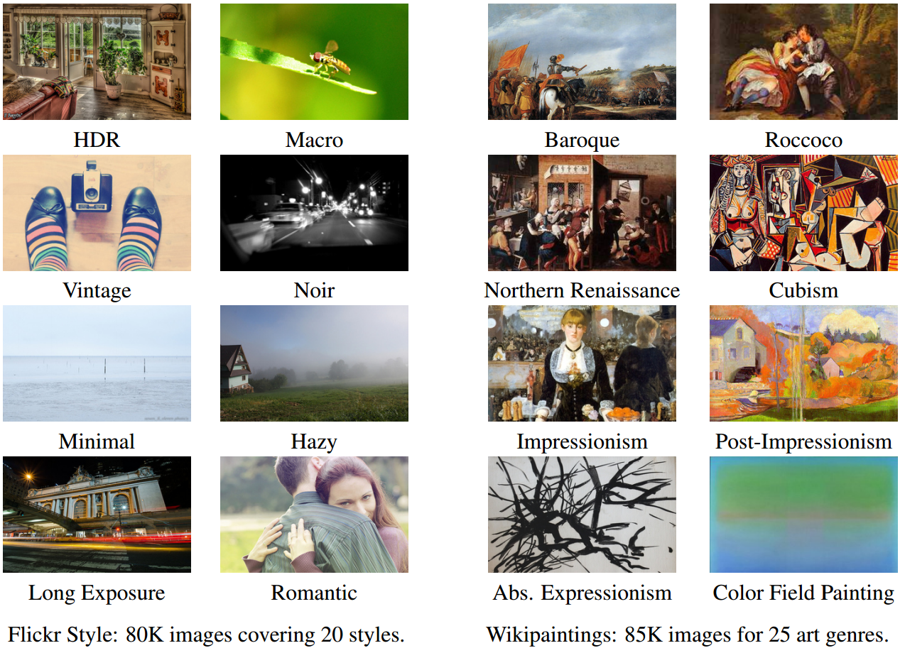
Image Categorization
Image style recognition
[Karayev et al. BMVC 2014]
Slide credit: D. Hoiem

Slide 39
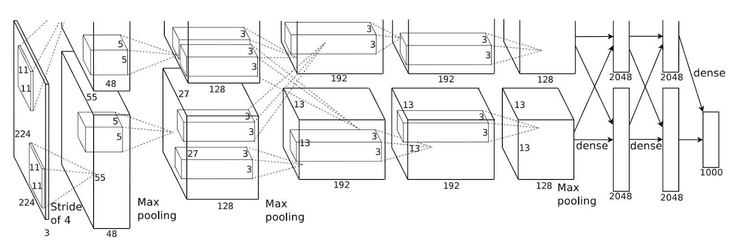
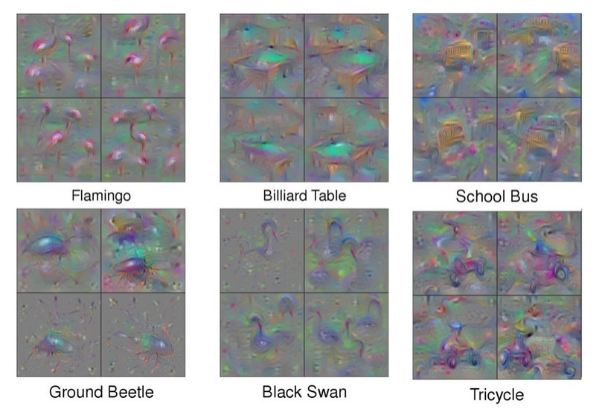
Convolutional Neural Networks (CNNs)
State-of-the-art on many recognition tasks
Image
Prediction
Krizhevsky et al., NIPS 2012
Yosinski et al., ICML DL workshop 2015

Slide 40
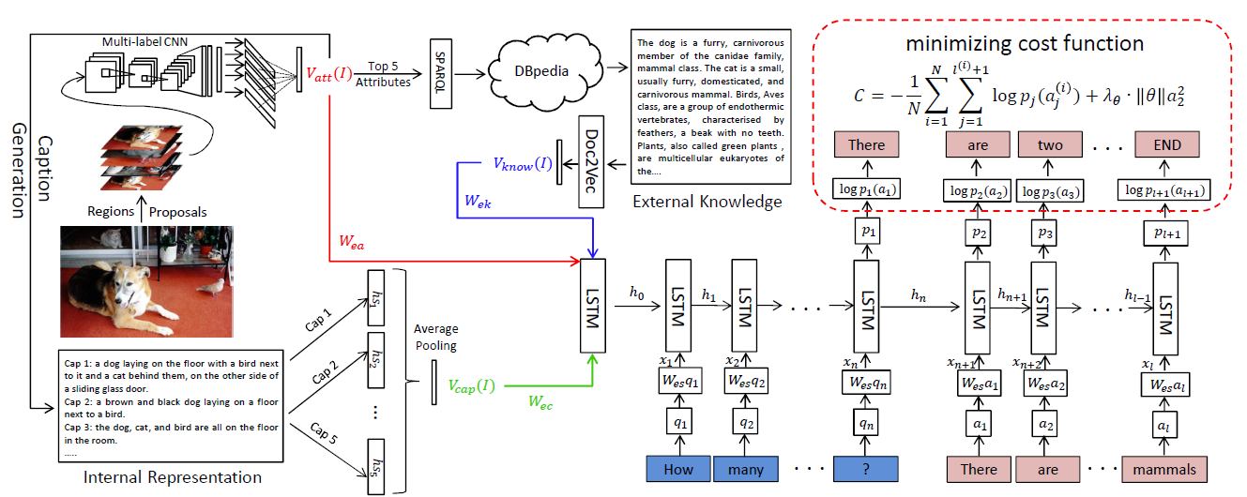
Recurrent Neural Networks (RNNs)
Sequence processing, e.g. question answering
Wu et al., CVPR 2016

Slide 41
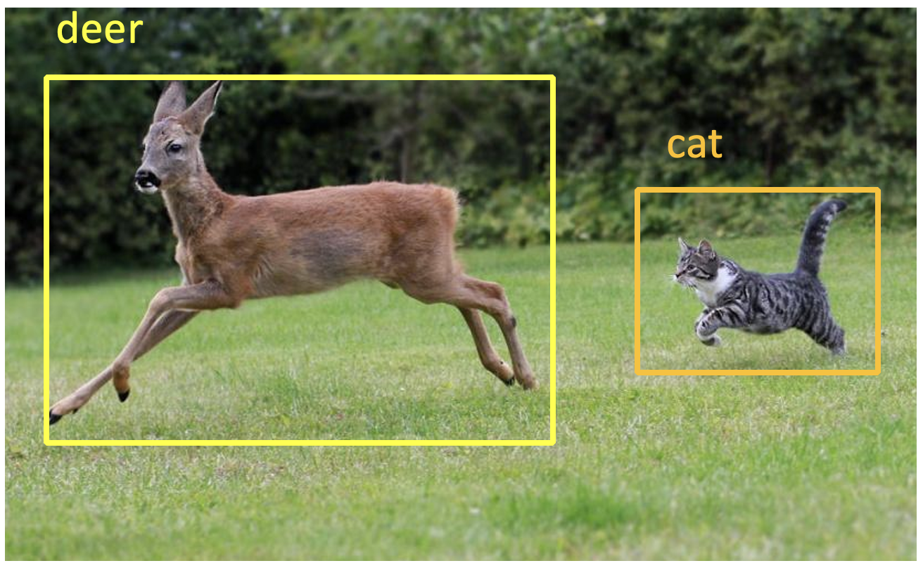
Object Recognition
Adapted from Vicente Ordoñez

Slide 42
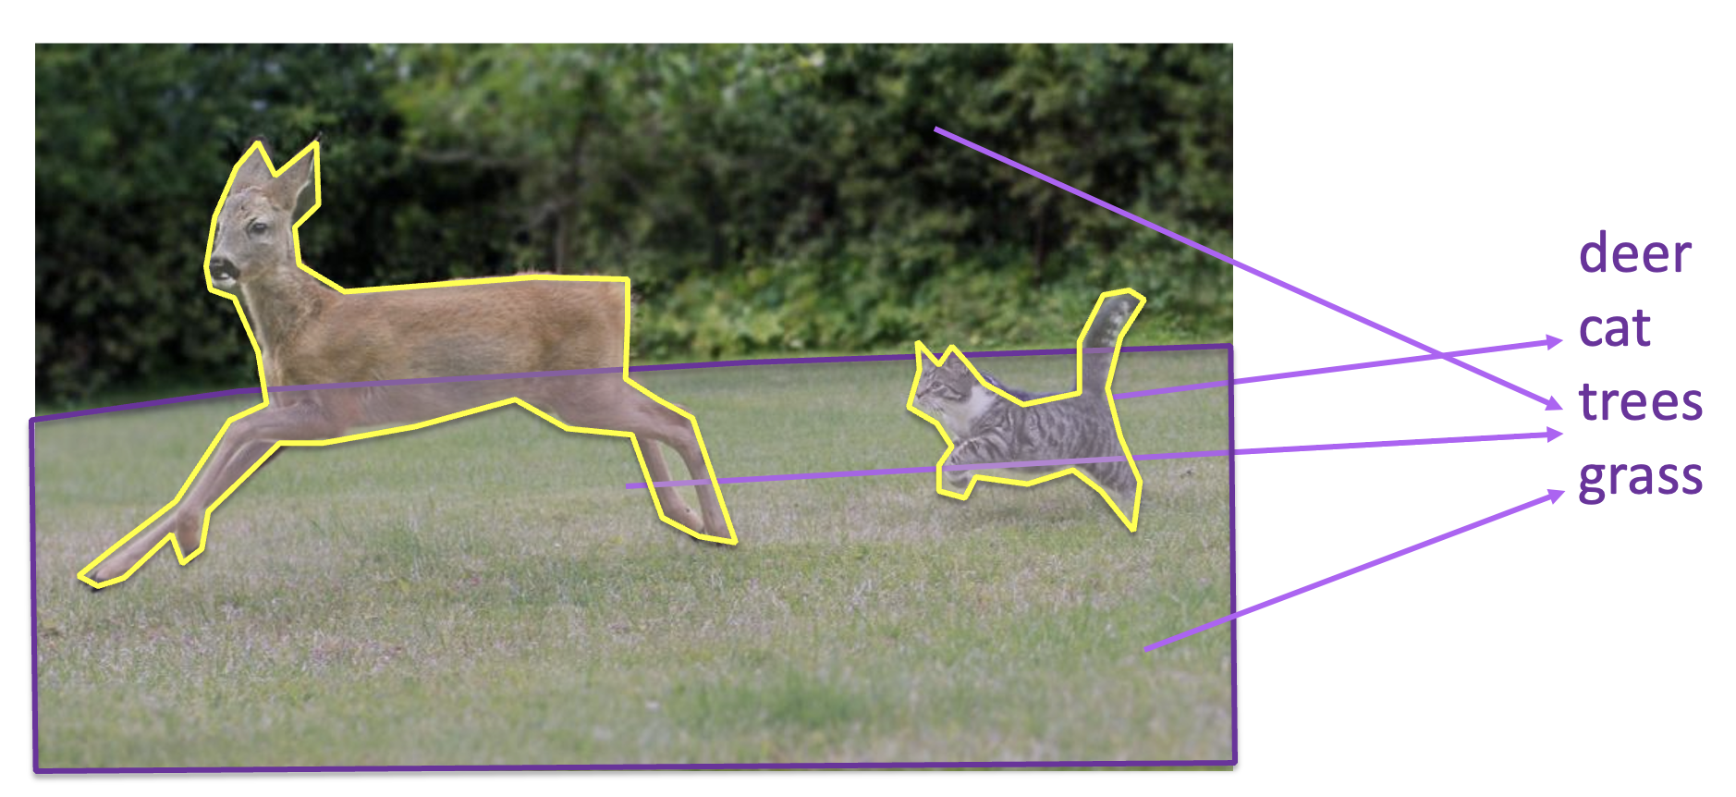
Image Segmentation
Adapted from Vicente Ordoñez

Slide 43
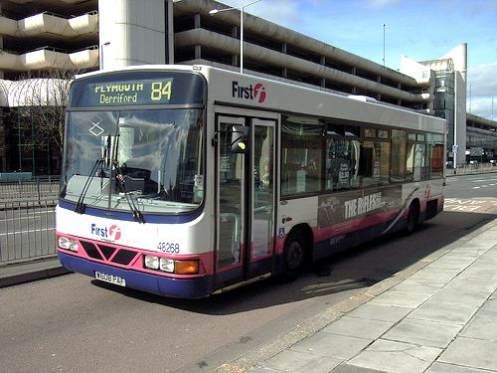
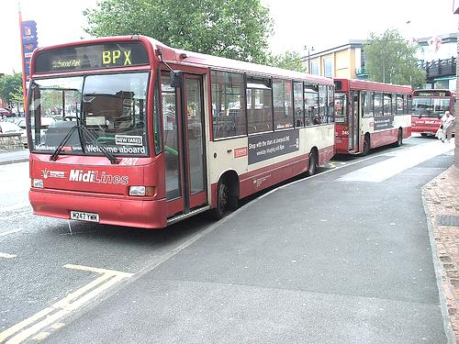



Unsupervised / Self-supervised Learning
Doersch et al., ICCV 2015
Notes:
- This is hard if you don’t know what a bus is, but easy if you do.
- We hope that if we give this task to a machine learner, it will also solve it by recognizing semantics.

Slide 44



Generative AI
Stable Diffusion: “Triceratops programming on a MacBook in a startup office”
Dall.e 2: https://learnopencv.com/mastering-dall-e-2/
Text-conditional image-inpainting [ref]
Notes:
https://www.assemblyai.com/blog/how-dall-e-2-actually-works/
https://www.edge-ai-vision.com/2023/01/from-dall%C2%B7e-to-stable-diffusion-how-do-text-to-image-generation-models-work/

Slide 45



Multimodal Generative AI
Multimodal Prompt Perceiver: Empower Adaptiveness, Generalizability and Fidelity for All-in-One Image Restoration [CVPR]
LION : Empowering Multimodal Large Language Model with Dual-Level Visual Knowledge [CVPR]
MM-Narrator: Narrating Long-form Videos with Multimodal In-Context Learning [CVPR]

Slide 46


Large Language Models
﻿ChatGPT is a Natural Language Generation (NLG) system!
NLG Systems
﻿Xiang Lisa Li, Antoine Bosselut, Chris Maning - https://web.stanford.edu/class/archive/cs/cs224n/cs224n.1234/
Notes:
https://www.assemblyai.com/blog/how-dall-e-2-actually-works/

Slide 47


Multimodal Large Language Models
Gpt-4: https://medium.com/@amol-wagh/whats-new-in-gpt-4-an-overview-of-the-gpt-4-architecture-and-capabilities-of-next-generation-ai-900c445d5ffe
Notes:
https://www.assemblyai.com/blog/how-dall-e-2-actually-works/

Slide 48
Agentic AI
https://our-thinking.nashtechglobal.com/insights/how-will-agentic-ai-reshape-your-work-and-organisation
Notes:
https://our-thinking.nashtechglobal.com/insights/how-will-agentic-ai-reshape-your-work-and-organisation

Slide 49

Agentic AI
https://encord.com/blog/ai-agents-guide-to-agentic-ai/
Notes:
https://encord.com/blog/ai-agents-guide-to-agentic-ai/

