Slide 1

CS 1674: Convolutional Neural Networks
PhD. Nils Murrugarra-Llerena
nem177@pitt.edu

Slide 2


Slide 3
Outline
Neural network Recap
Convolutional neural networks (CNNs)
  What is a Convolution?
  Why CNNs? Special operations: convolution and pooling
CNN Architectures
  AlexNet, VGGNet, GoogleNet, Resnet, among others
Practical matters
  Tips and tricks for training
  Transfer learning
  Software packages
Notes:
Op1: Curve
Instructor will decide and apply a curve on students’ final score. Minimum curve will be +3 points and Maximum curve will be +5 points.
Op2: Extra Credit (cap to 10 points applied to Exam 1)
Op 2.1. Submit an exercise / algorithm question with a solution for 10 extra points for Exam 1. Solution should be detailed and well-explained
Op 2.2. Exam 2 will have 10 extra points. These extra points can increase your score in Exam 1 (If you score 110, 10 points will go to your Exam 1)

Slide 4
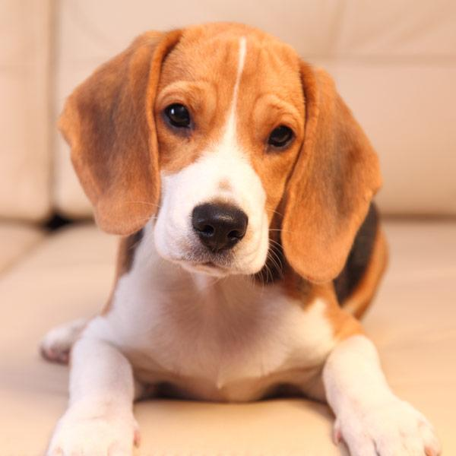
Neural Networks
4
0 | 0 | 3 | 2
1 | 1 | 0 | 1
4 | 2 | 1 | 2
0 | 2 | 1 | 5
Slide Credit: Prof. Sandra Avila - UNICAMP

Slide 5
Neural Networks
5
0 | 0 | 3 | 2
1 | 1 | 0 | 1
4 | 2 | 1 | 2
0 | 2 | 1 | 5
Slide Credit: Prof. Sandra Avila - UNICAMP

Slide 6
Neural Networks
6
0
0
3
2
0 | 0 | 3 | 2
1 | 1 | 0 | 1
4 | 2 | 1 | 2
0 | 2 | 1 | 5
Slide Credit: Prof. Sandra Avila - UNICAMP

Slide 7
Neural Networks
7
0
0
3
2
1
1
0
1
0 | 0 | 3 | 2
1 | 1 | 0 | 1
4 | 2 | 1 | 2
0 | 2 | 1 | 5
Slide Credit: Prof. Sandra Avila - UNICAMP

Slide 8
Neural Networks
8
0
0
3
2
1
1
0
1
⠇
2
1
5
0 | 0 | 3 | 2
1 | 1 | 0 | 1
4 | 2 | 1 | 2
0 | 2 | 1 | 5
Slide Credit: Prof. Sandra Avila - UNICAMP

Slide 9
What is a Convolution?

Slide 10
What is a Convolution?
10
Convolution is the process of adding each element of the image to its local neighbors, weighted by the kernel/filter.
Slide Credit: Prof. Sandra Avila - UNICAMP

Slide 11
What is a Convolution?
11
1 | 1 | 1 | 0 | 0
0 | 1 | 1 | 1 | 0
0 | 0 | 1 | 1 | 1
0 | 0 | 1 | 1 | 0
0 | 1 | 1 | 0 | 0
*
1 | 0 | 1
0 | 1 | 0
1 | 0 | 1
3 x 3 filter
5 x 5 matrix
(image)
Slide Credit: Prof. Sandra Avila - UNICAMP

Slide 12
What is a Convolution?
12
1 | 1 | 1 | 0 | 0
0 | 1 | 1 | 1 | 0
0 | 0 | 1 | 1 | 1
0 | 0 | 1 | 1 | 0
0 | 1 | 1 | 0 | 0
*
1 | 0 | 1
0 | 1 | 0
1 | 0 | 1
3 x 3 filter
5 x 5 matrix
(image)
Slide Credit: Prof. Sandra Avila - UNICAMP

Slide 13
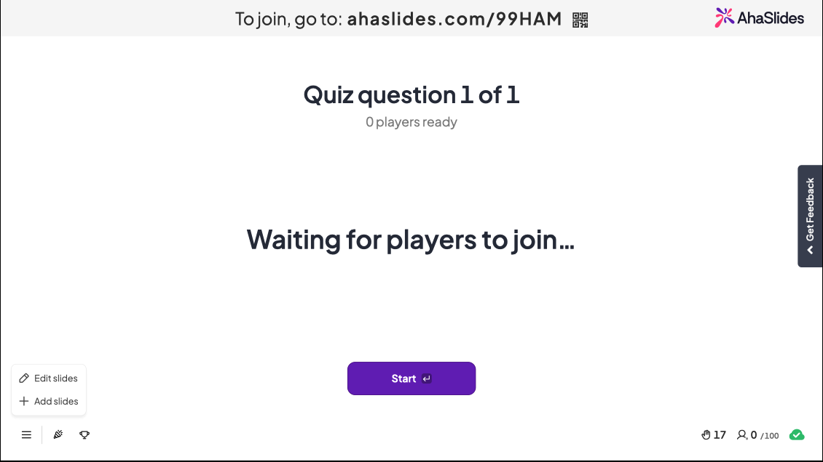

Slide 14
What is a Convolution?
14
1 | 1 | 1 | 0 | 0
0 | 1 | 1 | 1 | 0
0 | 0 | 1 | 1 | 1
0 | 0 | 1 | 1 | 0
0 | 1 | 1 | 0 | 0
*
1 | 0 | 1
0 | 1 | 0
1 | 0 | 1
4
3 x 3 filter
1*1 + 1*0 + 1*1 +
0*0 + 1*1 + 1*0 +
0*1 + 0*0 + 1*1 = 4
5 x 5 matrix
(image)
Slide Credit: Prof. Sandra Avila - UNICAMP

Slide 15
What is a Convolution?
15
1 | 1 | 1 | 0 | 0
0 | 1 | 1 | 1 | 0
0 | 0 | 1 | 1 | 1
0 | 0 | 1 | 1 | 0
0 | 1 | 1 | 0 | 0
*
1 | 0 | 1
0 | 1 | 0
1 | 0 | 1
4 | 3
3 x 3 filter
1*1 + 1*0 + 0*1 +
1*0 + 1*1 + 1*0 +
0*1 + 1*0 + 1*1 = 3
5 x 5 matrix
(image)
Slide Credit: Prof. Sandra Avila - UNICAMP

Slide 16
What is a Convolution?
16
1 | 1 | 1 | 0 | 0
0 | 1 | 1 | 1 | 0
0 | 0 | 1 | 1 | 1
0 | 0 | 1 | 1 | 0
0 | 1 | 1 | 0 | 0
*
1 | 0 | 1
0 | 1 | 0
1 | 0 | 1
4 | 3 | 4
3 x 3 filter
1*1 + 0*0 + 0*1 +
1*0 + 1*1 + 0*0 +
1*1 + 1*0 + 1*1 = 4
5 x 5 matrix
(image)
Slide Credit: Prof. Sandra Avila - UNICAMP

Slide 17
What is a Convolution?
17
1 | 1 | 1 | 0 | 0
0 | 1 | 1 | 1 | 0
0 | 0 | 1 | 1 | 1
0 | 0 | 1 | 1 | 0
0 | 1 | 1 | 0 | 0
*
1 | 0 | 1
0 | 1 | 0
1 | 0 | 1
4 | 3 | 4
2
3 x 3 filter
0*1 + 1*0 + 1*1 +
0*0 + 0*1 + 1*0 +
0*1 + 0*0 + 1*1 = 2
5 x 5 matrix
(image)
Slide Credit: Prof. Sandra Avila - UNICAMP

Slide 18
What is a Convolution?
18
1 | 1 | 1 | 0 | 0
0 | 1 | 1 | 1 | 0
0 | 0 | 1 | 1 | 1
0 | 0 | 1 | 1 | 0
0 | 1 | 1 | 0 | 0
*
1 | 0 | 1
0 | 1 | 0
1 | 0 | 1
4 | 3 | 4
2 | 4
3 x 3 filter
1*1 + 1*0 + 1*1 +
0*0 + 1*1 + 1*0 +
0*1 + 1*0 + 1*1 = 4
5 x 5 matrix
(image)
Slide Credit: Prof. Sandra Avila - UNICAMP

Slide 19
What is a Convolution?
19
1 | 1 | 1 | 0 | 0
0 | 1 | 1 | 1 | 0
0 | 0 | 1 | 1 | 1
0 | 0 | 1 | 1 | 0
0 | 1 | 1 | 0 | 0
*
1 | 0 | 1
0 | 1 | 0
1 | 0 | 1
4 | 3 | 4
2 | 4 | 3
3 x 3 filter
1*1 + 1*0 + 0*1 +
1*0 + 1*1 + 1*0 +
1*1 + 1*0 + 0*1 = 3
5 x 5 matrix
(image)
Slide Credit: Prof. Sandra Avila - UNICAMP

Slide 20
What is a Convolution?
20
1 | 1 | 1 | 0 | 0
0 | 1 | 1 | 1 | 0
0 | 0 | 1 | 1 | 1
0 | 0 | 1 | 1 | 0
0 | 1 | 1 | 0 | 0
*
1 | 0 | 1
0 | 1 | 0
1 | 0 | 1
4 | 3 | 4
2 | 4 | 3
2
3 x 3 filter
0*1 + 0*0 + 1*1 +
0*0 + 0*1 + 1*0 +
0*1 + 1*0 + 1*1 = 2
5 x 5 matrix
(image)
Slide Credit: Prof. Sandra Avila - UNICAMP

Slide 21
What is a Convolution?
21
1 | 1 | 1 | 0 | 0
0 | 1 | 1 | 1 | 0
0 | 0 | 1 | 1 | 1
0 | 0 | 1 | 1 | 0
0 | 1 | 1 | 0 | 0
*
1 | 0 | 1
0 | 1 | 0
1 | 0 | 1
4 | 3 | 4
2 | 4 | 3
2 | 3
3 x 3 filter
0*1 + 1*0 + 1*1 +
0*0 + 1*1 + 1*0 +
1*1 + 1*0 + 0*1 = 3
5 x 5 matrix
(image)
Slide Credit: Prof. Sandra Avila - UNICAMP

Slide 22
What is a Convolution?
22
1 | 1 | 1 | 0 | 0
0 | 1 | 1 | 1 | 0
0 | 0 | 1 | 1 | 1
0 | 0 | 1 | 1 | 0
0 | 1 | 1 | 0 | 0
*
1 | 0 | 1
0 | 1 | 0
1 | 0 | 1
4 | 3 | 4
2 | 4 | 3
2 | 3 | 4
3 x 3 filter
1*1 + 1*0 + 1*1 +
1*0 + 1*1 + 0*0 +
1*1 + 0*0 + 0*1 = 4
5 x 5 matrix
(image)
Slide Credit: Prof. Sandra Avila - UNICAMP

Slide 23
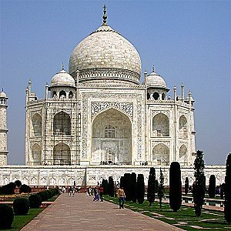
What is a Convolution?
23
*
0 | 1 | 0
1 | -4 | 1
0 | 1 | 0
Slide Credit: Prof. Sandra Avila - UNICAMP

Slide 24
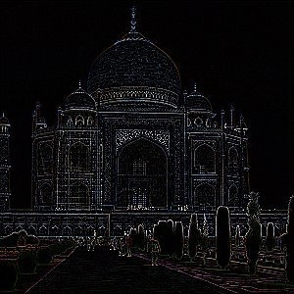
What is a Convolution?
24
Edge Detection
*
0 | 1 | 0
1 | -4 | 1
0 | 1 | 0
Slide Credit: Prof. Sandra Avila - UNICAMP

Slide 25
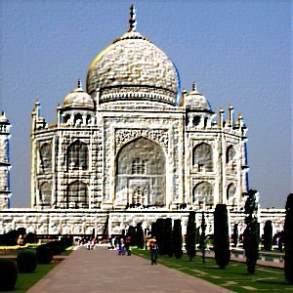
What is a Convolution?
25
Emboss
*
-2 | -1 | 0
-1 | 1 | 1
0 | 1 | 2
Slide Credit: Prof. Sandra Avila - UNICAMP
Notes:
Emboss:
A surface-modifying process that uses pressure to create a raised or sunken pattern on a material like paper or metal. Synonyms include decorate, impress, carve, or stamp.

Slide 26
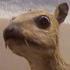
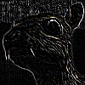
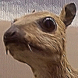


What is a Convolution?
26
-1 | -1 | -1
-1 | 8 | -1
-1 | -1 | -1
0 | -1 | 0
-1 | 5 | -1
0 | -1 | 0
1 | 1 | 1
1 | 1 | 1
1 | 1 | 1
1 | 2 | 1
2 | 4 | 2
1 | 2 | 1
1/9
1/16
Edge Detection
Sharpen
Box blur
Gaussian blur 3 × 3
Slide Credit: Prof. Sandra Avila - UNICAMP

Slide 27
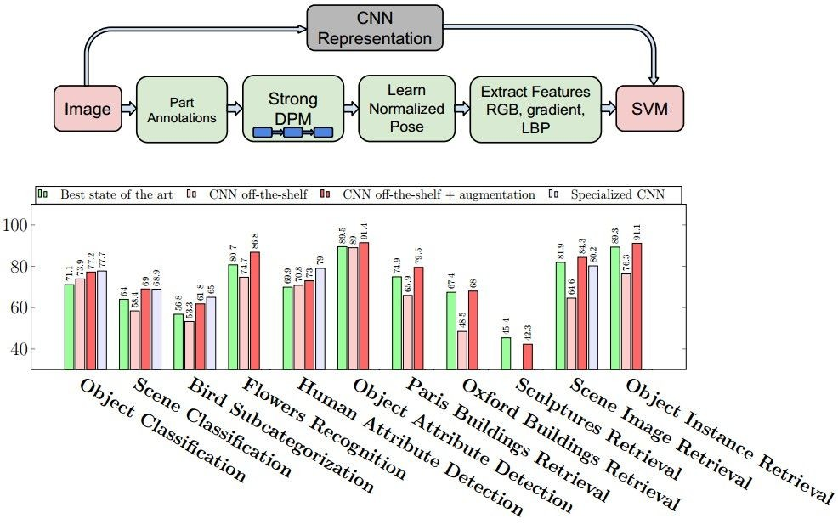
Why Convolutional Neural networks?
State of the art performance on many problems
Most papers in recent vision conferences use deep neural networks
Razavian et al., CVPR 2014 Workshops (4000+ citations)

Slide 28
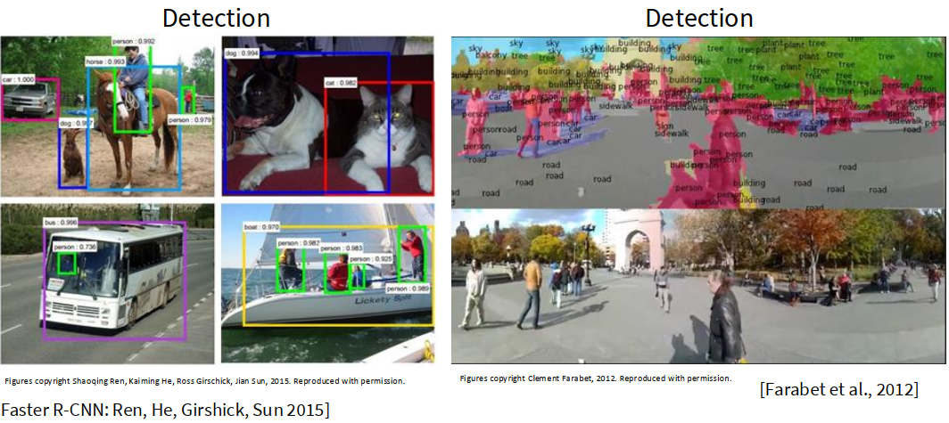
Why Convolutional Neural networks?
~2012 – 2020: ConvNets dominate all vision tasks

Slide 29
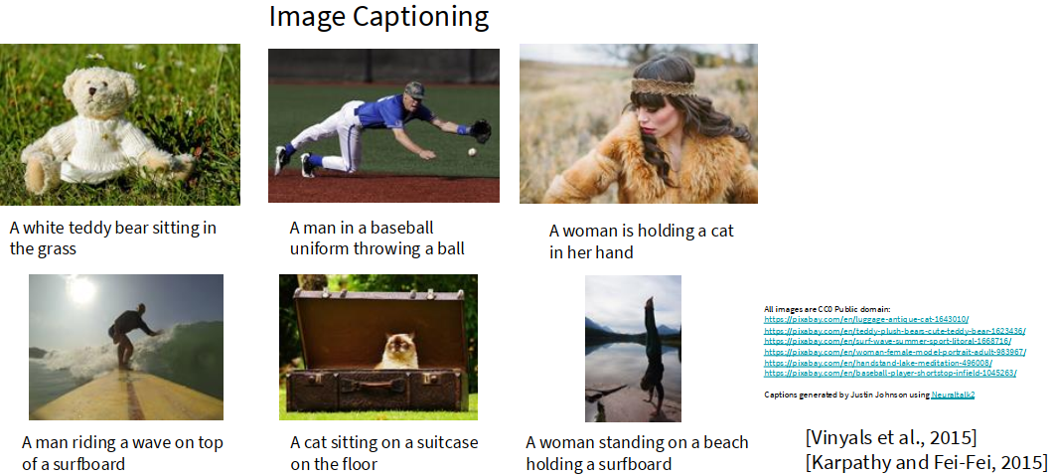
Why Convolutional Neural networks?
~2012 – 2020: ConvNets dominate all vision tasks

Slide 30
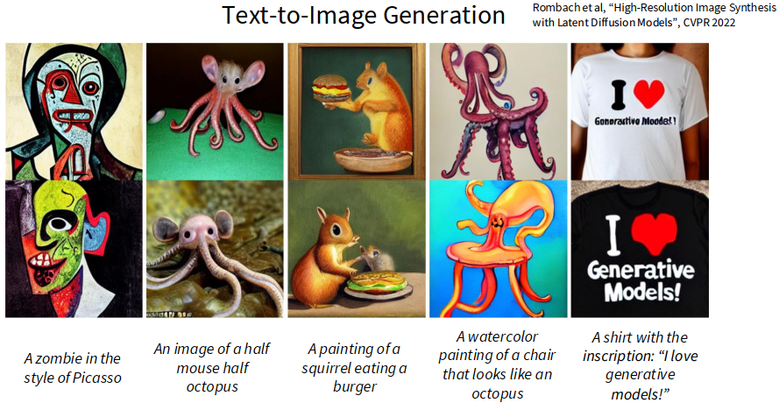
Why Convolutional Neural networks?
~2012 – 2020: ConvNets dominate all vision tasks

Slide 31
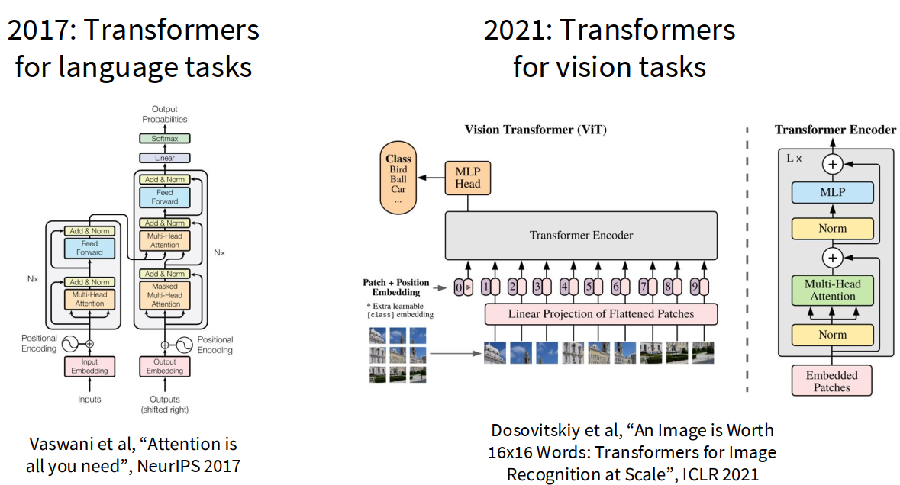
2021-Present: Transformers have taken over

Slide 32
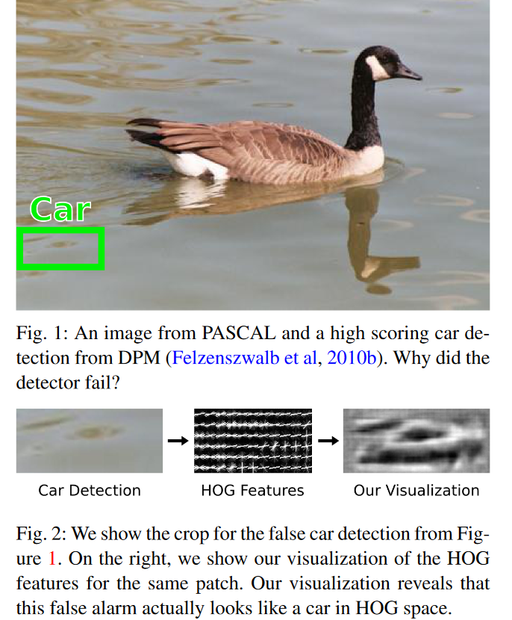
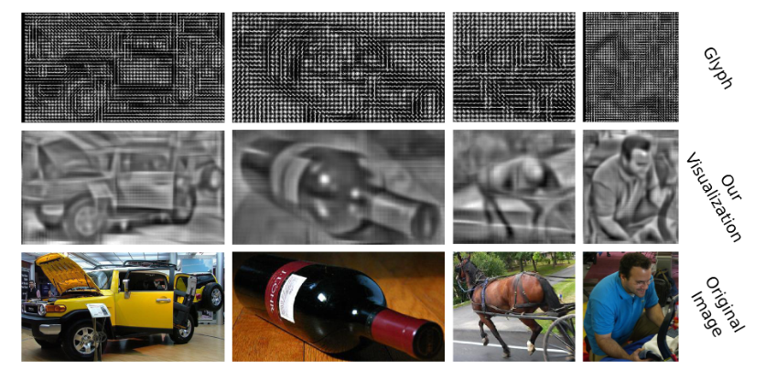
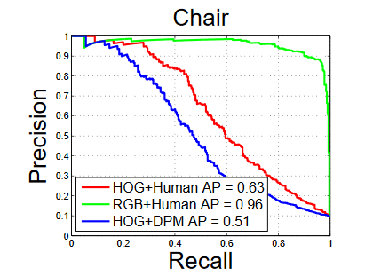
Traditional Recognition Approach
Hand-designed
feature extraction (SIFT+BOW, HOG)
Trainable
classifier
Image/ Video
Pixels
Object
Class
  Features are key to recent progress in recognition, but research shows they’re flawed… Where next?
Adapted from Lana Lazebnik, figures from Vondrick: http://www.cs.columbia.edu/~vondrick/ihog/ijcv.pdf

Slide 33
What about learning the features?
  Learn a feature hierarchy all the way from pixels to classifier
  Each layer extracts features from the output of previous layer
  Train all layers jointly
Image/ Video
Pixels
Layer 1
Layer 2
Layer 3
Object
Class
Lana Lazebnik

Slide 34
“Shallow” vs. “deep” architectures
Traditional recognition: “Shallow” architecture
Image/ Video
Pixels
Hand-designed
feature extraction
Trainable
classifier
Object
Class
Deep learning: “Deep” architecture
Image/ Video
Pixels
Layer 1
Layer N
Simple classifier
…
Object Class
Lana Lazebnik

Slide 35
Convolutional Neural Networks

Slide 36
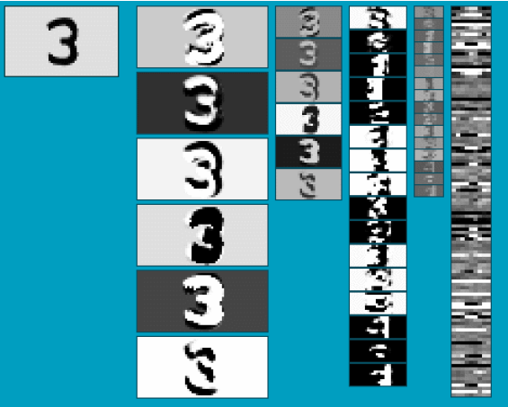
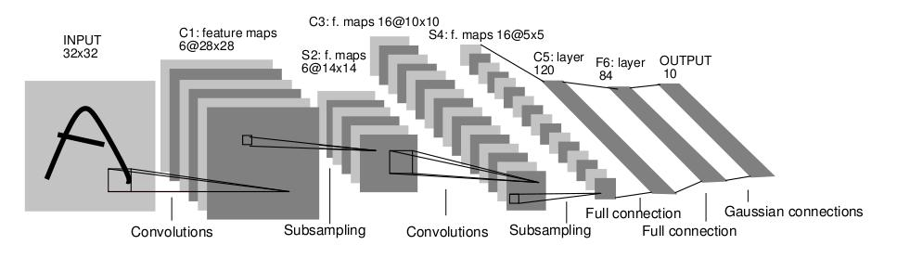
Convolutional Neural Networks (CNN)
Neural network with specialized connectivity structure
Stack multiple stages of feature extractors
Higher stages compute more global, more invariant, more abstract features
Classification layer at the end
Y. LeCun, L. Bottou, Y. Bengio, and P. Haffner, Gradient-based learning applied to document recognition, Proceedings of the IEEE 86(11): 2278–2324, 1998.
Adapted from Rob Fergus

Slide 37
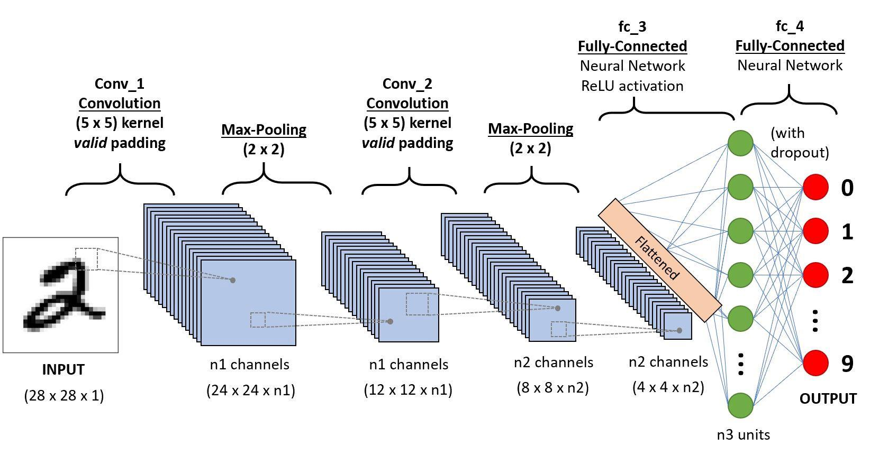
37
There are a few distinct types of layers (e.g., CONV/POOL/FC are by far the most popular).
Slide Credit: Prof. Sandra Avila - UNICAMP

Slide 38
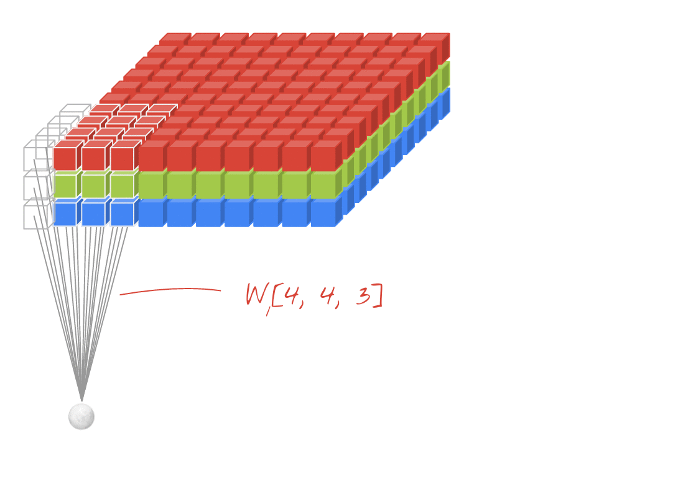
Credit: Martin Görner, @martin_gorner (twitter)
38
Slide Credit: Prof. Sandra Avila - UNICAMP
Notes:
Example works with padding.

Slide 39
Convolution Layer
39
32 x 32 x 3 image ⇒ preserve spatial structure
32
3
32
Slide Credit: Prof. Sandra Avila - UNICAMP

Slide 40
Convolution Layer
40
32 x 32 x 3 image ⇒ preserve spatial structure
Convolve the filter with the image i.e. “slide over the image spatially, computing dot products”
32
5 x 5 x 3 filter
3
32
Slide Credit: Prof. Sandra Avila - UNICAMP

Slide 41
Convolution Layer
41
32 x 32 x 3 image ⇒ preserve spatial structure
Convolve the filter with the image i.e. “slide over the image spatially, computing dot products”
32
5 x 5 x 3 filter
3
32
Filters always extend the full depth of the input volume
Slide Credit: Prof. Sandra Avila - UNICAMP

Slide 42
Convolution Layer
42
32 x 32 x 3 image ⇒ preserve spatial structure
32
5 x 5 x 3 filter
3
3
32
Slide Credit: Prof. Sandra Avila - UNICAMP

Slide 43
Convolution Layer
43
32 x 32 x 3 image ⇒ preserve spatial structure
32
3
32
Slide Credit: Prof. Sandra Avila - UNICAMP

Slide 44
Convolution Layer
44
32 x 32 x 3 image ⇒ preserve spatial structure
32
1 number:
5*5*3 = 75-dimensional
dot product + bias)
w^{T}x + b
3
32
Slide Credit: Prof. Sandra Avila - UNICAMP

Slide 45
Convolution Layer
45
32 x 32 x 3 image ⇒ preserve spatial structure
32
1 number:
5*5*3 = 75-dimensional
dot product + bias)
w^{T}x + b
3
32
Slide Credit: Prof. Sandra Avila - UNICAMP

Slide 46
Convolution Layer
46
32 x 32 x 3 image ⇒ preserve spatial structure
32
1 number:
5*5*3 = 75-dimensional
dot product + bias
w^{T}x + b
3
32
That region in the input image is called the local receptive field for the hidden neuron.

Slide 47
Convolutions: More detail
32x32x3 image
32
height
32
depth
width
3
Andrej Karpathy

Slide 48
48
Convolutions: More detail
32x32x3 image
5x5x3 filter
32
Convolve the filter with the image
i.e. “slide over the image spatially, computing dot products”
32
3
Andrej Karpathy

Slide 49


Convolution Layer
Convolutions: More detail
32x32x3 image 5x5x3 filter
32
1 number:
the result of taking a dot product between the filter and a small 5x5x3 chunk of the image
(i.e. 5*5*3 = 75-dimensional dot product + bias)
32
3
Andrej Karpathy

Slide 50
Convolution Layer
Convolutions: More detail
activation map
32x32x3 image
5x5x3 filter
32
28
convolve (slide) over all spatial locations
32
28
3
1
Andrej Karpathy

Slide 51
consider a second, green filter
Convolutions: More detail
Convolution Layer
32x32x3 image 5x5x3 filter
activation maps
32
28
convolve (slide) over all spatial locations
32
28
3
1
Andrej Karpathy

Slide 52
For example, if we had 6 5x5 filters, we’ll get 6 separate activation maps:
Convolutions: More detail
activation maps
32
28
Convolution Layer
32
28
3
6
We stack these up to get a “new image” of size 28x28x6!
Andrej Karpathy

Slide 53
Preview: ConvNet is a sequence of Convolution Layers, interspersed with activation functions
Convolutions: More detail
32
28
CONV, ReLU
e.g. 6 5x5x3 filters
32
28
3
6
Andrej Karpathy

Slide 54
Preview: ConvNet is a sequence of Convolutional Layers, interspersed with activation functions
54
Convolutions: More detail
32
28
24
….
CONV, ReLU
e.g. 6 5x5x3 filters
CONV, ReLU
e.g. 10 5x5x6 filters
CONV, ReLU
32
28
24
3
6
10
Andrej Karpathy

Slide 55
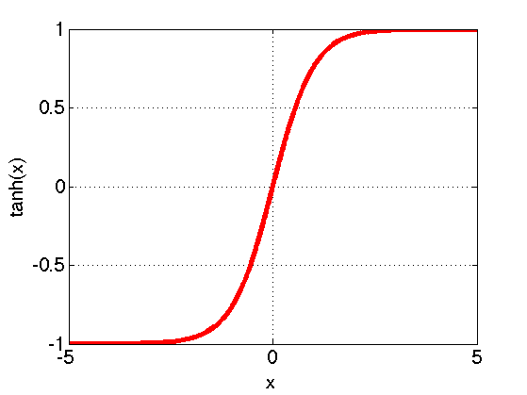
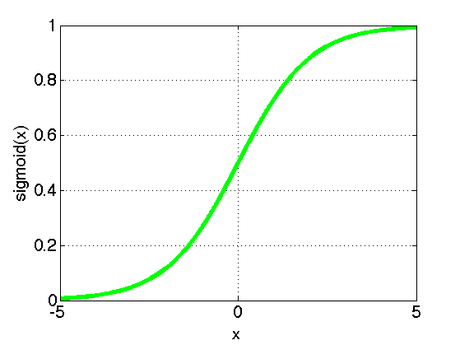
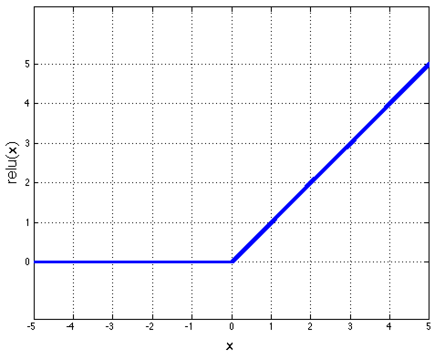
Convolutions: Non Linearity
Per-element (independent)
Some options:
  Tanh
  Sigmoid: 1/(1+exp(-x))
  Rectified linear unit (ReLU)
    Avoids saturation issues
tanh(x)
sigmoid(x)
relu(x)
Adapted from Rob Fergus

Slide 56
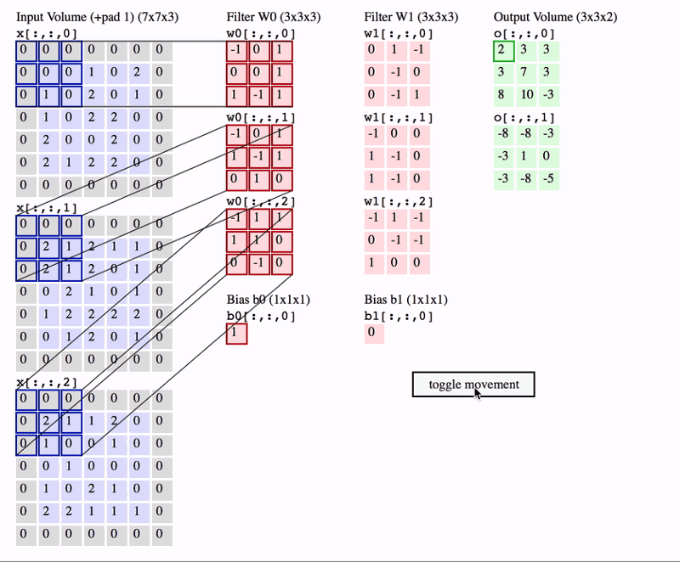
http://cs231n.github.io/convolutional-networks
* Animation with Stride of 2
Slide Credit: Prof. Sandra Avila - UNICAMP

Slide 57
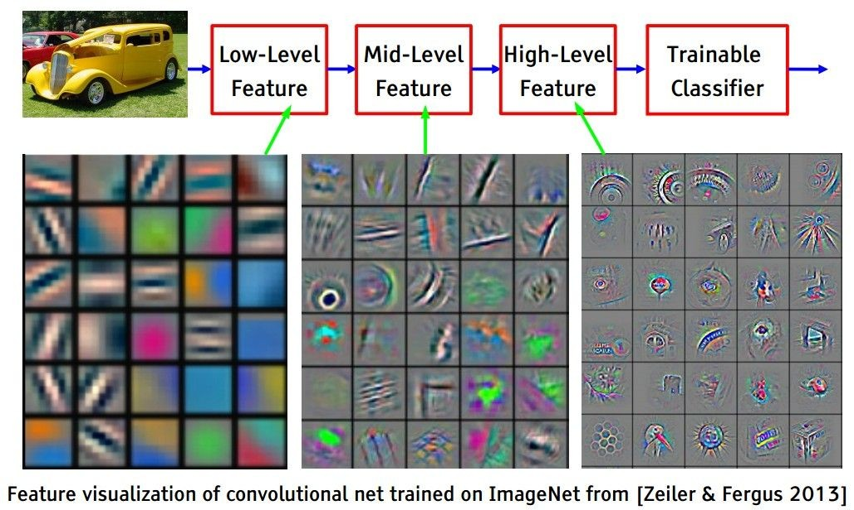
Preview
Convolutions: More detail
[From recent Yann LeCun slides]
Andrej Karpathy

Slide 58
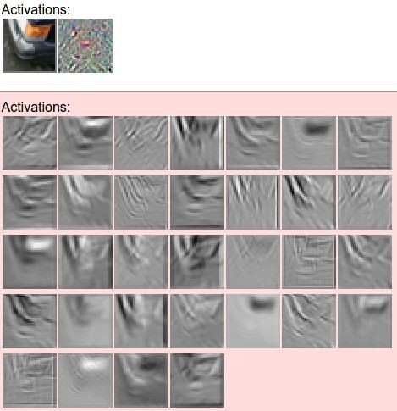
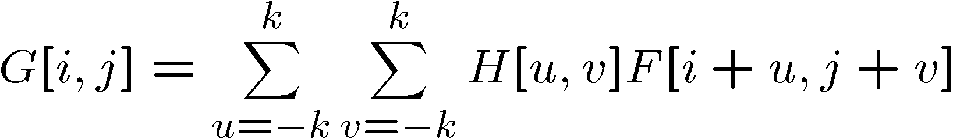
one filter =>
one activation map
Convolutions: More detail
example 5x5 filters
(32 total)
We call the layer convolutional because it is related to convolution of two signals:
Element-wise multiplication and sum of a filter and the signal (image)
Adapted from Andrej Karpathy, Kristen Grauman

Slide 59
A Closer Look at Spatial Dimensions
59
7 x 7 input (spatially)
assume 3 x 3 filter
7
7
Andrej Karpathy

Slide 60
A Closer Look at Spatial Dimensions
60
7 x 7 input (spatially)
assume 3 x 3 filter
7
7
Andrej Karpathy

Slide 61
A Closer Look at Spatial Dimensions
61
7 x 7 input (spatially)
assume 3 x 3 filter
7
7
Andrej Karpathy

Slide 62
A Closer Look at Spatial Dimensions
62
7 x 7 input (spatially)
assume 3 x 3 filter
7
7
Andrej Karpathy

Slide 63
A Closer Look at Spatial Dimensions
63
7 x 7 input (spatially)
assume 3 x 3 filter
7
7
Andrej Karpathy

Slide 64
A Closer Look at Spatial Dimensions
64
7 x 7 input (spatially)
assume 3 x 3 filter
7
7
Andrej Karpathy

Slide 65
A Closer Look at Spatial Dimensions
65
7 x 7 input (spatially)
assume 3 x 3 filter
7
⇒ 5 x 5 output
7
Andrej Karpathy

Slide 66
A Closer Look at Spatial Dimensions
66
7 x 7 input (spatially)
assume 3 x 3 filter
applied with stride 2
7
7
Andrej Karpathy

Slide 67
A Closer Look at Spatial Dimensions
67
7 x 7 input (spatially)
assume 3 x 3 filter
applied with stride 2
7
7
Andrej Karpathy

Slide 68
A Closer Look at Spatial Dimensions
68
7 x 7 input (spatially)
assume 3 x 3 filter
applied with stride 2
7
7
Andrej Karpathy

Slide 69
A Closer Look at Spatial Dimensions
69
7 x 7 input (spatially)
assume 3 x 3 filter
applied with stride 2
7
7
Andrej Karpathy

Slide 70
A Closer Look at Spatial Dimensions
70
7 x 7 input (spatially)
assume 3 x 3 filter
applied with stride 2
7
⇒ 3 x 3 output
7
Andrej Karpathy

Slide 71
A Closer Look at Spatial Dimensions
71
7 x 7 input (spatially)
assume 3 x 3 filter
applied with stride 3?
7
7
Andrej Karpathy

Slide 72
A Closer Look at Spatial Dimensions
72
7 x 7 input (spatially)
assume 3 x 3 filter
applied with stride 3?
7
7
Andrej Karpathy

Slide 73
A Closer Look at Spatial Dimensions
73
7 x 7 input (spatially)
assume 3 x 3 filter
applied with stride 3?
7
7
Andrej Karpathy

Slide 74
A Closer Look at Spatial Dimensions
74
7 x 7 input (spatially)
assume 3 x 3 filter
applied with stride 3?
7
Doesn’t fit!
cannot apply 3 x 3 filter on
7 x 7 input with stride 3.
7
Andrej Karpathy

Slide 75
A Closer Look at Spatial Dimensions
75
Output size:
(N - F) / stride + 1
N
 |  |  | F
 | F
N
Andrej Karpathy

Slide 76
A Closer Look at Spatial Dimensions
76
Output size:
(N - F) / stride + 1
e.g. N = 7, F = 3:
stride 1 ⇒ (7 - 3)/1 + 1 = 5
N
 |  |  | F
 | F
N
Andrej Karpathy

Slide 77
A Closer Look at Spatial Dimensions
77
Output size:
(N - F) / stride + 1
e.g. N = 7, F = 3:
stride 1 ⇒ (7 - 3)/1 + 1 = 5
stride 2 ⇒ (7 - 3)/2 + 1 = 3
N
 |  |  | F
 | F
N
Andrej Karpathy

Slide 78
A Closer Look at Spatial Dimensions
78
Output size:
(N - F) / stride + 1
e.g. N = 7, F = 3:
stride 1 ⇒ (7 - 3)/1 + 1 = 5
stride 2 ⇒ (7 - 3)/2 + 1 = 3
stride 3 ⇒ (7 - 3)/3 + 1 = 2.33
N
 |  |  | F
 | F
N
Andrej Karpathy

Slide 79
In Practice: Common to zero pad the border
79
0 | 0 | 0 | 0 | 0 | 0 | 0 | 0 | 0
0 |  |  |  |  |  |  |  | 0
0 |  |  |  |  |  |  |  | 0
0 |  |  |  |  |  |  |  | 0
0 |  |  |  |  |  |  |  | 0
0 |  |  |  |  |  |  |  | 0
0 |  |  |  |  |  |  |  | 0
0 |  |  |  |  |  |  |  | 0
0 | 0 | 0 | 0 | 0 | 0 | 0 | 0 | 0
Andrej Karpathy

Slide 80
In Practice: Common to zero pad the border
80
0 | 0 | 0 | 0 | 0 | 0 | 0 | 0 | 0
0 |  |  |  |  |  |  |  | 0
0 |  |  |  |  |  |  |  | 0
0 |  |  |  |  |  |  |  | 0
0 |  |  |  |  |  |  |  | 0
0 |  |  |  |  |  |  |  | 0
0 |  |  |  |  |  |  |  | 0
0 |  |  |  |  |  |  |  | 0
0 | 0 | 0 | 0 | 0 | 0 | 0 | 0 | 0
7 x 7 input,
3 x 3 filter applied
with stride 1 with pad 1
What is the output?
Andrej Karpathy

Slide 81
In Practice: Common to zero pad the border
81
0 | 0 | 0 | 0 | 0 | 0 | 0 | 0 | 0
0 |  |  |  |  |  |  |  | 0
0 |  |  |  |  |  |  |  | 0
0 |  |  |  |  |  |  |  | 0
0 |  |  |  |  |  |  |  | 0
0 |  |  |  |  |  |  |  | 0
0 |  |  |  |  |  |  |  | 0
0 |  |  |  |  |  |  |  | 0
0 | 0 | 0 | 0 | 0 | 0 | 0 | 0 | 0
7 x 7 input,
3 x 3 filter applied
with stride 1 with pad 1
What is the output?
7 x 7 output
Output Size
(N + 2*padding - F) / stride + 1
Andrej Karpathy
Notes:
N = 7
F = 3
Stride = 1
Padding = 1
(N + 2*padding - F) / stride + 1
(7 + 2*1 – 3) / 1 + 1
6 / 1 + 1
7

Slide 82
In Practice: Common to zero pad the border
82
0 | 0 | 0 | 0 | 0 | 0 | 0 | 0 | 0
0 |  |  |  |  |  |  |  | 0
0 |  |  |  |  |  |  |  | 0
0 |  |  |  |  |  |  |  | 0
0 |  |  |  |  |  |  |  | 0
0 |  |  |  |  |  |  |  | 0
0 |  |  |  |  |  |  |  | 0
0 |  |  |  |  |  |  |  | 0
0 | 0 | 0 | 0 | 0 | 0 | 0 | 0 | 0
In general, common to see CONV layers with stride 1, filters of size
F x F, and zero-padding with size (F-1)/2 (will preserve size spatially).
e.g. F = 3 ⇒ zero pad with size 1
e.g. F = 5 ⇒ zero pad with size 2
e.g. F = 7 ⇒ zero pad with size 3
Andrej Karpathy

Slide 83
Convolutions: Output Size
Examples time:
Input volume: 32x32x3
10 5x5x3 filters with stride 1, pad 2
Output volume size: ?
Andrej Karpathy
Notes:
N = 32
F = 5
Stride = 1
Padding = 2
(N + 2*padding - F) / stride + 1
(32 + 2*2 - 5) / 1 + 1
31 / 1 + 1
32

Slide 84


Slide 85
Convolutions: Output Size
Examples time:
Input volume: 32x32x3
10 5x5x3 filters with stride 1, pad 2
Output volume size:
(32+2*2-5)/1+1 = 32 spatially, so
32x32x10
Andrej Karpathy

Slide 86
Convolutions: Number of Parameters
Examples time:
Input volume: 32x32x3
10 5x5x3 filters with stride 1, pad 2
Number of parameters in this layer?
Andrej Karpathy

Slide 87
Examples time:
Convolutions: Number of Parameters
Input volume: 32x32x3
10 5x5x3 filters with stride 1, pad 2
Number of parameters in this layer? each filter has 5*5*3 + 1 = 76 params
=> 76*10 = 760
(+1 for bias)
Andrej Karpathy
Notes:
TODO: Update color orange, may confuse number 3

Slide 88


Slide 89
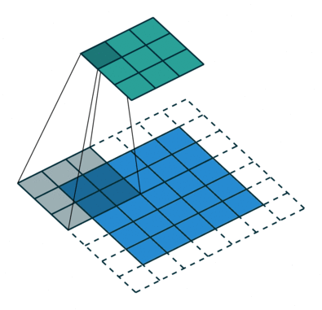
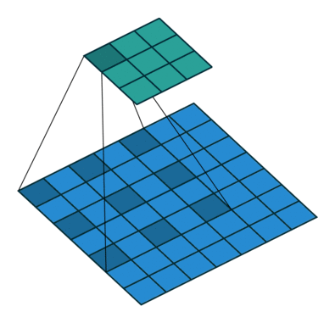
89
Standard Convolution
Dilated Convolution
Slide Credit: Prof. Sandra Avila - UNICAMP
Notes:
Dilated convolutions (also known as atrous convolutions) are used primarily to increase the receptive field of a convolutional neural network (CNN) without increasing the number of parameters or the computational cost (FLOPs)
This is crucial for tasks that require long-range spatial information to make a prediction, such as semantic segmentation and object detection. It allows the network to incorporate a wider context for each pixel prediction.

Slide 90
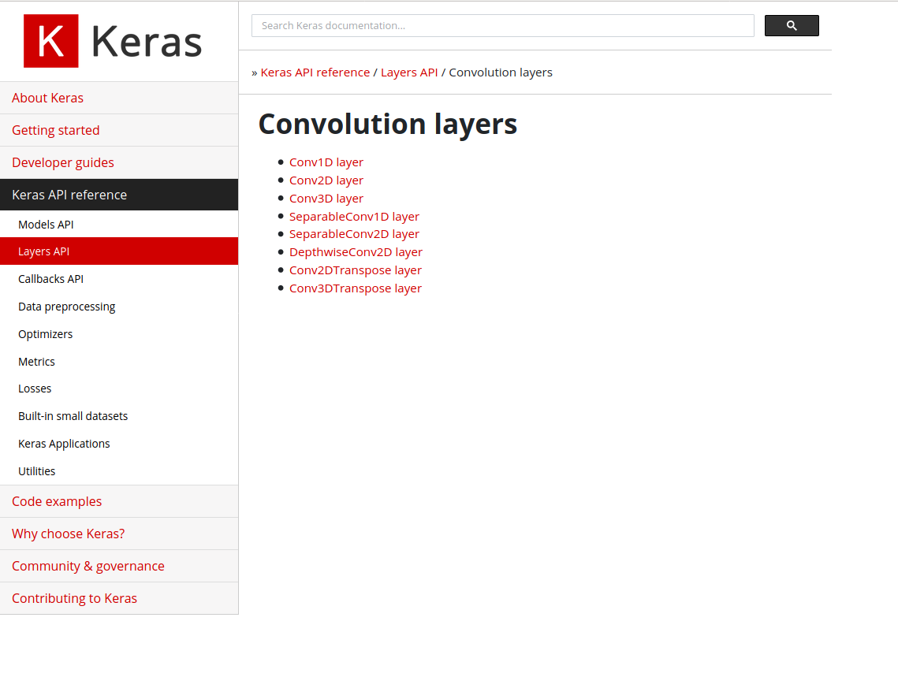
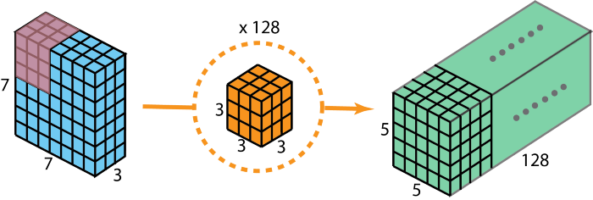
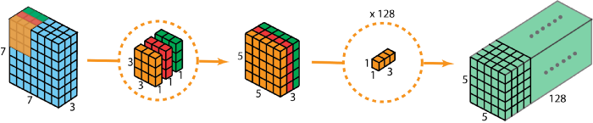
Convolutions Layers https://keras.io/api/layers/convolution_layers
90

Slide 91
91
There are a few distinct types of layers (e.g., CONV/POOL/FC are by far the most popular).

Slide 92
Pooling Layer
92
Makes the representations smaller and more manageable
Operates over each activation map independently
1 | 1 | 2 | 4
5 | 6 | 7 | 8
3 | 2 | 1 | 0
1 | 2 | 3 | 4
Max pooling with 2 x 2 filters and stride 2
Slide Credit: Prof. Sandra Avila - UNICAMP

Slide 93
Pooling Layer
93
Makes the representations smaller and more manageable
Operates over each activation map independently
1 | 1 | 2 | 4
5 | 6 | 7 | 8
3 | 2 | 1 | 0
1 | 2 | 3 | 4
Max pooling with 2 x 2 filters and stride 2
6
Slide Credit: Prof. Sandra Avila - UNICAMP

Slide 94
Pooling Layer
94
Makes the representations smaller and more manageable
Operates over each activation map independently
1 | 1 | 2 | 4
5 | 6 | 7 | 8
3 | 2 | 1 | 0
1 | 2 | 3 | 4
Max pooling with 2 x 2 filters and stride 2
6 | 8
Slide Credit: Prof. Sandra Avila - UNICAMP

Slide 95
Pooling Layer
95
Makes the representations smaller and more manageable
Operates over each activation map independently
1 | 1 | 2 | 4
5 | 6 | 7 | 8
3 | 2 | 1 | 0
1 | 2 | 3 | 4
Max pooling with 2 x 2 filters and stride 2
6 | 8
3
Slide Credit: Prof. Sandra Avila - UNICAMP

Slide 96
Pooling Layer
96
Makes the representations smaller and more manageable
Operates over each activation map independently
1 | 1 | 2 | 4
5 | 6 | 7 | 8
3 | 2 | 1 | 0
1 | 2 | 3 | 4
Max pooling with 2 x 2 filters and stride 2
6 | 8
3 | 4
Slide Credit: Prof. Sandra Avila - UNICAMP

Slide 97
Pooling Layer
97
Makes the representations smaller and more manageable
Operates over each activation map independently
1 | 1 | 2 | 4
5 | 6 | 7 | 8
3 | 2 | 1 | 0
1 | 2 | 3 | 4
Average pooling with
2 x 2 filters and stride 2
3 | 5
2 | 2
Slide Credit: Prof. Sandra Avila - UNICAMP

Slide 98
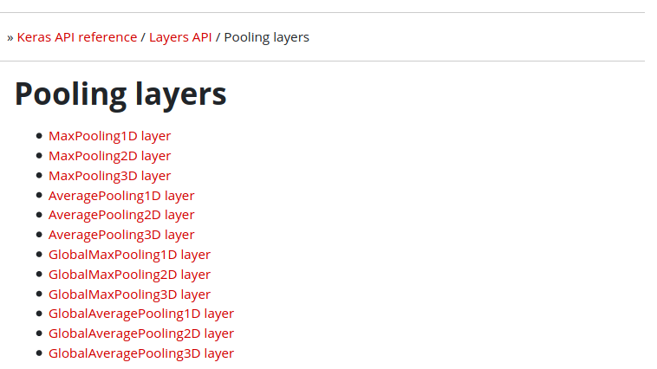
Pooling Layers
https://keras.io/api/layers/pooling_layers
98

Slide 99
99
There are a few distinct types of layers (e.g., CONV/POOL/FC are by far the most popular).
Slide Credit: Prof. Sandra Avila - UNICAMP

Slide 100
Fully Connected Layer
100
Contains neurons that connect to the entire input volume, as in ordinary Neural Networks
Slide Credit: Prof. Sandra Avila - UNICAMP

Slide 101
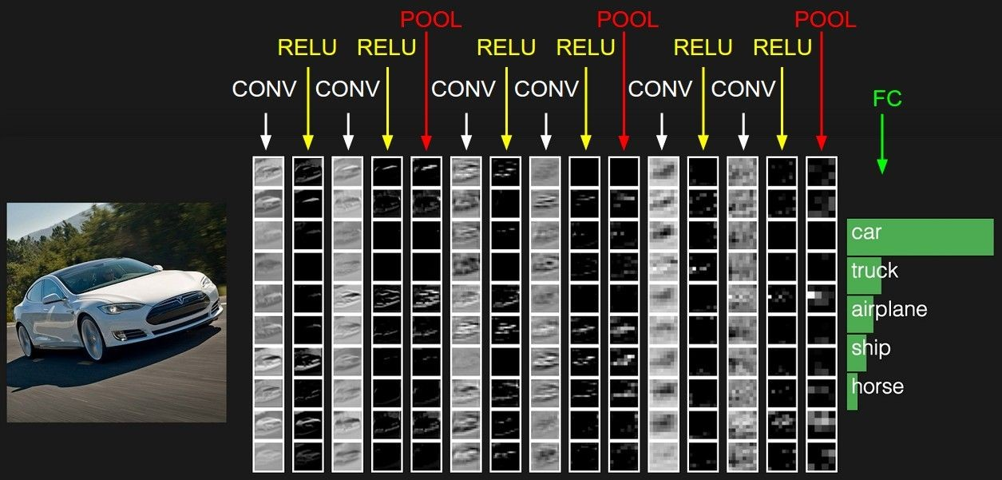
Putting it all together
Andrej Karpathy

Slide 102
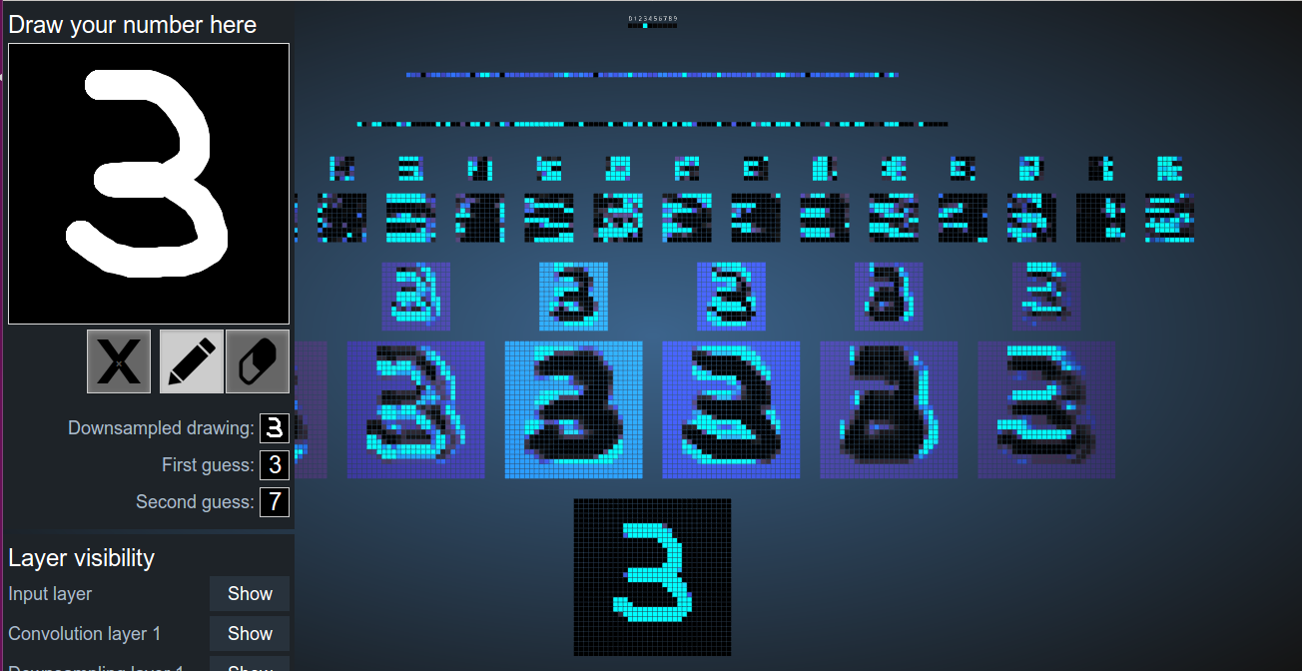
https://adamharley.com/nn_vis/cnn/2d.html
Notes:
Draw # 4
Pick 2 different filters ( Filter 3 with Filter 6) from first row
* Observe different weights from kernel/filter
See Max pooling from second row
See conversion from conv layer to fully connected layer

Slide 103
Visualizing a CNN trained on Handwritten Digits
103
Input image: 1024 pixels (32 x 32 image)
CONV 1 (+ RELU): 6 5 × 5 (stride 1) filters
POOL 1: 2 × 2 max pooling (with stride 2)
CONV 2 (+ RELU): 16 5 × 5 (stride 1) filters
POOL 2: 2 × 2 max pooling (with stride 2)
2 FC layers:
  120 neurons in the first FC layer
  100 neurons in the second FC layer
Output layer: 10 neurons in the third FC
Slide Credit: Prof. Sandra Avila - UNICAMP

Slide 104
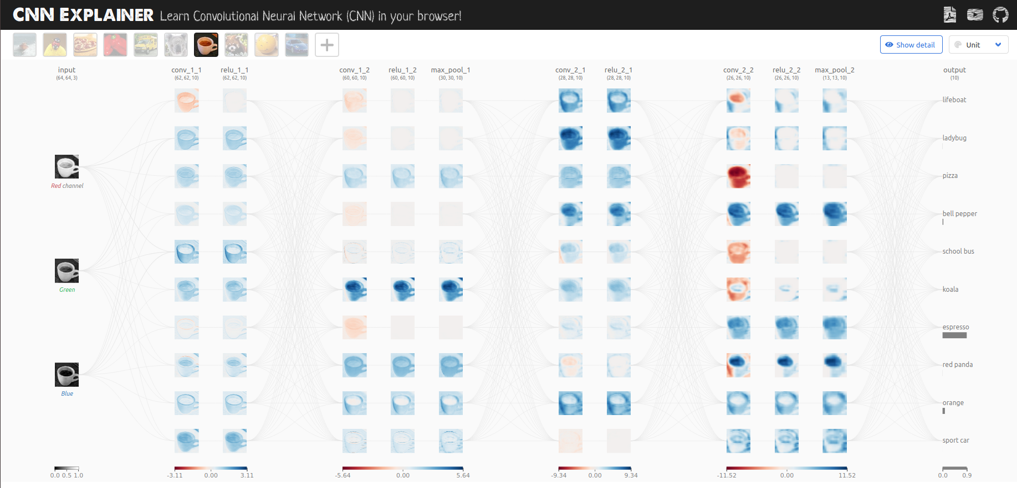
104
https://poloclub.github.io/cnn-explainer
Notes:
[Espresso Mug]
(conv_1_1) Select row 5, Select first filter for R channel
(relu_1_1) Select row 5
(max_pool_1) Select row 5
(output) Select category espresso – See weights, see color scale from light orange to dark red
[Sport Car]
(conv_1_1) Select row 5
(relu_1_1) Select row 5
(max_pool_1) Select row 5
(output) Select category Sport Car – See weights, see color scale from light orange to dark red

Slide 105

Lab 6: CNN
Duration: 15 min
Steps:
Introduce to a classmate
Work in pairs on the exercise
Submit your answers on AhaSlides
Notes:
[Content]
Section 1: Convolutions and Edge Detection
Interactive Demo 1: Visualization of Covolution [Extra]
1.1 Demonstration of a CNN in Pytorch [For Class]
Section 2: Kernels, pooling, and subsampling
Interactive Demo 2: Visualization of Convolution with multiple filters – Dataset/DataLoader Functions [For Class]
2.1. Multiple Filters [For Class]
Prereq: Visualization before Interactive Demo 2 (Images circles and crosses) [For Class]
2.2. Relu after convolutions [For Class]
2.3. Pooling [Extra]
Interactive Demo 3: The effect of the Stride [Extra]
Section 3: Putting all together
3.1. # of parameters in convolutional vs Fully connected models [Extra]
[Exercises]
Coding Exercise 1.1: Convolution of a simple kernel [Extra]
Coding Exercise 1.2: Convolution output size [Extra]
Coding Exercise 1.3: Coding a convolution [For Class / Extra]
##
Coding Exercise 2.3: Implement Max Pooling [Extra]
##
Coding Exercise 4: Implement your own CNN [For class]

Slide 106
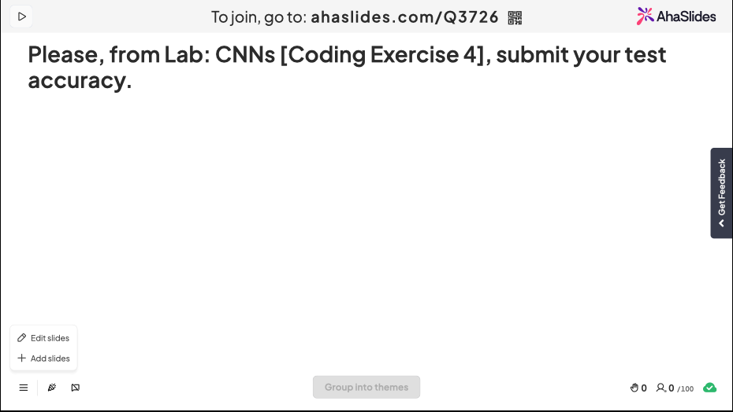

Slide 107
CNN Architectures

Slide 108
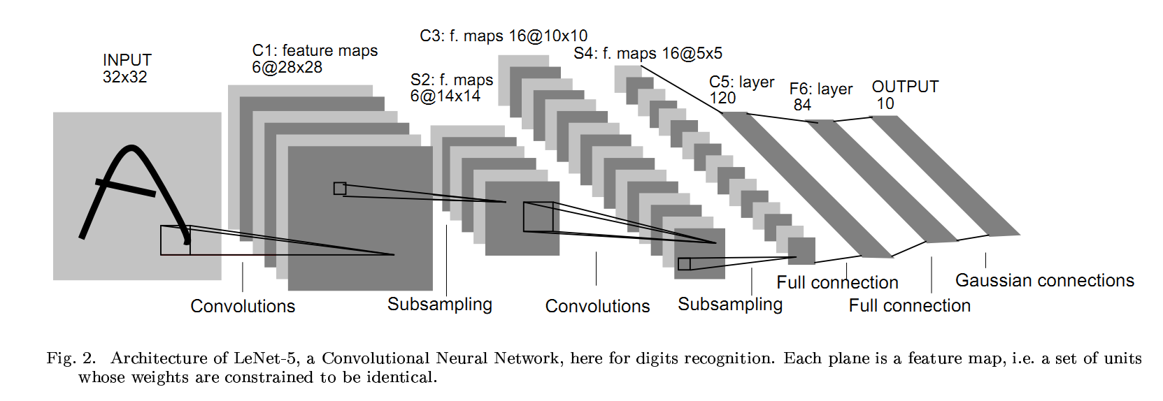
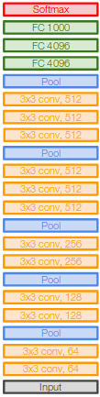
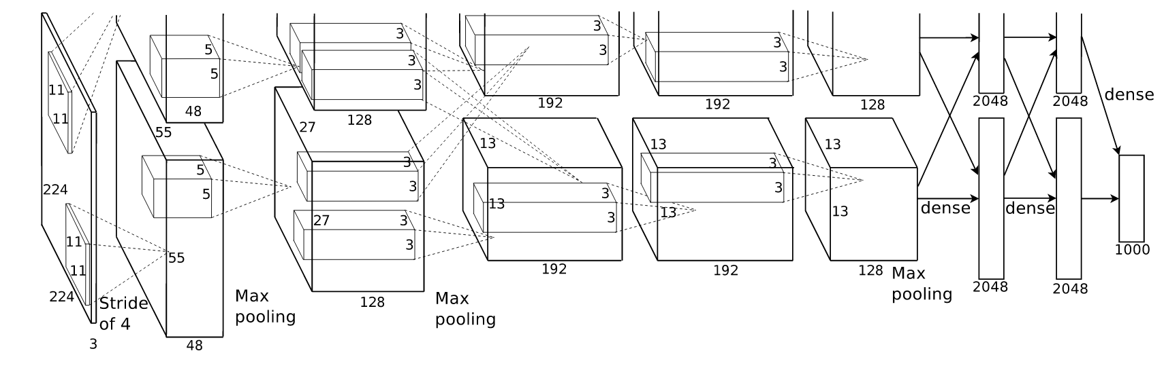
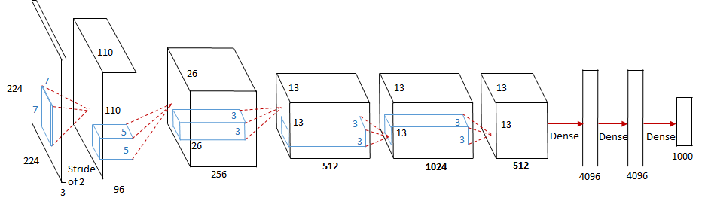
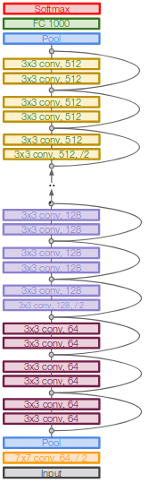
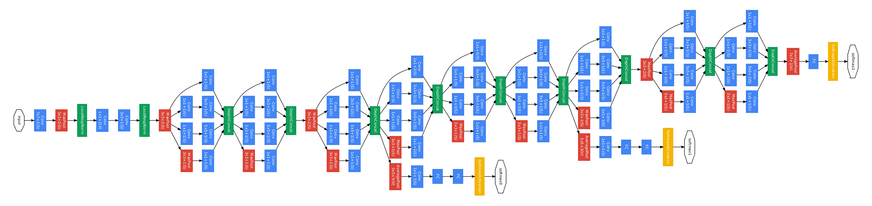
CNN Architectures
CNN Architectures
  LeNet (1998)
  AlexNet (2012)
  ZFNet (2013)
  VGGNet (2014)
  GoogLeNet (2014)
  ResNet (2015)

Slide 109

109
26.1%
AlexNet, 8 layers
Classification error
15.3%
2011 2012 2013 2014 2014 2015 2016
ILSVRC year
“ImageNet classification with deep convolutional neural networks”. NIPS, 2012.
Slide Credit: Prof. Sandra Avila - UNICAMP
109

Slide 110
AlexNet [Krizhevsky et al., 2012]
110
“ImageNet Classification with Deep Convolutional Neural Networks”, NIPS 2012.
Slide Credit: Prof. Sandra Avila - UNICAMP

Slide 111
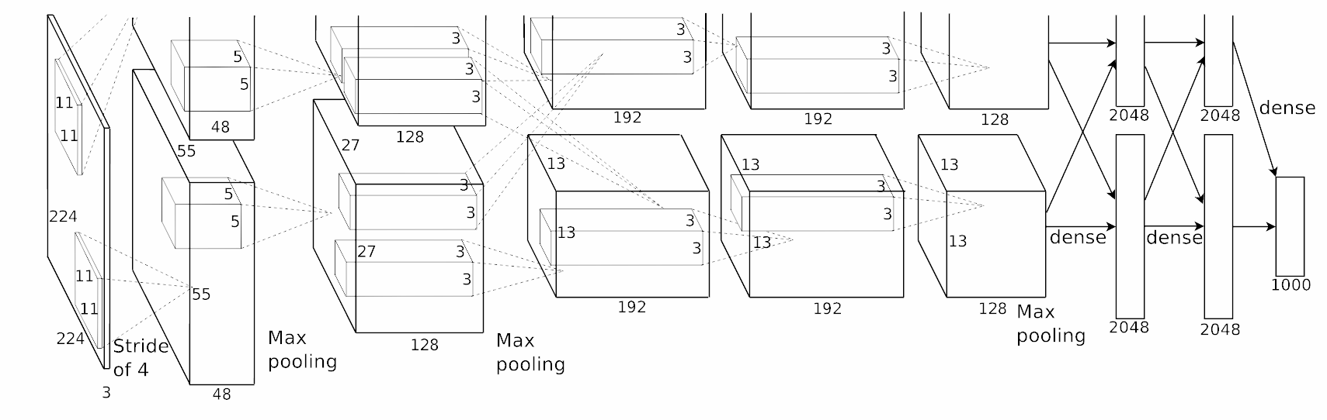
AlexNet [Krizhevsky et al., 2012]
111
Architecture:
CONV1
MAX POOL1
NORM1
CONV2
MAX POOL2
NORM2
CONV3
CONV4
CONV5
MAX POOL3
FC6
FC7
FC8
Slide Credit: Prof. Sandra Avila - UNICAMP

Slide 112
AlexNet [Krizhevsky et al., 2012]
112
[227x227x3] INPUT
[55x55x96] CONV1: 96 11x11 filters at stride 4, pad 0
[27x27x96] MAX POOL1: 3x3 filters at stride 2
[27x27x96] NORM1: Normalization layer
[27x27x256] CONV2: 256 5x5 filters at stride 1, pad 2
[13x13x256] MAX POOL2: 3x3 filters at stride 2
[13x13x256] NORM2: Normalization layer
[13x13x384] CONV3: 384 3x3 filters at stride 1, pad 1
[13x13x384] CONV4: 384 3x3 filters at stride 1, pad 1
[13x13x256] CONV5: 256 3x3 filters at stride 1, pad 1
[6x6x256] MAX POOL3: 3x3 filters at stride 2
[4096] FC6: 4096 neurons
[4096] FC7: 4096 neurons
[1000] FC8: 1000 neurons (class scores)

Slide 113
AlexNet [Krizhevsky et al., 2012]
113
Historical note: Trained on GTX 580 GPU with only 3 GB of memory. Network spread across 2 GPUs, half the neurons (feature maps) on each GPU.
[55x55x96] CONV1 [55x55x48] x 2
Slide Credit: Prof. Sandra Avila - UNICAMP

Slide 114
AlexNet [Krizhevsky et al., 2012]
114
Details:
60 million learned parameters
first use of ReLU
used Norm layers
heavy data augmentation
dropout 0.5
batch size 128
7 CNN ensemble: 18.2% -> 15.3%
5-6 days to train on 2 GTX 580 3GB GPUs
Slide Credit: Prof. Sandra Avila - UNICAMP

Slide 115
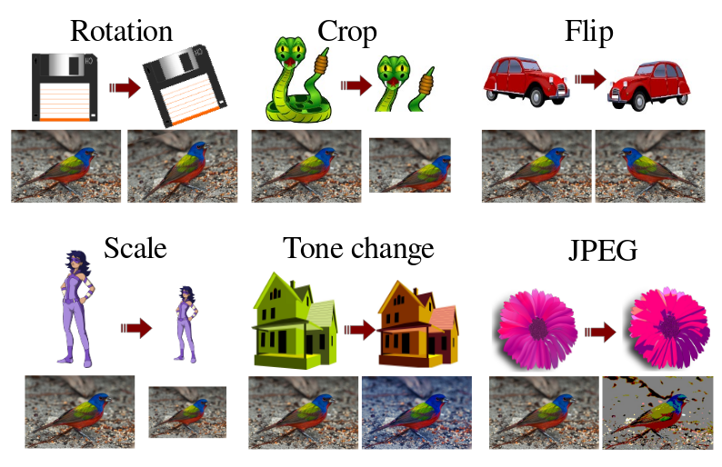
Data Augmentation
115
“Transformation Pursuit for Image Classification”, CVPR 2014.
Slide Credit: Prof. Sandra Avila - UNICAMP

Slide 116
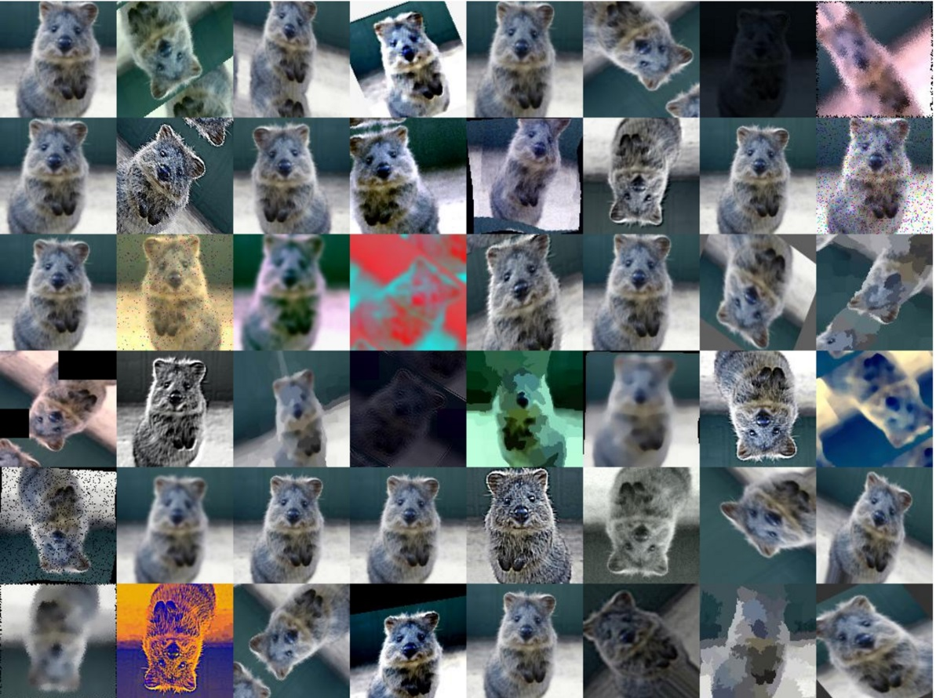
Data Augmentation
Create virtual training samples
  Horizontal flip
  Random crop
  Color casting
  Geometric distortion
Jia-bin Huang, Image: https://github.com/aleju/imgaug

Slide 117
AlexNet [Krizhevsky et al., 2012]
117
Details:
60 million learned parameters
first use of ReLU
used Norm layers (not common anymore)
heavy data augmentation
dropout 0.5
batch size 128
7 CNN ensemble: 18.2% -> 15.3%

Slide 118
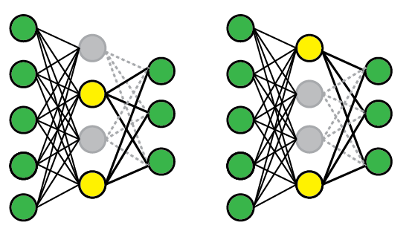
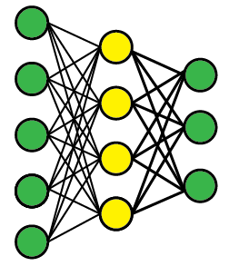
Dropout [Hinton et al., 2012]
118
Standard Network
After applying dropout
“Dropout: A Simple Way to Prevent Neural Networks from Overfitting”, https://www.cs.toronto.edu/~hinton/absps/JMLRdropout.pdf
Slide Credit: Prof. Sandra Avila - UNICAMP

Slide 119
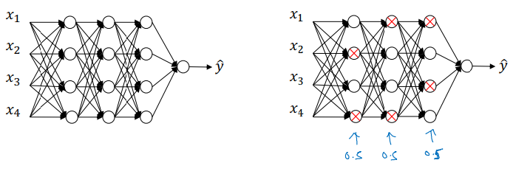
Regularization: Dropout
Adapted from Deep Coursera Specialization [Andrew Ng]

Slide 120
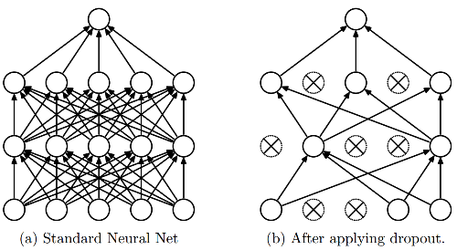

Regularization: Dropout
Randomly turn off some neurons
Allows individual neurons to independently be responsible for performance
Dropout: A simple way to prevent neural networks from overfitting [Srivastava JMLR 2014]
Adapted from Jia-bin Huang

Slide 121

Regularization: Why does dropout work?
﻿Intuition: Can’t rely on any one feature, so have to spread out weights (knowledge).
Have redundant information across different neurons
Adapted from Deep Coursera Specialization [Andrew Ng]

Slide 122
[Extra] Lab 5: Regularization
Section 2

Slide 123
CNN Architectures
CNN Architectures
  LeNet (1998)
  AlexNet (2012)
  ZFNet (2013)
  VGGNet (2014)
  GoogLeNet (2014)
  ResNet (2015)

Slide 124
124
26.1%
AlexNet, 8 layers
Classification error
15.3%
ZFNet, 8 layers
11.2%
VGGNet, 19 layers
7.3%
2011 2012 2013 2014 2014 2015 2016
ILSVRC year
“Very Deep Convolutional Networks for Large-Scale Image Recognition”, https://arxiv.org/pdf/1409.1556
Slide Credit: Prof. Sandra Avila - UNICAMP
124

Slide 125

VGGNet [Simonyan & Zisserman, 2014]
Small filters, Deeper networks
8 layers (AlexNet)
16-19 layers (VGG16Net)
Only 3x3 CONV stride 1, pad 1
and 2x2 MAX POOL stride 2
11.2% in ILSVRC’13 (ZFNet) 7.3% in ILSVRC’14
AlexNet VGG16 VGG19

Slide 126
CNN Architectures
CNN Architectures
  LeNet (1998)
  AlexNet (2012)
  ZFNet (2013)
  VGGNet (2014)
  GoogLeNet (2014)
  ResNet (2015)
Slide Credit: Prof. Sandra Avila - UNICAMP

Slide 127
127
26.1%
AlexNet, 8 layers
Classification error
15.3%
ZFNet, 8 layers
GoogLeNet, 22 layers
11.2%
VGGNet, 19 layers
7.3%
6.7%
2011 2012 2013 2014 2014 2015 2016
ILSVRC year
“Very Deep Convolutional Networks for Large-Scale Image Recognition”, https://arxiv.org/pdf/1409.1556
127

Slide 128
GoogLeNet [Szegedy et al., 2014]
Deeper networks, with computational efficiency
22 layers
Inception module
No FC layers
Only 5 million parameters!
12x less than AlexNet
Slide Credit: Prof. Sandra Avila - UNICAMP

Slide 129
GoogLeNet [Szegedy et al., 2014]
Inception module: design a good local network topology (network within a network) and then stack these modules on top of each other.
Slide Credit: Prof. Sandra Avila - UNICAMP

Slide 130
GoogLeNet [Szegedy et al., 2014]
input
3x3
max pooling
1x1 convolution
1x1
convolution
1x1 convolution
3x3 convolution
5x5 convolution
1x1 convolution
concatenation

Slide 131


GooLeNet [Szegedy et al., 2014]
Inception
Module
https://youtu.be/VxhSouuSZDY

Slide 132
GoogLeNet [Szegedy et al., 2014]
132
Apply parallel filters on the input from previous layer:
Multiple receptive field sizes for convolution (1x1, 3x3, 5x5)
Pooling operation (3x3)
Concatenate all filter outputs together depth-wise
previous layer
3x3
max pooling
3x3 convolution
5x5 convolution
1x1 convolution
concatenation
Naive Inception Module
Q: What is the problem with this?
Computational complexity!
Notes:
28x28x256 --> 28x28x128 Many weights needed, 256x128

Slide 133


Slide 134
GoogLeNet [Szegedy et al., 2014]
134
Example: What is the output size of the 1x1 conv, with 128 filters?
28x28x256
previous layer
3x3
max pooling
3x3 conv
192
5x5 conv
96
1x1 conv
128
concatenation
Slide Credit: Prof. Sandra Avila - UNICAMP
Notes:
256*192*3*3 = 442’368
256*96*5*5 = 614’400
256*128*1*1 = 32’768
Total # weights: 1’089’537

Slide 135
GoogLeNet [Szegedy et al., 2014]
135
Example: What is the output size of the 1x1 conv, with 128 filters?
28x28x256
previous layer
3x3
max pooling
3x3 conv
192
5x5 conv
96
1x1 conv
128
28x28x128
concatenation
Slide Credit: Prof. Sandra Avila - UNICAMP

Slide 136
GoogLeNet [Szegedy et al., 2014]
136
Example: What are the output sizes of all different filter operations?
28x28x256
previous layer
3x3
max pooling
3x3 conv
192
5x5 conv
96
1x1 conv
128
28x28x128
concatenation
Slide Credit: Prof. Sandra Avila - UNICAMP

Slide 137
GoogLeNet [Szegedy et al., 2014]
137
Example: What are the output sizes of all different filter operations?
28x28x256
previous layer
3x3
max pooling
3x3 conv
192
5x5 conv
96
1x1 conv
128
28x28x256
28x28x192
28x28x96
28x28x128
concatenation
Slide Credit: Prof. Sandra Avila - UNICAMP
Notes:
5x5 → Add 2 padding to keep same dimensions
3x3 → Add 1 padding to keep same dimensions
3x3 max pooling --> padding 1 and stride 1

Slide 138
GoogLeNet [Szegedy et al., 2014]
138
Example: What is output size after filter concatenation?
28x28x256
previous layer
3x3
max pooling
3x3 conv
192
5x5 conv
96
1x1 conv
128
28x28x256
28x28x192
28x28x96
28x28x128
concatenation
28x28x(128+192+96+256) = 28x28x672
Slide Credit: Prof. Sandra Avila - UNICAMP

Slide 139
GoogLeNet [Szegedy et al., 2014]
139
Example: What is output size after filter concatenation?
28x28x256
previous layer
3x3
max pooling
3x3 conv
192
5x5 conv
96
1x1 conv
128
28x28x256
28x28x192
28x28x96
28x28x128
Total: 854M ops!!!
concatenation
28x28x(128+192+96+256) = 28x28x672

Slide 140
GoogLeNet [Szegedy et al., 2014]
140
Example: What is output size after filter concatenation?
28x28x256
Solution: “bottleneck” layers that use 1x1 convolutions to reduce feature depth
previous layer
3x3
max pooling
3x3 conv
192
5x5 conv
96
1x1 conv
128
28x28x256
28x28x192
28x28x96
28x28x128
Total: 854M ops!!!
concatenation
28x28x(128+192+96+256) = 28x28x672
Slide Credit: Prof. Sandra Avila - UNICAMP

Slide 141

GoogLeNet [Szegedy et al., 2014]
141
Reminder: 1x1 convolutions
56
56
1x1 CONV
with 32 filters
(each filter has size 1x1x64, and performs a 64-d dot product)
56
56
64
32
Slide Credit: Prof. Sandra Avila - UNICAMP

Slide 142
GoogLeNet [Szegedy et al., 2014]
142
Reminder: 1x1 convolutions
56
56
1x1 CONV
with 32 filters
preserves spatial dimensions, reduces depth!
Projects depth to lower dimension (combination of feature maps)
56
56
64
32

Slide 143
GoogLeNet [Szegedy et al., 2014]
143
input
3x3
max pool
1x1 conv
1x1 conv
input
3x3
max pool
3x3 conv
5x5 conv
1x1 conv
1x1 conv
5x5 conv
3x3 conv
1x1 conv
concatenation
concatenation
Naive Inception Module
Inception Module
Slide Credit: Prof. Sandra Avila - UNICAMP

Slide 144
GoogLeNet [Szegedy et al., 2014]
144
1x1 conv “bottleneck” layers
input
3x3
max pool
1x1 conv
1x1 conv
input
3x3
max pool
3x3 conv
5x5 conv
1x1 conv
1x1 conv
5x5 conv
3x3 conv
1x1 conv
concatenation
concatenation
Naive Inception Module
Inception Module
Slide Credit: Prof. Sandra Avila - UNICAMP

Slide 145
358M ops!!!
(vs. 854M)
145
28x28x256
input
3x3
max pooling
1x1 conv
64
1x1 conv
64
28x28x256
28x28x64
28x28x64
1x1 conv
64
3x3 conv
192
5x5 conv
96
1x1 conv
128
28x28x64
28x28x192
28x28x96
28x28x128
Concatenation of outputs
28x28x(128+192+96+64) = 28x28x480
Slide Credit: Prof. Sandra Avila - UNICAMP
Notes:
Mega Operations Per Second (MOPS): One Million Operations per Second
256*64*1*1 = 16’384
256*64*1*1 = 16’384
64*192*3*3 = 110’592
64*96*1*1 = 6’144
256*128*1*1 = 32’768
Total # weights: 182’272

Slide 146
GoogLeNet [Szegedy et al., 2014]
146
Conv-Pool 2x Conv-Pool
Slide Credit: Prof. Sandra Avila - UNICAMP

Slide 147
GoogLeNet [Szegedy et al., 2014]
147
Stacked Inception Modules
Slide Credit: Prof. Sandra Avila - UNICAMP

Slide 148
GoogLeNet [Szegedy et al., 2014]
148
Classifier Output
Slide Credit: Prof. Sandra Avila - UNICAMP

Slide 149
GoogLeNet [Szegedy et al., 2014]
149
Auxiliary Classifiers
Slide Credit: Prof. Sandra Avila - UNICAMP

Slide 150
GoogLeNet [Szegedy et al., 2014]
150
The total loss function is a weighted sum of the auxiliary loss and the real loss.
total_loss = real_loss + 0.3*aux_loss_1 + 0.3*aux_loss_2
Slide Credit: Prof. Sandra Avila - UNICAMP

Slide 151
GoogLeNet [Szegedy et al., 2014]
151
GoogLeNet has 9 inception modules stacked linearly.
It is 22 layers deep (27, including the pooling layers).
It uses global average pooling at the end of the last inception module.
GoogLeNet = Inception v1
Inception v2, v3, v4, Inception-ResNet v1, v2: https://towardsdatascience.com/a-simple-guide-to-the-versions-of-the-inception-network-7fc52b863202
Slide Credit: Prof. Sandra Avila - UNICAMP

Slide 152

GoogLeNet [Szegedy et al., 2014]
152
Slide Credit: Prof. Sandra Avila - UNICAMP

Slide 153
CNN Architectures
CNN Architectures
  LeNet (1998)
  AlexNet (2012)
  ZFNet (2013)
  VGGNet (2014)
  GoogLeNet (2014)
  ResNet (2015)
Slide Credit: Prof. Sandra Avila - UNICAMP

Slide 154
154
26.1%
AlexNet, 8 layers
Classification error
15.3%
ZFNet, 8 layers
GoogLeNet, 22 layers
11.2%
VGGNet, 19 layers
7.3%
6.7%
ResNet, 152 layers
3.6%
2011 2012 2013 2014 2014 2015 2016
ILSVRC year
“Deep Residual Learning for Image Recognition”, CVPR 2016, https://arxiv.org/pdf/1512.03385
Slide Credit: Prof. Sandra Avila - UNICAMP
154

Slide 155
ResNet [He et al., 2015]
155
ResNet @ ILSVRC & COCO 2015 Competitions
1st place in ALL five main tracks
ImageNet Classification: “Ultra-deep” 152-layer nets
ImageNet Detection: 16% better than 2nd
ImageNet Localization: 27% better than 2nd
COCO Detection: 11% better than 2nd
COCO Segmentation: 12% better than 2nd
Slide Credit: Prof. Sandra Avila - UNICAMP

Slide 156

ResNet [He et al., 2015]
Very deep networks using residual connections
152-layer model for ImageNet
ILSVRC’15 classification winner
(3.57% top 5 error)
Slide Credit: Prof. Sandra Avila - UNICAMP

Slide 157

ResNet [He et al., 2015] – Vanishing Gradient
Overflow/Underflow
Vanishing/exploding gradients
Adapted from Deep Coursera Specialization [Andrew Ng]

Slide 158

ResNet [He et al., 2015]
158
Solution: Use network layers to fit a residual mapping instead of directly trying to fit a desired underlying mapping
H(x) = F(x) + x
Slide Credit: Prof. Sandra Avila - UNICAMP

Slide 159

ResNet [He et al., 2015]
Full ResNet architecture:
Stack residual blocks
Every residual block has two 3x3 conv layers
Periodically, double # of filters and downsample spatially using stride 2 (/2 in each dimension)
Additional conv layer at the beginning
No FC layers at the end (only FC 1000 to output classes)
Slide Credit: Prof. Sandra Avila - UNICAMP

Slide 160

ResNet [He et al., 2015]
160
1x1 conv, 256 filters projects back to 256 feature maps (28x28x256)
3x3 conv operates over
only 64 feature mapsto project to 28x28x64
1x1 conv, 64 filters
to project to
28x28x64
28x28x256
For deeper networks (ResNet-50+), use “bottleneck” layer to improve efficiency (similar to GoogLeNet)
Slide Credit: Prof. Sandra Avila - UNICAMP

Slide 161
161
26.1%
AlexNet, 8 layers
Classification error
15.3%
ZFNet, 8 layers
GoogLeNet, 22 layers
11.2%
VGGNet, 19 layers
7.3%
6.7%
ResNet, 152 layers
3.6%
3.0%
2011 2012 2013 2014 2014 2015 2016
ILSVRC year
“Good Practices for Deep Feature Fusion”, ECCV 2016, http://image-net.org/challenges/talks/2016/Trimps-Soushen@ILSVRC2016.pdf (Slides only)
161

Slide 162
Good Practices for Deep Feature Fusion [Shao et al., 2016]
162
 | Error (%)
Inception-v3 | 4.20
Inception-v4 | 4.01
Inception-ResNet-v2 | 3.52
ResNet-200 | 4.26
Wrm-68-3 | 4.65
Fusion (Test) | 2.99
Training
  Multi-scale augmentation & large mini-batch size
Testing
  Multi-scale & flip & dense fusion
Slide Credit: Prof. Sandra Avila - UNICAMP

Slide 163
163
26.1%
AlexNet, 8 layers
Classification error
15.3%
ZFNet, 8 layers
GoogLeNet, 22 layers
11.2%
VGGNet, 19 layers
7.3%
6.7%
ResNet, 152 layers
3.6%
3.0%
2.3%
2011 2012 2013 2014 2014 2015 2016 2017
ILSVRC year
SENet, 152 layers
“Squeeze-and-Excitation Networks”, CVPR 2018, https://arxiv.org/pdf/1709.01507
Slide Credit: Prof. Sandra Avila - UNICAMP
163

Slide 164

SENets [Hu et al. 2017]
164
Add a “feature recalibration” module that learns to adaptively reweight feature maps.
Slide Credit: Prof. Sandra Avila - UNICAMP

Slide 165

165
https://keras.io/api/applications/

Slide 166

166
https://keras.io/api/applications/

Slide 167
Practical matters

Slide 168

Comments on training algorithm
Not guaranteed to converge to zero training error, may converge to local optima or oscillate indefinitely.
However, in practice, does converge to low error for many large networks on real data, with good choice of hyperparameters (e.g. learning rate).
Thousands of epochs (epoch = network sees all training data once) may be required, hours or days to train.
May be hard to set learning rate and to select number of hidden units and layers
Ray Mooney, Carlos Guestrin, Dhruv Batra

Slide 169

Over-training prevention
Running too many epochs can result in over-fitting.
Keep a hold-out validation set and test accuracy on it after every epoch.
Stop training when additional epochs actually increase validation error.
Adapted from Ray Mooney

Slide 170
Training: Best practices
Data
  Center (subtract mean from) your data
  Use data augmentation
  Use mini-batch
Weights/activations
  To initialize weights, use “Xavier initialization”
  Use regularization
  Use RELU (most common), don’t use sigmoid
Hyperparameters:
  Learning rate: too high? Too low?
  Use cross-validation to pick best model

Slide 171


Best practices: Data
Adapted from Deep Coursera Specialization [Andrew Ng]

Slide 172


Best practices: Data. Why normalize inputs?
Adapted from Deep Coursera Specialization [Andrew Ng]

Slide 173

Best Practices: Hyperparameters (Coarse Search)
https://cs231n.stanford.edu/slides/2017/cs231n_2017_lecture6.pdf

Slide 174

Best Practices: Hyperparameters (Finer Search)
https://cs231n.stanford.edu/slides/2017/cs231n_2017_lecture6.pdf

Slide 175

Best Practices: Hyperparameters (Coarse to fine search)
Adapted from Deep Coursera Specialization [Andrew Ng]

Slide 176
Transfer Learning
“You need a lot of a data if you want to train/use CNNs”
BUSTED
Andrej Karpathy
Notes:
Not true anymore

Slide 177

Transfer Learning with CNNs
The more weights you need to learn, the more data you need
That’s why with a deeper network, you need more data to train than for a shallower net
One possible solution:
Set these to the already learned
weights from another network
Learn these on your own task

Slide 178
Transfer Learning with CNNs
178
Reinitialize this and train
FC C
Freeze these
Small dataset (C classes):
Transfer learning with fine-tuning
Train on
ImageNet
Slide Credit: Prof. Sandra Avila - UNICAMP

Slide 179
Transfer Learning with CNNs
179
Reinitialize this and train
Train this
FC C
FC C
Freeze these
Medium dataset (C classes):
Transfer learning with fine-tuning
Train on
ImageNet
Transfer learning with fine-tuning
Slide Credit: Prof. Sandra Avila - UNICAMP

Slide 180
Transfer Learning with CNNs
180
Reinitialize this and train
Train this
FC C
FC C
Lower learning rate when fine-tuning; 1/10 of original LR is good starting point
Freeze these
Train on
ImageNet
Transfer learning with fine-tuning
Transfer learning with fine-tuning
Slide Credit: Prof. Sandra Avila - UNICAMP

Slide 181

181
Transfer Learning with CNNs
 | Very similar dataset | Very different dataset
Very little data | Use classifier on top layer | You’re in trouble... Try classifier from different stages
Quite a lot of data | Finetune a few layers | Finetune a larger number of layers
More specific
More generic
Adapted from Andrej Karpathy
Slide Credit: Prof. Sandra Avila - UNICAMP

Slide 182
Lab 7: Using Modern ConvNets
Duration: 15 min
Steps:
Introduce to a classmate
Work in pairs on the exercise
Submit your answers on AhaSlides
Notes:
[Content]
Section 1: Big and Deep Convnets
Section 1.1: Introduction to AlexNet [Extra]
Section 1.2: What does AlexNet learn? [For Class]
Section 2: Convnets After AlexNet – download data and out-of-distribution examples [For Class]
Section 3: Transfer Learning [For Class]
Section 3.1: Download and prepare the data
Section 3.2: Fine-tuning a ResNet
Section 3.3: Train only classification layer
Section 3.4: Training ResNet from scratch
Section 3.5: Head to Head Comparison
[Exercises]
Coding Exercise 2.1: Use the ResNet model [Extra]

Slide 183


Slide 184

184
https://distill.pub/2017/feature-visualization
Edges
Textures
Patterns
Parts
Objects
More generic More specific
Slide Credit: Prof. Sandra Avila - UNICAMP

Slide 185

185
https://distill.pub/2017/feature-visualization
Slide Credit: Prof. Sandra Avila - UNICAMP

Slide 186

Pre-training on ImageNet
Have a source domain and target domain
Train a network to classify ImageNet classes
  Coarse classes and ones with fine distinctions (dog breeds)
Remove last layers and train layers to replace them, that predict target classes
Oquab et al., “Learning and Transferring Mid-Level Image Representations…”, CVPR 2014

Slide 187


Transfer learning with CNNs is pervasive…
Image Captioning
Karpathy and Fei-Fei, “Deep Visual-Semantic Alignments for Generating Image Descriptions”, CVPR 2015
CNN pretrained on ImageNet
Object Detection
Ren et al., “Faster R-CNN“, NIPS 2015
Adapted from Andrej Karpathy
Notes:
Pervasive: Spread widely

Slide 188



Semantic segmentation
Extract patch
Run through a CNN
Classify center pixel
CNN
COW
Repeat for every pixel
Lecture 13 -
28
Andrej Karpathy

Slide 189
189
Software: A Zoo of Frameworks!
PaddlePaddle
(Baidu)
Chainer
Caffe
(UC Berkeley)
Caffe2
(Facebook)
MXNet
(Amazon)
CNTK
(Microsoft)
Torch
(NYU / Facebook)
PyTorch
(Facebook)
Deeplearning4j
Keras
Theano
(U Montreal)
TensorFlow
(Google)
And others...
Fei-Fei Li & Justin Johnson & Serena Yeung
Fei-Fei Li & Justin Johnson & Serena Yeung Lecture 8 - April 26, 2018
Fei-Fei Li, Andrej Karpathy, Justin Johnson, Serena Yeung

Slide 190
Some Learning Resources
http://deeplearning.net/
http://cs231n.stanford.edu

Slide 191
Additional Resources

Slide 192
Convolutions
192
“A Guide to Convolution Arithmetic for Deep Learning” https://arxiv.org/pdf/1603.07285.pdf (Jan. 2018)
“Convolution animations” https://github.com/vdumoulin/conv_arithmetic
“A Comprehensive Introduction to Different Types of Convolutions in Deep Learning” (Jan. 2019)
https://towardsdatascience.com/a-comprehensive-introduction-to-different-types-of-convolutions-in-deep-learning-669281e58215
Slide Credit: Prof. Sandra Avila - UNICAMP

Slide 193

193
https://youtu.be/HnWIHWFbuUQ (3 min)
Slide Credit: Prof. Sandra Avila - UNICAMP

Slide 194

“A friendly introduction to Convolutional Neural Networks
and Image Recognition” https://youtu.be/2-Ol7ZB0MmU
194
Slide Credit: Prof. Sandra Avila - UNICAMP

Slide 195
Summary
We use deep neural networks because of their strong performance in practice
Convolutional neural network (CNN)
  Special operations: Convolution, max pooling
Common CNN Architectures
Practices for good training and preventing overfitting
  Dropout; data augmentation; transfer learning

Slide 196


Midterm Surveys
https://insights.classranked.com/surveys/d3d5ee64-6536-404c-9fb8-edd41ad4188f

Slide 197

Midterm Surveys
https://insights.classranked.com/surveys/a326c54f-e737-4db5-811f-47e9d402cbda

Slide 198
Extra

Slide 199
CNN Architectures
CNN Architectures
  LeNet (1998)
  AlexNet (2012)
  ZFNet (2013)
  VGGNet (2014)
  GoogLeNet (2014)
  ResNet (2015)
Slide Credit: Prof. Sandra Avila - UNICAMP

Slide 200
Extra: CNN Architectures
CNN Architectures
  LeNet (1998)
  AlexNet (2012)
  ZFNet (2013)
  VGGNet (2014)
  GoogLeNet (2014)
  ResNet (2015)
Slide Credit: Prof. Sandra Avila - UNICAMP

Slide 201
LeNet-5 [LeCun et al., 1998]
Convolution filters: 5x5 with stride 1
Subsampling (Pooling) layers: 2x2 with stride 2
[CONV-POOL-CONV-POOL-FC-FC]

Slide 202
CNN Architectures
CNN Architectures
  LeNet (1998)
  AlexNet (2012)
  ZFNet (2013)
  VGGNet (2014)
  GoogLeNet (2014)
  ResNet (2015)
Slide Credit: Prof. Sandra Avila - UNICAMP

Slide 203
26.1%
AlexNet, 8 layers
Classification error
15.3%
ZFNet, 8 layers
11.2%
2011 2012 2013 2014 2014 2015 2016
ILSVRC year
“Visualizing and Understanding Convolutional Networks”, ECCV 2014.
Slide Credit: Prof. Sandra Avila - UNICAMP
203

Slide 204
ZFNet [Zeiler & Fergus, 2013]
AlexNet but:
CONV1: change from (11x11 stride 4) to (7x7 stride 2)
CONV3,4,5: instead of 384, 384, 256 filters use 512, 1024, 512
Slide Credit: Prof. Sandra Avila - UNICAMP

Slide 205
VGGNet [Simonyan & Zisserman, 2014]
fc8
fc7
fc6
conv5-3
conv5-2
conv5-1
conv4-3
conv4-2
conv4-1
conv3-2
conv3-1
conv2-2
conv2-1
conv1-2
conv1-1
Details:
138M parameters
2nd in classification, 1st in localization
Use VGG16 or VGG19 (VGG19 only slightly better, more memory)
Use ensembles for best results
FC7 features generalize well to other tasks
AlexNet VGG16
Slide Credit: Prof. Sandra Avila - UNICAMP

Slide 206


Aggregated Residual Transformations for Deep
Extra: Improving ResNets …
Neural Networks (ResNeXt)
[Xie et al. 2016]
Also from creators of ResNet
Increases width of residual block through multiple parallel pathways (“cardinality”)
Parallel pathways similar in spirit to Inception module
Fei-Fei Li, Andrej Karpathy, Justin Johnson, Serena Yeung

Slide 207
Deep Networks with Stochastic Depth
Improving ResNets …
[Huang et al. 2016]
Motivation: reduce vanishing gradients and training time through short networks during training
Randomly drop a subset of layers during each training pass
Bypass with identity function
Use full deep network at test time
Fei-Fei Li, Andrej Karpathy, Justin Johnson, Serena Yeung

Slide 208




208
ImageNet Large Scale Visual Recognition Challenge (ILSVRC) winners
Adaptive feature map reweighting
152 layers
152 layers 152 layers
19 layers
22 layers
shallow
8 layers
8 layers
Lecture 9 - 98
Fei-Fei Li & Justin Johnson & Serena Yeung Lecture 9 - May 1, 2018
Fei-Fei Li, Andrej Karpathy, Justin Johnson, Serena Yeung

Slide 209


Squeeze-and-Excitation Networks (SENet)
Improving ResNets …
[Hu et al. 2017]
Add a “feature recalibration” module that learns to adaptively reweight feature maps
Global information (global avg. pooling layer) + 2 FC layers used to determine feature map weights
ILSVRC’17 classification winner (using ResNeXt-152 as a base architecture)
Lecture 9 - 99
Fei-Fei Li, Andrej Karpathy, Justin Johnson, Serena Yeung

Slide 210

Beyond ResNets …
Densely Connected Convolutional Networks
[Huang et al. 2017]
Dense blocks where each layer is connected to every other layer in feedforward fashion
Alleviates vanishing gradient, strengthens feature propagation, encourages feature reuse
Lecture 9 -
Fei-Fei Li & Justin Johnson & Serena Yeung Lecture 9 - May 1, 2018
Fei-Fei Li, Andrej Karpathy, Justin Johnson, Serena Yeung

Slide 211

https://arxiv.org/pdf/2103.07579.pdf, NeurIPS 2021

Slide 212

https://arxiv.org/pdf/2103.07579.pdf, NeurIPS 2021

Slide 213

Efficient Networks …
SqueezeNet: AlexNet-level Accuracy With 50x Fewer Parameters and <0.5Mb Model Size
[Iandola et al. 2017]
Fire modules consisting of a ‘squeeze’ layer with 1x1 filters feeding an ‘expand’ layer with 1x1 and 3x3 filters
AlexNet level accuracy on ImageNet with 50x fewer parameters
Can compress to 510x smaller than AlexNet (0.5Mb)
Figure copyright Iandola, Han, Moskewicz, Ashraf, Dally, Keutzer, 2017.
Lecture 9 -
Fei-Fei Li & Justin Johnson & Serena Yeung Lecture 9 - May 1, 2018
Fei-Fei Li, Andrej Karpathy, Justin Johnson, Serena Yeung

Slide 214

https://arxiv.org/pdf/1905.11946.pdf, ICML 2019

Slide 215
https://arxiv.org/pdf/1905.11946.pdf, ICML 2019

Slide 216


Meta-Learning: Learning to learn network architectures
Neural Architecture Search with Reinforcement Learning (NAS)
[Zoph et al. 2016]
“Controller” network that learns to design a good network architecture (output a string corresponding to network design)
Iterate:
  Sample an architecture from search space
  Train the architecture to get a “reward” R corresponding to accuracy
  Compute gradient of sample probability, and scale by R to perform controller parameter update (i.e. increase likelihood of good architecture being sampled, decrease likelihood of bad architecture)
Lecture 9 - ¹⁰
3
Fei-Fei Li, Andrej Karpathy, Justin Johnson, Serena Yeung

Slide 217



Extra: Optimization
W_2
W_1
Fei-Fei Li & Justin Johnson & Serena Yeung Lecture 7 - April 24, 2018
Fei-Fei Li, Andrej Karpathy, Justin Johnson, Serena Yeung

Slide 218

Optimization: Problems with SGD
What if loss changes quickly in one direction and slowly in another? What does gradient descent do?
Loss function has high condition number: ratio of largest to smallest
singular value of the Hessian matrix is large
Fei-Fei Li & Justin Johnson & Serena Yeung Lecture 7 - April 24, 2018
Fei-Fei Li, Andrej Karpathy, Justin Johnson, Serena Yeung

Slide 219

Optimization: Problems with SGD
What if loss changes quickly in one direction and slowly in another? What does gradient descent do?
Very slow progress along shallow dimension, jitter along steep direction
Loss function has high condition number: ratio of largest to smallest
singular value of the Hessian matrix is large
Fei-Fei Li & Justin Johnson & Serena Yeung Lecture 7 - April 24, 2018
Fei-Fei Li, Andrej Karpathy, Justin Johnson, Serena Yeung

Slide 220


Optimization: Problems with SGD
What if the loss function has a local minima or saddle point?
Zero gradient, gradient descent gets stuck
Fei-Fei Li & Justin Johnson & Serena Yeung Lecture 7 - April 24, 2018
Fei-Fei Li, Andrej Karpathy, Justin Johnson, Serena Yeung

Slide 221



221
Optimization: Problems with SGD
Our gradients come from minibatches so they can be noisy!
Fei-Fei Li & Justin Johnson & Serena Yeung Lecture 7 - April 24, 2018
Fei-Fei Li, Andrej Karpathy, Justin Johnson, Serena Yeung

Slide 222





Optimization: SGD + Momentum
SGD
SGD+Momentum
Build up “velocity” as a running mean of gradients
Rho gives “friction”; typically rho=0.9 or 0.99
Sutskever et al, “On the importance of initialization and momentum in deep learning”, ICML 2013
Fei-Fei Li, Andrej Karpathy, Justin Johnson, Serena Yeung

Slide 223

Optimization: SGD + Momentum
Fei-Fei Li, Andrej Karpathy, Justin Johnson, Serena Yeung

Slide 224


Optimization: RMSProp
RMSProp
Tieleman and Hinton, 2012
Adapted from Andrew Ng - Coursera
High b → High grad_squared → High Denominator → Decrease magnitude of dx (gradient)
Low w → Low grad_squared → Low Denominator → Keep magnitude similar to dx (gradient)
Fei-Fei Li, Andrej Karpathy, Justin Johnson, Serena Yeung

Slide 225


Optimization: RMSProp
SGD
RMSProp
Adapted from Andrew Ng - Coursera
Tieleman and Hinton, 2012
Fei-Fei Li, Andrej Karpathy, Justin Johnson, Serena Yeung

Slide 226

Optimization: Adam
beta_1 = rho
first_moment = v_x
beta2 = decay_rate
second_moment = grad_squared
Momentum
Bias correction
RMSProp
Bias correction for the fact that first and second moment estimates start at zero
Adam with beta1 = 0.9,
beta2 = 0.999, and learning_rate = 1e-3 or 5e-4 is a great starting point for many models!
Kingma and Ba, “Adam: A method for stochastic optimization”, ICLR 2015
Fei-Fei Li & Justin Johnson & Serena Yeung Lecture 7 - April 24, 2018
Fei-Fei Li, Andrej Karpathy, Justin Johnson, Serena Yeung
Notes:
beta_1 = rho
first_moment = v_x
beta2 = decay_rate
second_moment = grad_squared

Slide 227

Optimization: Adam
Fei-Fei Li, Andrej Karpathy, Justin Johnson, Serena Yeung

Slide 228
Extra: Comparison of Models

Slide 229
26.1%
Completion of the challenge: Annual ImageNet competition no longer held after 2017 -> now moved to Kaggle.
AlexNet, 8 layers
Classification error
15.3%
ZFNet, 8 layers
GoogLeNet, 22 layers
11.2%
VGGNet, 19 layers
7.3%
6.7%
ResNet, 152 layers
3.6%
3.0%
2.3%
2011 2012 2013 2014 2014 2015 2016 2017
ILSVRC year
SENet, 152 layers
“Squeeze-and-Excitation Networks”, CVPR 2018, https://arxiv.org/pdf/1709.01507
229

Slide 230

The size of the blobs is proportional to the number of network parameters.
https://medium.com/towards-data-science/neural-network-architectures-156e5bad51ba
Slide Credit: Prof. Sandra Avila - UNICAMP

Slide 231
VGG: Highest memory, most operations
The size of the blobs is proportional to the number of network parameters.
https://medium.com/towards-data-science/neural-network-architectures-156e5bad51ba
Slide Credit: Prof. Sandra Avila - UNICAMP

Slide 232
GoogLeNet: most efficient
The size of the blobs is proportional to the number of network parameters.
https://medium.com/towards-data-science/neural-network-architectures-156e5bad51ba
Slide Credit: Prof. Sandra Avila - UNICAMP

Slide 233
AlexNet: Smaller compute, still memory heavy, lower accuracy
The size of the blobs is proportional to the number of network parameters.
https://medium.com/towards-data-science/neural-network-architectures-156e5bad51ba
Slide Credit: Prof. Sandra Avila - UNICAMP

Slide 234
ResNet: Moderate efficiency depending on model, highest accuracy
The size of the blobs is proportional to the number of network parameters.
https://medium.com/towards-data-science/neural-network-architectures-156e5bad51ba
Slide Credit: Prof. Sandra Avila - UNICAMP

Slide 235

ShuffleNet
MobileNet
Xception
DenseNet
SqueezeNet
https://medium.com/towards-data-science/neural-network-architectures-156e5bad51ba
Slide Credit: Prof. Sandra Avila - UNICAMP

Slide 236

“Benchmark Analysis of Representative Deep Neural Network Architectures”, Nov. 2018. https://doi.org/10.1109/ACCESS.2018.2877890

Slide 237

Best Practices: Hyperparameters (Use random search instead of Grid Search)
Illustration of Bergstra et al., 2012 by Shayne Longpre, copyright CS231n 2017

Slide 238
Extra: Understanding CNNs

Slide 239


Recall: Biological analog
Hubel and Weisel’s architecture
Multi-layer neural network
Adapted from Jia-bin Huang

Slide 240


Layer 1
Visualizing and Understanding Convolutional Networks [Zeiler and Fergus, ECCV 2014]

Slide 241

Layer 2
Activations projected down to pixel level via decovolution
Patches from validation images that give maximal activation of a given feature map
Visualizing and Understanding Convolutional Networks [Zeiler and Fergus, ECCV 2014]

Slide 242

Layer 3
Visualizing and Understanding Convolutional Networks [Zeiler and Fergus, ECCV 2014]

Slide 243

Layer 4 and 5
Visualizing and Understanding Convolutional Networks [Zeiler and Fergus, ECCV 2014]

Slide 244


Occlusion experiments
(as a function of the position of the square of zeros in the original image)
[Zeiler & Fergus 2014]
Andrej Karpathy

Slide 245
Occlusion experiments
(as a function of the position of the square of zeros in the original image)
[Zeiler & Fergus 2014]
Andrej Karpathy

Slide 246

What image maximizes a class score?
Repeat:
Forward an image
Set activations in layer of interest to all zero, except for a 1.0 for a neuron of interest
Backprop to image
Do an “image update”
Andrej Karpathy

Slide 247

What image maximizes a class score?
[Understanding Neural Networks Through Deep Visualization, Yosinski et al. , 2015]
http://yosinski.com/deepvis
Andrej Karpathy

Slide 248

What image maximizes a class score?
Andrej Karpathy

Slide 249

GradCAM
Selvaraju et al. ICCV 2017, IJCV 2019

Slide 250

Breaking CNNs
250
Intriguing properties of neural networks [Szegedy ICLR 2014]
Andrej Karpathy

Slide 251

Fooling a linear classifier
How to fool?
Add a small multiple of the weight vector to the training example:
x ← x + α w
http://karpathy.github.io/2015/03/30/breaking-convnets/
Jia-bin Huang

Slide 252

Breaking CNNs
252
Deep Neural Networks are Easily Fooled: High Confidence Predictions for Unrecognizable Images [Nguyen et al. CVPR 2015]
Jia-bin Huang

Slide 253


Shape vs Texture
253
ImageNet-trained CNNs are biased towards texture; increasing shape bias improves accuracy and robustness [Geirhos et al., ICLR 2019]

