Slide 1

CS 441: Sets
PhD. Nils Murrugarra-Llerena
nem177@pitt.edu

Slide 2

[Key CS Link] Sets
Using Sets to manage User Roles
Imagine you're designing a social media platform. You have a list of users and a set of roles they can have, such as ADMIN, MODERATOR, and GUEST. You also have a set of permissions, like CREATE_POST, DELETE_POST, BAN_USER, and VIEW_DASHBOARD.
How do you efficiently model which users have which permissions?
Let’s assume Bob is a Moderator and Guest, can Bob ban a user?
Source: Gemini
Notes:
Source: Gemini
###
The Set-Based Approach
Defining the Sets: First, we define the set of all possible permissions.
P_all​ = {CREATE_POST, DELETE_POST, BAN_USER, VIEW_DASHBOARD}
Next, we can define the permissions associated with each role.
P_ADMIN​ = {CREATE_POST, DELETE_POST, BAN_USER, VIEW_DASHBOARD}
P_MODERATOR​ = {CREATE_POST, DELETE_POST}
P_GUEST​ = {CREATE_POST}
Assigning Roles to Users: Now, we can assign these roles to users. A user's total permissions can be represented by the union of the permissions of all their assigned roles.
Let's say a user, Alice, has the roles ADMIN and GUEST.
Alice's total permissions would be PADMIN​∪PGUEST​.
P_ADMIN ​ ∪ P_GUEST​ = {CREATE_POST, DELETE_POST, BAN_USER, VIEW_DASHBOARD} ∪ {CREATE_POST} = {CREATE_POST, DELETE_POST, BAN_USER, VIEW_DASHBOARD}
Let's say another user, Bob, has the MODERATOR and GUEST roles.
Bob's total permissions would be PMODERATOR​∪PGUEST​.
P_MODERATOR ​∪ P_GUEST​ = {CREATE_POST, DELETE_POST} ∪ {CREATE_POST} = {CREATE_POST, DELETE_POST}
Answering a Practical Question: Now, the program can easily check if a user has a specific permission. For example, to check if Bob can ban a user, the system simply checks if BAN_USER is an element of Bob's permission set (PMODERATOR​∪PGUEST​). Since it's not, the action is denied.
The BAN_USER permission is not in Bob's permission set.
‘BANU​SER‘∈/(PMODERATOR​∪PGUEST​)
This example is a great way to motivate sets because it's a real-world application of core concepts like union, subsets (PGUEST​ is a subset of PMODERATOR​), and membership testing. It shows students that these abstract ideas are the building blocks of practical software systems.

Slide 3

Today's topics
Introduction to set theory
  What is a set?
  Set notation
  Basic set operations

Slide 4
What is a set?
Definition: A set is an unordered collection of objects
Examples:
  A = {1, 2, 3, 4}
  B = {Cooper, Dougie, Mr. C}
  C = {motorcycle, 3.14159, Socrates}
  E = {{1, 2, 3}, {6, 7, 8}, {23, 42}}
Informally: Sets are really just a precise way of grouping a “bunch of stuff”
Sets can contain items of mixed types
Sets can contain other sets

Slide 5
A set is made up of elements
Definition: The objects making up a set are called elements of that set.
Examples:
  3 is an element of {1, 2, 3}
  Azhar is an element of {Azhar, Boipelo, Camilla, Dov}
We can express the above examples in a more precise manner as follows:
  3 ∈ {1, 2, 3}
  Azhar ∈ {Azhar, Boipelo, Camilla, Dov}
Question: Is 5 ∈ {1, 2, 3, {4, 5}}? NO!

Slide 6
There are many different ways to describe a set
Explicit enumeration:
  A = {1, 2, 3, 4}
Using ellipses if the general pattern is obvious:
  E = {2, 4, 6, …, 98}
Set builder notation (aka, set comprehensions):
  M = {y | y = 3k for some integer k}
The set M contains…
… all elements y…
… such that…
… y = 3k for some integer k

Slide 7
There are a number of sets that are so important to mathematics that they get their own symbol
N = {0, 1, 2, 3, …} Natural numbers
Z = {…, -2, -1, 0, 1, 2, …} Integers
Z⁺ = {1, 2, …} Positive integers
Q = {p/q | p, q ∈ Z, q≠0} Rational numbers
R Real numbers
∅ = {} Empty set
Note: This notation differs from book to book
  Some authors write these sets as ℕ, ℤ, ℤ⁺, ℚ, and ℝ
    I’ll do so in handwriting (“blackboard bold”)
  Some authors do not include zero in the natural numbers
    I like the above because it makes N≠Z⁺ (more expressive)
Be careful when reading other books or researching on the Web, as things may be slightly different!

Slide 8
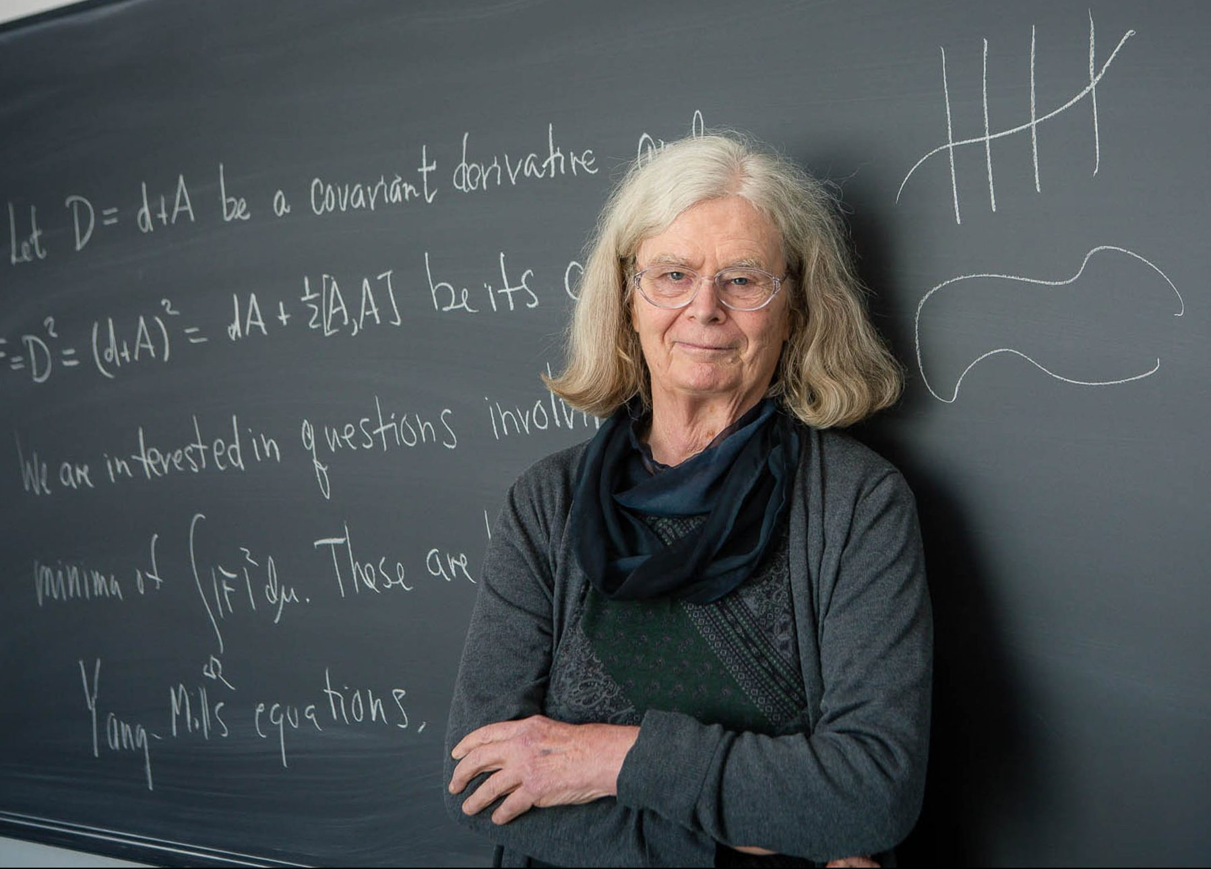
You’ve actually been using sets implicitly all along!
F(x,y) ≡ x and y are friends
Domain: “All people”
∀x ∃y F(x,y)
Mathematics
Domains of propositional functions
Function min(int x, int y) : int
if x < y then
return x
else
return y
endif
end function
Programming language data types
Notes:
(Karen Uhlenbeck, geometric analysis, first woman to win the Abel Prize 2019, presented by King of Norway. Some call it the Nobel of Maths)

Slide 9
Set equality
Definition: Two sets are equal if and only if they contain exactly the same elements.
Mathematically: A = B iff ∀x (x ∈ A ↔︎ x ∈ B)
Example: Are the following sets equal?
  {1, 2, 3, 4} and {1, 2, 3, 4} Yes!
  {1, 2, 3, 4} and {4, 1, 3, 2} Yes!
  {a, b, c, d, e} and {a, a, c, b, e, d} Yes!
  {a, e, i, o} and {a, e, i, o, u} No!
Notes:
For 3 item, duplicates does not matter.

Slide 10
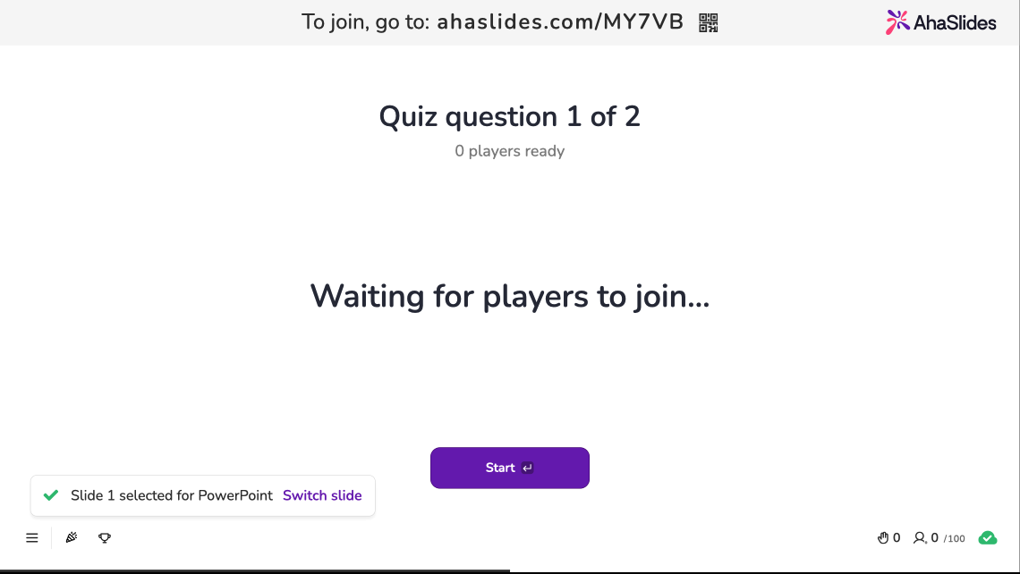
Notes:
Equality

Slide 11
We can use Venn diagrams to graphically represent sets
U is the “universe” of all elements
U
V
a
i
e
u
o
The set V of all vowels is contained within the universe of “all letters”
Sometimes, we add points for the elements of a set

Slide 12
Sets can be contained within one another
Definition: Some set A is a subset of another set B iff every element of A is an element in the set B. We denote this fact as A ⊆ B, and call B a superset of A.
Graphically:
Mathematically: A ⊆ B iff ∀x (x ∈ A → x ∈ B)
Definition: We say that A is a proper subset of B iff A ⊆ B, but A ≠ B. We denote this by A ⊂ B. More precisely:
A ⊂ B iff ∀x (x ∈ A → x ∈ B) ∧ ∃y (y ∈ B ∧ y ∉ A)
U
B
A

Slide 13
Properties of subsets
Property 1: For all sets S, we have that ∅ ⊆ S
Proof: The set ∅ contains no elements. So, trivially, every element of the set ∅ is contained in any other set S. ❏
Property 2: For any set S, S ⊆ S.
Property 3: If S₁ = S₂, then S₁ ⊆ S₂ and S₂ ⊆ S₁.

Slide 14
Note: Differences between ⊆ and ∈
Recall that A ⊆ B if A is a subset of B, whereas a ∈ A means that a is an element of A.
Examples:
  Is {1} ∈ {1, 2, 3}? No!
  Is {1} ⊆ {1, 2, 3}? Yes!
  Is 1 ∈ {1, 2, 3}? Yes!
  Is {2, 3} ⊆ {1, {2, 3}, {4, 5}}? No! But {{2, 3}} is…
  Is {2, 3} ∈ {1, {2, 3}, {4, 5}}? Yes!
  Is ∅ ∈ {1, 2, 3}? No!
  Is ∅ ⊆ {1, 2, 3}? Yes! ∅ is a subset of every set
Notes:
Read {x} as “the set containing x”

Slide 15
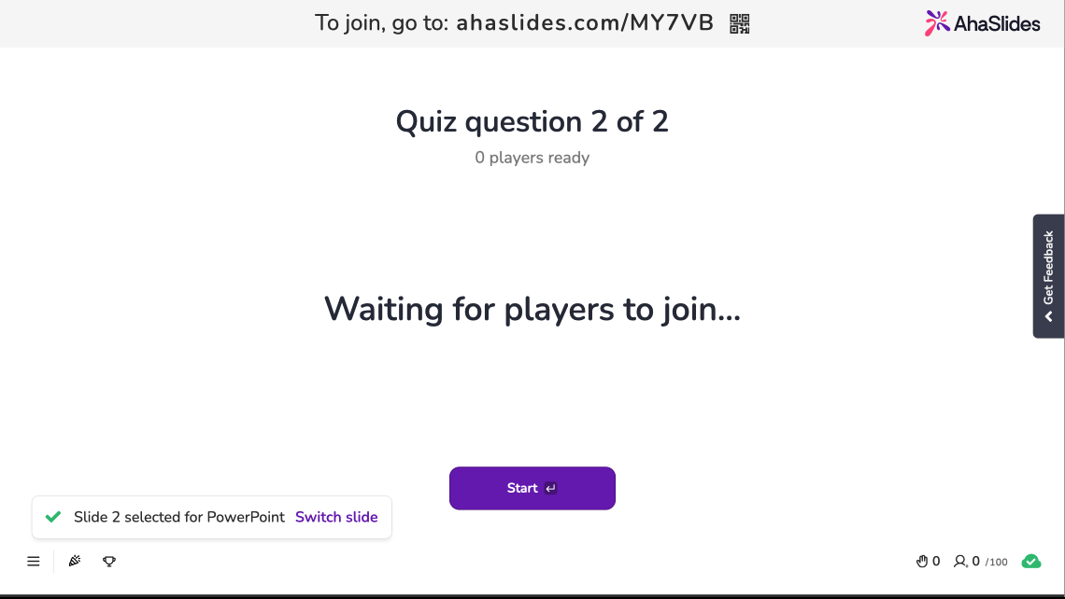
Notes:
Element

Slide 16

In-class Activities
Activity 1: Come up with two ways to represent each of the following sets: [miro]
  The even integers
  Negative integers between -1 and -10, inclusive
  The positive integers
Activity 2: Draw a Venn diagram representing the sets {1, 2, 3} and {3, 4, 5}. [miro]
Activity 3: Solve our Using Sets to manage User Roles case study. [miro]
Submit on
Steps:
Introduce to a classmate
Work in pairs on the exercise
Submit answers on miro
Volunteers to share answers
Notes:
1a and 2

Slide 17
We can create a new set by combining two or more existing sets
Definition: The union of two sets A and B contains every element that is either in A or in B. We denote the union of the sets A and B as A ∪ B.
Graphically:
Mathematically: A ∪ B = {x | x ∈ A ∨ x ∈ B}
Example: {1, 2, 3} ∪ {6, 7, 8} = {1, 2, 3, 6, 7, 8}
U
B
A

Slide 18
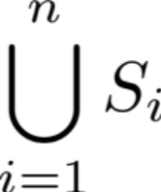
We can take the union of any number of sets
Example: A ∪ B ∪ C
Graphically:
In general, we can express the union S₁ ∪ S₂ ∪ … ∪ S_{n} using the following notation:
U
B
A
C
This is just like summation notation!

Slide 19
Sometimes we’re interested in the elements that are in more than one set
Definition: The intersection of two sets A and B contains every element that is in A and also in B. We denote the intersection of the sets A and B as A ∩ B.
Graphically:
Mathematically: A ∩ B = {x | x ∈ A ∧ x ∈ B}
Examples:
  {1, 2, 3, 7, 8} ∩ {6, 7, 8} = {7, 8}
  {1, 2, 3} ∩ {6, 7, 8} = ∅
U
B
A
We say that two sets A and B are disjoint if A ∩ B = ∅

Slide 20
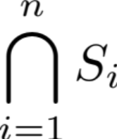
We can take the intersection of any number of sets
Example: A ∩ B ∩ C
Graphically:
As with the union operation, we can express the intersection S₁ ∩ S₂ ∩ … ∩ S_{n} as:
U
B
A
C

Slide 21
Set differences
Definition: The difference of two sets A and B, denoted by A – B, contains every element that is in A, but not in B.
Graphically:
Mathematically: A - B = {x | x ∈ A ∧ x ∉ B}
Example: {1, 2, 3, 4, 5} – {4, 5, 6, 7, 8} = {1, 2, 3}
Be careful: Some authors use the notation A \ B to denote the set difference A – B.
U
B
A

Slide 22
If we have specified a universe U, we can determine the complement of a set
Definition: The complement of a set A, denoted by A, contains every element that is in U, but not in A.
Graphically:
Mathematically: A = {x | x ∈ U ∧ x ∉ A}
Examples: Assume that U = {1, 2, …, 10}
  {1, 2, 3, 4, 5} = {6, 7, 8, 9, 10}
  {2, 4, 6, 8, 10} = {1, 3, 5, 7, 9}
U
A

Slide 23
Cardinality is the measure of a set’s size
Definition: Let S be a set. If there are exactly n elements in S, where n is a nonnegative integer, then S is a finite set whose cardinality is n. The cardinality of S is denoted by |S|.
Example: If S = {a, e, i, o, u}, then |S| = 5.
Useful facts: If A and B are finite sets, then
  |A ∪ B| = |A| + |B| – |A ∩ B|
  |A – B| = |A| – |A ∩ B|
Aside: We’ll talk about the cardinality of infinite sets later in the course.

Slide 24
Power set
Definition: Given a set S, its power set is the set containing all subsets of S. We denote the power set of S as P(S).
Examples:
  P({1}) = {∅, {1}}
  P({1, 2, 3}) = {∅, {1}, {2}, {3}, {1,2}, {1,3}, {2, 3}, {1, 2, 3}}
Note:
  The set ∅ is in the power set of any set S: ∀S(∅ ∈P(S))
  The set S is in its own power set: ∀S(S∈P(S))
  |P(S)| = 2^{|S|}
  Some authors use the notation 2^{S} to represent the power set of S

Slide 25
Be careful when computing power sets
Question: What is P({1, 2, {1, 2}})?
Note: The set {1, 2, {1, 2}} has three elements
  1
  2
  {1, 2}
So, we need all combinations of those elements:
  ∅
  {1}
  {2}
  {{1,2}}
  {1, 2}
  {1, {1,2}}
  {2, {1,2}}
  {1, 2, {1, 2}}
∴ P({1, 2, {1,2}}) = {∅, {1}, {2}, {{1,2}},
{1, 2}, {1, {1,2}},
{2, {1,2}},
{1, 2, {1,2} } }
This power set has 2³ = 8 elements.

Slide 26
How do we represent ordered collections?
Definition: The ordered n-tuple (a₁, a₂, …, a_{n}) is the ordered collection that has a₁ as its first element, a₂ as its second element, …, and a_{n} as its n^{th} element.
Note: (a₁, a₂, …, a_{n}) = (b₁, b₂, …, b_{n}) iff a_{i} = b_{i} for i = 1, …, n.
Special case: Ordered pairs of the form (x ∈ Z, y ∈ Z) are the basis of the Cartesian plane!
  (a, b) = (c, d) iff a = c and b = d
  (a, b) = (b, a) iff a = b
How can we construct and describe ordered n-tuples?

Slide 27
We use the Cartesian product operator to construct ordered n-tuples
Definition: If A and B are sets, the Cartesian product of A and B, which is denoted A × B, is the set of all ordered pairs (a, b) such that a ∈ A and b ∈ B.
Mathematically: A × B = {(a, b) | a ∈ A ∧ b ∈ B}
Examples: Let A = {1, 2} and B = {y, z}
  What is A × B? {(1, y), (1, z), (2, y), (2, z)}
  B × A? {(y, 1), (z, 1), (y, 2), (z, 2)}
  Are A × B and B × A equivalent? NO!!

Slide 28
Cartesian products can be made from more than two sets
Example: Let
  S = {x | x is enrolled in CS 441}
  G = {x | x ∈ R ∧ 0 ≤ x ≤ 100}
  Y = {freshman, sophomore, junior, senior}
The set S × Y × G consists of all possible (CS441 student, year, grade) combinations.
Note: My grades database is a subset of S × Y × G that defines a relation between students in the class, their year at Pitt, and their grade!
We will study the properties of relations later in this course.

Slide 29
Set notation allows us to make quantified statements more precise
We can use set notation to make the domain of a quantified statement explicit.
Example: ∀x∈R (x² ≥ 0)
  The square of any real number is at least zero
Example: ∀n∈Z ∃j,k∈Z [(3n+2 = 2j+1)→(n = 2k+1)]
  If n is an integer and 3n + 2 is odd, then n is odd.
Note: This notation is far less ambiguous than simply stating the domains of propositional functions. In the remainder of the course, we will use this notation whenever possible.

Slide 30
Truth sets describe when a predicate is true
Definition: Given a predicate P and its corresponding domain D the truth set of P enumerates all elements in D that make the predicate P true.
Examples: What are the truth sets of the following predicates, given that their domain is the set Z?
  P(x) ≡ |x| = 1 {-1, 1}
  Q(x) ≡ x² > 0 {x | x∈Z ∧ x≠0} -or- Z–{0}
  R(x) ≡ x⁵ = 1049 ∅
Note:
  ∀x P(x) is true iff the truth set of P is the entire domain D
  ∃x P(x) is true iff the truth set of P is non-empty

Slide 31
How do computers represent and manipulate finite sets?
Observation: Representing sets as unordered collections of elements (e.g., arrays of Java Object data types) can be inefficient.
As a result, sets are usually represented using either hash maps or bitmaps.
You’ll learn about these in CS 445, so today we’ll focus on bitmap representations.
Notes:
Membership check is O(n)
Union is O(m+n)
Intersection and difference are O(m × n)

Slide 32
Playing with the set S={x | x∈N, x<10}
To represent a set as a bitmap, we must first agree on an ordering for the set. In the case of S, let’s use the natural ordering of the numbers.
Now, any subset of S can be represented using |S|=10 bits. For example:
  {1, 3, 5, 7, 9} = 0101 0101 01
  {1, 1, 1, 4, 5} = 0100 1100 00
What subsets of S do the following bitmaps represent?
  0101 1010 11 {1, 3, 4, 6, 8, 9}
  1111 0000 10 {0, 1, 2, 3, 8}
Notes:
Each number is represented by 10 bits.

Slide 33
Set operations can be carried out very efficiently as bitwise operations
Example: {1, 3, 7} ∪ {2, 3, 8}
0101 0001 00
∨ 0011 0000 10
0111 0001 10 = {1, 2, 3, 7, 8}
Example: {1, 3, 7} ∩ {2, 3, 8}
0101 0001 00
∧ 0011 0000 10
0001 0000 00 = {3}
Note: These operations are much faster than searching through unordered lists!

Slide 34
Set operations can be carried out very efficiently as bitwise operations
Example: {1, 3, 7}
¬0101 0001 00
1010 1110 11 = {0, 2, 4, 5, 6, 8, 9}
Since the set difference A – B can be written as A ∩ (A ∩ B), we can calculate it as A ∧ ¬(A ∧ B).
Although set difference is more complicated than the basic operations, it is still much faster to calculate set differences using a bitmap approach as opposed to an unordered search.

Slide 35
In-class Activities
Activity 4: Let A = {1, 2, 3, 4}, B = {3, 5, 7, 9}, and C = {7, 8, 9, 10}. Calculate the following: [miro]
  A ∩ B
  A ∪ B ∪ C
  B ∩ C
  A ∩ B ∩ C
Activity 5: Come up with a bitmap representation of the sets A = {a, c, d, f} and B = {a, b, c}. Use this to calculate the following: [miro]
  A ∪ B
  A ∩ B
Submit on
Steps:
Introduce to a classmate
Work in pairs on the exercise
Submit answers on miro
Volunteers to share answers
Notes:
Act 5

Slide 36
Final thoughts
Sets are one of the most basic data structures used in computer science
Today, we looked at:
  How to define sets
  Basic set operations
  How computers represent sets
Next time:
  Set identities (Section 2.2)
  Functions (Section 2.3)

Slide 37
Extra

Slide 38
Sets and Cartesian products can be used to represent trees and graphs
Duru
Chausiku
Avetis
Bluma
Node
Elise
Irune
Edge
Ali
Let:
  N = All names
  F = N × N
A social network can be represented as a graph (V, E) in which the set V denotes the people in the network and the set E denotes the set of “friendship” links: (V, E) ∈ P(N) × P(F)
In the above network:
  V = {Avetis, Bluma, …, Colin} ⊆ N
  E = {(Avetis, Bluma), (Avetis, Duru), …, (Sekai, Colin)} ⊆ N × N
Sekai
Colin

