Slide 1

CS 441: Functions
PhD. Nils Murrugarra-Llerena
nem177@pitt.edu

Slide 2

[Key CS Link] Functions
The URL Router
When you type a URL into your browser, like https://www.example.com/users/profile/123, a web server needs to figure out which specific piece of code should handle that request. It needs to:
Identify the part of the URL that's important (/users/profile/123).
Extract any variables from the URL (in this case, the user ID 123).
Map this specific URL to a function that will generate the user's profile page.
This is a classic function problem: a well-defined input (the URL) needs to be mapped to a single, specific output (the correct function to execute).
Source: Gemini
Notes:
Source: Gemini
The Function-Based Approach
Define the Function: The URL router itself acts as a function, let's call it f(u).
The domain of the function is the set of all possible URLs that the web application can handle.
The codomain is the set of all possible functions or "views" that are designed to handle those URLs.
Mapping the Input to the Output: The router function works by establishing a set of rules (routes) that define the mapping. For our example, a route might look like this:
f("/users/profile/{user_id}") → show_user_profile(user_id)
Here, the URL acts as the input, and the function show_user_profile is the output. The router extracts the variable user_id and passes it as an argument to the output function.
Key Function Properties: This example effectively demonstrates several core concepts:
Every Input Has Exactly One Output: A well-designed router ensures that each unique URL path is mapped to a single, designated function. This prevents ambiguity and ensures the right page is always served.
One-to-One and Many-to-One: You can discuss how some routes might be one-to-one (e.g., /home always maps to a single home page function), while others might be many-to-one. For example, /users/profile/123 and /users/profile/456 are two different URLs (inputs), but they both map to the same output function, show_user_profile, which then uses the user_id to retrieve the correct data.
This example is highly relatable for computer science students because web development is a common career path. It shows how the abstract concept of a function is the fundamental logic that powers the web's navigation and structure.

Slide 3

Today's topics
Set Functions
  Important definitions
  Relationships to sets, relations
  Specific functions of particular importance

Slide 4
Sets give us a way to formalize the concept of a function
Definition: Let A and B be nonempty sets. A function, f, is an assignment of exactly one element of set B to each element of set A.
Note: We write f : A → B to denote that f is a function from A to B
Note: We say that f(a) = b if the element a ∈ A is mapped to the unique element b ∈ B by the function f
f
A
B
f(a) = b
a ●
● b
Notes:
This is probably more precise than how you learned functions in high school courses and even calculus

Slide 5
Functions can be defined in a number of ways
Explicitly
  f : Z → Z
  f(x) = x² + 2x + 1
Using a programming language
  int min(int x, int y) = { x < y ? return x : return y; }
Using a relation
  Let S = {Anna, Brian, Christine}
  Let G = {A, B, C, D, F}
f : S → G
Anna ●
● A
Brian ●
● B
Christine ●
● C
● D
● F

Slide 6
More terminology
The domain of a function is the set that the function maps from, while the codomain is the set that is mapped to
If f(a) = b, b is called the image of a, and a is called the preimage of b
The range of a function f : A → B is the set of all images of elements of A
Domain = S = {Anna, Brian, Christine}
Codomain = G = {A, B, C, D, F}
f : S → G
Anna ●
● A
Brian ●
● B
Christine ●
● C
● D
Range = {A, C}
● F

Slide 7
What are the domain, codomain, and range of the following functions?
f : Z → Z, f(x) = x³
  Domain: Integers
  Codomain: Integers
  Range: Perfect cubes
g : R → R, g(x) = x - 2
  Domain: Real numbers
  Codomain: Real numbers
  Range: Real numbers
int foo(int x, int y) = { return (x*y)%2; }
  Domain: All (x, y) ∈ Z×Z
  Codomain: Integers
  Range: {0, 1}

Slide 8
A one-to-one function never assigns the same image to two different elements
Definition: A function f : A → B is one-to-one, or injective, iff ∀x,y∈A [(f(x) = f(y)) → (x = y)]
Are the following functions injections?
  f : R → R, f(x) = x + 1 Yes
  f : Z → Z, f(x) = x² No
  f : R⁺ → R⁺, f(x) = √x Yes
  f : S → G No
f : S → G
Anna ●
● A
Brian ●
● B
Christine ●
● C
● D
● E

Slide 9
An onto function “uses” every element of its codomain
Definition: We call a function f : A → B onto, or surjective, iff for every element b ∈ B, there is some element a ∈ A such that f(a) = b.
The following function is a surjection:
Think about an onto function as “covering” the entirety of its codomain.
f : A → B
a ●
● 1
b ●
● 2
c ●
● 3
d ●

Slide 10
Are the following functions one-to-one, onto, both, or neither?
f : A → B
f : A → B
a ●
● 1
a ●
● 1
b ●
● 2
b ●
● 2
c ●
● 3
c ●
● 3
d ●
d ●
● 4
Neither!
One-to-one and onto
(Aside: Functions that are both one-to-one
and onto are called bijections)
f : A → B
f : A → B
a ●
● 1
b ●
● 2
a ●
● 1
c ●
● 3
b ●
● 2
d ●
● 4
c ●
● 3
● 5
d ●
One-to-one
Onto

Slide 11
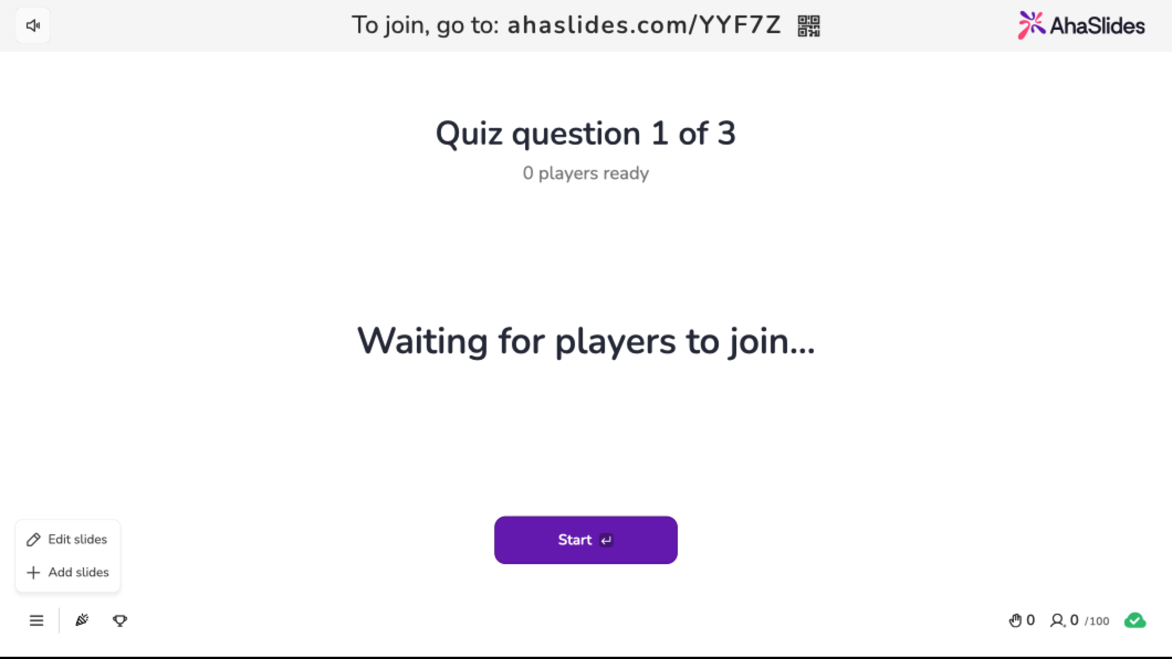
Notes:
Onto
[Option b] No Onto.
This is not a valid function from Z to Z. For many integers (like 2), the square root is not an integer. For negative integers, the square root is not a real number.
Result: Not onto (and not a valid function on Z).

Slide 12
Bijections have inverses
Definition: If f : A → B is a bijection, the inverse of f is the function f⁻¹ : B → A that assigns to each b ∈ B the unique value a ∈ A such that f(a) = b. That is, f⁻¹(b) = a iff f(a) = b.
Graphically:
Note: Only a bijection can have an inverse. (Why?)
f
A
B
f(a) = b
a ●
● b
f⁻¹(b) = a
Reversal is only possible:
Each element in the domain maps to a unique element in the codomain (injective).
Every element in the codomain has a corresponding element in the domain (surjective).
Notes:
Each element in the domain maps to a unique element in the codomain (injective).
Every element in the codomain has a corresponding element in the domain (surjective).
This properties is ensured by bijection

Slide 13
Do the following functions have inverses?
f : R → R, f(x) = x²
  No, since this function is not one-to-one. E.g. f(-1) = 1, f ⁻¹(1)=sqrt(1) = 1
g : Z → Z, g(x) = x + 1
  Yes, g⁻¹(x) = x – 1
h : A → B
  Yes
h : A → B
h⁻¹ : B → A
a ●
● 1
1 ●
● a
b ●
● 2
2 ●
● b
c ●
● 3
3 ●
● c
d ●
● 4
4 ●
● d

Slide 14
Functions can be composed with one another
Given functions g : A → B and f : B → C, the composition of f and g, denoted f◦g, is defined as (f◦g)(x) = f(g(x)).
Note: For f◦g to exist, the codomain of g must be a subset of the domain of f.
Definition: If g : A → B and f : D → C and B ⊆ D, f◦g is a function A → C where (f◦g)(x) = f(g(x))
g
f
A
B
C
g(a) = b
f(g(a)) = c
a ●
● g(a)
● c
f ◦ g

Slide 15
Can the following functions be composed? If so, what is their composition?
Let f : A → A such that f(a) = b, f(b) = c, f(c) = a
g : B → A such that g(1) = b, g(4) = a
  (f◦g)(x)? Yes! f(g(1)) = c, f(g(4)) = b
  (g◦f)(x)? No! A ⊄ B
Let f : Z → Z, f(x) = 2x + 1
g : Z → Z, g(x) = x²
  (f◦g)(x)? Yes! (f◦g)(x) = 2x² + 1
  (g◦f)(x)? Yes! (g◦f)(x) = 4x² + 4x + 1
Note: There is not a guarantee that (f◦g)(x) = (g◦f)(x).

Slide 16
Important functions
Definition: The floor function maps a real number x to the largest integer y that is not greater than x. The floor of x is denoted ⌊x⌋.
Definition: The ceiling function maps a real number x to the smallest integer y that is not less than x. The ceiling of x is denoted ⌈x⌉.
Examples:
  ⌊1.2⌋ = 1
  ⌊7.0⌋ = 7
  ⌊-42.24⌋ = -43
  ⌈1.2⌉ = 2
  ⌈7.0⌉ = 7
  ⌈-42.24⌉ = -42

Slide 17
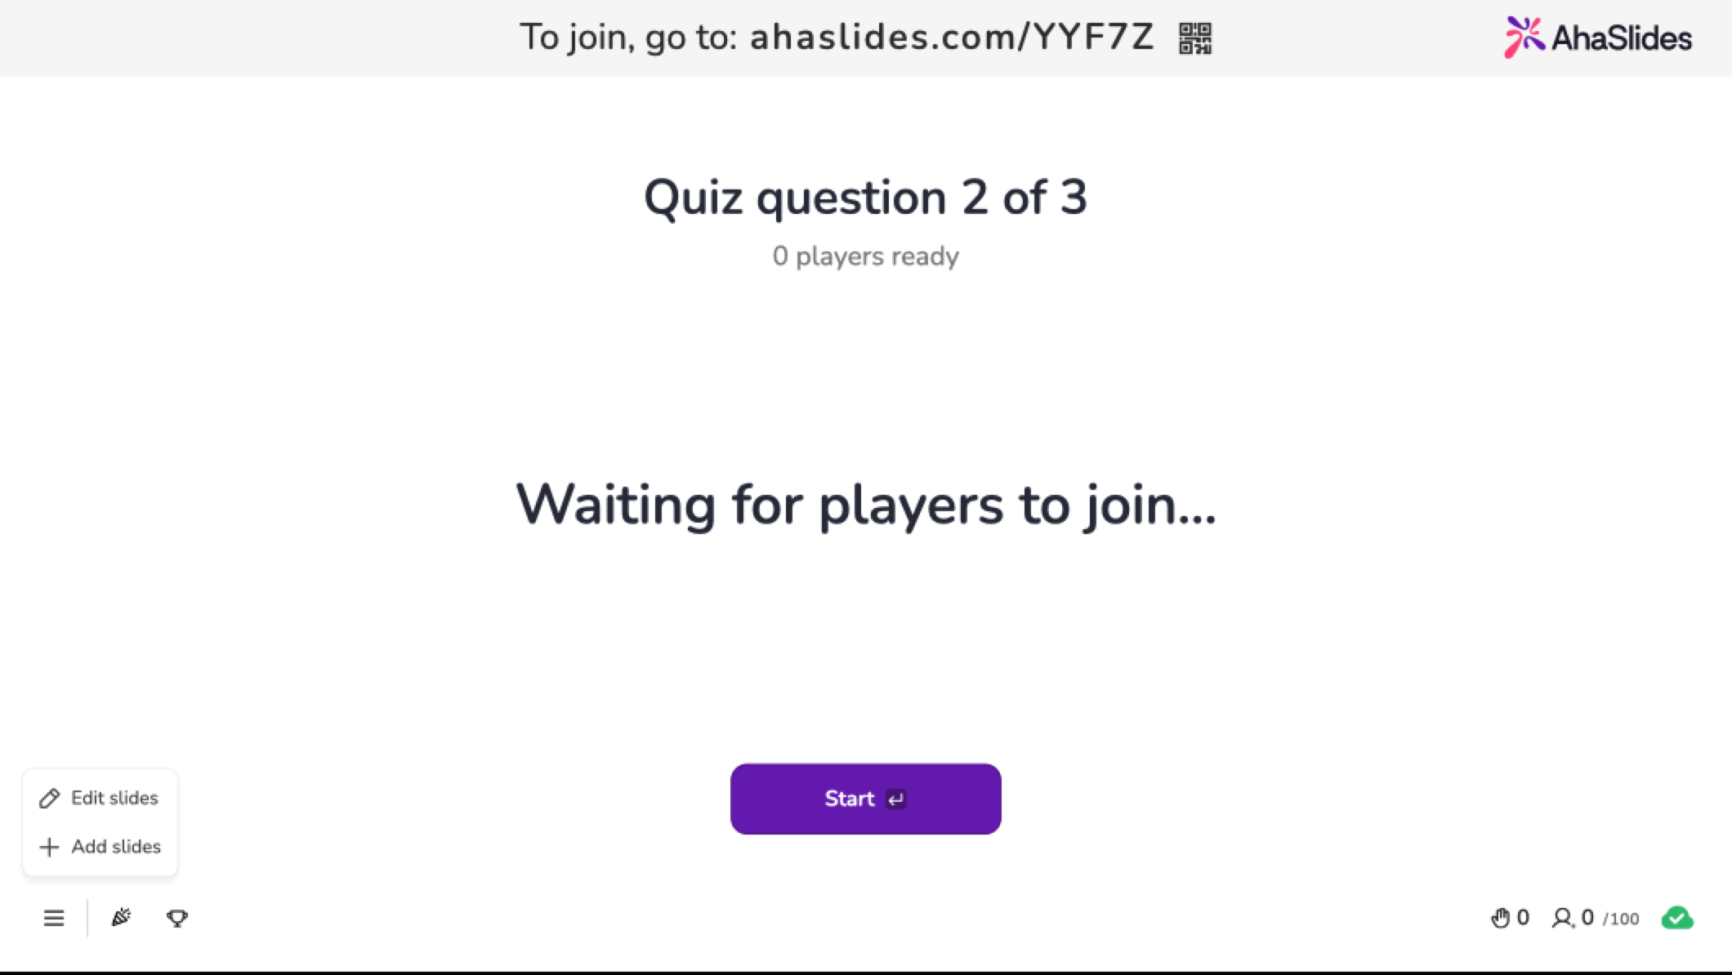
Notes:
Floor / ceiling (at least one of those)

Slide 18
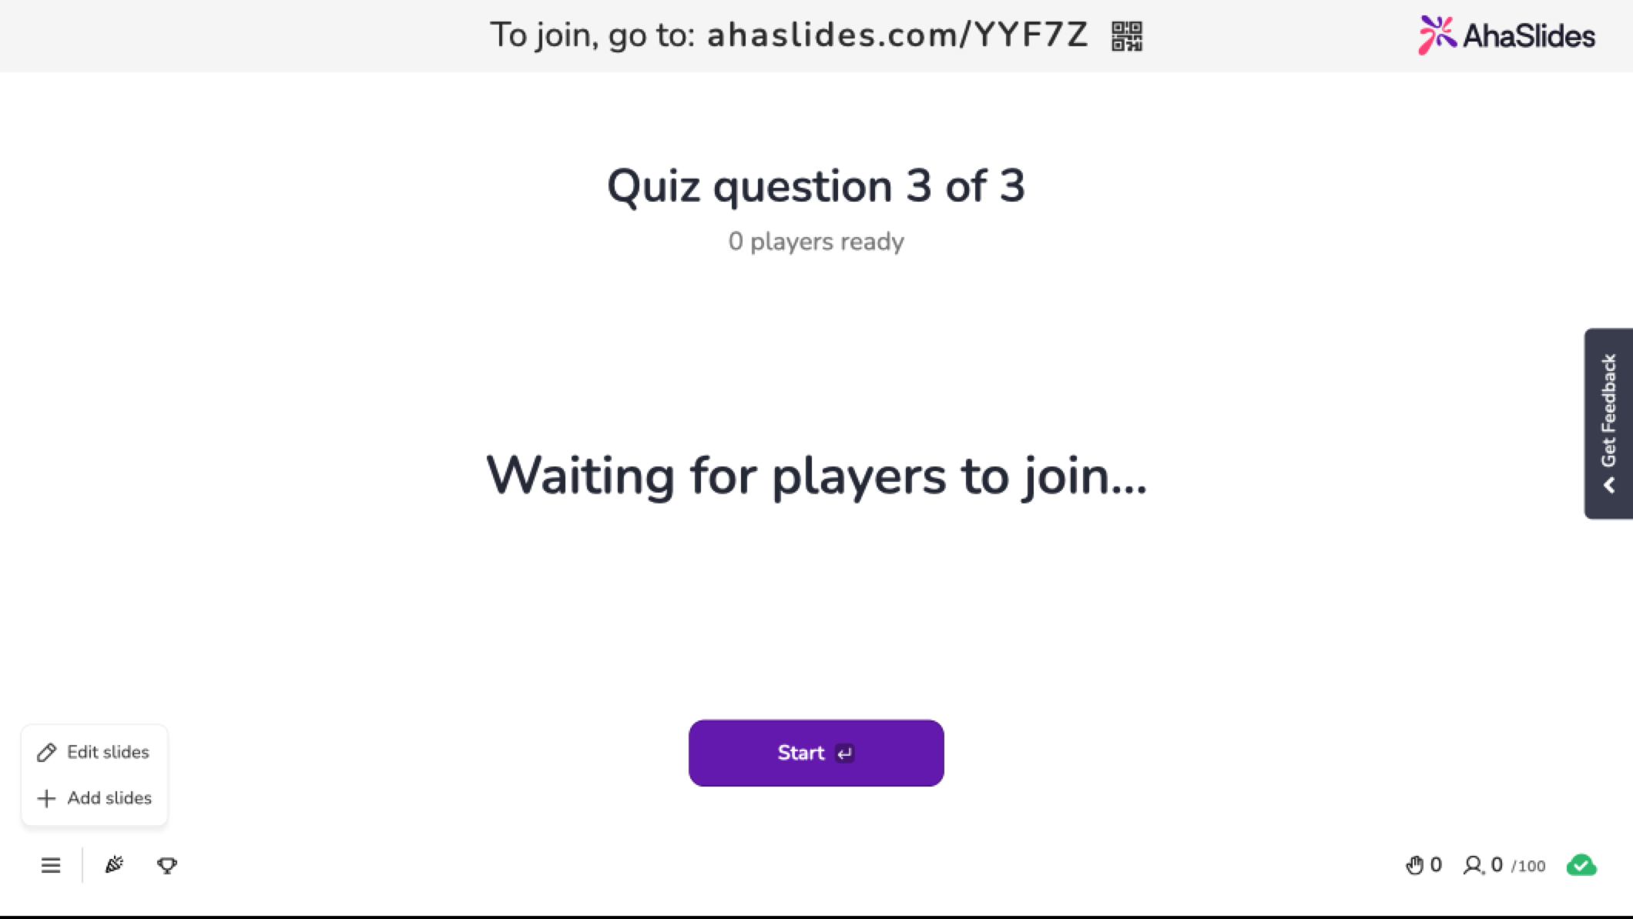
Notes:
Floor / ceiling (at least one of those)

Slide 19
We actually use floor and ceiling quite a bit in computer science…
Example: A byte, which holds 8 bits, is typically the smallest amount of memory that can be allocated on most systems. How many bytes are needed to store 123 bits of data?
Answer: We need ⌈123/8⌉ = ⌈15.375⌉ = 16 bytes
Example: How many 1400 byte packets can be transmitted over a 14.4 kbps modem in one minute?
Answer: A 14.4 kbps modem can transmit 14,400*60 = 864,000 bits per minute. Therefore, we can transmit ⌊864,000/(1400*8)⌋ = ⌊77.1428571⌋ = 77 packets.
Notes:
14’400 bits/sec * 60 sec/(1 min) = 864’000 bits/min
1400 byte packets = (1400 * 8) bit packets 1 byte = 8 bits
864’000 / (1400*8) = 77 packets

Slide 20

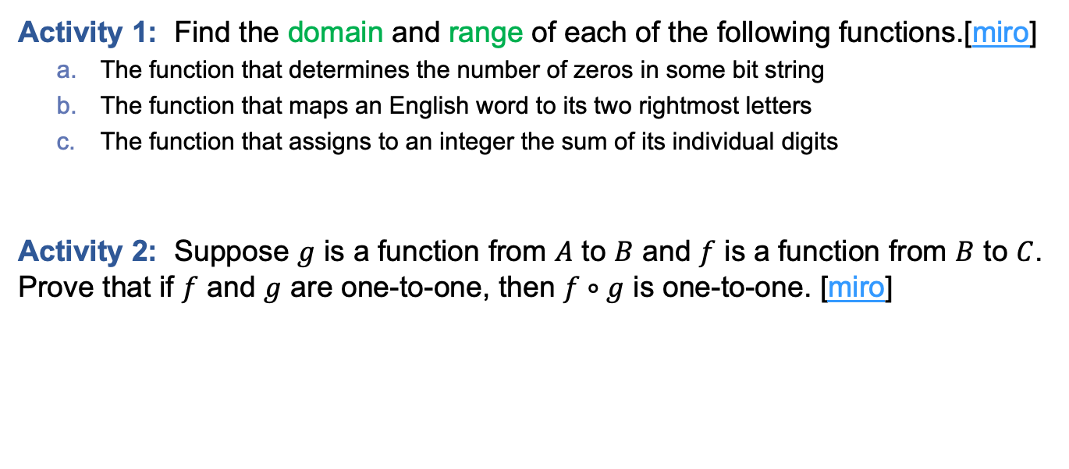
In-class Activities
Activity 1: Find the domain and range of each of the following functions.[miro]
  The function that determines the number of zeros in some bit string
  The function that maps an English word to its two rightmost letters
  The function that assigns to an integer the sum of its individual digits
Activity 2: Suppose $g$ is a function from $A$ to $B$ and $f$ is a function from $B$ to $C$. Prove that if $f$ and $g$ are one-to-one, then $f∘g$ is one-to-one. [miro]
Submit on
Steps:
Introduce to a classmate
Work in pairs on the exercise
Submit answers on miro
Volunteers to share answers
Notes:
1a
2

Slide 21
Final thoughts
Set identities are useful tools!
We can prove set identities in a number of (equivalent) ways
Sets are the basis of functions, which are used throughout computer science and mathematics
Next time:
  Summations (Section 2.4)

