Slide 1

CS 441: Predicates and Quantifiers
PhD. Nils Murrugarra-Llerena
nem177@pitt.edu

Slide 2
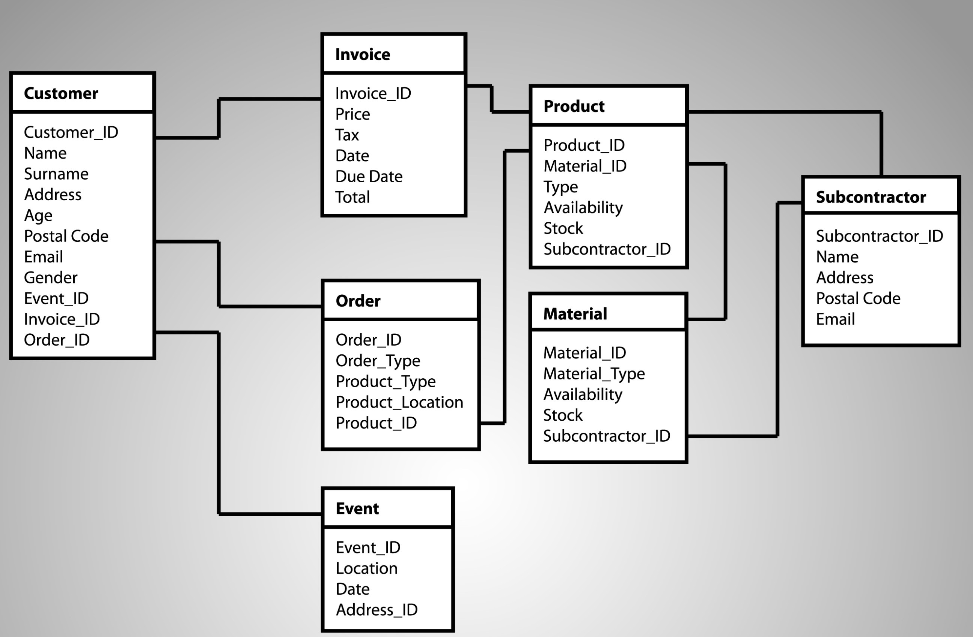

[Key CS Link] Quantifiers
E-commerce Website Developer
Imagine you're the lead developer for an e-commerce website. You need to write a program that checks the inventory and shipping status for customer orders. Your task is to confirm if the following statement is true:
"For every customer, there is a product they have ordered that is currently in stock."
Source: Gemini
Notes:
Source: Gemini
Activity used on 6. Nested Quantifiers slide.

Slide 3

Today’s topics
Predicates
Quantifiers
Logical equivalences in predicate logic
Translations using quantifiers

Slide 4
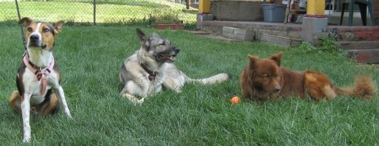

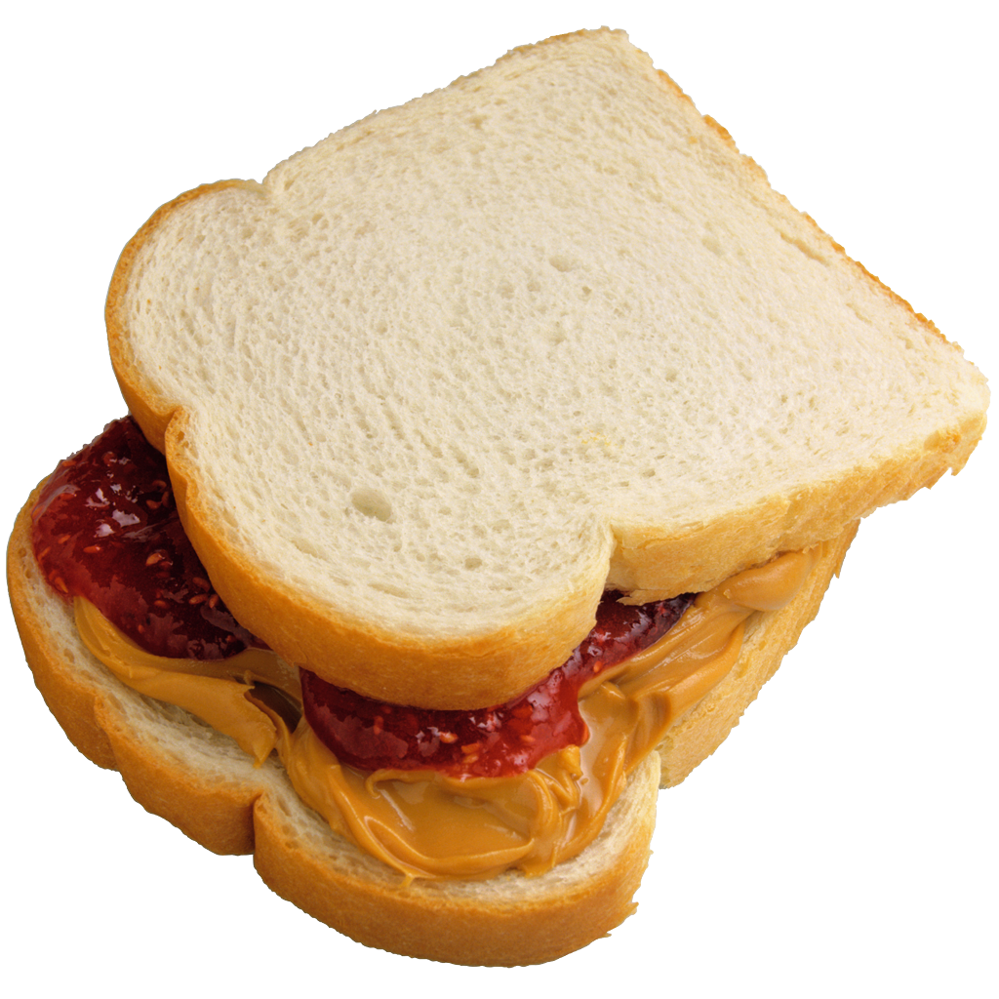
Propositional logic is simple, therefore limited
Propositional logic cannot represent some classes of natural language statements…
Given: Kody is one
of my dogs
?
Given: All of my dogs like peanut butter
Propositional logic gives us no way to draw the (obvious) conclusion that Kody likes peanut butter!

Slide 5
Propositional logic also limits the mathematical truths that we can express and reason about
Consider the following:
  p₁ ≡ 2 has no divisors other than 1 and itself
  p₂ ≡ 3 has no divisors other than 1 and itself
  p₃ ≡ 5 has no divisors other than 1 and itself
  p₄ ≡ 7 has no divisors other than 1 and itself
  p₅ ≡ 11 has no divisors other than 1 and itself
  …
This is an inefficient way to reason about the properties of prime numbers!
General problem: Propositional logic has no way of reasoning about instances of general statements.

Slide 6
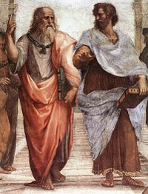

Historical Context
The previous examples are called syllogisms
Aristotle used syllogisms in his Prior Analytics to deductively infer new facts from existing knowledge
Major premise
All men are mortal
Socrates is a man
Minor premise
Socrates is mortal
Conclusion
Notes:
We’ll talk about the rules of inference that permit these deductions later in the course
Syllogism: two premises, one conclusion. term in each premise w conclusion, and addl term in both premises

Slide 7
Predicate logic allows us to reason about the properties of individual objects and classes of objects
Predicate logic allows us to use propositional functions during our logical reasoning
P(x) ≡ x³ > 0
variable
predicate
Note: A propositional function P(x) has no truth value unless it is evaluated for a given x or set of xs.

Slide 8
Examples
Assume P(x) ≡ x³ > 0. What are the truth values of the following expressions:
  P(0)
  P(23)
  P(-42)
We can express the prime number property using predicate logic:
  P(x) ≡ “x is prime”
  D(x) ≡ “x has no divisors other than 1 and itself”
  P(x) ↔ D(x)
False
True
False

Slide 9
Predicates can also be defined on more than one variable
Let P(x, y) ≡ x + y = 42. What are the truth values of the following expressions:
  P(45, -3)
  P(23, 23)
  P(1, 119)
Let S(x, y, z) ≡ x + y = z. What are the truth values of the following expressions:
  S(1, 1, 2)
  S(23, 24, 42)
  S(-9, 18, 9)
True
False
False
True
False
True

Slide 10
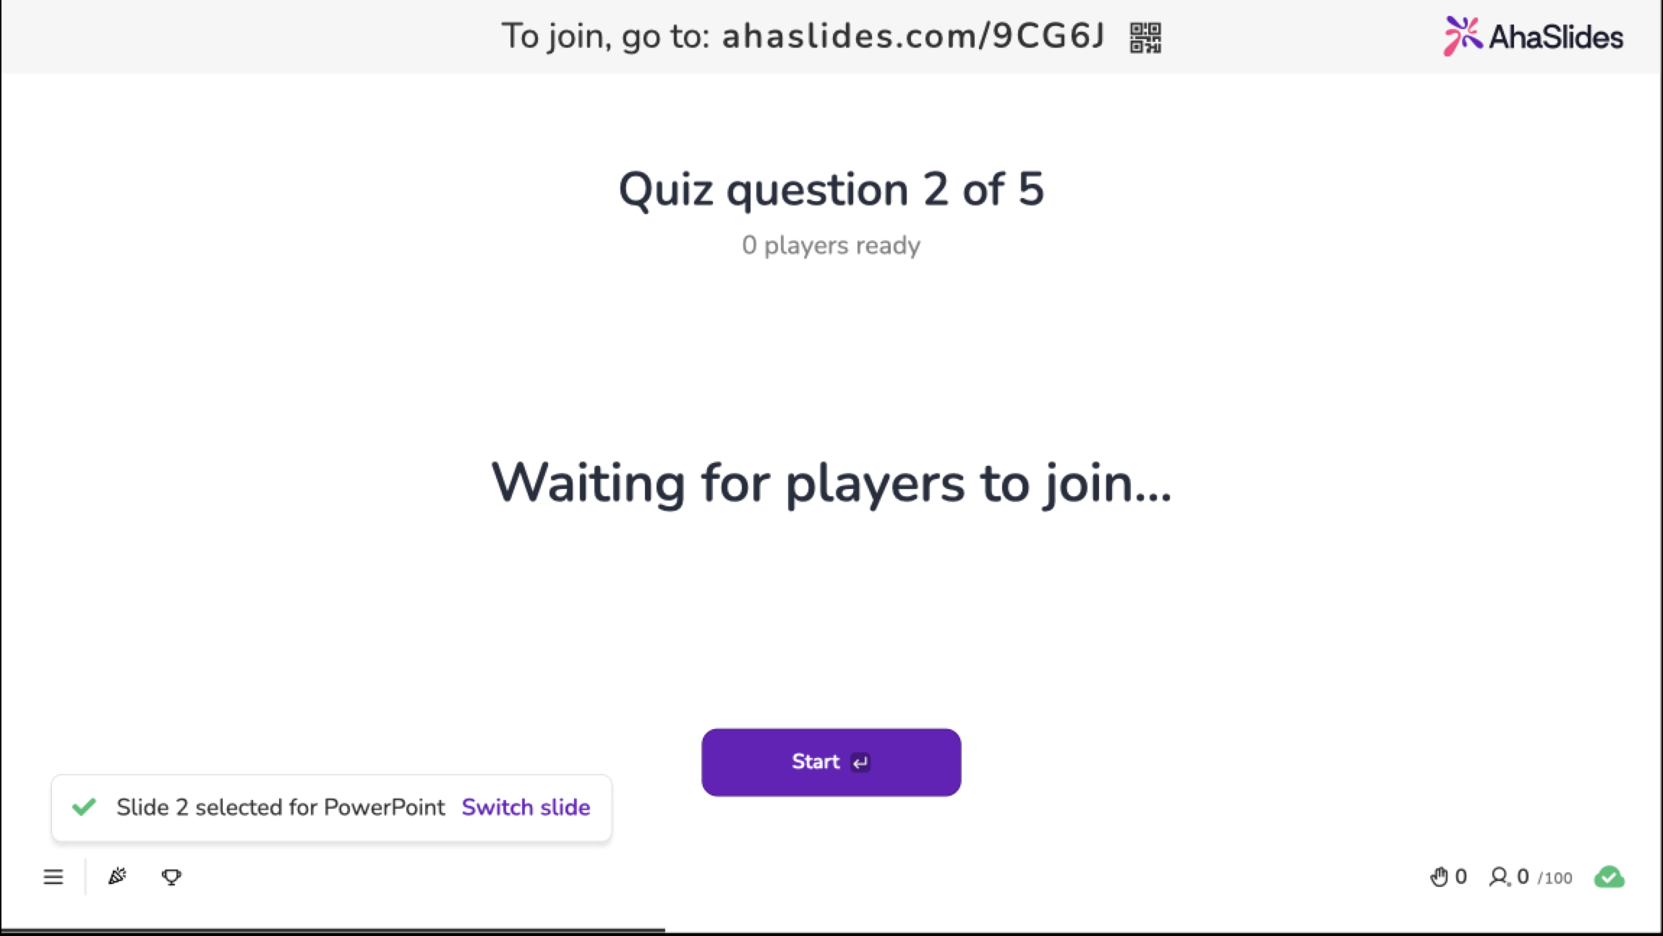
Notes:
Q2 / Q3

Slide 11
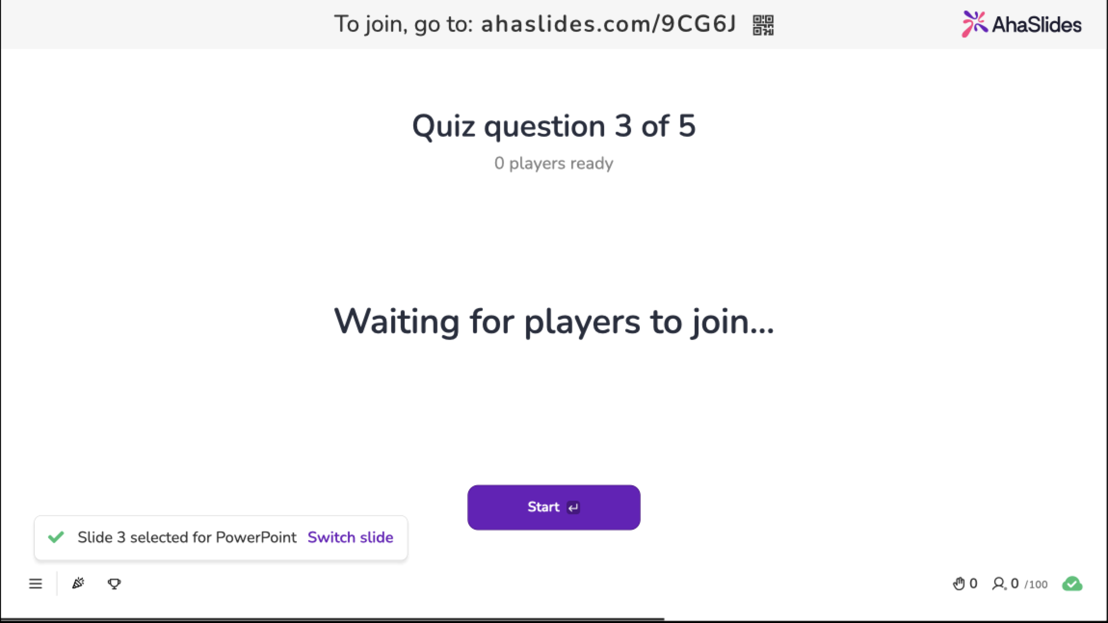
Notes:
Q2 / Q3

Slide 12
Predicates play a central role in program control flow and debugging
If/then statements:
  if x > 17 then y = 13
Loops:
  while y <= 14 do
  …
  end while
Debugging in C/C++:
  assert(strlen(passwd) > 0);
This is a predicate!

Slide 13
Quantifiers allow us to make general statements that turn propositional functions into propositions
In English, we use quantifiers on a regular basis:
  All students can ride the bus for free
  Many people like chocolate
  I enjoy some types of tea
  At least one person will sleep through their final exam
Quantifiers require us to define a universe of discourse (also called a domain) in order for the quantification to make sense
  “Many like chocolate” doesn’t make sense!
What are the universes of discourse for the above statements?

Slide 14
Universal quantification allows us to make statements about the entire universe of discourse
Examples:
  All of my dogs like peanut butter
  Every even integer is a multiple of two
  For each positive integer x, 2x > x
Given a propositional function P(x), we express the universal quantification of P(x) as ∀x P(x)
What is the truth value of ∀x P(x)?
  True if P(x) is True for every x in the universe of discourse
  False if P(x) is False for even one x in the universe of discourse

Slide 15
Examples
All rational numbers are greater than 42
  Domain: rational numbers
  Propositional function: Let G(x) ≡ “x is greater than 42”
  Statement: ∀x G(x)
  Truth value: False (counterexample: ½)
If a natural number is prime, it has no divisors other than 1 and itself
  Domain: natural numbers
  Propositional functions:
    Let P(x) ≡ “x is prime”
    Let D(x) ≡ “x has no divisors other than 1 and itself”
  Statement: ∀x [P(x) → D(x)]
  Truth value: True (by definition)

Slide 16
Existential quantifiers allow us to make statements about some objects
Examples:
  Some elephants are scared of mice
  There exist integers a, b, and c such that the equality
  a² + b² = c² is true
  There is at least one person who did better than John on the midterm
Given a propositional function P(x), we express the existential quantification of P(x) as ∃x P(x)
What is the truth value of ∃x P(x)?
  True if P(x) is True for at least one x in the universe of discourse
  False if P(x) is False for each x in the universe of discourse

Slide 17
Examples
The inequality x + 1 < x holds for at least one integer
  Domain: Integers
  Propositional function: P(x) ≡ x + 1 < x
  Statement: ∃x P(x)
  Truth value: False
For some integers, the equality a² + b² = c² is True
  Domain: Integers
  Propositional function: P(a, b, c) ≡ a² + b² = c²
  Statement: ∃a,b,c P(a,b,c)
  Truth value: True

Slide 18
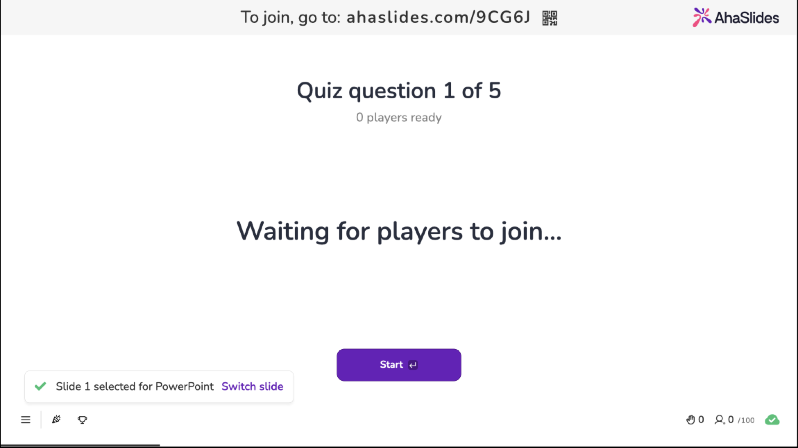
Notes:
[Not a quantifier]

Slide 19
A common idiom in logic: Restricting the domain of quantification
The square of every natural number less than 4 is no more than 9
  Domain: natural numbers
  Statement: ∀x<4 (x² ≤ 9)
  Truth value: True
Some integers between 0 and 6 are prime
  Domain: Integers
  Propositional function: P(x) ≡ “x is prime”
  Statement: ∃0≤x≤6 P(x)
  Truth value: True
This is equivalent to writing
∀x [(x < 4) → (x² ≤ 9)]
This is equivalent to writing
∃x [(0≤x≤6) ∧ P(x)]

Slide 20
Precedence of quantifiers
The universal and existential quantifiers have the highest precedence of all logical operators
For example:
  ∀x P(x) → Q(x) actually means (∀x P(x)) → Q(x)
  ∃x P(x) ∧ Q(x) actually means (∃x P(x)) ∧ Q(x)
When needed, use parentheses to disambiguate a quantifier’s scope
x is undefined outside!

Slide 21

Notes:
Q4 / Q5

Slide 22
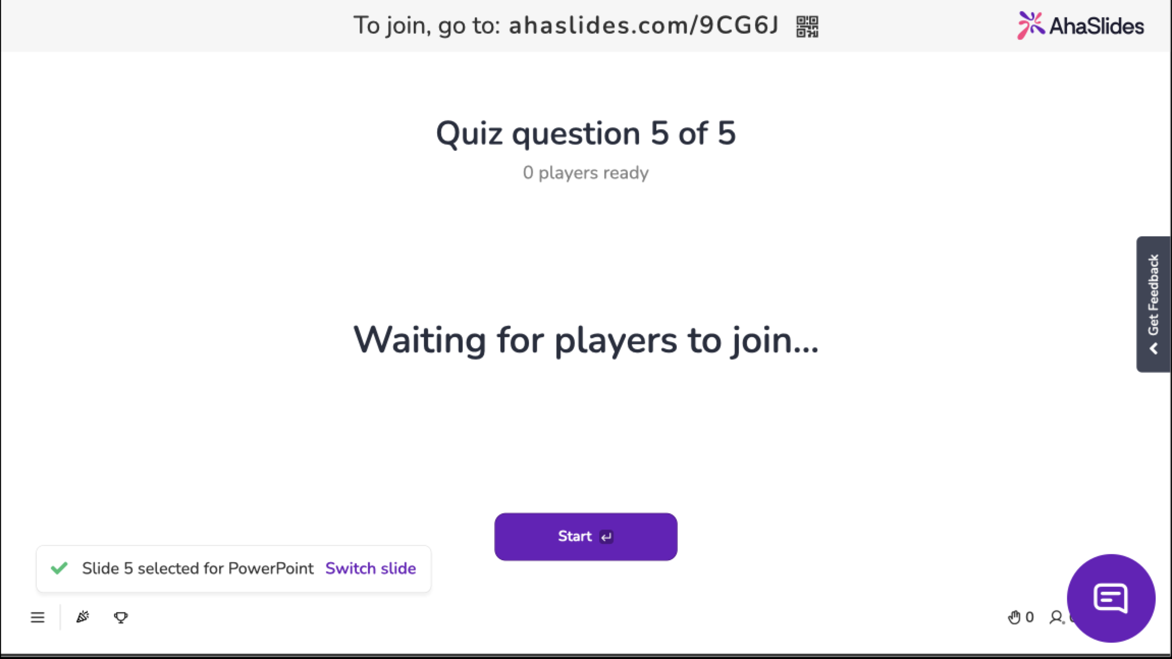
Notes:
Q4 / Q5

Slide 23
We can extend the notion of logical equivalence to expressions containing predicates or quantifiers
Definition: Two statements involving predicates and quantifiers are logically equivalent iff they take on the same truth value regardless of which predicates are substituted into these statements and which domains of discourse are used.

Slide 24
Prove: ∃x [P(x) ∨ Q(x)] ≡ ∃x P(x) ∨ ∃x Q(x)
We must prove each “direction” of the equivalence. Assume that P and Q have the same domain.
First, prove ∃x [P(x) ∨ Q(x)] → ∃x P(x) ∨ ∃x Q(x):
  If ∃x [P(x) ∨ Q(x)] is True, this means that there is some value v in the domain such that either P(v) is True or Q(v) is True
  If P(v) is True, then ∃x P(x) is True and [∃x P(x) ∨ ∃x Q(x)] is True
  If Q(v) is True, then ∃x Q(x) is True and [∃x P(x) ∨ ∃x Q(x)] is True
  Thus ∃x [P(x) ∨ Q(x)] → ∃x P(x) ∨ ∃x Q(x)

Slide 25
Prove: ∃x [P(x) ∨ Q(x)] ≡ ∃x P(x) ∨ ∃x Q(x)
Then, prove ∃x P(x) ∨ ∃x Q(x) → ∃x [P(x) ∨ Q(x)]:
  If ∃x P(x) ∨ ∃x Q(x) is True, this means that there is some value v in the domain such that either P(v) is True or Q(v) is True
  If P(v) is True, then ∃x [P(x) ∨ Q(x)] is True
  If Q(v) is True, then ∃x [P(x) ∨ Q(x)] is True
  Thus ∃x P(x) ∨ ∃x Q(x) → ∃x [P(x) ∨ Q(x)]
Since ∃x [P(x) ∨ Q(x)] → ∃x P(x) ∨ ∃x Q(x) and
∃x P(x) ∨ ∃x Q(x) → ∃x [P(x) ∨ Q(x)] then
∃x [P(x) ∨ Q(x)] ≡ ∃x P(x) ∨ ∃x Q(x).

Slide 26
We also have DeMorgan’s laws for quantifiers
Negation over universal quantifier: ¬(∀x P(x)) ≡ ∃x (¬P(x))
Negation over existential quantifier: ¬(∃x P(x)) ≡ ∀x (¬P(x))
These are very useful logical equivalences, so let’s prove one of them…
Intuition: If P(x) is not true for all x, then there is at least one x for which P(x) is false
Intuition: If P(x) is not true for at least one value x, then P(x) is false for all x

Slide 27
Prove: ¬∀x P(x) ≡ ∃x ¬P(x)
¬∀x P(x) → ∃x ¬P(x)
  ¬∀x P(x) is True if and only if ∀x P(x) is False
  ∀x P(x) is False if and only if there is some v such that P(v) is False
  P(v) is False is equivalent to ¬P(v) is True
  If ¬P(v) is True, then ∃x ¬P(x)
∃x ¬P(x) → ¬∀x P(x)
  ∃x ¬P(x) is True if and only if there is some v such that ¬P(v) is True
  If ¬P(v) is True, then clearly P(x) does not hold for all possible values in the domain and thus we have ¬∀x P(x)
Therefore ¬∀x P(x) ≡ ∃x ¬P(x).
Notes:
[Second part]
∃x ¬P(x) is True -- ¬P(v) is True – P(v) is False -- ∀x P(x) is False -- ¬∀x P(x) is True

Slide 28
Translations from English
To translate English sentences into logical expressions:
  Rewrite the sentence to make it easier to translate
  Determine the appropriate quantifiers to use
  Look for words that indicate logical operators
  Formalize sentence fragments
  Put it all together

Slide 29
Example: At least one person in this classroom is named Nils and has lived in Pittsburgh for 12 years
2
Existential quantifier
1
Rewrite: There exists at least one person who is in this classroom, is named Nils, and has lived in Pittsburgh for 12 years
Formalize:
  C(x) ≡ “x is in this classroom”
  N(x) ≡ “x is named Nils”
  P(x) ≡ “x has lived in Pittsburgh for 12 years”
Final expression: ∃x [C(x) ∧ N(x) ∧ P(x)]
Conjunctions
3
4
5
Notes:
TODO: Add numbers to steps

Slide 30
Example: If a student is taking CS441, then they have taken high school algebra
2
Universal quantifier
Rewrite: For all students, if a student is in CS 441, then they have taken high school algebra
Formalize:
  C(x) ≡ “x is taking CS441”
  H(x) ≡ “x has taken high school algebra”
Final expression: ∀x [C(x) → H(x)]
1
Implication
4
3
5
Notes:
TODO: Add numbers to steps

Slide 31
Negate the previous example
DeMorgan’s law for negation over the universal quantifier
¬∀x [C(x) → H(x)] ≡ ∃x ¬[C(x) → H(x)]
≡ ∃x ¬[¬C(x) ∨ H(x)]
≡ ∃x [¬¬C(x) ∧ ¬H(x)]
≡ ∃x [C(x) ∧ ¬H(x)]
Translate back into English:
  There is a student taking CS441 that has not taken high school algebra!
a → b ≡ ¬a ∨ b
DeMorgan’s law for negation over disjunction
Double negation law

Slide 32
Example: Jane enjoys drinking some types of tea
Rewrite: There exist some types of tea that Jane enjoys drinking
Formalize:
  T(x) ≡ “x is a type of tea”
  D(x) ≡ “Jane enjoys drinking x”
Final expression: ∃x [T(x) ∧ D(x)]
Negate the previous example:
  ¬∃x [T(x) ∧ D(x)] ≡ ∀x ¬[T(x) ∧ D(x)]
  ≡ ∀x [¬T(x) ∨ ¬D(x)]
  ≡ ∀x [T(x) → ¬D(x)]
  “For all types of drink, if x is a tea, Jane does not enjoy drinking it.”

Slide 33

In-class Activities
Activity 1: Translate the following sentences into logical expressions. Remember to state all domains [miro].
  Some cows have black spots
  At least one student likes to watch football or ice hockey
Activity 2: Negate the translated expressions from Activity 1. Translate these back into English. [miro]
Submit on
Steps:
Introduce to a classmate
Work in pairs on the exercise
Submit answers on miro
Volunteers to share answers
Notes:
Let’s do 1a and 2a

Slide 34
Final Thoughts
The simplicity of propositional logic makes it unsuitable for solving certain types of problems
Predicate logic makes use of
  Propositional functions to describe properties of objects
  The universal quantifier to assert properties of all objects within a given domain
  The existential quantifier to assert properties of some objects within a given domain
Predicate logic can be used to reason about relationships between objects and classes of objects
Next lecture:
  Applications of predicate logic and nested quantifiers
  Please read section 1.5

