Slide 1

CS 441: Rules of Inference
PhD. Nils Murrugarra-Llerena
nem177@pitt.edu

Slide 2


[Key CS Link] Rules of Inference
💻 The Case of the Missing Laptop
A brand-new, top-of-the-line laptop has gone missing from the university's computer science lab. There are three suspects: Alice, Bob, and Carol, all known to have been in the lab that day. Your job, as the Logic Detective Agency, is to use the provided clues to deduce who took the laptop.
The Suspects: Alice, Bob, and Carol
The Clues:
If Alice took the laptop, then she was in the computer lab at 2 PM.
Carol was in the lab at 2 PM.
If Bob took the laptop, then he was not in the lab at 2 PM.
Either Alice took the laptop or Carol took the laptop.
If Carol was in the lab at 2 PM, then she did not take the laptop.
Who took the Laptop?
Precise / accurate Programs
Notes:
Source: Gemini
The Clues (Premises):
If Alice took the laptop, then she was in the computer lab at 2 PM. (A→PA)
Carol was in the lab at 2 PM. (C)
If Bob took the laptop, then he was not in the lab at 2 PM. (B→¬PB)
Either Alice took the laptop or Carol took the laptop. (A ∨ Carol)
If Carol was in the lab at 2 PM, then she did not take the laptop. (C→¬Carol)
Solution (for the Instructor)
This section shows the logical steps a student group should follow to solve the puzzle.
Step 1:
We have Premise 2: "Carol was in the lab at 2 PM." (C)
We have Premise 5: "If Carol was in the lab at 2 PM, then she did not take the laptop." (C→¬Carol)
Deduction: Since both C and (C→¬Carol) are true, we can conclude that Carol did not take the laptop. (¬Carol)
Rule Used: Modus Ponens
Step 2:
We have Premise 4: "Either Alice took the laptop or Carol took the laptop." (A ∨ Carol)
From Step 1, we know that "Carol did not take the laptop." (¬Carol)
Deduction: Since one of the two options must be true, and we have proven that Carol did not take it, it must be the case that Alice took the laptop. (A)
Rule Used: Disjunctive Syllogism
Step 3:
We have Premise 3: "If Bob took the laptop, then he was not in the lab at 2 PM." (B→¬PB)
We have Premise 2: "Carol was in the lab at 2 PM." (C). This premise doesn't directly connect to Bob, so we can ignore it for this step. What about Alice?
Let's check our previous deductions to be sure. We know Alice took the laptop (A). Let's see if this is consistent.
From Premise 1, we have: "If Alice took the laptop, then she was in the computer lab at 2 PM." (A→PA).
From our deduction in Step 2, we know Alice took the laptop (A).
By Modus Ponens, this means she must have been in the lab at 2 PM (PA).
This is a consistent result. Let's see if we can find anything about Bob.
We know from our deduction that Alice took the laptop, so it cannot be Bob. Therefore, we can conclude Bob is not the suspect using elimination. We could formalize this by saying if we assume Bob took the laptop, we would get a contradiction, therefore Bob is not the suspect.
Final Conclusion: The suspect who took the laptop is Alice.

Slide 3

Today’s topics
Rules of inference
  Logical equivalences allowed us to rewrite and simplify single logical statements.
  How do we deduce new information by combining information from (perhaps multiple) known truths?

Slide 4

What have we learned? Where are we going?
Predicate logic
(refined representation)
Propositional logic (representation)
Quantifiers (generalization)
Inference and proof (deriving new knowledge!)

Slide 5



Writing valid proofs is a subtle art
This is called
“research”
Step 1: Discover and formalize the property that you wish to prove
Step 2: Formalize the ground truths (axioms) that you will use to prove this property
Mysterious, but not terribly difficult
Step 3: Show that the property in question follows from the truth of your axioms
This is the hard part…
Notes:
In this class, step 1 is easy. We give it to you!
Stress that step 2 is the first three weeks of this class

Slide 6
What is science without jargon?
A conjecture is a statement that is thought to be true.
A proof is a valid argument that establishes the truth of a given statement (i.e., a conjecture)
After a proof has been found for a given conjecture, it becomes a theorem
The truth of the conclusion follows from the truth of the preceding statements
A sequence of statements ending with a conclusion
Notes:
Valid: The conclusion's validity depends on the preceding premises being true.
Argument: connected steps to derive conclusion

Slide 7


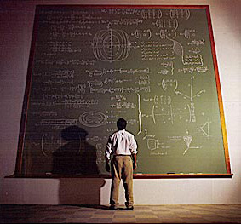
A tale of two proof techniques
In a formal proof, each step of the proof clearly follows from the postulates and axioms assumed in the conjecture.
Statements that are assumed to be true
In an informal proof, one step in the proof may consist of multiple derivations, portions of the proof may be skipped or assumed correct, and axioms may not be explicitly stated.
Notes:
Formal proofs: Types of proof made by machines. Every step is explicit.
Informal proofs: Types of proof made by people. Often not totally explicit.

Slide 8
How can we formalize an argument?
Consider the following argument:
“If you have an account, you can access the network”
“You have an account”
Therefore,
“You can access the network”
Premises
Conclusion
This argument seems valid, but how can we demonstrate this formally??

Slide 9
Let’s analyze the form of our argument
p
q
“If you have an account, then you can access the network”
“You have an account”
Therefore,
“You can access the network”
This is called a “rule of inference”
p → q
p
∴ q
Notes:
Could use truth tables but this is cumbersome. Instead, can use rules of inference.

Slide 10
Rules of inference are logically valid ways to draw conclusions when constructing a formal proof
The previous rule is called modus ponens
  Rule of inference:
  Informally: Given an implication p → q, if we know that p is true, then q is also true
But why can we trust modus ponens?
  Tautology: ((p → q) ∧ p) → q
  Truth table:
p → q
p
∴ q
p | q | p→q
T | T | T
T | F | F
F | T | T
F | F | T
Any time that p→q and p are both true, q is also true!

Slide 11
There are lots of other rules of inference that we can use!
Addition
  Tautology: p → (p ∨ q)
  Rule of inference:
  Example: “It is raining now, therefore it is raining now or it is snowing now.”
Simplification
  Tautology: p ∧ q → p
  Rule of inference:
  Example: “It is cold outside and it is snowing. Therefore, it is cold outside.”
p
∴ p ∨ q
p ∧ q
∴ p
Notes:
[Addition]
P = T
p v q
p v T = T
[Simplification]
p ^ q In order to be true p=T and q=T
So, we can deduce p

Slide 12
There are lots of other rules of inference that we can use!
Modus tollens
  Tautology: [¬q ∧ (p → q)] → ¬p
  Rule of inference:
  Example: “If I am hungry, then I will eat. I am not eating. Therefore, I am not hungry.”
Hypothetical syllogism
  Tautology: [(p → q) ∧ (q → r)] → (p → r)
  Rule of inference:
  Example: “If I eat a big meal, then I feel full. If I feel full, then I am happy. Therefore, if I eat a big meal, then I am happy.”
p → q
¬q
∴ ¬p
(p → q)
(q → r)
∴ (p → r)
Notes:
[Modus Tollens]
[Op1]
~q is True --> q is False
p → q is True --> p → q is True --> p → F is True --> p is False --> ~p is True
[Op2]
~q ^ (~p v q) Distributive
(~q ^ ~p) v (~q ^ q) Negation law
(~q ^ ~p) v F Identity law
(~q ^ ~p) Commutative
(~p ^ ~q) Simplification
~p

Slide 13
In-class Activities
Activity 1: Which rule of inference was used to make the following argument?
​
"Kangaroos live in Australia and are marsupials. Therefore, kangaroos are marsupials.”
Disjunctive syllogism
Modus tollens
Simplification
Modus ponens
Submit on
AhaSlides
Notes:
Act 1 or 2, if time allows Act 3

Slide 14
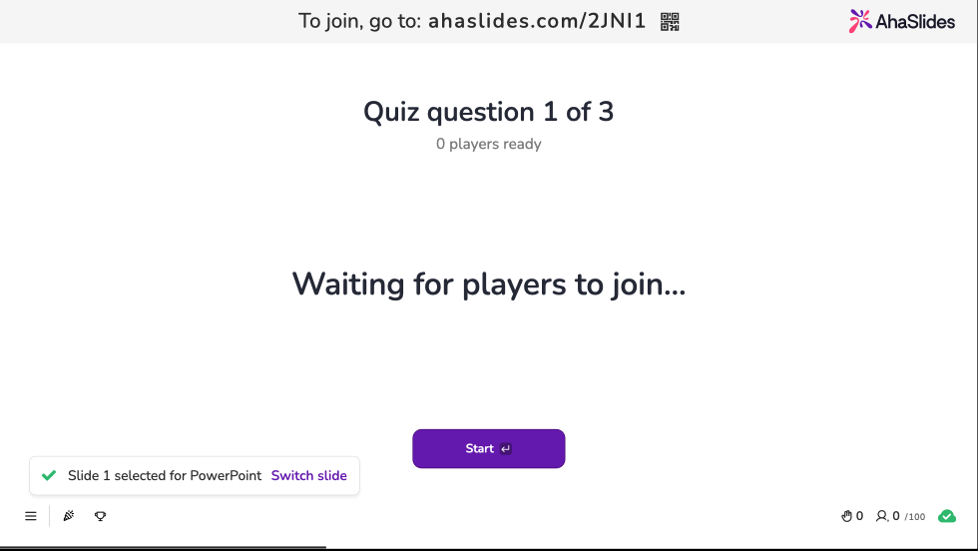
Notes:
Act 1 or 2, if time allows Act 3

Slide 15
There are lots of other rules of inference that we can use!
Disjunctive syllogism
  Tautology: [¬p ∧ (p ∨ q)] → q
  Rule of inference:
  Example: “Either the heat is broken, or I have a fever. The heat is not broken, therefore I have a fever.”
Conjunction
  Tautology: [(p) ∧ (q)] → (p ∧ q)
  Rule of inference:
  Example: “Jack is tall. Jack is skinny. Therefore, Jack is tall and skinny.”
p ∨ q
¬p
∴ q
p
q
∴ (p ∧ q)
Notes:
[Disjunctive Syllogism]
[op1]
~p is True --> p is False
p v q is True --> F v q is True --> q is True
[op2]
~p ^ (p v q) Distributive
(~p ^ p) v (~p ^ q) Negation Law
F v (~p ^ q) Domination Law
(~p ^ q) Simplification
q
[Conjunction]
If p = T and q=T, we can deduce that p ^ q = True also.

Slide 16
There are lots of other rules of inference that we can use!
Resolution
  Tautology: [(p ∨ q) ∧ (¬p ∨ r)] → (q ∨ r)
  Rule of inference:
  Example: “If it is not raining, I will ride my bike. If it is raining, I will lift weights. Therefore, I will ride my bike or lift weights”
Special cases:
  If r = q, we get
  If r = F, we get
p ∨ q
¬p ∨ r
∴ q ∨ r
p ∨ q
¬p ∨ q
∴ q
p ∨ q
¬p
∴ q
Notes:
p v q is True
~p v r is True

Slide 17
In-class Activities
Activity 2: Which rule of inference was used to make the following argument?
​
"Adna is an excellent swimmer. If Adna is an excellent swimmer, then she can work as a lifeguard. Therefore, Adna can work as a lifeguard.”
Disjunctive syllogism
Modus tollens
Simplification
Modus ponens
Submit on
AhaSlides
Notes:
Act 1 or 2, if time allows Act 3

Slide 18
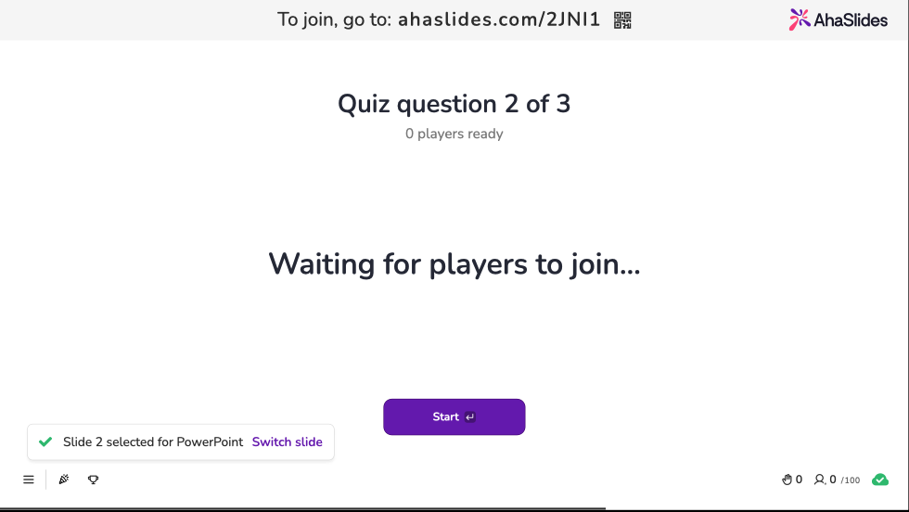
Notes:
Act 1 or 2, if time allows Act 3

Slide 19
We can use rules of inference to build valid arguments
If it is raining, I will stay inside. If I am inside, Lisa will stay home. If Lisa stays home and it is a Saturday, then we will play video games. Today is Saturday. It is raining.
Let:
  r ≡ It is raining
  i ≡ I am inside
  l ≡ Lisa will stay home
  p ≡ we will play video games
  s ≡ it is Saturday
Hypotheses:
  r → i
  i → l
  (l ∧ s) → p
  s
  r

Slide 20
We can use rules of inference to build valid arguments
Let:
  r ≡ It is raining
  i ≡ I am inside
  l ≡ Lisa will stay home
  p ≡ we will play video games
  s ≡ it is Saturday
Step:
  r → i hypothesis
  i → l hypothesis
  r → l hypothetical syllogism with 1 and 2
  r hypothesis
  l modus ponens with 3 and 4
  s hypothesis
  l ∧ s conjunction of 5 and 6
  (l ∧ s) → p hypothesis
  p modus ponens with 7 and 8
Hypotheses:
  r → i
  i → l
  (l ∧ s) → p
  s
  r
I will play
video games!

Slide 21
We also have rules of inference for statements with quantifiers
Universal Instantiation
  Intuition: If we know that P(x) is true for all x, then P(c) is true for a particular c
  Rule of inference:
Universal Generalization
  Intuition: If we can show that P(c) is true for an arbitrary c, then we can conclude that P(x) is true for any specific x
  Rule of inference:
∀x P(x)
∴ P(c)
P(c)
∴ ∀xP(x)
P(c) is True for all elements c in its domain
Note that “arbitrary” does not mean “randomly chosen.” It means that we cannot make any assumptions about c other than the fact that it comes from the appropriate domain.
Notes:
Example about even numbers to explain “arbitrary”

Slide 22
We also have rules of inference for statements with quantifiers
Existential Instantiation
  Intuition: If we know that ∃x P(x) is true, then we know that P(c) is true for some c
  Rule of inference:
Existential Generalization
  Intuition: If we can show that P(c) is true for a particular c, then we can conclude that ∃x P(x) is true
  Rule of inference:
∃x P(x)
∴ P(c)
Again, we cannot make assumptions about c other than the fact that it exists and is from the appropriate domain.
P(c)
∴ ∃xP(x)

Slide 23
In-class Activities
Activity 3: Put the proof steps in order. Introduce each premise immediately before using it.
​
Premises: Someone won the jackpot. Everyone who wins the jackpot is rich.
​
Prove: Someone is rich.
​
J(x) ≡ x won the jackpot
R(x) ≡ x is rich
R(s); modus ponens
∃x R(x); existential generalization
J(s) → R(s); universal instantiation
∃x J(x); premise
∀x (J(x) → R(x)); premise
J(s); existential instantiation
Steps:
Introduce to a classmate
Work in pairs on the exercise
Submit answers
Submit on
AhaSlides
Notes:
Act 1 or 2, if time allows Act 3

Slide 24
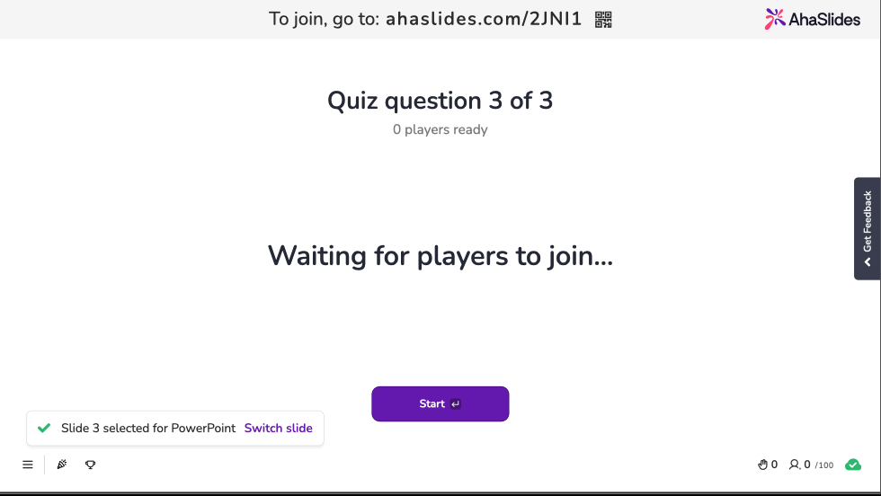
Notes:
If time allows Act 3

Slide 25
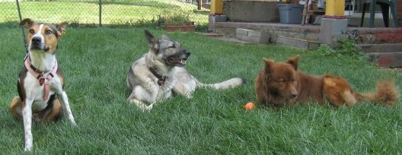
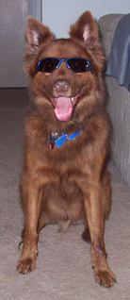
Hungry dogs redux
Given: Kody is one
of my dogs
M(Kody)
Given: All of my dogs like peanut butter
M(x)
P(x)
∀x [M(x) → P(x)] hypothesis
M(Kody) hypothesis
M(Kody) → P(Kody) universal instantiation from 1
P(Kody) modus ponens from 2 and 3

Slide 26
Reasoning about our class
Show that the premises “A student in this class has not read the book” and “everyone in this class turned in HW1” imply the conclusion “Someone who turned in HW1 has not read the book.”
Let:
  C(x) ≡ x is in this class
  B(x) ≡ x has read the book
  T(x) ≡ x turned in HW1
Premises:
  ∃x [C(x) ∧ ¬B(x)]
  ∀x [C(x) → T(x)]

Slide 27
Reasoning about our class
Let:
  C(x) ≡ x is in this class
  B(x) ≡ x has read the book
  T(x) ≡ x turned in HW1
Steps:
  ∃x [C(x) ∧ ¬B(x)] hypothesis
  C(a) ∧ ¬B(a) existential instantiation from 1
  C(a) simplification from 2
  ∀x [C(x) → T(x)] hypothesis
  C(a) → T(a) universal instantiation from 4
  T(a) modus ponens from 5 and 3
  ¬B(a) simplification from 2
  T(a) ∧ ¬B(a) conjunction of 6 and 7
  ∃x [T(x) ∧ ¬B(x)] existential generalization from 8
Premises:
  ∃x [C(x) ∧ ¬B(x)]
  ∀x [C(x) → T(x)]

Slide 28

In-class Activities
Activity 4: Solve The Case of the Missing Laptop activity [miro]
Activity 5: Show that the premises “Everyone in this discrete math class has taken a course in computer science” and “Chike is a student in this discrete math class” lead to the conclusion “Chike has taken a course in computer science.” [miro]
Submit on
Steps:
Introduce to a classmate
Work in pairs on the exercise
Submit answers on miro
Volunteers to share answers
Notes:
Act 5

Slide 29
Final Thoughts
Until today, we had look at representing different types of logical statements
Rules of inference allow us to derive new results by reasoning about known truths
Next time:
  Proof techniques
  Please read section 1.8

