Slide 1

CS 441: Proof Methods
PhD. Nils Murrugarra-Llerena
nem177@pitt.edu

Slide 2


Muddiest Point
What was the most confusing or 'muddiest' point from previous lectures? or What topic do you need more clarification on?
Submit on
AhaSlides
https://classroomclipart.com/
https://classroomclipart.com/
Notes:
https://classroomclipart.com/

Slide 3
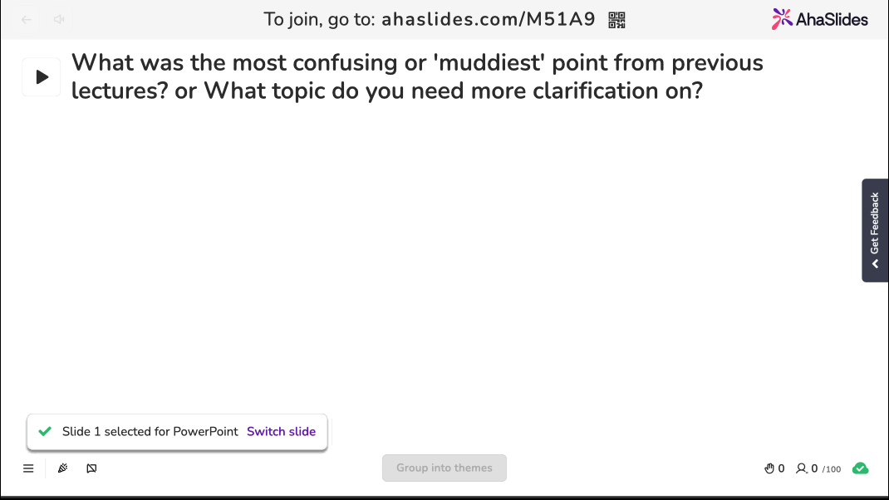
Notes:
https://classroomclipart.com/

Slide 4

Today's topics
Proof techniques
  Proof by exhaustion
  Proof by cases
  Existence proofs
  Uniqueness proofs

Slide 5
Not all theorems are of the form p → q
Sometimes, we need to prove a theorem of the form:
p₁ ∨ p₂ ∨ … ∨ p_{n} → q
Note: (p₁ ∨ p₂ ∨ … ∨ p_{n})→ q
≡ ¬(p₁ ∨ p₂ ∨ … ∨ p_{n}) ∨ q
≡ (¬p₁ ∧ ¬p₂ ∧ … ∧ ¬p_{n}) ∨ q
≡ (¬p₁ ∨ q) ∧ (¬p₂ ∨ q) ∧ … ∧ (¬p_{n} ∨ q)
≡ (p₁ → q) ∧ (p₂ →q) ∧ … ∧ (p_{n} → q)
So, we might need to examine multiple cases!
Distributive law
Notes:
Good for small numbers of cases (human based), not large numbers of cases (computer based).

Slide 6
Prove that n² + 1 ≥ 2n where n is a positive integer with 1 ≤ n ≤ 4
Proof:
  n = 1: (1)² + 1 = 2, 2(1) = 2, and 2 ≥ 2
  n = 2: (2)² + 1 = 5, 2(2) = 4, and 5 ≥ 4
  n = 3: (3)² + 1 = 10, 2(3) = 6, and 10 ≥ 6
  n = 4: (4)² + 1 = 17, 2(4) = 8, and 17 ≥ 8
Since we have verified each case, we have shown that n² + 1 ≥ 2n where n is a positive integer with 1 ≤ n ≤ 4. ☐
With only 4 cases to consider, exhaustive proof was a good choice!

Slide 7
Sometimes, exhaustive proof isn’t an option, but we still need to examine multiple possibilities
Example: Prove the triangle inequality. That is, if x and y are real numbers, then |x| + |y| ≥ |x + y|.
Clearly, we can’t use exhaustive proof here since there are infinitely many real numbers to consider.
We also can’t use a simple direct proof either, since our proof depends on the signs of x and y.
What should we do?
Notes:
Proof by cases, based on the SIGNs of x and y

Slide 8
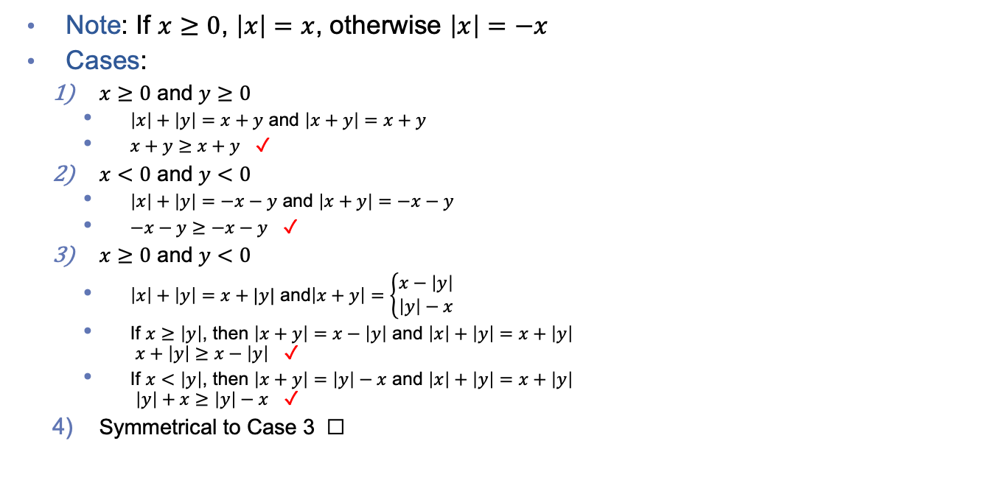
Example: Prove that if x and y are real numbers, then |x| + |y| ≥ |x + y|.
Note: If $x≥0$, $\left|x\right|=x$, otherwise $\left|x\right|=−x$
Cases:
  $x≥0$ and $y≥0$
    $\left|x\right|+\left|y\right|=x+y$ and $\left|x+y\right|=x+y$
    $x+y≥x+y$ ✓
  $x<0$ and $y<0$
    $\left|x\right|+\left|y\right|=−x−y$ and $\left|x+y\right|=−x−y$
    $−x−y≥−x−y$ ✓
  $x≥0$ and $y<0$
    $\left|x\right|+\left|y\right|=x+|y|$ and$\left|x+y\right|=\left\{\begin{matrix}x−\left|y\right| \\ \left|y\right|−x\end{matrix}\right.$
    If $x≥\left|y\right|$, then $\left|x+y\right|=x−\left|y\right|$ and $\left|x\right|+\left|y\right|=x+\left|y\right|$
    $x+\left|y\right|≥x−\left|y\right|$ ✓
    If $x<\left|y\right|$, then $\left|x+y\right|=\left|y\right|−x$ and $\left|x\right|+\left|y\right|=x+\left|y\right|$
    $\left|y\right|+x≥\left|y\right|−x$ ✓
  Symmetrical to Case 3 ☐
Notes:
For #3, add examples in the board
[Case 1]
x = 3
y = -2
|x|+|y| >= |x+y|
3 + 2 >= |3-2|
5 >= |1|
5 >= 1 (T)
Ask students for different test cases …
[Case 2]
x = 3
y = -4
|x|+|y| >= |x+y|
3 + 4 >= |3-4|
7 >= |-1|
7 >= 1 (T)
No change on |x|+|y|, some changes on |x+y|
|x|+|y| --> x+|y|
|x+y| -->
Case 1: x - |y| when happens this situation? |x+y| >= 0 --> x - |y| >=0 --> x >= |y|
Case 2: |y| - x when happens this situation? |x+y| >= 0 --> |y| - x >=0 --> |y| >= x --> |y| > x --> x < |y|
####
|x+y| generates a difference. How to write it?
|x|+|y| = x+|y|
For #3, we need to apply absolute value to one term, and that will generate a subtraction. Do we have any special situations?

Slide 9
Making mistakes when using proof by cases is all too easy!
Mistake 1: Proof by “a few cases” is not equivalent to proof by cases.
Example: Prove that all odd numbers are prime.
“Proof:”
  Case (i): The number 1 is both odd and prime
  Case (ii): The number 3 is both odd and prime
  Case (iii): The number 5 is both odd and prime
  Case (iv): The number 7 is both odd and prime
Thus, we have shown that odd numbers are prime. ☐
This is a “there exists” proof, not a “for all” proof!

Slide 10
Making mistakes when using proof by cases is all too easy!
Mistake 2: Leaving out critical cases.
Example: Prove that x² > 0 for all integers x
“Proof:”
  Case (i): Assume that x < 0. Since the product of two negative numbers is always positive, x² > 0.
  Case (ii): Assume that x > 0. Since the product of two positive numbers is always positive, x² > 0.
Since we have proven the claim for all cases, we can conclude that x² > 0 for all integers x. ☐
What about the case in which x = 0?

Slide 11

Notes:
[Special Cases]

Slide 12

Notes:
[Proof by Cases]

Slide 13

Sometimes we need to prove the existence of a given element
There are two ways to do this
Prove the claim by showing how to construct an example
The constructive approach
Show that it is guaranteed that such an element exists
The non-constructive approach
Notes:
Constructive: ﻿Sometimes an existence proof of ∃xP(x) can be given by finding an element a, such that P(a) is true.
Non-constructive: ﻿We do not find an element a such that P(a) is true, but rather prove that ∃xP(x) is true in some other way

Slide 14
A constructive existence proof
Prove: Show that there is a positive integer that can be written as the sum of cubes of positive integers in two different ways.
Proof: 1729 = 10³ + 9³ = 12³ + 1³ ☐
Obviously, the claim has been proven because we have shown that a specific instance of the claim is valid.
Constructive existence proofs are really just instances of “existential generalization.”

Slide 15
A non-constructive existence proof
Prove: Show that there exist two irrational numbers x and y such that x^{y} is rational.
Proof:
  We know that √2 is irrational, so let x = √2
  Case 1: If √2^{√2} is rational, then we are done! (i.e., x = y = √2)
  Case 2: If √2^{√2} is irrational, then let x = √2^{√2} and y = √2, both of which are irrational
    Now, x^{y} = (√2^{√2})^{√2} = √2² = 2, which is rational (i.e., 2 = 2/1) ☐
Note: We don’t know whether √2^{√2} is rational or irrational. However, in either case, we can use it to construct a rational number.
Notes:
Rational number: It can be represented in the form of a fraction. P/Q, where P and Q are integers, and Q ~= 0
Irrational number: It can not be represented in the form of a fraction. E.g. sqrt(2)
Examples of irrational number: sqrt(2) = 1.414…, pi = 3.14 ….,

Slide 16
Sometimes, existence is not enough, and we need to prove uniqueness
This process has two steps:
  Provide an existence proof
  Show that any other solution to the problem is equivalent to the solution generated in step 1
Example: Prove that if a and b are real numbers, then there exists a unique real number r such that ar + b = 0
Proof:
  Note that r = -b/a is a solution to this equality since
  a(-b/a) + b = -b + b = 0.
  Assume that as + b = 0
  Then as = -b, so s = -b/a = r, which means s is just r ☐
Existence
Uniqueness

Slide 17

Notes:
[Uniqueness]

Slide 18

In-class Activities
Activity 1: Prove that there exists a positive integer that is equal to the sum of all positive integers less than it. Is your proof constructive or non-constructive? [miro]
Activity 2: Prove that there is no positive integer n such that n² + n³ = 100. [miro]
Submit on
Steps:
Introduce to a classmate
Work in pairs on the exercise
Submit answers on miro
Volunteers to share answers
Notes:
Constructive or non-constructive (based on 1)
Proof by cases (independent)
At least do Act 1

Slide 19
Final Thoughts
Proving theorems is not always straightforward
Having several proof strategies at your disposal will make a huge difference in your success rate!
We are “done” with our intro to logic and proofs
Next lecture:
  Intro to set theory
  Please read sections 2.1 and 2.2

