Slide 1

[Supp] CS 2770: Linear Algebra
PhD. Nils Murrugarra-Llerena
nem177@pitt.edu

Slide 2
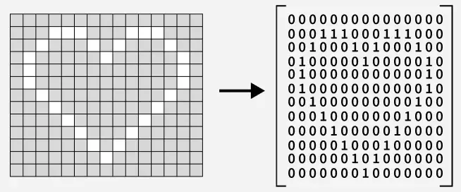
Motivation: How can we encode this image?
https://www.geeksforgeeks.org/engineering-mathematics/matrices/
Notes:
https://www.geeksforgeeks.org/engineering-mathematics/matrices/
https://www.asciiart.eu/cartoons/simpsons

Slide 3
Linear Algebra Review
See http://cs229.stanford.edu/section/cs229-linalg.pdf for more

Slide 4
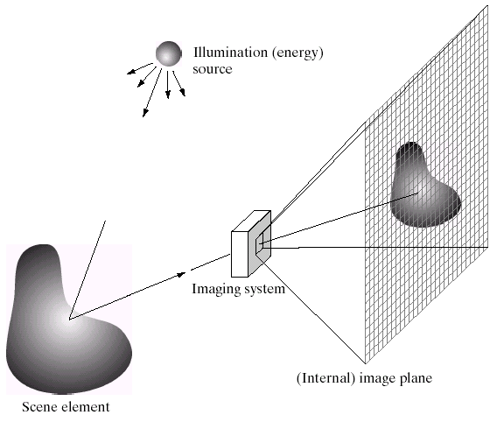
What are images? (in Python) – Image Formation
Python treats images as matrices of numbers
To proceed, let’s talk very briefly about how images are formed
Slide credit: Derek Hoiem

Slide 5
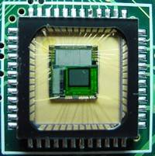
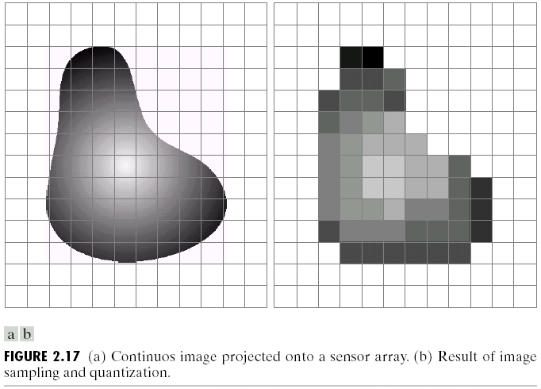
Digital Images
Sample the 2D space on a regular grid
Quantize each sample (round to nearest integer)
Slide credit: Derek Hoiem, Steve Seitz

Slide 6
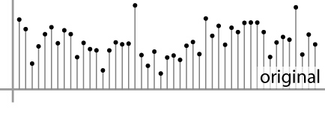

Digital Images
Sample the 2D space on a regular grid
Quantize each sample (round to nearest integer)
What does quantizing signal look like?
Image thus represented as a matrix of integer values.
6 5
5.9 4.6
1D
2D
Adapted from S. Seitz

Slide 7
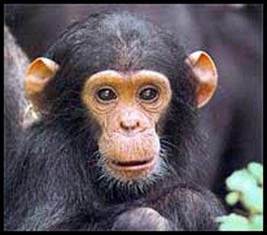
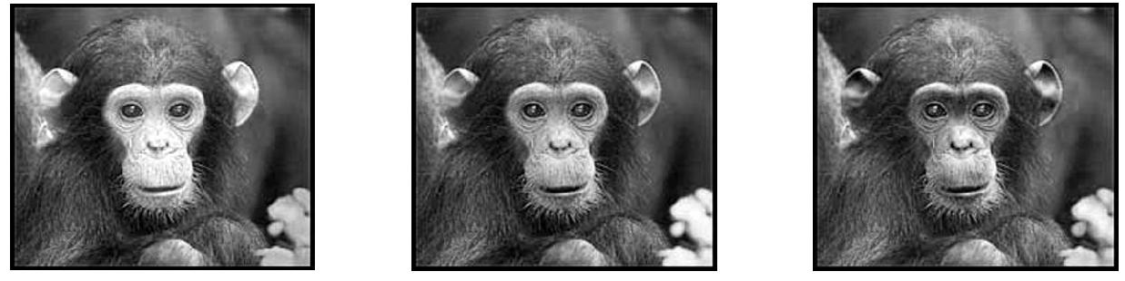
Digital Color Images
Color images, RGB color space:
Split image into three channels
R
G
B
Adapted from Kristen Grauman

Slide 8
Images in Python
Color images represented as a matrix with multiple channels (=1 if grayscale)
Suppose we have a NxM RGB image called “im”
Im[0,0,0] = top-left pixel value in R-channel
im(y, x, b) = y pixels down, x pixels to right in the b^{th} channel
im(N, M, 2) = bottom-right pixel in B-channel
cv2.imread(filename) returns a uint8 image (values 0 to 255)
column
row
R
0.92 | 0.93 | 0.94 | 0.97 | 0.62 | 0.37 | 0.85 | 0.97 | 0.93 | 0.92 | 0.99
0.95 | 0.89 | 0.82 | 0.89 | 0.56 | 0.31 | 0.75 | 0.92 | 0.81 | 0.95 | 0.91
0.89 | 0.72 | 0.51 | 0.55 | 0.51 | 0.42 | 0.57 | 0.41 | 0.49 | 0.91 | 0.92
0.96 | 0.95 | 0.88 | 0.94 | 0.56 | 0.46 | 0.91 | 0.87 | 0.90 | 0.97 | 0.95
0.71 | 0.81 | 0.81 | 0.87 | 0.57 | 0.37 | 0.80 | 0.88 | 0.89 | 0.79 | 0.85
0.49 | 0.62 | 0.60 | 0.58 | 0.50 | 0.60 | 0.58 | 0.50 | 0.61 | 0.45 | 0.33
0.86 | 0.84 | 0.74 | 0.58 | 0.51 | 0.39 | 0.73 | 0.92 | 0.91 | 0.49 | 0.74
0.96 | 0.67 | 0.54 | 0.85 | 0.48 | 0.37 | 0.88 | 0.90 | 0.94 | 0.82 | 0.93
0.69 | 0.49 | 0.56 | 0.66 | 0.43 | 0.42 | 0.77 | 0.73 | 0.71 | 0.90 | 0.99
0.79 | 0.73 | 0.90 | 0.67 | 0.33 | 0.61 | 0.69 | 0.79 | 0.73 | 0.93 | 0.97
0.91 | 0.94 | 0.89 | 0.49 | 0.41 | 0.78 | 0.78 | 0.77 | 0.89 | 0.99 | 0.93
G
0.92 | 0.93 | 0.94 | 0.97 | 0.62 | 0.37 | 0.85 | 0.97 | 0.93 | 0.92 | 0.99
0.95 | 0.89 | 0.82 | 0.89 | 0.56 | 0.31 | 0.75 | 0.92 | 0.81 | 0.95 | 0.91
0.89 | 0.72 | 0.51 | 0.55 | 0.51 | 0.42 | 0.57 | 0.41 | 0.49 | 0.91 | 0.92
0.96 | 0.95 | 0.88 | 0.94 | 0.56 | 0.46 | 0.91 | 0.87 | 0.90 | 0.97 | 0.95
0.71 | 0.81 | 0.81 | 0.87 | 0.57 | 0.37 | 0.80 | 0.88 | 0.89 | 0.79 | 0.85
0.49 | 0.62 | 0.60 | 0.58 | 0.50 | 0.60 | 0.58 | 0.50 | 0.61 | 0.45 | 0.33
0.86 | 0.84 | 0.74 | 0.58 | 0.51 | 0.39 | 0.73 | 0.92 | 0.91 | 0.49 | 0.74
0.96 | 0.67 | 0.54 | 0.85 | 0.48 | 0.37 | 0.88 | 0.90 | 0.94 | 0.82 | 0.93
0.69 | 0.49 | 0.56 | 0.66 | 0.43 | 0.42 | 0.77 | 0.73 | 0.71 | 0.90 | 0.99
0.79 | 0.73 | 0.90 | 0.67 | 0.33 | 0.61 | 0.69 | 0.79 | 0.73 | 0.93 | 0.97
0.91 | 0.94 | 0.89 | 0.49 | 0.41 | 0.78 | 0.78 | 0.77 | 0.89 | 0.99 | 0.93
B
0.92 | 0.93 | 0.94 | 0.97 | 0.62 | 0.37 | 0.85 | 0.97 | 0.93 | 0.92 | 0.99
0.95 | 0.89 | 0.82 | 0.89 | 0.56 | 0.31 | 0.75 | 0.92 | 0.81 | 0.95 | 0.91
0.89 | 0.72 | 0.51 | 0.55 | 0.51 | 0.42 | 0.57 | 0.41 | 0.49 | 0.91 | 0.92
0.96 | 0.95 | 0.88 | 0.94 | 0.56 | 0.46 | 0.91 | 0.87 | 0.90 | 0.97 | 0.95
0.71 | 0.81 | 0.81 | 0.87 | 0.57 | 0.37 | 0.80 | 0.88 | 0.89 | 0.79 | 0.85
0.49 | 0.62 | 0.60 | 0.58 | 0.50 | 0.60 | 0.58 | 0.50 | 0.61 | 0.45 | 0.33
0.86 | 0.84 | 0.74 | 0.58 | 0.51 | 0.39 | 0.73 | 0.92 | 0.91 | 0.49 | 0.74
0.96 | 0.67 | 0.54 | 0.85 | 0.48 | 0.37 | 0.88 | 0.90 | 0.94 | 0.82 | 0.93
0.69 | 0.49 | 0.56 | 0.66 | 0.43 | 0.42 | 0.77 | 0.73 | 0.71 | 0.90 | 0.99
0.79 | 0.73 | 0.90 | 0.67 | 0.33 | 0.61 | 0.69 | 0.79 | 0.73 | 0.93 | 0.97
0.91 | 0.94 | 0.89 | 0.49 | 0.41 | 0.78 | 0.78 | 0.77 | 0.89 | 0.99 | 0.93
Adapted from Derek Hoiem

Slide 9

Vectors and Matrices
9
Vectors and matrices are just collections of ordered numbers that represent something: movements in space, scaling factors, word counts, movie ratings, pixel brightness, etc.
We’ll define some common uses and standard operations on them.

Slide 10
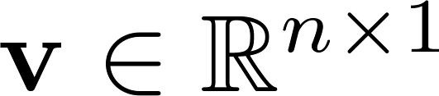
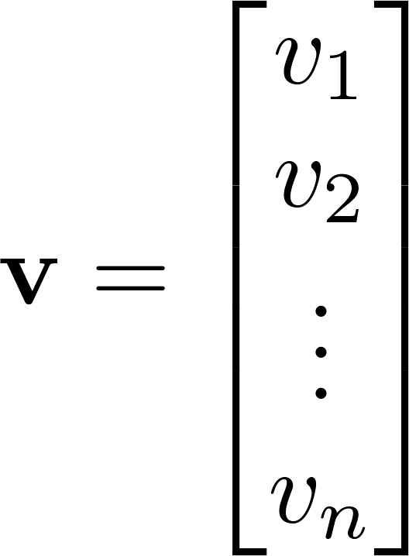
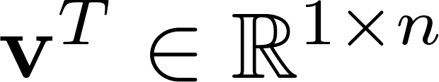
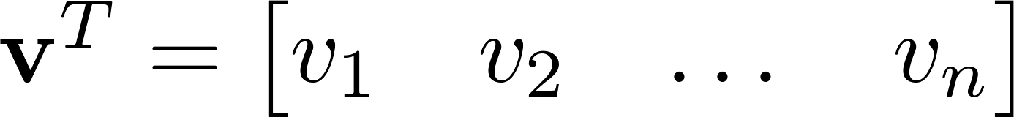

Vector
A column vector where
A row vector where
denotes the transpose operation

Slide 11
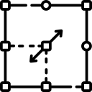
Vector
You’ll want to keep track of the orientation of your vectors when programming in Python.
You can transpose a vector V in Python by writing V.T.

Slide 12
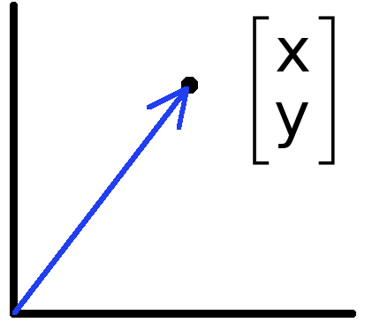
Vectors have two main uses
Data can also be treated as a vector
Such vectors don’t have a geometric interpretation, but calculations like “distance” still have value
Vectors can represent an offset in 2D or 3D space
Points are just vectors from the origin

Slide 13
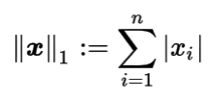
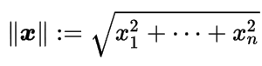
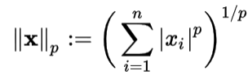
Norms
L1 norm
L2 norm
L^{p} norm (for real numbers p ≥ 1)

Slide 14

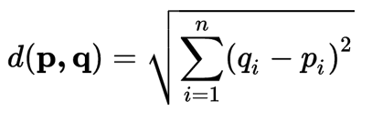
Distances
L1 (Manhattan) distance
L2 (Euclidean) distance

Slide 15
Example: feature representation
A vector representing measurable characteristics of a data sample we have.
E.g. a glass of juice can be represented via its color = {yellow=1, red=2, green=3, purple=4} and taste = {sweet=1, sour=2}
A given glass i can be represented as a vector: x_{i} = [3 2] represents green , sour juice
For D features, this defines a D-dimensional space where we can measure similarity between samples

Slide 16
Example: Feature representation
L2 distance:
d(x1, x2) = sqrt(4+0)
d(x1, x3) = sqrt(0+1)
d(x2, x3) = sqrt(4+1)
L1 distance:
d(x1, x2) = 2+0
d(x1, x3) = 0+1
d(x2, x3) = 2+1
E.g. a glass of juice can be represented via its color = {yellow=1, red=2, green=3, purple=4} and taste = {sweet=1, sour=2}
2
1
x1 = [1 2]
x2 = [3 2]
taste
x3 = [1 1]
0 1 2 3 4
color

Slide 17
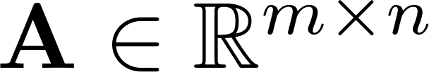
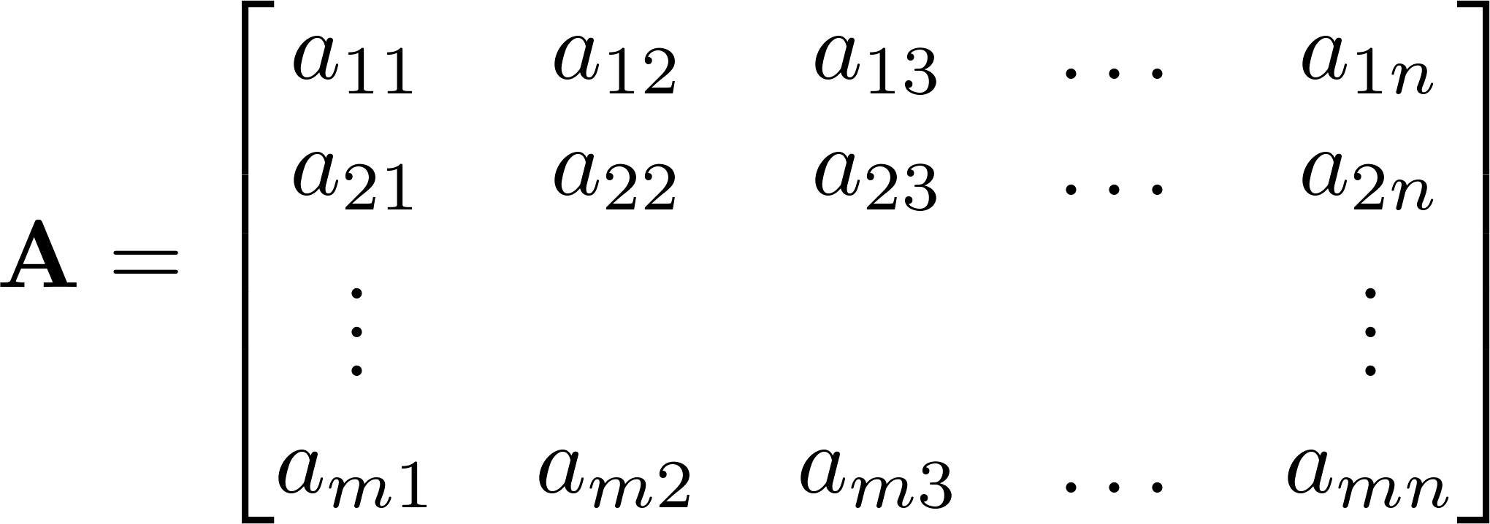



Matrix
A matrix is an array of numbers with size $m↓$ by $n→$, i.e. m rows and n columns.
If , we say that is square.

Slide 18
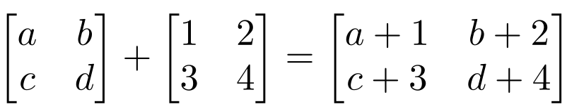
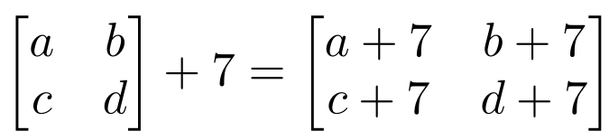
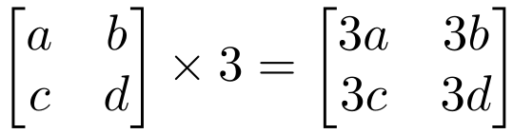
Matrix Operations
Addition
Can only add a matrix with matching dimensions, or a scalar.
Scaling

Slide 19
Matrix Multiplication
Let X be an axb matrix, Y be an bxc matrix
Then Z = X*Y is an axc matrix
Second dimension of first matrix, and first dimension of second matrix have to be the same, for matrix multiplication to be possible

Slide 20
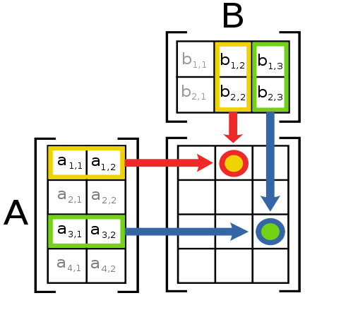
Matrix Multiplication
The product AB is:
Each entry in the result is (that row of A) dot product with (that column of B)

Slide 21
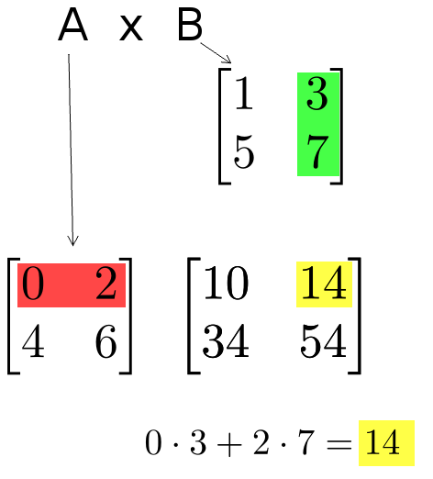
Matrix Multiplication
Example:
Each entry of the matrix product is made by taking the dot product of the corresponding row in the left matrix, with the corresponding column in the right one.

Slide 22
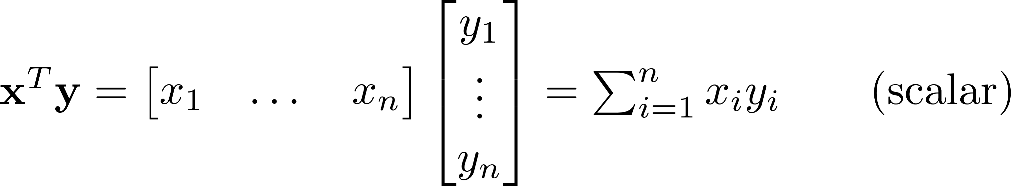
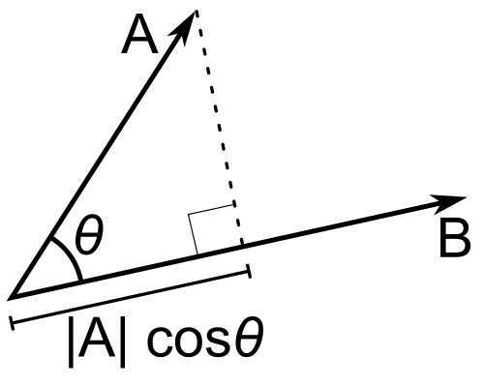
Inner Product
Multiply corresponding entries of two vectors and add up the result
x·y is also |x||y|Cos( angle between x and y )
If B is a unit vector, then A·B gives the length of A which lies in the direction of B (projection)
(if B is unit-length hence norm is 1)

Slide 23
Different Types of Product
x, y = column vectors (nx1)
X, Y = matrices (mxn)
x, y = scalars (1x1)
x^{T} y = x · y = inner product (1xn x nx1 = scalar)
x ⊗ y = x y^{T} = outer product (nx1 x 1xn = matrix)
X * Y = matrix product
X .* Y = element-wise product

Slide 24
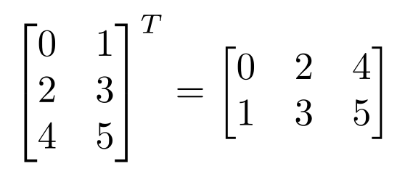
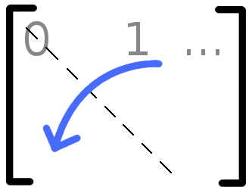

Matrix Operations
Transpose – flip matrix, so row 1 becomes column 1
A useful identity:

Slide 25
Matrix Operation Properties
Matrix addition is commutative and associative
A + B = B + A
A + (B + C) = (A + B) + C
Matrix multiplication is associative and distributive but not commutative
A(B*C) = (A*B)C
A(B + C) = A*B + A*C
A*B != B*A

Slide 26
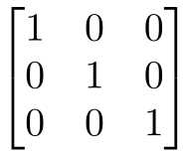
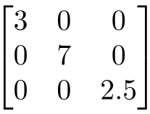
Special Matrices
Identity matrix I
Square matrix, 1’s along diagonal, 0’s elsewhere
I ∙ [another matrix] = [that matrix]
Diagonal matrix
Square matrix with numbers along diagonal, 0’s elsewhere
A diagonal ∙ [another matrix] scales the rows of that matrix

Slide 27
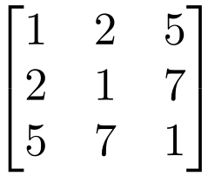

Special Matrices
Symmetric matrix
Fei-Fei Li

Slide 28
Python tutorial Setup Conda Environment: https://canvas.pitt.edu/courses/350892/pages/setup-conda-environment?module_item_id=6256065

Slide 29

Python Tutorial Duration: 60 min https://github.com/nineil-pitt/cs2770_spri26/tree/main/supp/lab_1_python

Slide 30


