Slide 1

CS 441: Set Identities
PhD. Nils Murrugarra-Llerena
nem177@pitt.edu

Slide 2

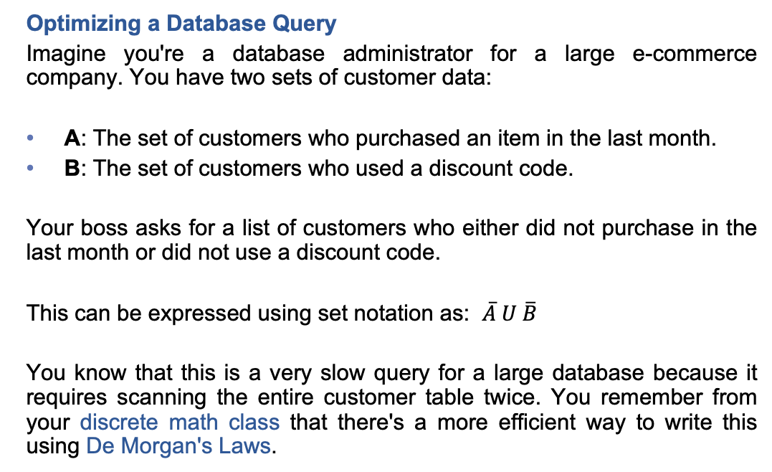
[Key CS Link] Set Identities
Optimizing a Database Query
Imagine you're a database administrator for a large e-commerce company. You have two sets of customer data:
A: The set of customers who purchased an item in the last month.
B: The set of customers who used a discount code.
Your boss asks for a list of customers who either did not purchase in the last month or did not use a discount code.
This can be expressed using set notation as: $\overline{A} U \overline{B}$
You know that this is a very slow query for a large database because it requires scanning the entire customer table twice. You remember from your discrete math class that there's a more efficient way to write this using De Morgan's Laws.
Source: Gemini
Notes:
Source: Gemini
###
The Set Identity Proof
De Morgan's First Law states: ~(A∩B)=~A ∪ ~B
This identity tells you that the two expressions are logically equivalent.
Start with the original, inefficient query: ~A∪~B (customers who did not purchase OR did not use a discount).
Apply De Morgan's Law: You can directly substitute the right side of the identity with the left side.
~A∪~B=~(A∩B)
Translate to a more efficient query:
The expression ~(A∩B) means "the set of customers who are NOT in the intersection of A and B."
The intersection, A∩B, represents the small, manageable set of customers who both purchased in the last month AND used a discount code.
The Proof's Payoff: The optimized query is to first find the small set of customers in the intersection (A∩B) and then find everyone else ~(A∩B). This is much faster than the original query, which required scanning for two large groups of customers and then combining them.
This example proves that set identities are not just abstract rules; they are powerful tools for optimizing real-world algorithms and database queries. Understanding these identities can directly lead to writing more efficient code and building faster software systems.

Slide 3

Today's topics
Set Identities
  Methods of proof
  Relationships to logical equivalences

Slide 4
Set identities help us manipulate complex expressions
Recall from last lecture that set operations have a striking resemblance to logical operations
  Disjunction (∨) and set union (∪)
  Conjunction (∧) and set intersection (∩)
  Negation (¬) and complement ( )
Just as logical equivalences helped us manipulate logical expressions, set identities help us simplify and understand complex set definitions.

Slide 5
Some important set identities
Identity | Name
A ∪ ∅ = A A ∩ U = A | Identity laws
A ∪ U = U A ∩ ∅ = ∅ | Domination laws
A ∪ A = A A ∩ A = A | Idempotent laws
A = A | Complementation law
A ∪ B = B ∪ A A ∩ B = B ∩ A | Commutative laws
A ∪ (B ∪ C) = (A ∪ B) ∪ C A ∩ (B ∩ C) = (A ∩ B) ∩ C | Associative laws
Note that set difference is not commutative nor associative!

Slide 6
Some important set identities
Identity | Name
A ∩ (B ∪ C) = (A ∩ B) ∪ (A ∩ C) A ∪ (B ∩ C) = (A ∪ B) ∩ (A ∪ C) | Distributive laws
A ∪ B = A ∩ B A ∩ B = A ∪ B | DeMorgan’s laws
A ∪ (A ∩ B) = A A ∩ (A ∪ B) = A | Absorption laws
A ∪ A = U A ∩ A = ∅ | Complement laws

Slide 7
There are many ways to prove set identities
Today, we’ll discuss four common methods:
  Membership tables
    Similar to using truth tables to prove logical equivalence.
  Logical argument (“mutual subset” method)
    Similar to the biconditional method for proving logical equivalence.
  Using set builder notation
    (No direct comparison to equivalences.)
  Applying other known set identities
    Similar to using existing logical equivalences to prove new ones.

Slide 8
Membership tables allow us to write proofs like we did using truth tables!
The membership table for an expression has columns for sub-expressions and rows to indicate the ways in which an arbitrary element may or may not be included.
Example: A membership table for set intersection
A | B | A ∩ B
1 | 1 | 1
1 | 0 | 0
0 | 1 | 0
0 | 0 | 0
An element is in A ∩ B iff it is in both A and B

Slide 9
Prove that A ∩ (B ∪ C) = (A ∩ B) ∪ (A ∩ C)
A | B | C | B∪C | A ∩ (B ∪ C) | A ∩ B | A ∩ C | (A ∩ B) ∪ (A ∩ C)
1 | 1 | 1 | 1 | 1 | 1 | 1 | 1
1 | 1 | 0 | 1 | 1 | 1 | 0 | 1
1 | 0 | 1 | 1 | 1 | 0 | 1 | 1
1 | 0 | 0 | 0 | 0 | 0 | 0 | 0
0 | 1 | 1 | 1 | 0 | 0 | 0 | 0
0 | 1 | 0 | 1 | 0 | 0 | 0 | 0
0 | 0 | 1 | 1 | 0 | 0 | 0 | 0
0 | 0 | 0 | 0 | 0 | 0 | 0 | 0
Since the appropriate columns of the membership table are the same, we can conclude that A ∩ (B ∪ C) = (A ∩ B) ∪ (A ∩ C). ❏

Slide 10
Sometimes, it’s easier to make a logical argument about a set identity
Recall: A = B iff A ⊆ B and B ⊆ A
As a result, we can prove a set identity by arguing that each side of the equality is a subset of the other.
Example: Prove that A ∩ B = A ∪ B
First prove that A ∩ B ⊆ A ∪ B
Then prove that A ∪ B ⊆ A ∩ B
Let’s see how this is done…
  Compare this mutual subset method to the biconditional (mutual implication) method!

Slide 11
Prove that A ∩ B = A ∪ B
First show A ∩ B ⊆ A ∪ B
  Let x be an arbitrary element of A ∩ B
  By def'n of complement, x ∉ (A ∩ B)
  By def'n of ∉, ¬(x ∈ A ∩ B)
  By def'n of intersection, ¬(x ∈ A ∧ x ∈ B)
  By DeMorgan's, ¬(x ∈ A) ∨ ¬(x ∈ B)
    In the first case, x ∉ A, so x ∈ A
    In the second case, x ∉ B, so x ∈ B
    Combining both cases, x ∈ A ∪ x ∈ B
  Thus, if x ∈ A ∩ B, then x ∈ A ∪ B
  Therefore, A ∩ B ⊆ A ∪ B

Slide 12
Prove that A ∩ B = A ∪ B
Next show A ∪ B ⊆ A ∩ B
  Let x be an arbitrary element of A ∪ B
  By def'n of union, x ∈ A ∨ x ∈ B
  By def'n of complement, x ∉ A ∨ x ∉ B
    In the first case, x ∉ A, so x cannot be in both A and B
    In the second case, x ∉ B, so x cannot be in both A and B
  Thus, if x ∈ A ∪ B, then x ∈ A ∩ B
  Therefore, A ∪ B ⊆ A ∩ B
  Since we have shown A ∩ B ⊆ A ∪ B and A ∪ B ⊆ A ∩ B, we have shown that A ∩ B = A ∪ B

Slide 13
We can use set builder notation and logical definition to make very precise proofs
Example: Prove that A ∩ B = A ∪ B
Proof:
  A ∩ B = {x | x ∉ (A ∩ B)} Def’n of complement
  = {x | ¬(x ∈ (A ∩ B))} Def’n of ∉
  = {x | ¬(x ∈ A ∧ x ∈ B)} Def’n of ∩
  = {x | ¬(x ∈ A) ∨ ¬(x ∈ B)} DeMorgan’s law
  = {x | x ∉ A ∨ x ∉ B} Def’n of ∉
  = {x | x ∈ A ∨ x ∈ B} Def’n of complement
  = {x | x ∈ A ∪ B} Def’n of ∪
  = A ∪ B Set builder notation
❏
Note that the argument here uses equivalence rather than subset (deduction), so we do not need to argue in both directions

Slide 14
We can also construct proofs by repeatedly applying known set identities
Example: Prove that A ∪ (B ∩ C) = (C ∪ B) ∩ A
Proof:
  A ∪ (B ∩ C) = A ∩ (B ∩ C) DeMorgan’s law
  = A ∩ (B ∪ C) DeMorgan’s law
  = (B ∪ C) ∩ A Commutative law
  = (C ∪ B) ∩ A Commutative law
❏
Note how similar this process is to that of proving logical equivalences using known logical equivalences.
As with set builder, only one direction is needed since we’re using equivalence at every step.

Slide 15

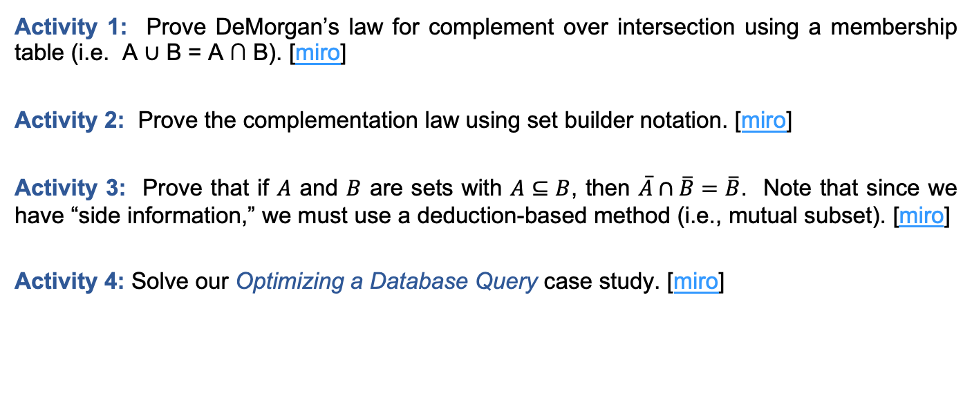
In-class Activities
Activity 1: Prove DeMorgan’s law for complement over intersection using a membership table (i.e. A ∪ B = A ∩ B). [miro]
Activity 2: Prove the complementation law using set builder notation. [miro]
Activity 3: Prove that if $A$ and $B$ are sets with $A⊆B$, then $\overline{A}∩\overline{B}=\overline{B}$. Note that since we have “side information,” we must use a deduction-based method (i.e., mutual subset). [miro]
Activity 4: Solve our Optimizing a Database Query case study. [miro]
Submit on
Steps:
Introduce to a classmate
Work in pairs on the exercise
Submit answers on miro
Volunteers to share answers
Notes:
Act 1 and Act 2

Slide 16
Final thoughts
Set identities are useful tools!
We can prove set identities in a number of (equivalent) ways
Next time:
  Functions (Section 2.3)

Slide 17
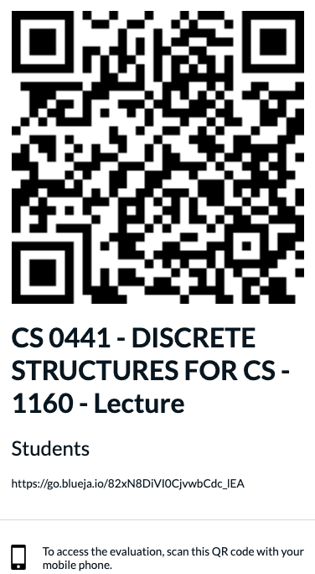

OMET Midterm Surveys
https://go.blueja.io/82xN8DiVI0CjvwbCdc_lEA

Slide 18
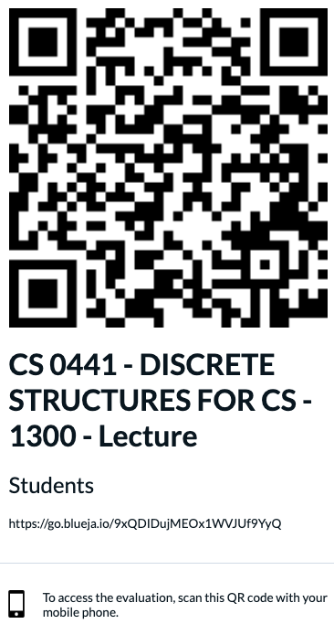
OMET Midterm Surveys
https://go.blueja.io/9xQDIDujMEOx1WVJUf9YyQ

