Slide 1

CS 441: Sequences and Summations
PhD. Nils Murrugarra-Llerena
nem177@pitt.edu

Slide 2

[Key CS Link] Summations
💻 Analyzing a Nested Loop
Consider a simple, but common, programming task: multiplying every element of an array with every other element. A naive approach would use two nested for loops. The number of operations, and thus the algorithm's runtime, can be expressed as a summation.
Here's a pseudocode example:
let n be the size of the array
count = 0
for i from 1 to n:
for j from 1 to n:
count = count + 1
Notes:
Source: Gemini

Slide 3

Today's topics
Sequences and Summations
  Specifying and recognizing sequences
  Summation notation
  Closed forms of summations

Slide 4
Sequences are ordered lists of elements
Definition: A sequence is a function from a subset of the set of integers to a set S. We use the notation a_{n} to denote the image of the integer n. a_{n} is called a term of the sequence.
Examples:
  1, 3, 5, 7, 9, 11 A sequence with 6 terms
  1, 1/2, 1/3, 1/4, 1/5, … An infinite sequence
Note: The second example can be described as the sequence {a_{n}} where a_{n} = 1/n

Slide 5

In-class Activities
Submit on
Notes:
Q1: Sequence

Slide 6
What makes sequences so special?
Question: Aren’t sequences just sets?
Answer: The elements of a sequence are members of a set, but a sequence is ordered, a set is not.
Question: How are sequences different from ordered n-tuples?
Answer: An ordered n-tuple is ordered, but always contains n elements. Sequences can be infinite!

Slide 7
Some special sequences
Geometric progressions are sequences of the form {ar^{n}} where a and r are real numbers
Examples:
  1, 1/2, 1/4, 1/8, 1/16, … a = 1, r = ½
  1, -1, 1, -1, 1, -1, … a = 1, r = -1
Arithmetic progressions are sequences of the form
{a + nd} where a and d are real numbers.
Examples:
  2, 4, 6, 8, 10, … a = 2, d = 2
  -10, -15, -20, -25, … a = -10, d = -5

Slide 8
In-class Activities
Submit on
Notes:
Q2: Arithmetic Progression
Q3: Geometric Progression

Slide 9
Sometimes we need to figure out the formula for a sequence given only a few terms
Questions to ask yourself:
  Are there runs of the same value?
  Are terms obtained by multiplying the previous value by a particular amount? (Possible geometric sequence)
  Are terms obtained by adding a particular amount to the previous value? (Possible arithmetic sequence)
  Are terms obtained by combining previous terms in a certain way?
  Are there cycles amongst terms?

Slide 10
What are the formulas for these sequences?
Problem 1: 1, 5, 9, 13, 17, …
  Arithmetic sequence with a = 1, d = 4
Problem 2: 1, 3, 9, 27, 81, …
  Geometric sequence with a = 1, r = 3
Problem 3: 2, 3, 3, 5, 5, 5, 7, 7, 7, 7, 11, 11, 11, 11, 11, …
  Sequence in which the n^{th} prime number is listed n times
Problem 4: 1, 1, 2, 3, 5, 8, 13, 21, 34, …
  Each term is the sum of the two previous terms
This is called the Fibonacci sequence.
Notes:
Think about a TH break for 2 problems

Slide 11
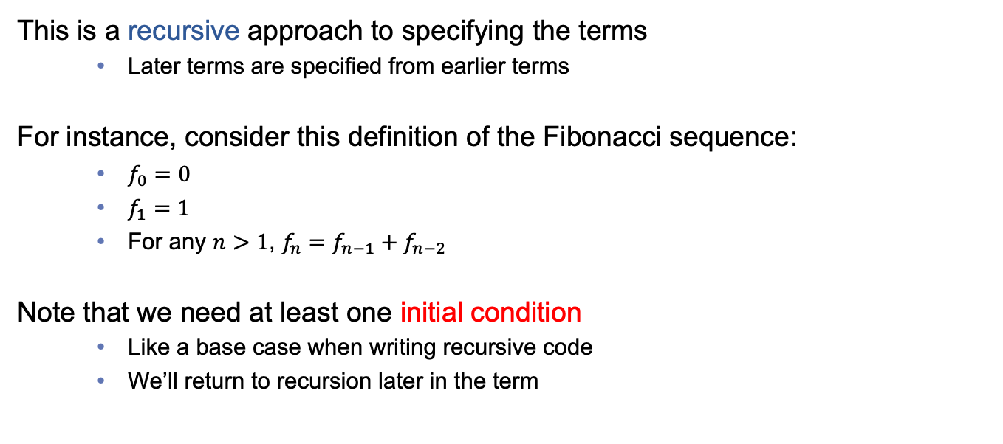
Sequences are often specified using recurrence relations
This is a recursive approach to specifying the terms
  Later terms are specified from earlier terms
For instance, consider this definition of the Fibonacci sequence:
  $f_{0}=0$
  $f_{1}=1$
  For any $n>1$, $f_{n}=f_{n−1}+f_{n−2}$
Note that we need at least one initial condition
  Like a base case when writing recursive code
  We’ll return to recursion later in the term

Slide 12
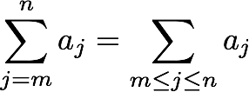
Sometimes we want to find the sum of the terms in a sequence
Summation notation lets us compactly represent the sum of terms a_{m} + a_{m+1} + … + a_{n}
Example: ∑_{1≤i≤5} i² = 1 + 4 + 9 + 16 + 25 = 55
Upper limit
Index of summation
Lower limit

Slide 13
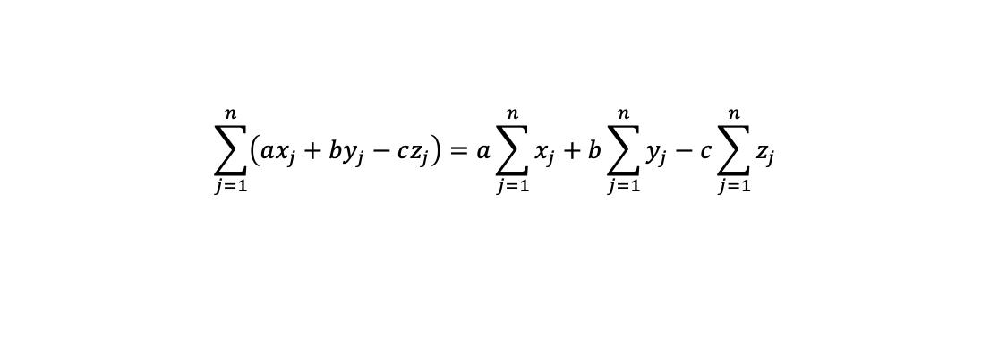
Summations are linear: The usual laws of algebra apply
$$\sum_{j=1}^{n}{\left(ax_{j}+by_{j}−cz_{j}\right)=a\sum_{j=1}^{n}{x_{j}}}+b\sum_{j=1}^{n}{y_{j}}−c\sum_{j=1}^{n}{z_{j}}$$
Constant factors can be pulled out of the summation
A summation over a sum (or difference) can be split into a sum (or difference) of smaller summations
Example:
  ∑_{1≤j≤3} (4j + j²) = (4+1) + (8+4) + (12+9) = 38
  4∑_{1≤j≤3} j + ∑_{1≤j≤3} j² = 4(1+2+3) + (1+4+9) = 38

Slide 14

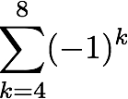
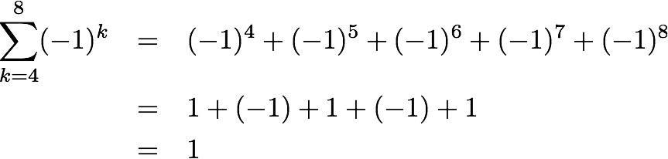
Example sums
Example: Express the sum of the first 50 terms of the sequence 1/n² for n = 1, 2, 3, …
Answer:
Example: What is the value of
Answer:

Slide 15


We can also compute the summation of the elements of some set
Example: Compute
Answer: (0 + 2) + (2 + 2) + (4 + 2) + (6 + 2) = 20
Example: Let f(x) = x³ + 1. Compute
Answer: f(1) + f(3) + f(5) + f(7) = 2 + 28 + 126 + 344 = 500

Slide 16
In-class Activities
Submit on
Notes:
Q4: Recurrence [Extra]
Q5: Summation
Q6: Summation 2 [Extra]

Slide 17
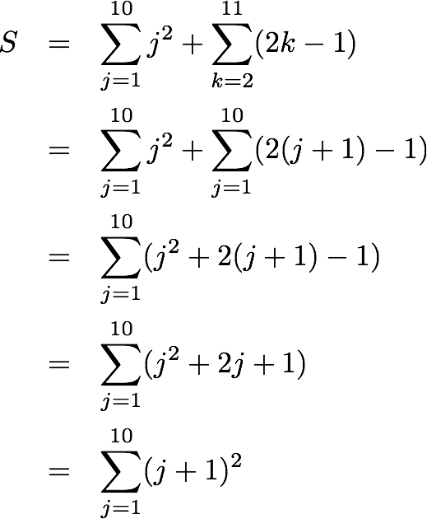
Sometimes it is helpful to shift the index of a summation
This is particularly useful when combining two or more summations. For example:
Let j = k - 1
Need to add 1 to each j
Notes:
j = k – 1
k = j + 1

Slide 18
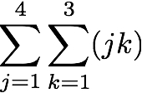
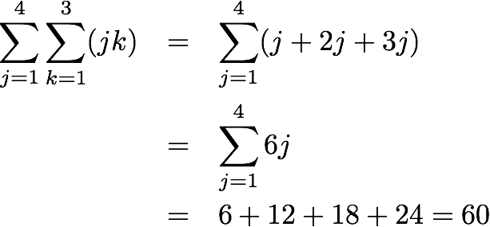
Summations can be nested within one another
Often, you’ll see this when analyzing nested loops within a program (i.e., CS 1501/1502)
Example: Compute
Solution:
Expand inner sum
Simplify if possible
Expand outer sum

Slide 19
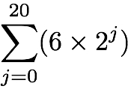
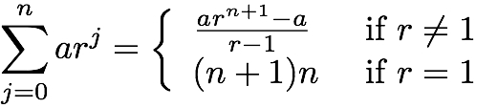
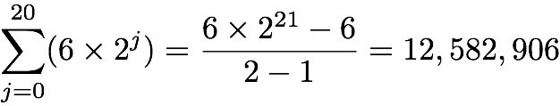
Computing the sum of a geometric series by hand is time consuming…
Would you really want to calculate by hand?
Fortunately, we have a closed-form solution for computing the sum of a geometric series:
So,
Why?

Slide 20
Proof of geometric series closed form
On Whiteboard
Notes:
WHITEBOARD

Slide 21






There are other closed form summations that you should know
Sum | Closed Form

Slide 22
Final thoughts
Sequences allow us to represent (potentially infinite) ordered lists of elements
Summation notation is a compact representation for adding together the elements of a sequence
Next time:
  Midterm exam review

