Slide 1

CS 441: Algorithms and Pseudocode
PhD. Nils Murrugarra-Llerena
nem177@pitt.edu

Slide 2

Exam 1 – Stats [Section 1160. TTh 9:30-10:45am]
# Students | Max Score | Average
26 | 94 | 71.3

Slide 3
Exam 1 – Stats [Section 1300. TTh 4-5:15pm]
# Students | Max Score | Average
68 | 99 | 74.9

Slide 4

[Key CS Link] Algorithms
🥪 The Algorithm as a Recipe
What is the recipe for making a peanut butter and jelly sandwich? What are the instructions/steps?
Notes:
Source: Gemini
Think of an algorithm as a set of instructions. Just like a good recipe, an algorithm must be precise, ordered, and have a clear goal.
Here is the simple recipe:
Get two slices of bread.
Spread peanut butter on one slice.
Spread jelly on the other slice.
Put the two slices together, with the peanut butter and jelly sides facing each other.
Enjoy your sandwich!

Slide 5

Today's topics
Algorithms and pseudocode
  What is an algorithm?
  Pseudocode allows us to describe an algorithm in a semi-structured way
  Algorithms for basic problems

Slide 6
What is an algorithm?
Definition: An algorithm is a finite sequence of precise instructions for solving a problem
Note these important features!
  Finite: In order to execute, it must be finite
  Sequence: The steps needs to be in the correct order
  Precise: Each step must be unambiguous
  Instructions: Each step can be carried out
  Solving a problem: ?

Slide 7
What is a problem?
A “problem” should be general enough to be broadly useful, but specific enough to dictate strategies
  “Sort the numbers (6, 8, 5, 3)” is too specific; let’s allow the input to be specified
  “Return the numeric solution to the input query” is too general; different instances may not be solved similarly
In computing, we usually represent a problem using its desired solutions
  Inputs: What is provided to identify the instance of the problem?
  Outputs: What are the correct outputs for each input?

Slide 8
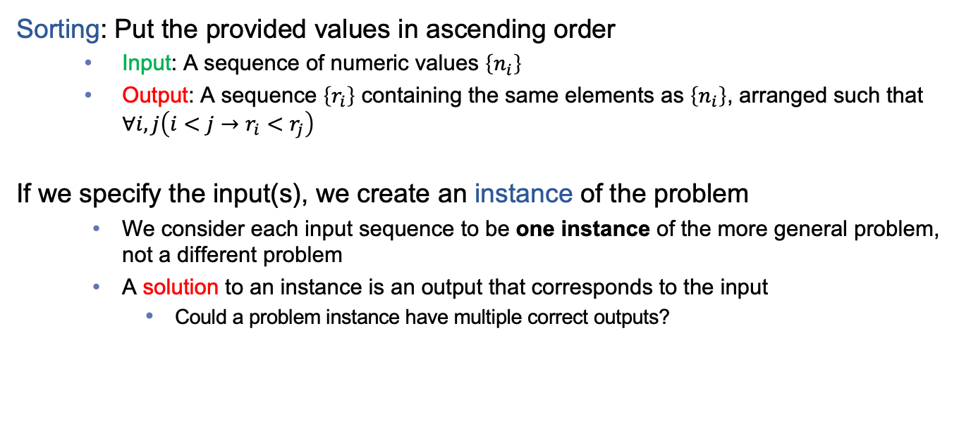
An example problem: Sorting
Sorting: Put the provided values in ascending order
  Input: A sequence of numeric values $\left\{n_{i}\right\}$
  Output: A sequence $\left\{r_{i}\right\}$ containing the same elements as $\left\{n_{i}\right\}$, arranged such that $∀i,j\left(i<j→r_{i}<r_{j}\right)$
If we specify the input(s), we create an instance of the problem
  We consider each input sequence to be one instance of the more general problem, not a different problem
  A solution to an instance is an output that corresponds to the input
    Could a problem instance have multiple correct outputs?

Slide 9
The searching problem
Intuition: Given a list, find a specific element (if possible)
  How would you solve this?
  To help with describing a solution, let’s assign our inputs to have variable names that we can refer to, and describe the desired output more precisely
Problem: Given a sequence of values a₁, a₂, …, a_{n}, and a target value, x, return an index i such that a_{i} = x (or 0 if no such index exists)
  One possible algorithm to solve this:
  Compare each a_{i} to x, starting from a₁ and proceeding sequentially. Return the first i which yields a_{i} = x.

Slide 10
Search: Example
Example: Search 19 in the list:
1 2 3 5 6 7 8 10 12 13 15 16 18 19 20 22
Position: 1 2 3 4 5 6 7 8 9 10 11 12 13 14 15 16
Values: 1 2 3 5 6 7 8 10 12 13 15 16 18 19 20 22
19
10

Slide 11
Pseudocode provides a structured way to represent an algorithm
If we start describing a way to solve sorting, it may not feel very precise
  Examples?
Pseudocode is a semi-structured set of notations
  More precise than describing in prose
  Less overhead than a programming language
Compare to proof techniques
  A formal proof is analogous to a program in (say) Java
    Meant to be executed by a machine, very precise
  An informal proof is analogous to an algorithm in pseudocode
    Meant to be understood by a human, so steps can be abstracted. Different communities may prefer different conventions.

Slide 12
An algorithm for the searching problem
Algorithm name
Input variables
Input data types
procedure linear search(x: integer, a₁, a₂, …, a_{n}: distinct integers)
i := 1
while (i ≤ n and x ≠ a_{i})
i := i + 1
if i ≤ n then
location := i
else
location := 0
return location {location is the subscript of the term that equals x, or is 0 if x is not found}
Assigning a variable
Repetition structure
Selection structure
Return the solution
Comment (exposition; no effect)

Slide 13
Selection structure executes instructions conditionally
if condition then statement 1
else statement 2
if condition then
statement 1
statement 2
…
statement n
statement n+1
if condition 1 then statement 1
else if condition 2 then statement 2
…
else if condition n then statement n
else statement n+1
optional else case
multiple conditional statements
statements after are always executed
mutually-exclusive cases

Slide 14
Repetition structure executes instructions multiple times
for variable := initial value to final value
statement
while condition
statement
for-loop: execute statement(s) for each value in a sequence
sum := 0
for i := 1 to n
sum := sum + i
sum := 0
i := 1
while i ≤ n
sum := sum + i
i := i + 1
variable is assumed to update automatically for each iteration
while-loop: if condition is true, execute statement(s), then check again
statements must update variable(s) to make condition false

Slide 15

In-class Activities
Activity 1: Consider a version of the search problem where the sequence to search is in sorted order. Write an updated version of the linear search algorithm that stops searching once it is determined that the target element is not present. [miro]
Activity 2: What is the output of this algorithm given input 100? Show your process [miro]
procedure problem 2(t: integer)
x := 1
while (x ≤ t)
x := x * 2
return x
Submit on
Steps:
Introduce to a classmate
Work in pairs on the exercise
Submit answers on miro
Volunteers to share answers
Notes:
Problem 1: Change second condition in while statement
Problem 2: Answer 128

Slide 16
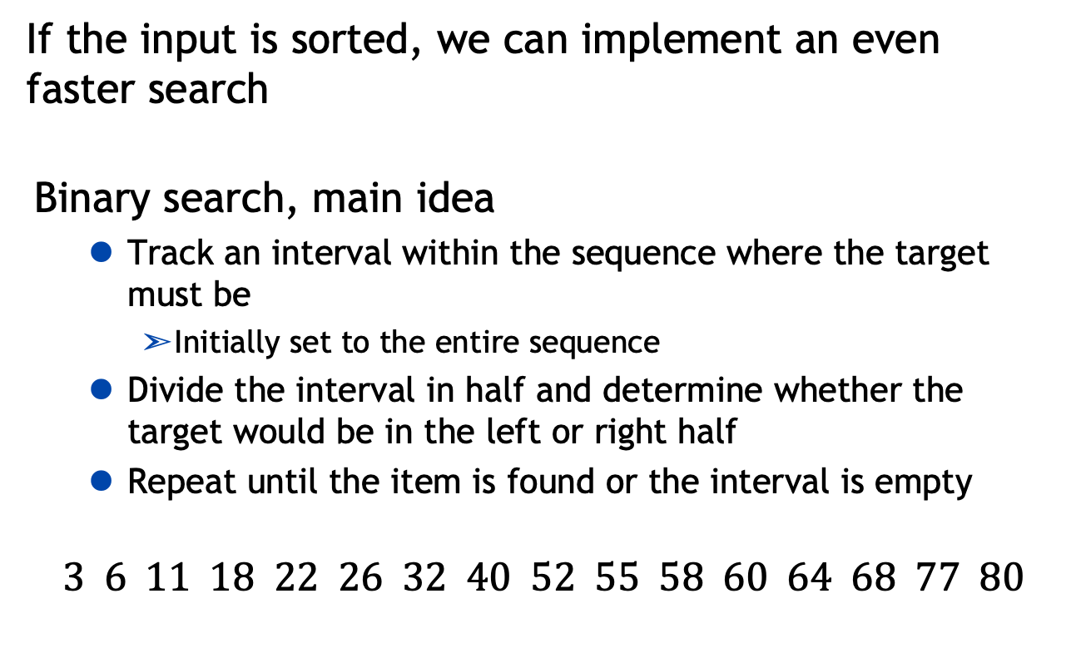
More efficient approaches to searching?
If the input is sorted, we can implement an even faster search
Binary search, main idea
  Track an interval within the sequence where the target must be
    Initially set to the entire sequence
  Divide the interval in half and determine whether the target would be in the left or right half
  Repeat until the item is found or the interval is empty
$$3 6 11 18 22 26 32 40 52 55 58 60 64 68 77 80$$
Search for 64

Slide 17
Binary search, pseudocode
procedure binary search(x: integer, a₁, a₂, …, a_{n}: integers in non-decreasing order)
start := 1
end := n
while start < end
mid := ⌊ (start + end) / 2 ⌋
if x > a_{mid} then
start := mid + 1
else if x < a_{mid} then
end := mid – 1
else
start := mid
end := mid
if x = a_{start} then
location := start
else
location := 0
return location

Slide 18
18
Binary search: Example
Example: The steps taken by a binary search for 19 in the list:
1 2 3 5 6 7 8 10 12 13 15 16 18 19 20 22
The list has 16 elements, so the midpoint is 8. The value in the 8th position is 10. Since 19 > 10, further search is restricted to positions 9 through 16.
Position: 1 2 3 4 5 6 7 8 9 10 11 12 13 14 15 16
Values: 1 2 3 5 6 7 8 10 12 13 15 16 18 19 20 22
The midpoint of the list (positions 9 through 16) is now the 12th position with a value of 16. Since 19 > 16, further search is restricted to the 13th position and above.
Position: 1 2 3 4 5 6 7 8 9 10 11 12 13 14 15 16
Values: 1 2 3 5 6 7 8 10 12 13 15 16 18 19 20 22
18

Slide 19
19
Binary search: Example
The midpoint of the current list is now the 14th position with a value of 19. Since
19 = 19, the location 14 is returned.
Position: 1 2 3 4 5 6 7 8 9 10 11 12 13 14 15 16
Values: 1 2 3 5 6 7 8 10 12 13 15 16 18 19 20 22
19

Slide 20
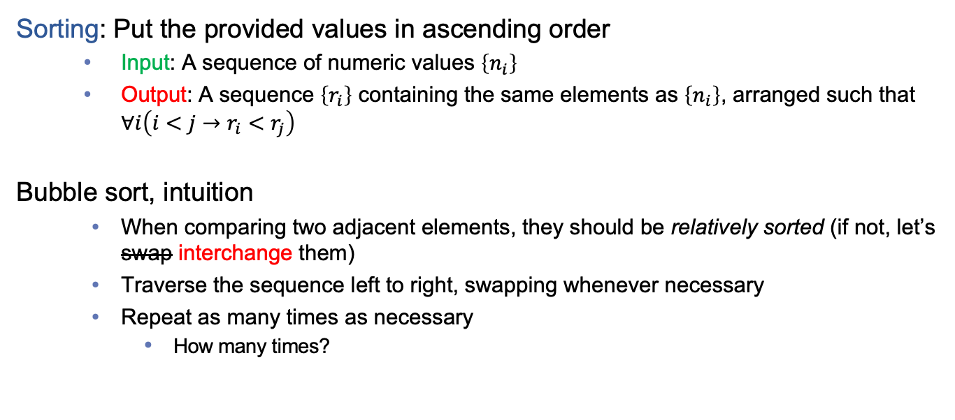
Let’s revisit a problem we specified earlier
Sorting: Put the provided values in ascending order
  Input: A sequence of numeric values $\left\{n_{i}\right\}$
  Output: A sequence $\left\{r_{i}\right\}$ containing the same elements as $\left\{n_{i}\right\}$, arranged such that $∀i\left(i<j→r_{i}<r_{j}\right)$
Bubble sort, intuition
  When comparing two adjacent elements, they should be relatively sorted (if not, let’s swap interchange them)
  Traverse the sequence left to right, swapping whenever necessary
  Repeat as many times as necessary
    How many times?

Slide 21
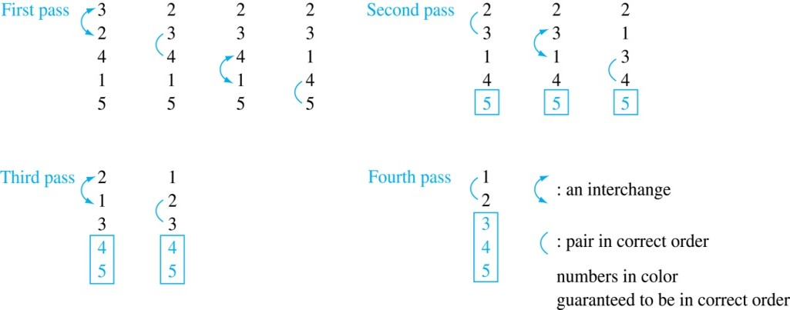
Bubble Sort: Example
Example: Show the steps of bubble sort with 3 2 4 1 5
At the first pass the largest element has been put into the correct position
At the end of the second pass, the 2nd largest element has been put into the correct position.
In each subsequent pass, an additional element is put in the correct position.
McGraw Hill

Slide 22
Bubble sort pseudocode
procedure bubble sort(a₁, a₂, …, a_{n}: real numbers)
for i := 1 to n-1
for j := 1 to n-1
if a_{j} > a_{j+1} then
swap a_{j} and a_{j+1}
Any optimizations?
  Inner loop stopping value: Consider how much progress we can guarantee from each pass
  Outer loop responsive termination: Might we finish sorting before i = n-1?
Do we need to go all the way to the end?
Notes:
n -1 → n – i [ inner loop ]

Slide 23
Specific types of problems and algorithms
Definition: An optimization problem is a problem in which the goal is to find the solution (among a set of possible solutions) that maximizes or minimizes the value of some parameter
Examples:
  Given the locations of a set of cities, what visitation order minimizes total travel? (Traveling salesperson problem)
  Given an amount of change, what denominations should be given to minimize the number of coins? (Change-making problem)
  Given an actor, what is the minimum number of “hops” (each to an actor that appeared with the previous in some movie) to arrive at Kevin Bacon?

Slide 24
One strategy for optimization problems: Greedy algorithms
Definition: A greedy algorithm is an algorithm that makes what seems to be the “best” choice at each step while iteratively constructing a solution.
A greedy approach to change-making:
  At each step, select the greatest denomination that can fit within the remaining change to give
A greedy approach to traveling salesperson:
  At each step, visit the (unvisited) city closest to your current location
Note that, depending on the problem, a greedy algorithm might not find the optimal solution!
Notes:
This is a feature of the problem

Slide 25
Cashier’s algorithm, pseudocode
procedure cashier’s change (c₁, c₂, …, c_{r}: values of denominations in decreasing order; n: a positive integer)
for i := 1 to r
d_{i} := 0 {counts how many coins of denom. i}
while n ≥ c_{i}
d_{i} := d_{i} + 1 {add a coin of denom. i}
n := n – c_{i} {remove value from remaining change to give}
return {d_{i}} {this sequence specifies how many of each denom.}
Does this always return the optimal solution?
Notes:
r : # of coins
Assume we have infinite coins of each denomination
Example: Give change for 67 cents with quarters (25 cents), dimes (10 cents), nickels (5 cents), and pennies (1 cent).
67 = 2*25 + 1*10 + 1*5 + 2*1
####
Counter Example: Give change for 15 cents with coin A (12 cents), coin B (5 cents), and coin C (1 cents)
15 = 12*1 + 1*4 (no optimal)
15 = 5*3 (optimal)

Slide 26
Final thoughts
Algorithms are a major foundation of computer science
  More structured than prose, easier to write than “real” code
Greedy algorithms are convenient for optimization problems, but don’t always give optimal results
Next time:
  Growth rates and Big-O notations (Section 3.2)

