Slide 1

CS 441: Complexity of Algorithms
PhD. Nils Murrugarra-Llerena
nem177@pitt.edu

Slide 2

[Key CS Link] Complexity
🃏 The Card Sorting Problem
Imagine you have a deck of N cards and you need to sort them in ascending order.
What will be your approach? Can we use Bubble Sort? Can we improve it?
Notes:
Source: Gemini
Method 1: Selection Sort
A very simple way to sort the cards is to find the smallest card and place it in a new sorted pile. You repeat this for the remaining cards.
Process:
Look through all N cards to find the smallest one.
Place that card aside.
Look through the remaining N−1 cards to find the next smallest.
Place that card next to the first one.
Continue until all cards are sorted.
Complexity:
To find the first card, you check N cards.
To find the second card, you check N−1 cards.
...and so on.
The total number of comparisons is approximately N+(N−1)+⋯+1=2N(N+1)​.
This is a quadratic growth rate, meaning the time it takes grows with the square of the number of cards.
The time complexity is O(N2).
Method 2: Merge Sort
A much more efficient way is to use a "divide and conquer" strategy. You split the deck in half, sort each half independently, and then merge the two sorted halves back together.
Process:
Split the N cards into two halves of N/2 cards.
Repeat the splitting process on each half until you have decks with only one card (which is, by definition, sorted).
Merge the single-card decks back into sorted two-card decks.
Merge the sorted two-card decks into sorted four-card decks, and so on, until the entire deck is sorted.
Complexity:
Splitting the deck takes a logarithmic number of steps (logN).
Merging the cards takes a number of comparisons proportional to N.
The total time complexity is a combination of these, resulting in an NlogN growth rate.
The time complexity is O(NlogN).

Slide 3

Today's topics
Recap Growth rates of functions
Applying growth rates to algorithms
  Resource utilization functions and applying big-O
  Complexity of algorithms
    Worst case
    Best case
    Average case

Slide 4
[Reminder] What is an algorithm?
Definition: An algorithm is a finite sequence of precise instructions for solving a problem
Note these important features!
  Finite: In order to execute, it must be finite
  Sequence: The steps needs to be in the correct order
  Precise: Each step must be unambiguous
  Instructions: Each step can be carried out
  Solving a problem: ?

Slide 5
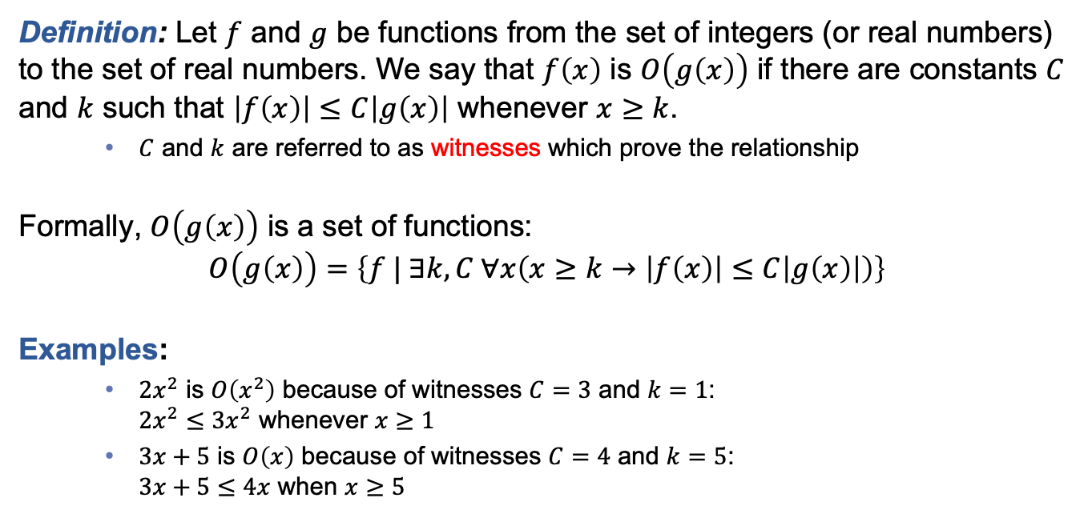
[Reminder] Big-O notation
Definition: Let $f$ and $g$ be functions from the set of integers (or real numbers) to the set of real numbers. We say that $f\left(x\right)$ is $O\left(g\left(x\right)\right)$ if there are constants $C$ and $k$ such that $\left|f\left(x\right)\right|≤C\left|g\left(x\right)\right|$ whenever $x≥k$.
  $C$ and $k$ are referred to as witnesses which prove the relationship
Formally, $O\left(g\left(x\right)\right)$ is a set of functions:
$$O\left(g\left(x\right)\right)=\left\{f | ∃k,C ∀x\left(x≥k→\left|f\left(x\right)\right|≤C\left|g\left(x\right)\right|\right)\right\}$$
Examples:
  $2x^{2}$ is $O\left(x^{2}\right)$ because of witnesses $C=3$ and $k=1$:
  $2x^{2}≤3x^{2}$ whenever $x≥1$
  $3x+5$ is $O\left(x\right)$ because of witnesses $C=4$ and $k=5$:
  $3x+5≤4x$ when $x≥5$
When considering positive values only, we will often drop the absolute value
Notes:
Intuitively, the set of functions whose growth is bounded above by g’s, ignoring constant multiples

Slide 6
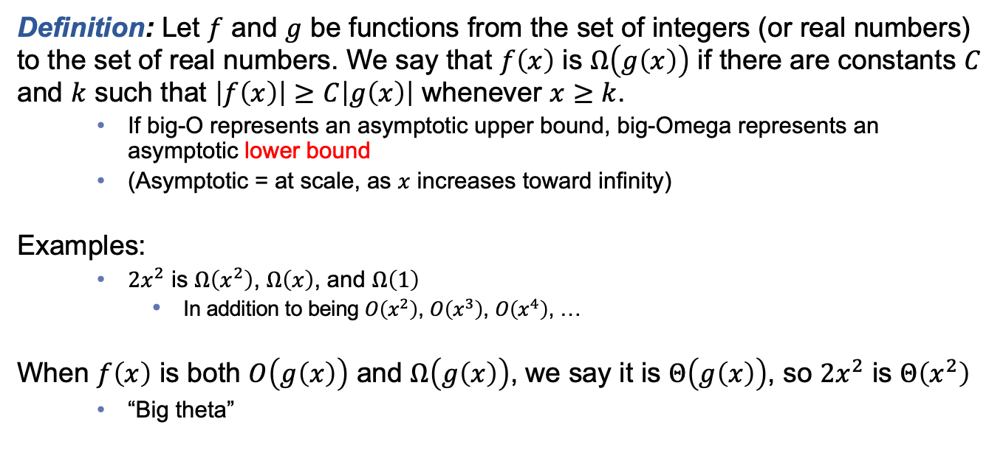
[Reminder] Related notations to big-O
Definition: Let $f$ and $g$ be functions from the set of integers (or real numbers) to the set of real numbers. We say that $f\left(x\right)$ is $Ω\left(g\left(x\right)\right)$ if there are constants $C$ and $k$ such that $\left|f\left(x\right)\right|≥C\left|g\left(x\right)\right|$ whenever $x≥k$.
  If big-O represents an asymptotic upper bound, big-Omega represents an asymptotic lower bound
  (Asymptotic = at scale, as $x$ increases toward infinity)
Examples:
  $2x^{2}$ is $Ω\left(x^{2}\right)$, $Ω\left(x\right)$, and $Ω\left(1\right)$
    In addition to being $O\left(x^{2}\right)$, $O\left(x^{3}\right)$, $O\left(x^{4}\right)$, …
When $f\left(x\right)$ is both $O\left(g\left(x\right)\right)$ and $Ω\left(g\left(x\right)\right)$, we say it is $Θ\left(g\left(x\right)\right)$, so $2x^{2}$ is $Θ\left(x^{2}\right)$
  “Big theta”
Notes:
Often we say big-O when we mean big-Theta, especially in computing. Say what you mean!

Slide 7
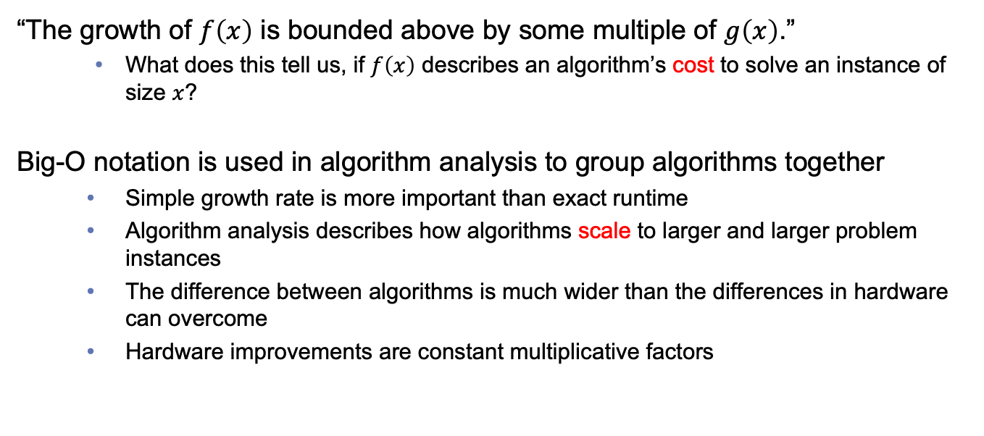
[Reminder] Why does algorithm analysis matter?
“The growth of $f\left(x\right)$ is bounded above by some multiple of $g\left(x\right)$.”
  What does this tell us, if $f\left(x\right)$ describes an algorithm’s cost to solve an instance of size $x$?
Big-O notation is used in algorithm analysis to group algorithms together
  Simple growth rate is more important than exact runtime
  Algorithm analysis describes how algorithms scale to larger and larger problem instances
  The difference between algorithms is much wider than the differences in hardware can overcome
  Hardware improvements are constant multiplicative factors
Notes:
If our hardware gets 10x better, most everything will be 1/10 the time, just need the trend.
On the other hand, growth rates tell us something fundamental about an algorithm that better hardware can’t fix forever.

Slide 8
Today: Applying growth rates to algorithms
Resource utilization functions and applying big-O
Complexity of algorithms
  Worst case
  Best case
  Average case

Slide 9
Let’s motivate with an example
Problem: Sum the integers from 1 through n
Analysis idea: Identify repeated instructions, count frequency
Algorithm A
sum := 0
for i := 1 to n
sum := sum + i
return sum
Algorithm B
sum := 0
for i := 1 to n
for j := 1 to i
sum := sum + 1
return sum
Algorithm C
sum := n*(n+1)/2
return sum
Notes:
sum^n_{i=1} sum^i_{j=1} 1
sum^n_{i=1} I
n(n+1) / 2

Slide 10
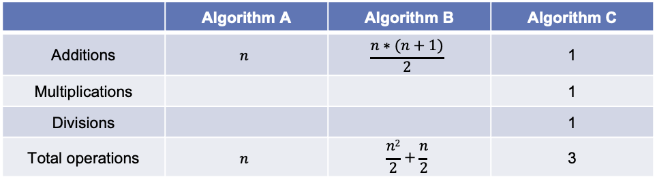
How many operations for these algorithms?
 | Algorithm A | Algorithm B | Algorithm C
Additions | $$n$$ | $$\frac{n∗(n+1)}{2}$$ | 1
Multiplications |  |  | 1
Divisions |  |  | 1
Total operations | $$n$$ | $$\frac{n2}{2}+\frac{n}{2}$$ | 3
Some operations may take longer…
… but as the input gets larger, the frequency is the most important factor

Slide 11
How many operations does this work out to be, for different inputs?
 | Algorithm A | Algorithm B | Algorithm C
n = 1 | 1 | 1 | 3
n = 10 | 10 | 55 | 3
n = 100 | 100 | 5,050 | 3
n = 1000 | 1,000 | 500,500 | 3
Algorithm analysis focuses on trends as the problem instances grow in size
(Measure runtimes as input size grows)
Next year, computers might be twice as fast, but a bad algorithm is still 500 times slower

Slide 12
How do we measure the runtime of an algorithm?
First, consider expressing the runtime as a function
  Domain: Natural numbers (Why?)
  Preimages represent the size of a problem instance
We rarely need to articulate this function exactly
  Different hardware can change multiplicative constants
  Optimization can reduce constants and lower-order terms
  As such, growth rates are effective at describing what is inherent in the algorithm
    (rather than how it is implemented)
For runtime: Identify the operations that happen most frequently, and determine the growth rate of how many
Notes:
Why not benchmark?
Natural numbers because we are using a discrete computer

Slide 13
Practice: Max algorithm, pseudocode
procedure max(a₁, a₂, …, a_{n}: integers)
max := 1
for i := 2 to n
if a_{i} > a_{max} then
max := i
return max
What is the most frequent operations?
How many of these operations occur, expressed as a growth rate? Θ(n)
Notes:
Comparisons

Slide 14
What about an algorithm with variability, even for a given size?
procedure linear search(x: integer, a₁, a₂, …, a_{n}: distinct integers)
i := 1
while (i ≤ n and x ≠ a_{i})
i := i + 1
if i ≤ n then
location := i
else
location := 0
return location {location is the subscript of the term that equals x, or is 0 if x is not found}

Slide 15
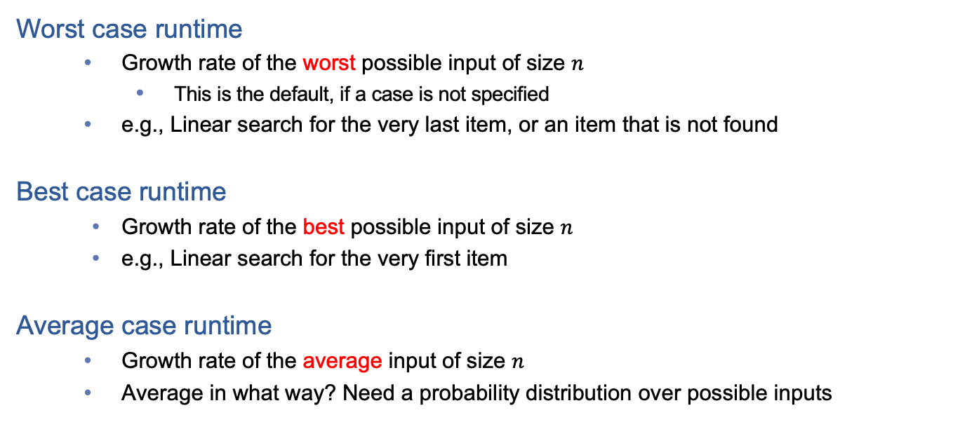
We can consider different scenarios for an algorithm
Worst case runtime
  Growth rate of the worst possible input of size $n$
    This is the default, if a case is not specified
  e.g., Linear search for the very last item, or an item that is not found
Best case runtime
  Growth rate of the best possible input of size $n$
  e.g., Linear search for the very first item
Average case runtime
  Growth rate of the average input of size $n$
  Average in what way? Need a probability distribution over possible inputs
Note: We can use big-O, big-Ω, and big-Θ for each case!

Slide 16
Worst case? Best case?
procedure linear search(x: integer, a₁, a₂, …, a_{n}: distinct integers)
i := 1
while (i ≤ n and x ≠ a_{i})
i := i + 1
if i ≤ n then
location := i
else
location := 0
return location {location is the subscript of the term that equals x, or is 0 if x is not found}

Slide 17
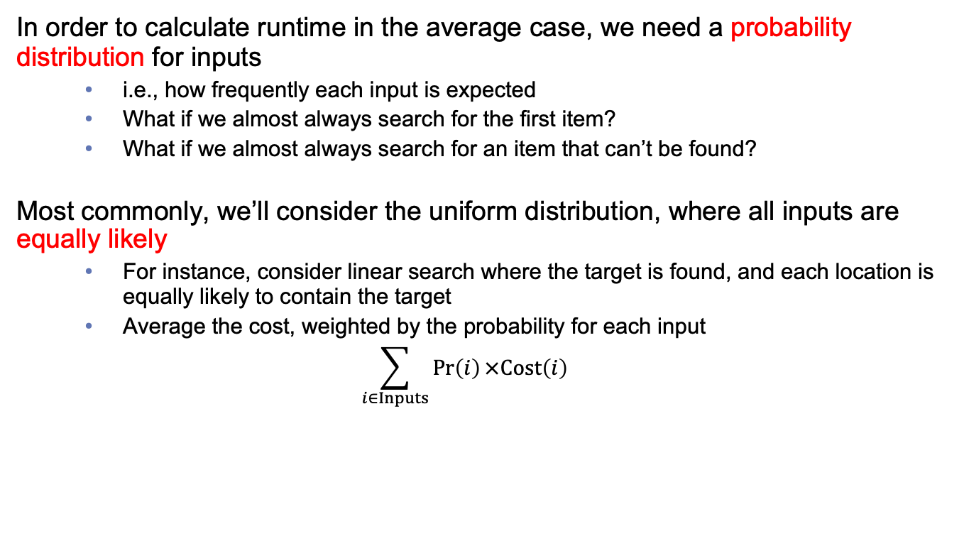
What about average case?
In order to calculate runtime in the average case, we need a probability distribution for inputs
  i.e., how frequently each input is expected
  What if we almost always search for the first item?
  What if we almost always search for an item that can’t be found?
Most commonly, we’ll consider the uniform distribution, where all inputs are equally likely
  For instance, consider linear search where the target is found, and each location is equally likely to contain the target
  Average the cost, weighted by the probability for each input
  $$\sum_{i∈Inputs}{\operatorname{Pr}\left(i\right)×Cost\left(i\right)}$$
Demonstrate for linear search!
Notes:
See Example 4, from Section 3.3.

Slide 18
What about average case?
On Whiteboard
Notes:
See Example 4, from Section 3.3. (Page 233)

Slide 19
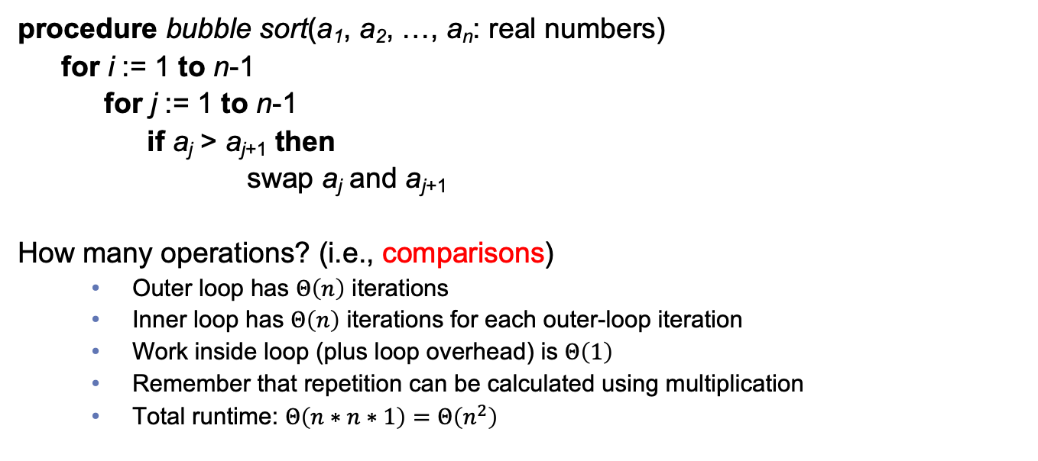
Let’s analyze bubble sort
procedure bubble sort(a₁, a₂, …, a_{n}: real numbers)
for i := 1 to n-1
for j := 1 to n-1
if a_{j} > a_{j+1} then
swap a_{j} and a_{j+1}
How many operations? (i.e., comparisons)
  Outer loop has $Θ\left(n\right)$ iterations
  Inner loop has $Θ\left(n\right)$ iterations for each outer-loop iteration
  Work inside loop (plus loop overhead) is $Θ\left(1\right)$
  Remember that repetition can be calculated using multiplication
  Total runtime: $Θ\left(n∗n∗1\right)=Θ\left(n^{2}\right)$

Slide 20
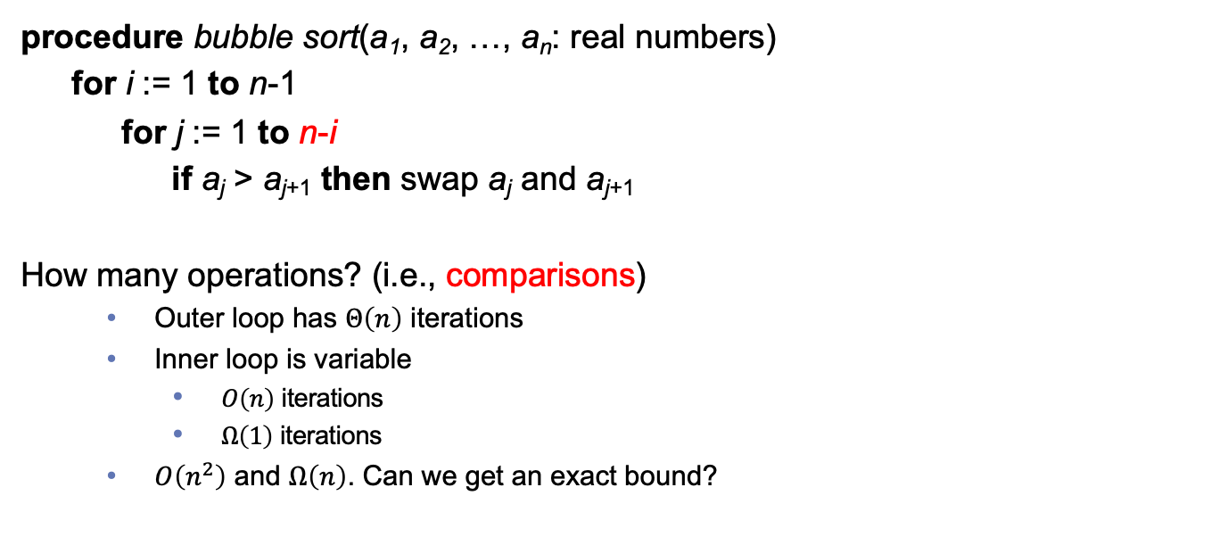
What about an improved version?
procedure bubble sort(a₁, a₂, …, a_{n}: real numbers)
for i := 1 to n-1
for j := 1 to n-i
if a_{j} > a_{j+1} then swap a_{j} and a_{j+1}
How many operations? (i.e., comparisons)
  Outer loop has $Θ\left(n\right)$ iterations
  Inner loop is variable
    $O\left(n\right)$ iterations
    $Ω\left(1\right)$ iterations
  $O\left(n^{2}\right)$ and $Ω\left(n\right)$. Can we get an exact bound?

Slide 21
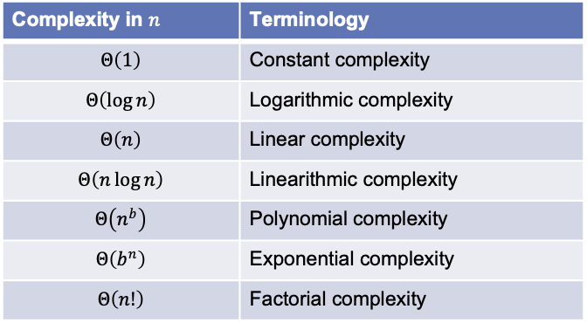
Common growth rates and their terminologies for complexity
Complexity in $n$ | Terminology
$$Θ\left(1\right)$$ | Constant complexity
$$Θ\left(\log{n}\right)$$ | Logarithmic complexity
$$Θ\left(n\right)$$ | Linear complexity
$$Θ\left(n\log{n}\right)$$ | Linearithmic complexity
$$Θ\left(n^{b}\right)$$ | Polynomial complexity
$$Θ\left(b^{n}\right)$$ | Exponential complexity
$$Θ\left(n!\right)$$ | Factorial complexity
These are considered intractable
Consider increasing the instance size:
How will runtime change for each?

Slide 22

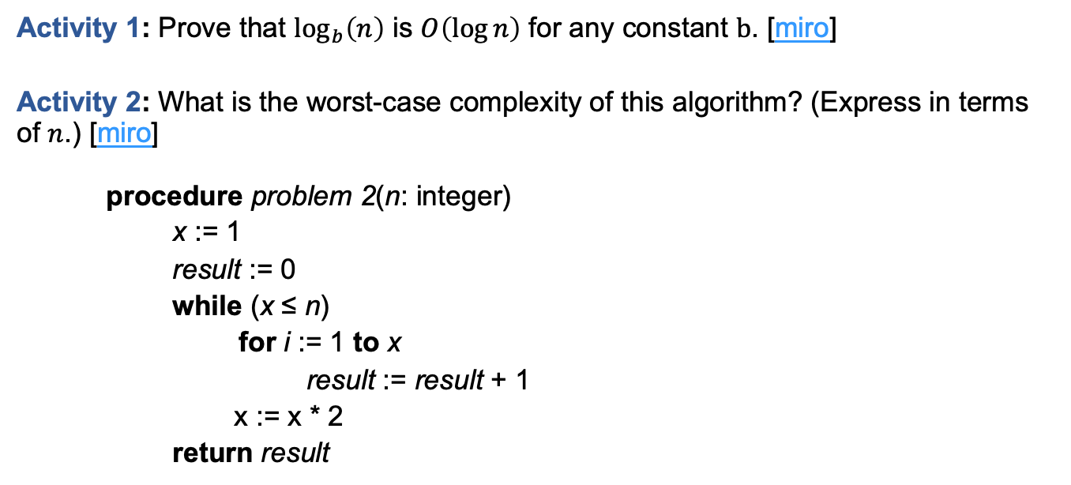
In-class Activities
Activity 1: Prove that $\log_{b}\left(n\right)$ is $O\left(\log{n}\right)$ for any constant $b$. [miro]
Activity 2: What is the worst-case complexity of this algorithm? (Express in terms of $n$.) [miro]
procedure problem 2(n: integer)
x := 1
result := 0
while (x ≤ n)
for i := 1 to x
result := result + 1
x := x * 2
return result
Submit on
Steps:
Introduce to a classmate
Work in pairs on the exercise
Submit answers on miro
Volunteers to share answers
Notes:
[Activity 2: Hints]
Logarithms properties: https://www.cuemath.com/algebra/properties-of-logarithms/
Remember Sum of Geometric Series Formula (Slide 17 from Sequences)

Slide 23
Final thoughts
We can use growth rates to study algorithms and their runtime
Big-O and related notations are useful for complexity since they represent the runtime trends at scale
Next time:
  Starting number theory: Divisibility and modular arithmetic (Section 4.1)

