Slide 1

CS 441: Divisibility and Modular Arithmetic
PhD. Nils Murrugarra-Llerena
nem177@pitt.edu

Slide 2


[Key CS Link] Divisibility
How do you know if a number is a valid credit card?
💳 The Luhn Algorithm
It is a simple formula used to validate a variety of identification numbers, such as credit card numbers and IMEI numbers.
The Luhn algorithm is a method for validating a string of digits. It's used as a simple check to catch common mistakes like a typo during manual entry. The algorithm is based entirely on the concepts of divisibility.
Notes:
Source: Gemini
simple checksum formula

Slide 3

Today's topics
Integers and division
The division algorithm
Modular arithmetic
Applications of modular arithmetic

Slide 4
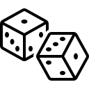
What is number theory?
Number theory is the branch of mathematics that explores the integers and their properties.
Number theory has many applications within computer science, including:
Organizing data
Encrypting sensitive data
Developing error correcting codes
Generating “random” numbers
…
We will only scratch the surface…
Notes:
Encription: enigma machine
Error correcting codes: sending message over the internet (how to avoid corruption)
Random numbers: lottery simulator, dice games, …

Slide 5
The notion of divisibility is one of the most basic properties of the integers
Definition: If a and b are integers and a ≠ 0, we say that a divides b iff there is an integer c such that b = ac. We write a | b to say that a divides b, and a | b to say that a does not divide b.
Mathematically: a | b ⇔ ∃ c∈Z (b = ac)
Note: If a | b, then
a is called a factor of b
b is called a multiple of a
We’ve been using the notion of divisibility all along!
E = {x | x = 2k ∧ k ∈ Z}
/

Slide 6
Division examples
Examples:
Does 4 | 16? Yes, 16 = 4 × 4
Does 3 | 11? No, because 11/3 is not an integer
Does 7 | 42? Yes, 42 = 7 × 6
Question: Let n and d be two positive integers. How many positive integers not exceeding n are divisible by d?
Answer: We want to count the number of integers of the form dk that are no more than n. That is, we want to know the number of integers k with 0 < dk ≤ n, or 0 < k ≤ n/d. Therefore, there are ⌊n/d⌋ positive integers not exceeding n that are divisible by d.

Slide 7

In-class Activities
Submit on
Notes:
Divisibility

Slide 8
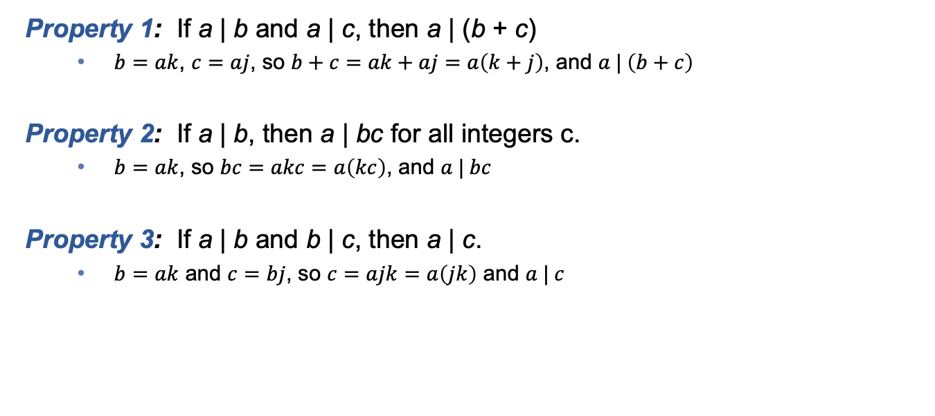
Important properties of divisibility
Property 1: If a | b and a | c, then a | (b + c)
$b=ak$, $c=aj$, so $b+c=ak+aj=a\left(k+j\right)$, and $a | \left(b+c\right)$
Property 2: If a | b, then a | bc for all integers c.
$b=ak$, so $bc=akc=a\left(kc\right)$, and $a | bc$
Property 3: If a | b and b | c, then a | c.
$b=ak$ and $c=bj$, so $c=ajk=a\left(jk\right)$ and $a | c$
Notes:
https://thirdspacelearning.com/us/blog/guide-division-for-kids-explained/

Slide 9
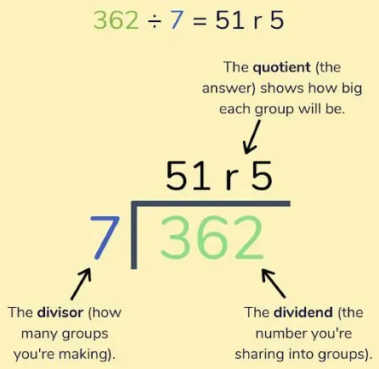
Division algorithm
Theorem: Let a be an integer and let d be a positive integer. There are unique integers q and r, with
0 ≤ r < d, such that a = dq + r.
For historical reasons, the above theorem is called the division algorithm, even though it isn’t an algorithm!
Terminology: Given a = dq + r
a is called the dividend
d is called the divisor
q is called the quotient
r is called the remainder
q = a div d
r = a mod d
div and mod are operators
https://thirdspacelearning.com/us/blog/guide-division-for-kids-explained/
Notes:
https://thirdspacelearning.com/us/blog/guide-division-for-kids-explained/
See range of remainder r

Slide 10
Examples
Question: What are the quotient and remainder when 123 is divided by 23?
Answer: We have that 123 = 23 × 5 + 8. So the quotient is 123 div 23 = 5, and the remainder is 123 mod 23 = 8.
Question: What are the quotient and remainder when -11 is divided by 3?
Answer: Since -11 = 3 × -4 + 1, we have that the quotient is -4 and the remainder is 1.
Recall that since the remainder must be non-negative, 3 × -3 − 2 is not a valid use of the division theorem!
Notes:
Quotient is -4

Slide 11
Many programming languages use the div and mod operations
For example, in Java, C, and C++
/ corresponds to div when used on integer arguments
% corresponds to mod
This can be a source of many errors, so be careful in your future classes!
public static void main(String[] args)
{
int x = 2;
int y = 5;
float z = 2.0;
System.out.println(y/x);
System.out.println(y%x);
System.out.println(y/z);
}
Prints out 2, not 2.5!
Prints out 1
Prints out 2.5

Slide 12
In-class Activities
Submit on
Notes:
Div Alg 1
Div Alg 3
Extra: Div Alg 2

Slide 13
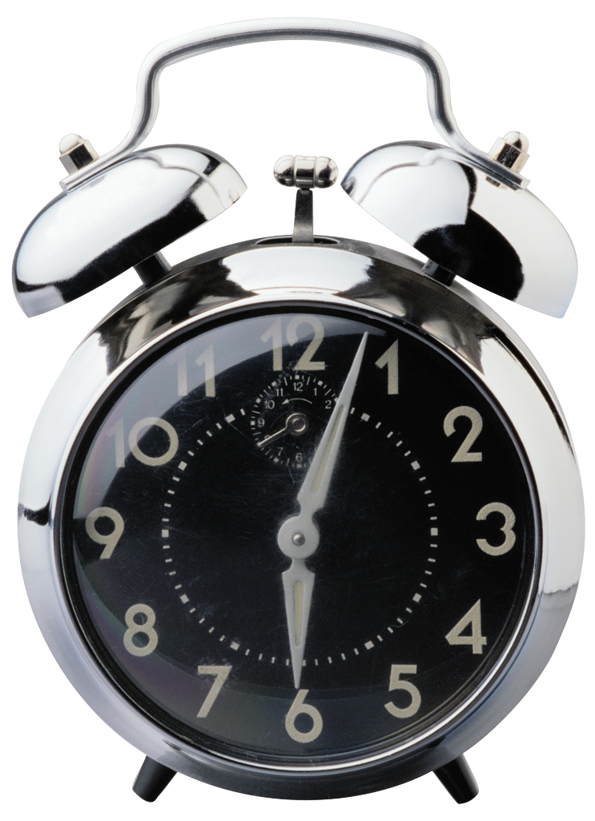
Sometimes, we care only about the remainder of an integer after it is divided by some other integer
Example: What time will it be 22 hours from 11:00 am?
Answer: If it is 11 am now, it will be (11 + 22) mod 24 = 33 mod 24 = 9 am in 22 hours.

Slide 14
Since remainders can be so important, they have their own special notation!
Definition: If a and b are integers and m is a positive integer, we say that a is congruent to b modulo m iff m | (a – b). We write this as a ≡ b (mod m).
Note: a ≡ b (mod m) iff a mod m = b mod m.
Examples:
Is 17 congruent to 5 modulo 6? Yes, since 6 | (17 – 5)
Is 24 congruent to 14 modulo 6? No, since 6 | (24 – 14)
/

Slide 15
In-class Activities
Submit on
Notes:
Congruences
Extra: Congruences matching

Slide 16
Properties of congruencies
Theorem: Let m be a positive integer. The integers a and b are congruent modulo m (a ≡ b (mod m)) iff there is an integer k such that a = b + km.
Theorem: Let m be a positive integer. If a ≡ b (mod m) and c ≡ d (mod m), then
(a + c) ≡ (b + d) (mod m)
ac ≡ bd (mod m)
These properties mean we can use addition and multiplication as usual, even if we are only considering remainders (mod m)
Notes:
Proofs on overhead

Slide 17
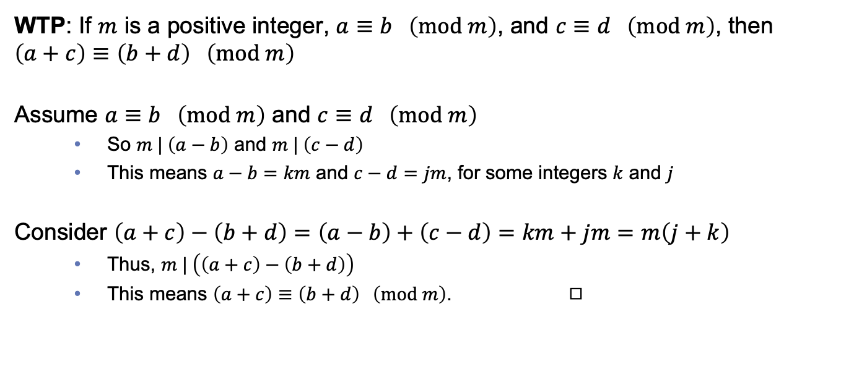
Proving one of these congruence rules
WTP: If $m$ is a positive integer, $a≡b \left(mod m\right)$, and $c≡d \left(mod m\right)$, then $\left(a+c\right)≡\left(b+d\right) \left(mod m\right)$
Assume $a≡b \left(mod m\right)$ and $c≡d \left(mod m\right)$
So $m | \left(a−b\right)$ and $m | \left(c−d\right)$
This means $a−b=km$ and $c−d=jm$, for some integers $k$ and $j$
Consider $\left(a+c\right)−\left(b+d\right)=\left(a−b\right)+\left(c−d\right)=km+jm=m\left(j+k\right)$
Thus, $m | \left(\left(a+c\right)−\left(b+d\right)\right)$
This means $\left(a+c\right)≡\left(b+d\right) \left(mod m\right)$. ◻︎
WTP: Want to Prove
Notes:
WTP: Want to Prove
How can we write ( a+c ) – ( b + d )

Slide 18
Defining arithmetic restricted to remainders when dividing by m
Z_{m} denotes the set of nonnegative integers less than m
i.e., the remainders when dividing by m
From our previous theorem we can show that mod “preserves” addition and multiplication
(a+b) mod m = ((a mod m) + (b mod m)) mod m
(ab) mod m = ((a mod m)(b mod m)) mod m
Thus, we can define versions of addition and multiplication that are restricted to this set
a +_{m} b = (a+b) mod m
a ·_{m} b = (a · b) mod m
These operations form arithmetic modulo m

Slide 19
Examples
Use the definition of addition and multiplication in Z_{m} to evaluate each of the following.
6 +₁₂ 10
6 +₁₂ 10 = (6 + 10) mod 12
= 16 mod 12 = 4
6 ·₁₂ 10
6 ·₁₂ 10 = (6 · 10) mod 12
= 60 mod 12 = 0
15 ·₁₂ 22
15 ·₁₂ 22 = (15 · 22) mod 12
= ((15 mod 12) · (22 mod 12)) mod 12
= (3 · 10) mod 12
= 30 mod 12 = 6
Notes:
Quotient is -4

Slide 20
Congruences have many applications within computer science
Today we’ll look at three:
Hash functions
The generation of pseudorandom numbers
Cryptography

Slide 21
Hash functions allow us to quickly and efficiently locate data
Problem: Given a large collection of records, how can we find the one we want quickly?
Solution: Apply a hash function that determines the storage location of the record based on the record’s ID. A common hash function is h(k) = k mod n, where n is the number of available storage locations.
Memory:
0 | 1 | 2 | 3 | 4 | 5 | 6 | 7
42 mod 8 = 2
276 mod 8 = 4
23 mod 8 = 7
ID: 42
…
…
ID: 276
…
…
ID: 23
…
…
Notes:
Ask who can see a problem with this scheme

Slide 22

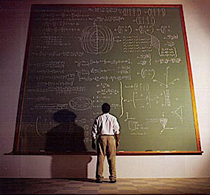


Many areas of computer science rely on the ability to generate pseudorandom numbers
Coding algorithms
Hardware, software, and network simulation
Security
Network protocols

Slide 23
Congruencies can be used to generate pseudorandom sequences
Step 1: Choose
A modulus m
A multiplier a
An increment c
A seed x₀
Step 2: Apply the following
x_{n+1} = (ax_{n} + c) mod m
Example: m = 9, a = 7, c = 4, x₀ = 3
x₁ = (7x₀ + 4) mod 9 = (7×3 + 4) mod 9 = 25 mod 9 = 7
x₂ = (7x₁ + 4) mod 9 = (7×7 + 4) mod 9 = 53 mod 9 = 8
x₃ = (7x₂ + 4) mod 9 = (7×8 + 4) mod 9 = 60 mod 9 = 6
x₄ = (7x₃ + 4) mod 9 = (7×6 + 4) mod 9 = 46 mod 9 = 1
x₅ = (7x₄ + 4) mod 9 = (7×1 + 4) mod 9 = 11 mod 9 = 2
…
Notes:
Linear congruential generator

Slide 24

Cryptography: The Caesar cipher is based on congruencies
Cryptography is the study of secret messages
To encode a message using the Caesar cipher:
Choose a shift index s
Convert each letter A-Z into a number 0-25
Compute f(p) = (p + s) mod 26
Example: Let s = 9. Encode “ATTACK”.
ATTACK = 0 19 19 0 2 10
f(0) = 9, f(19) = 2, f(2) = 11, f(10) = 19
Encrypted message: 9 2 2 9 11 19 = JCCJLT
Notes:
In true Caesar cipher, s = 3

Slide 25
Decryption involves using the inverse function
That is, f⁻¹(p) = (p – s) mod 26
Example: Assume that s = 3. Decrypt the message “UHWUHDW”.
UHWUHDW = 20 7 22 20 7 3 22
f⁻¹(20) = 17, f⁻¹(7) = 4, f⁻¹(22) = 19, f⁻¹(3) = 0
Decrypted result: 17 4 19 17 4 0 19 = RETREAT
Notes:
Note that the Caesar cipher is weak

Slide 26
Final thoughts
Number theory is the study of integers and their properties
Divisibility, modular arithmetic, and congruency are used throughout computer science
Later in Chapter 4 we will see how these are used throughout computer science
Next time:
Integer representations (Section 4.2)

Slide 27
Extra

Slide 28
The field of cryptography makes heavy use of number theory and congruencies
Cryptography is the study of secret messages
Uses of cryptography:
Protecting medical records
Storing and transmitting military secrets
Secure web browsing
…
Congruencies are used in cryptosystems from antiquity, as well as in modern-day algorithms
Since modern algorithms require quite a bit of background to discuss, we’ll examine an ancient cryptosystem

