Slide 1

CS 2770: Retrieval Augmented Generation (RAG) for Large Language Models
PhD. Nils Murrugarra-Llerena
nem177@pitt.edu

Slide 2
Plan for this lecture
﻿Introduction of Retrieval Augmented Large Language Models (RA LLMs)
Architecture of RA-LLMs and Main Modules
Learning Approach of RA-LLMs
Challenges and Future Directions of RA-LLMs
RAG meet LLMS: Towards Retrieval-Augmented LLMS Tutorial @ KDD 24 - https://advanced-recommender-systems.github.io/RAG-Meets-LLMs/

Slide 3
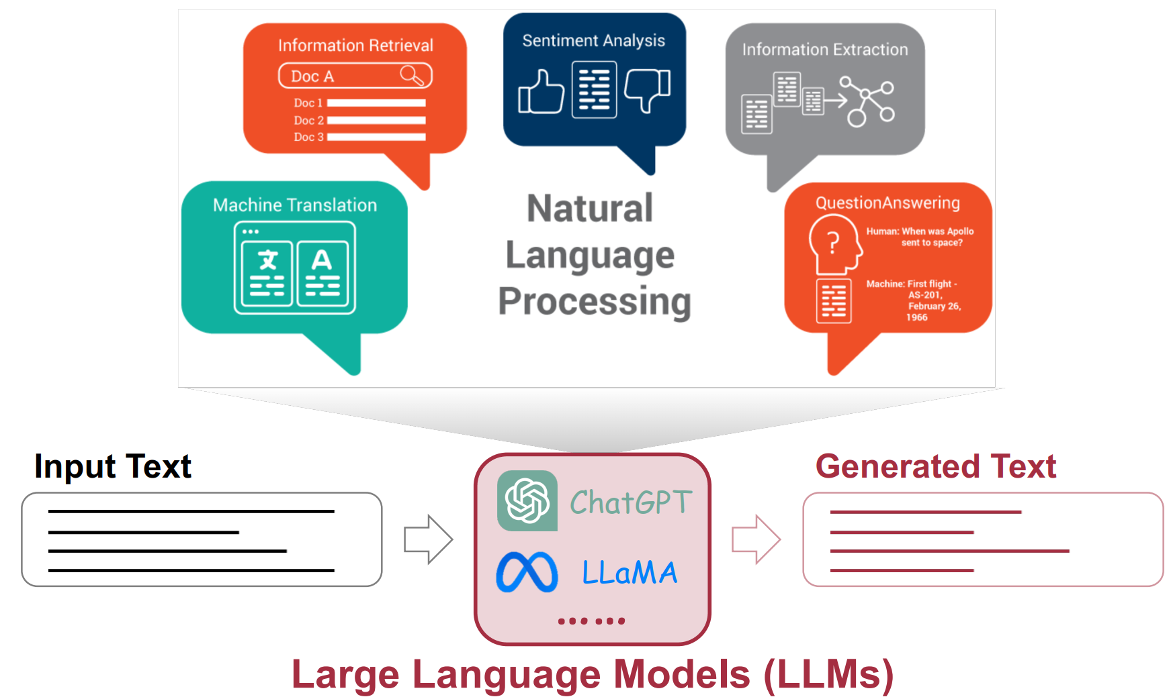
﻿Large Language Models (LLMs)
RAG meet LLMS: Towards Retrieval-Augmented LLMS Tutorial @ KDD 24 - https://advanced-recommender-systems.github.io/RAG-Meets-LLMs/

Slide 4
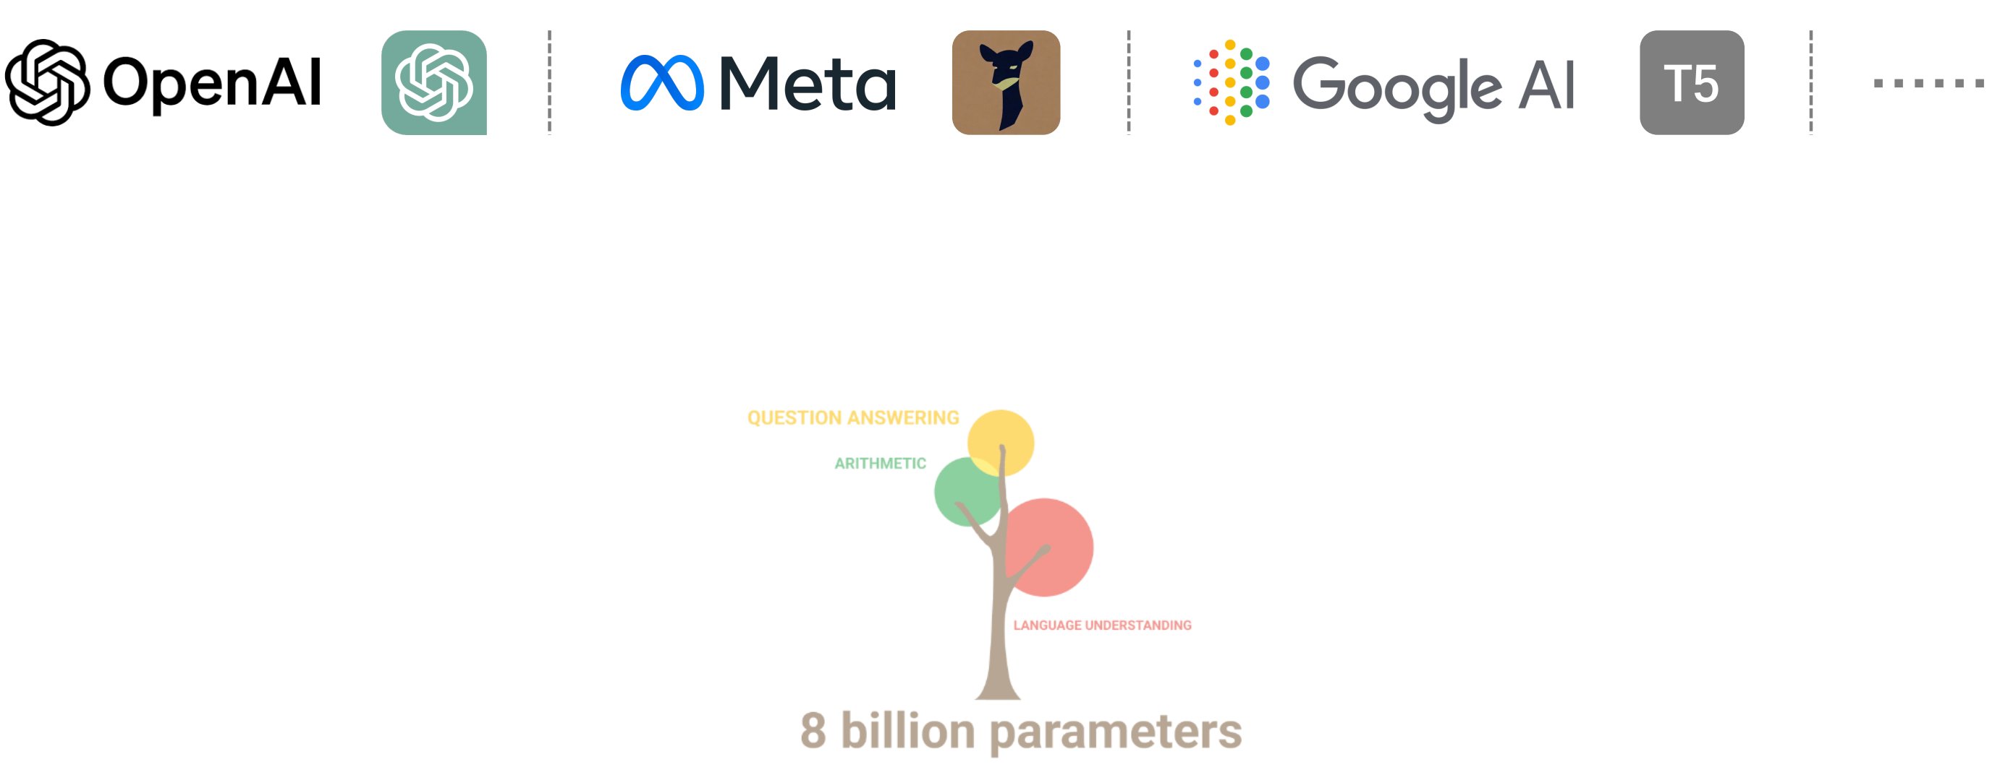
﻿Large Language Models (LLMs)
https://github.com/Hannibal046/Awesome-LLM/
RAG meet LLMS: Towards Retrieval-Augmented LLMS Tutorial @ KDD 24 - https://advanced-recommender-systems.github.io/RAG-Meets-LLMs/

Slide 5
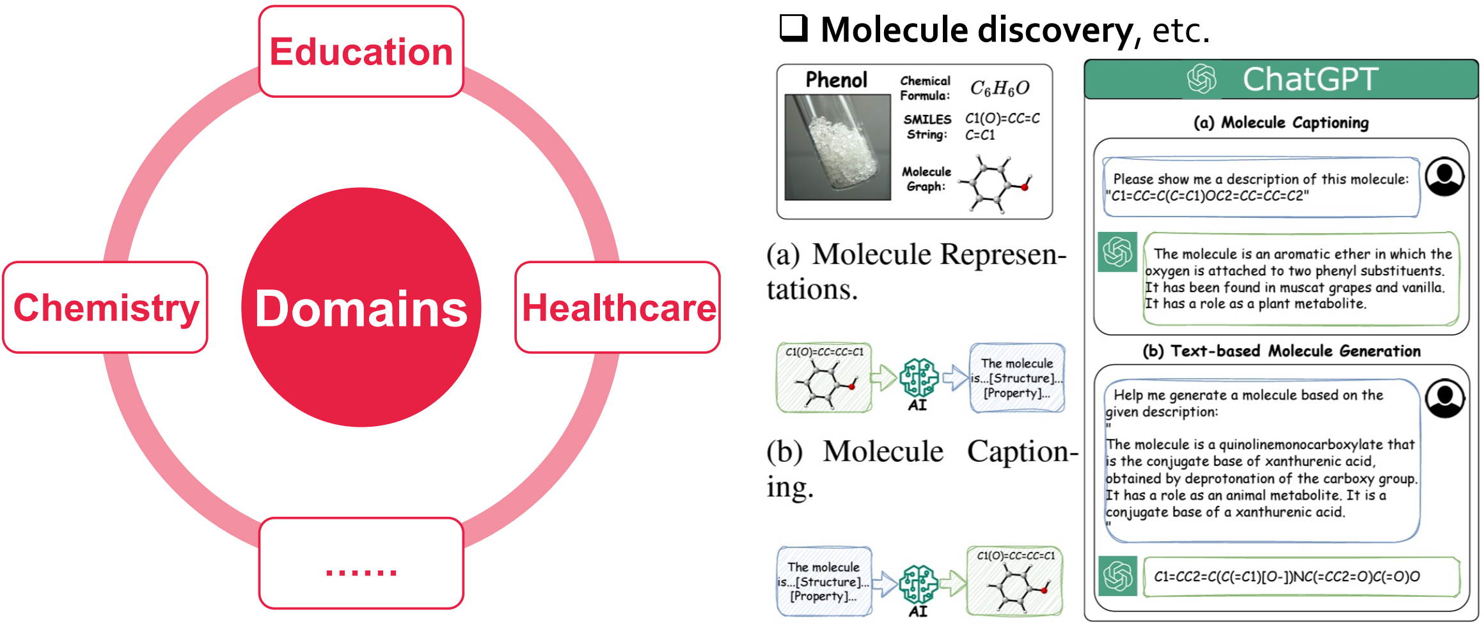
﻿LLMs in Downstream Domains
﻿Li et al, 2024, Empowering Molecule Discovery for Molecule-Caption Translation with Large Language Models: A ChatGPT Perspective,
Liu et al., 2024, MolecularGPT: Open Large Language Model (LLM) for Few-Shot Molecular Property Prediction,
RAG meet LLMS: Towards Retrieval-Augmented LLMS Tutorial @ KDD 24 - https://advanced-recommender-systems.github.io/RAG-Meets-LLMs/

Slide 6
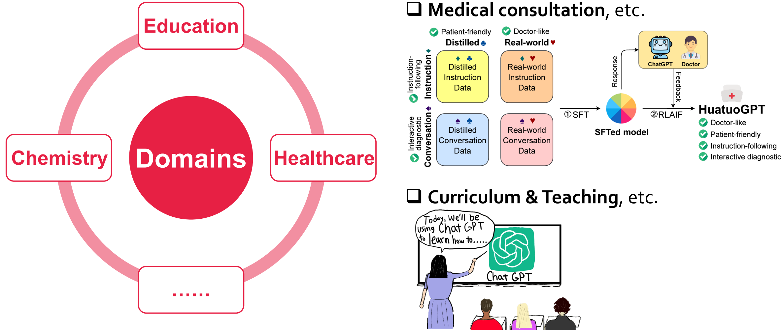
﻿LLMs in Downstream Domains
﻿Zhang et al., 2023, HuatuoGPT, towards Taming Language Model to Be a Doctor
RAG meet LLMS: Towards Retrieval-Augmented LLMS Tutorial @ KDD 24 - https://advanced-recommender-systems.github.io/RAG-Meets-LLMs/

Slide 7
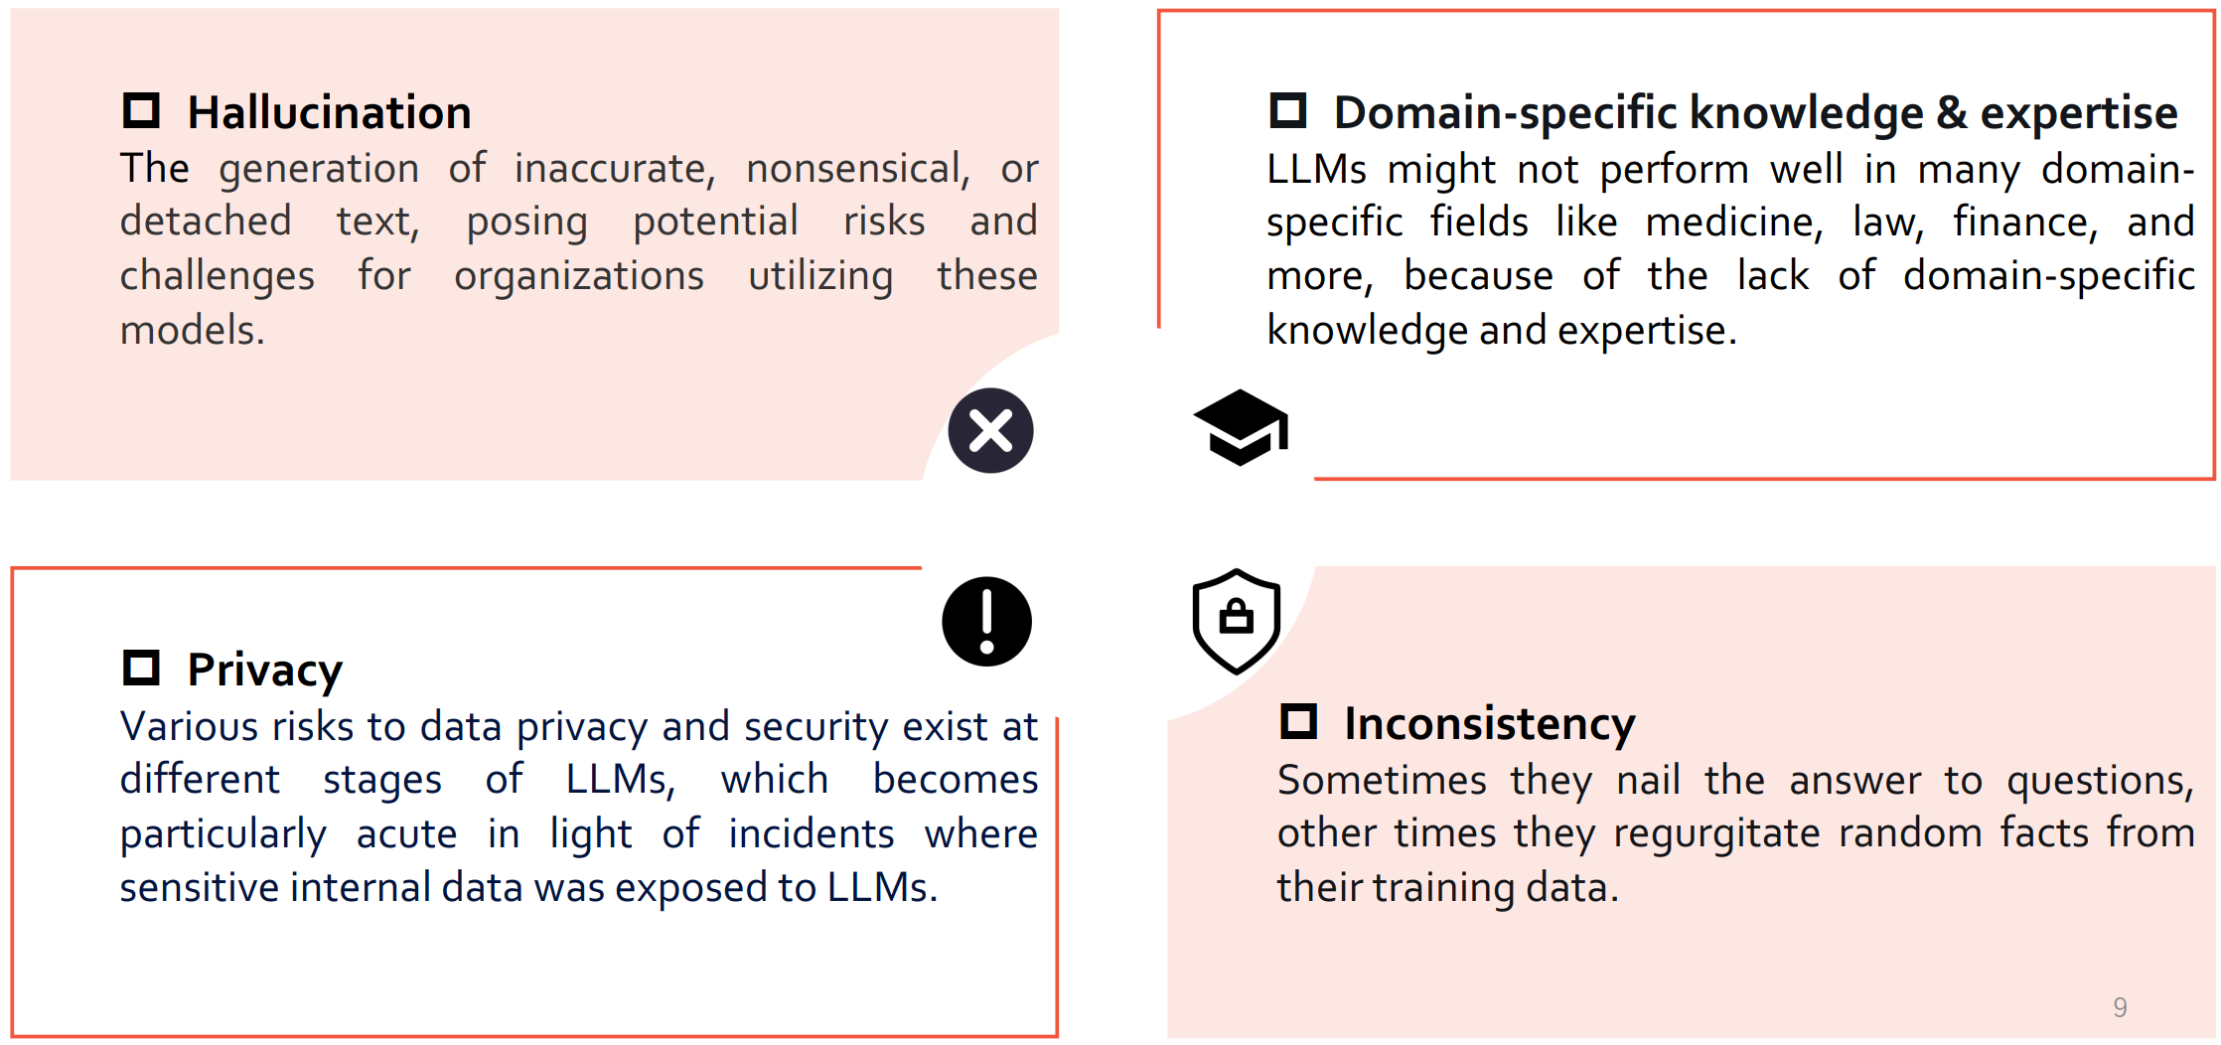
﻿Challenges and Risks of LLMs
RAG meet LLMS: Towards Retrieval-Augmented LLMS Tutorial @ KDD 24 - https://advanced-recommender-systems.github.io/RAG-Meets-LLMs/

Slide 8
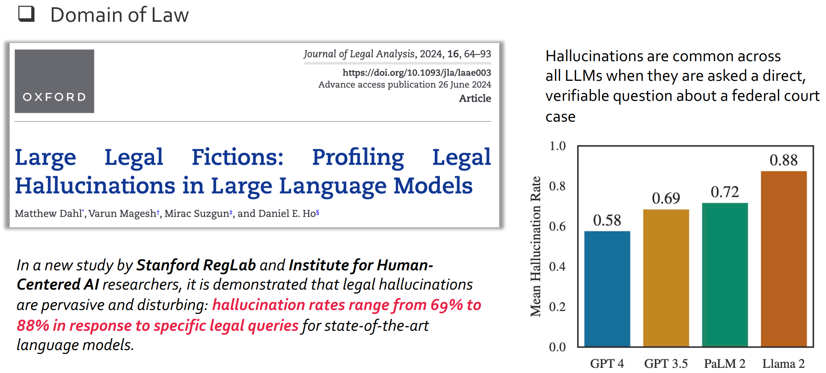
﻿LLMs’ Challenges in Vertical Domains
﻿Dahl M, et al. 2024, Large legal fictions: Profiling legal hallucinations in large language models.
RAG meet LLMS: Towards Retrieval-Augmented LLMS Tutorial @ KDD 24 - https://advanced-recommender-systems.github.io/RAG-Meets-LLMs/

Slide 9
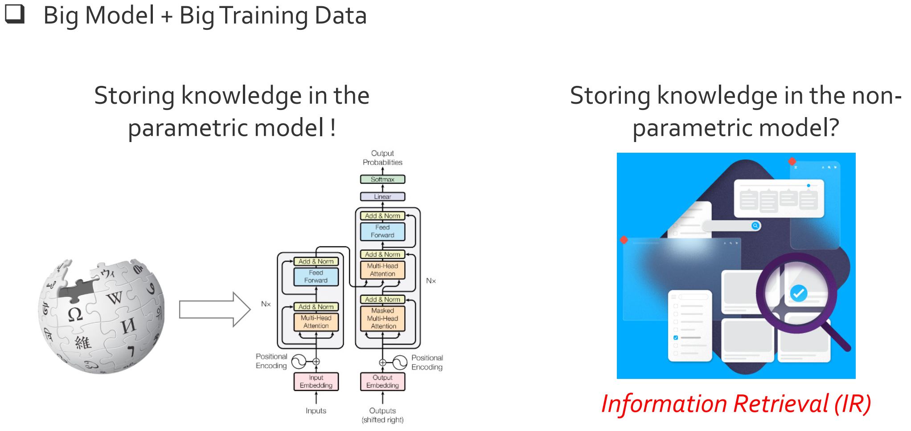
﻿Why Large Language Models Work Well?
RAG meet LLMS: Towards Retrieval-Augmented LLMS Tutorial @ KDD 24 - https://advanced-recommender-systems.github.io/RAG-Meets-LLMs/

Slide 10
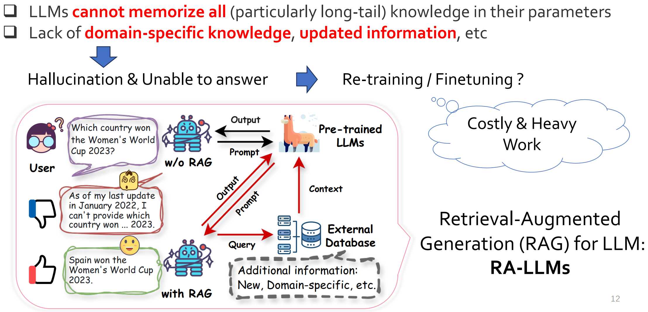
﻿Retrieval-Augmented Large Language Models (RA-LLMs)
RAG meet LLMS: Towards Retrieval-Augmented LLMS Tutorial @ KDD 24 - https://advanced-recommender-systems.github.io/RAG-Meets-LLMs/

Slide 11
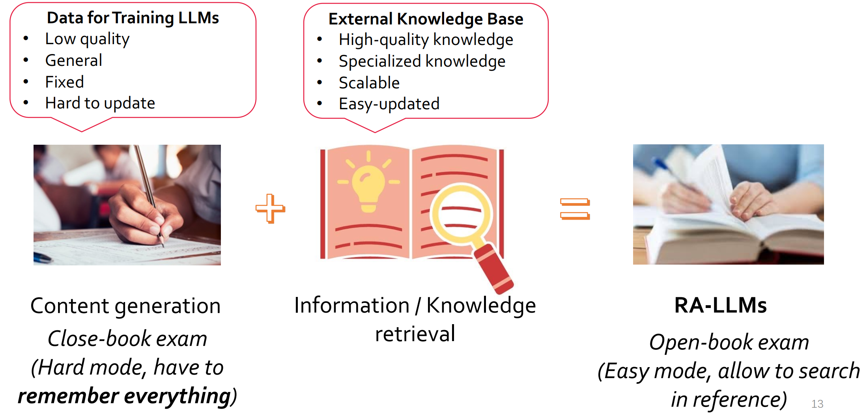
﻿Retrieval-Augmented Large Language Models (RA-LLMs)
RAG meet LLMS: Towards Retrieval-Augmented LLMS Tutorial @ KDD 24 - https://advanced-recommender-systems.github.io/RAG-Meets-LLMs/

Slide 12
Plan for this lecture
﻿Introduction of Retrieval Augmented Large Language Models (RA LLMs)
Architecture of RA-LLMs and Main Modules
Learning Approach of RA-LLMs
Challenges and Future Directions of RA-LLMs
RAG meet LLMS: Towards Retrieval-Augmented LLMS Tutorial @ KDD 24 - https://advanced-recommender-systems.github.io/RAG-Meets-LLMs/

Slide 13
Plan for this lecture
RA-LLM architecture overview
Retriever in RA-LLMs
Retrieval results integration
Pre/Post-retrieval techniques
RAG meet LLMS: Towards Retrieval-Augmented LLMS Tutorial @ KDD 24 - https://advanced-recommender-systems.github.io/RAG-Meets-LLMs/

Slide 14
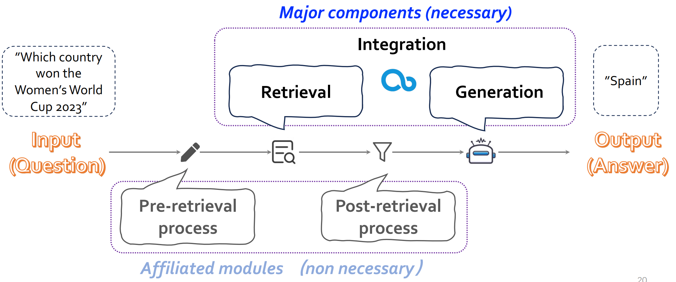
﻿RA-LLM Architecture: Standard Pipeline
﻿Technical component illustration in a RA-LLM for the Q&A task
RAG meet LLMS: Towards Retrieval-Augmented LLMS Tutorial @ KDD 24 - https://advanced-recommender-systems.github.io/RAG-Meets-LLMs/

Slide 15
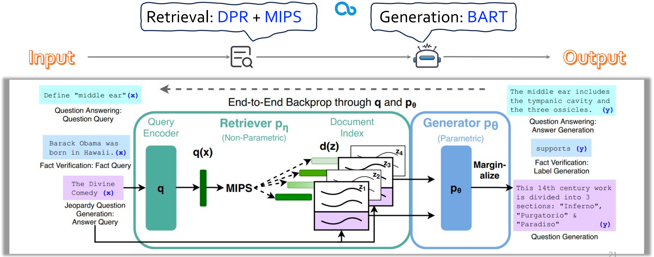
﻿A Simple Retrieval-Augmented Generation Model
﻿RAG Integration: concatenating each retrieved passage with the question
﻿Lewis et al. 2020. “Retrieval-Augmented Generation for Knowledge-Intensive NLP Tasks”
RAG meet LLMS: Towards Retrieval-Augmented LLMS Tutorial @ KDD 24 - https://advanced-recommender-systems.github.io/RAG-Meets-LLMs/

Slide 16
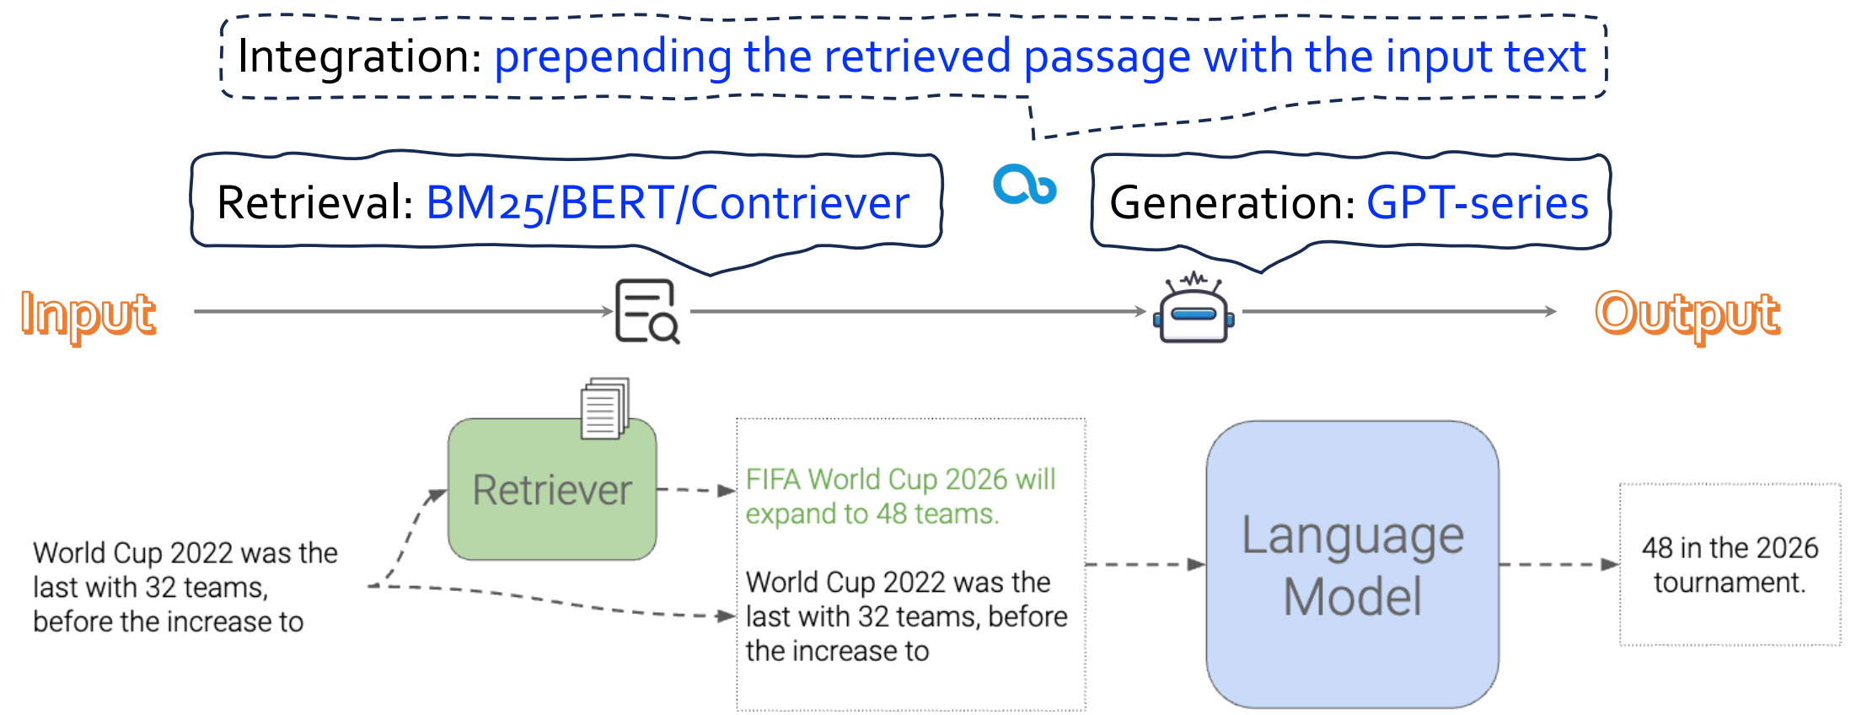
﻿A Simple Retrieval-Augmented Generation Model
﻿In-Context RALM
﻿Ram et al. 2023, In-Context Retrieval-Augmented Language Models
RAG meet LLMS: Towards Retrieval-Augmented LLMS Tutorial @ KDD 24 - https://advanced-recommender-systems.github.io/RAG-Meets-LLMs/

Slide 17
Plan for this lecture
RA-LLM architecture overview
Retriever in RA-LLMs
Retrieval results integration
Pre/Post-retrieval techniques
RAG meet LLMS: Towards Retrieval-Augmented LLMS Tutorial @ KDD 24 - https://advanced-recommender-systems.github.io/RAG-Meets-LLMs/

Slide 18
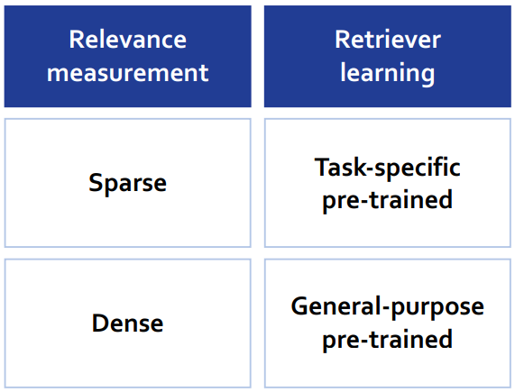
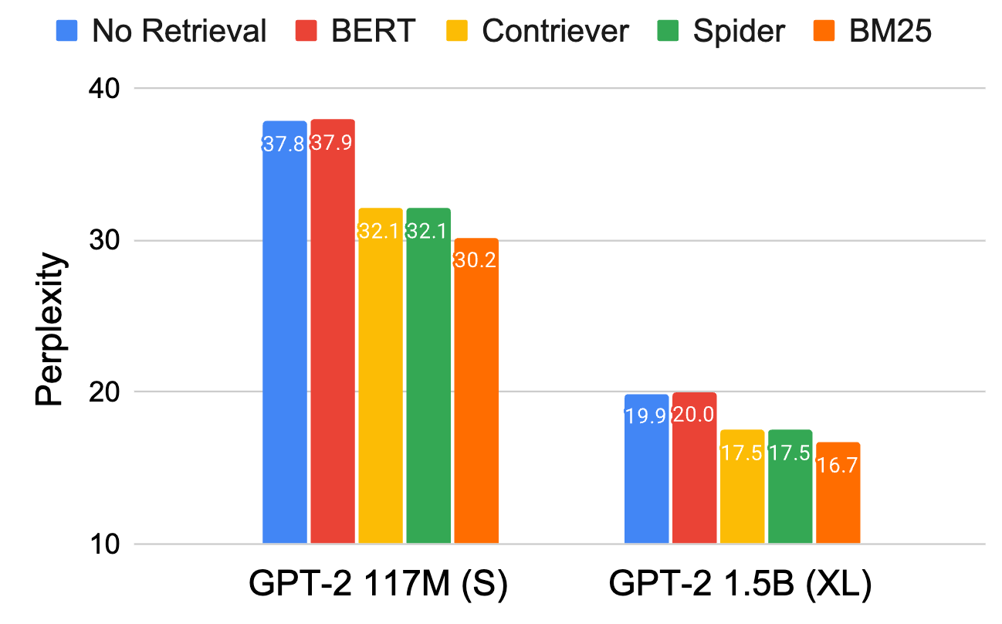
﻿RA-LLM Architecture: Retriever Types
﻿Different types of retriever deliver different generation performance
﻿Ram et al. 2023, In-Context Retrieval-Augmented Language Models
RAG meet LLMS: Towards Retrieval-Augmented LLMS Tutorial @ KDD 24 - https://advanced-recommender-systems.github.io/RAG-Meets-LLMs/

Slide 19
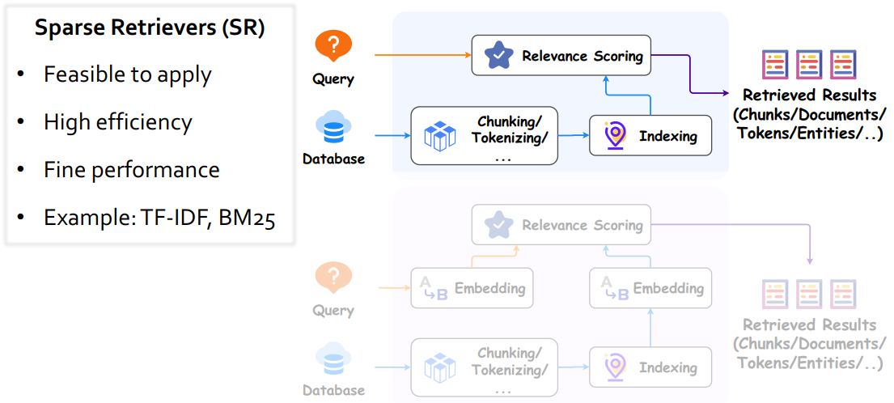
﻿Dense v.s. Sparse Retrievers
RAG meet LLMS: Towards Retrieval-Augmented LLMS Tutorial @ KDD 24 - https://advanced-recommender-systems.github.io/RAG-Meets-LLMs/

Slide 20
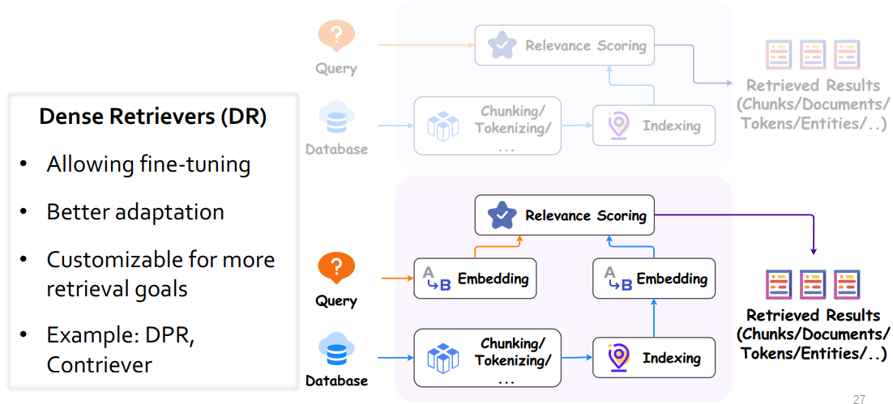
﻿Dense v.s. Sparse Retrievers
RAG meet LLMS: Towards Retrieval-Augmented LLMS Tutorial @ KDD 24 - https://advanced-recommender-systems.github.io/RAG-Meets-LLMs/

Slide 21
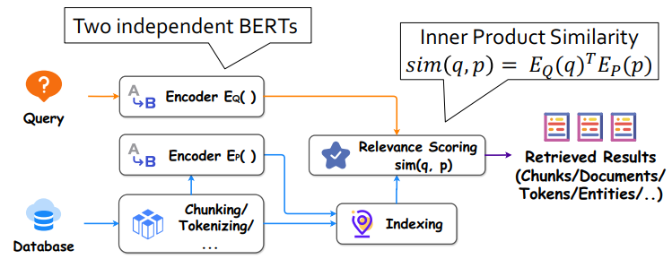
﻿Task-Specific Pre-trained Retriever (Supervised)
﻿Dense Passage Retriever (DPR): Pretrained for Question Answering (QA)
﻿Karpukhin et al. 2020. “Dense Passage Retrieval for Open-Domain Question Answering”
RAG meet LLMS: Towards Retrieval-Augmented LLMS Tutorial @ KDD 24 - https://advanced-recommender-systems.github.io/RAG-Meets-LLMs/

Slide 22
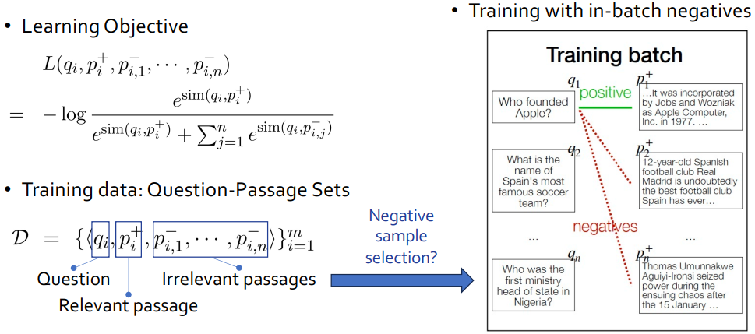
﻿Task-Specific Pre-trained Retriever (Supervised)
﻿Dense Passage Retriever (DPR): Pretrained for Question Answering (QA)
﻿Karpukhin et al. 2020. “Dense Passage Retrieval for Open-Domain Question Answering”
RAG meet LLMS: Towards Retrieval-Augmented LLMS Tutorial @ KDD 24 - https://advanced-recommender-systems.github.io/RAG-Meets-LLMs/

Slide 23
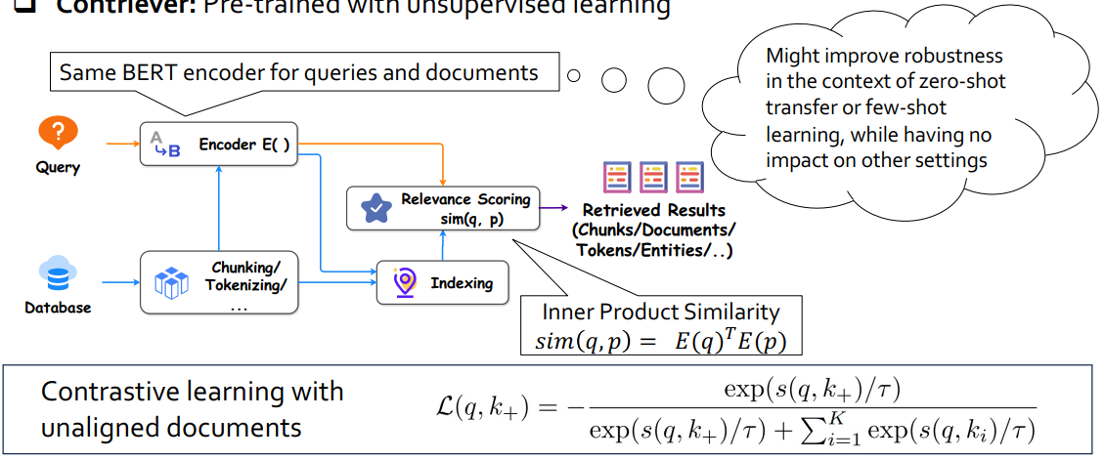
﻿General-Purpose Pre-trained Retriever (Unsupervised)
﻿Contriever: Pre-trained with unsupervised learning
﻿Izacard et al. 2022. “Unsupervised Dense Information Retrieval with Contrastive Learning
RAG meet LLMS: Towards Retrieval-Augmented LLMS Tutorial @ KDD 24 - https://advanced-recommender-systems.github.io/RAG-Meets-LLMs/

Slide 24
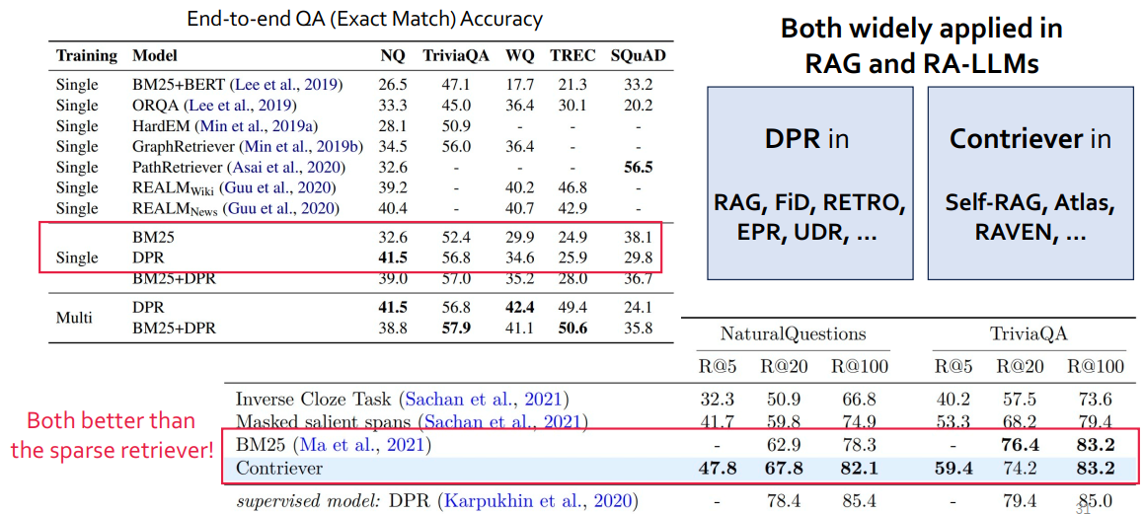
﻿DPR & Contriever Performance on OpenQA Tasks
RAG meet LLMS: Towards Retrieval-Augmented LLMS Tutorial @ KDD 24 - https://advanced-recommender-systems.github.io/RAG-Meets-LLMs/

Slide 25
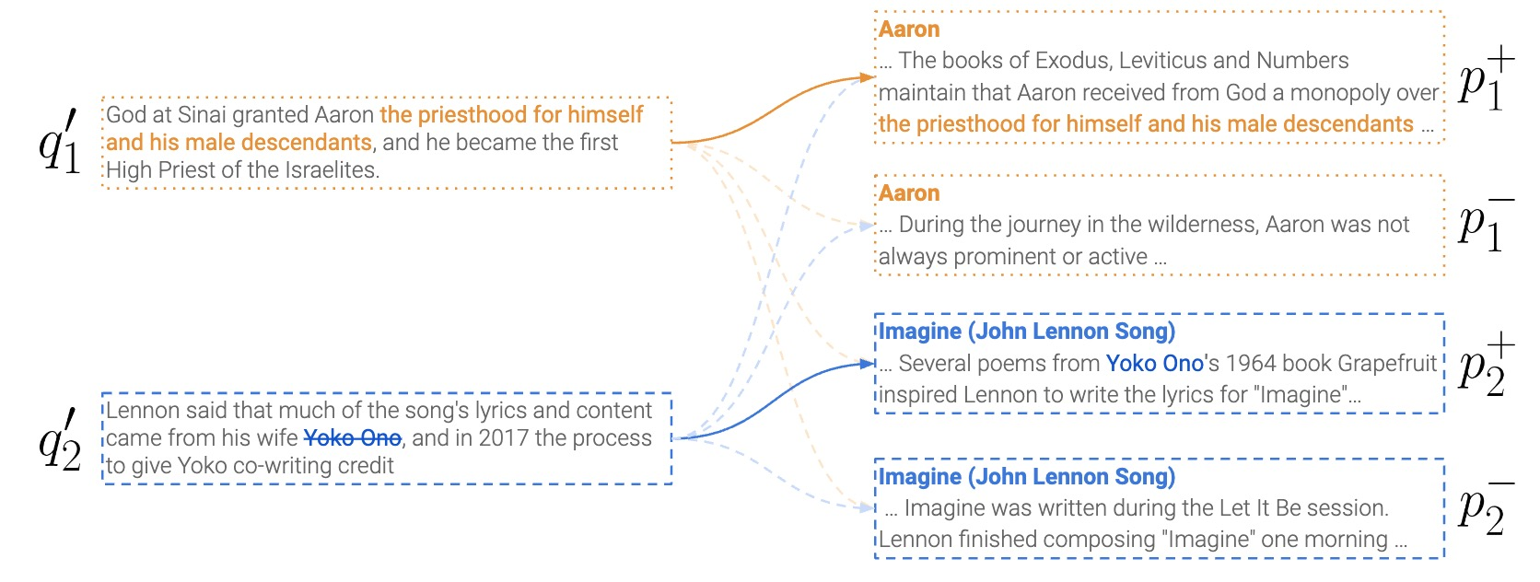
﻿Task-Specific Pre-trained Retriever (Unsupervised)
﻿Spider (Span-based unsupervised dense retriever)
Recurring Span Retrieval: It is based on the notion of recurring spans within a document: given two paragraphs with the same recurring span, we construct a query from one of the paragraphs, while the other is taken as the target for retrieval
﻿Ram et al., 2022, Learning to Retrieve Passages without Supervision
RAG meet LLMS: Towards Retrieval-Augmented LLMS Tutorial @ KDD 24 - https://advanced-recommender-systems.github.io/RAG-Meets-LLMs/

Slide 26
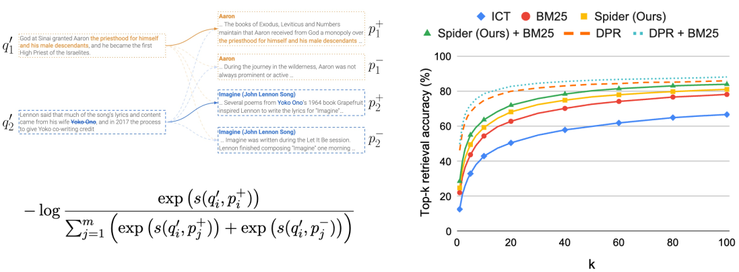
﻿Task-Specific Pre-trained Retriever (Unsupervised)
﻿Learning and results of Spider
﻿Ram et al., 2022, Learning to Retrieve Passages without Supervision
RAG meet LLMS: Towards Retrieval-Augmented LLMS Tutorial @ KDD 24 - https://advanced-recommender-systems.github.io/RAG-Meets-LLMs/

Slide 27
Plan for this lecture
RA-LLM architecture overview
Retriever in RA-LLMs
Retrieval results integration
Pre/Post-retrieval techniques
RAG meet LLMS: Towards Retrieval-Augmented LLMS Tutorial @ KDD 24 - https://advanced-recommender-systems.github.io/RAG-Meets-LLMs/

Slide 28
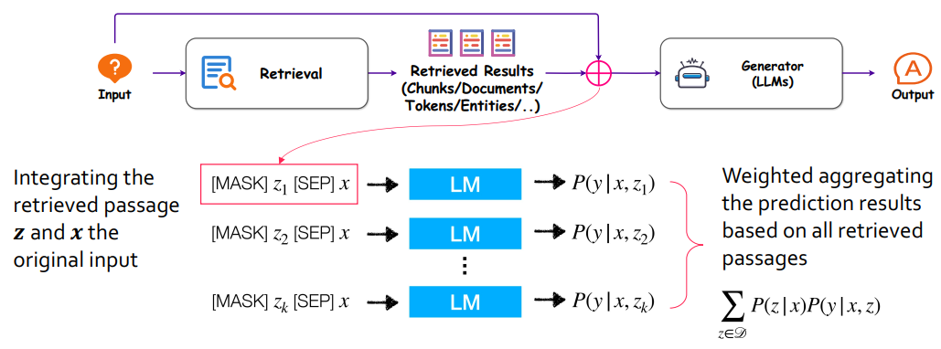
﻿Retrieved Results Integration: Input-layer Integration
REALM
﻿Guu et al. 2020. “REALM: Retrieval-Augmented Language Model Pre-Training”
RAG meet LLMS: Towards Retrieval-Augmented LLMS Tutorial @ KDD 24 - https://advanced-recommender-systems.github.io/RAG-Meets-LLMs/

Slide 29
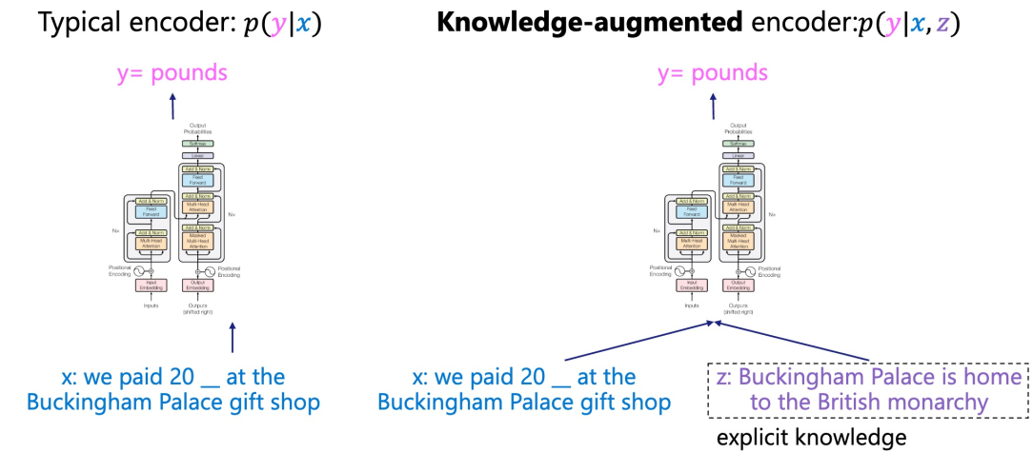
﻿Retrieval-Augmented Generator
RAG meet LLMS: Towards Retrieval-Augmented LLMS Tutorial @ KDD 24 - https://advanced-recommender-systems.github.io/RAG-Meets-LLMs/

Slide 30
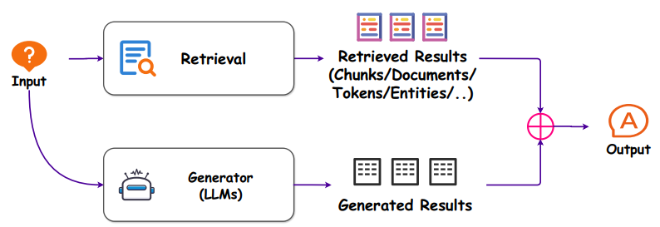
﻿Retrieved Results Integration: Output-layer integration
RAG meet LLMS: Towards Retrieval-Augmented LLMS Tutorial @ KDD 24 - https://advanced-recommender-systems.github.io/RAG-Meets-LLMs/

Slide 31
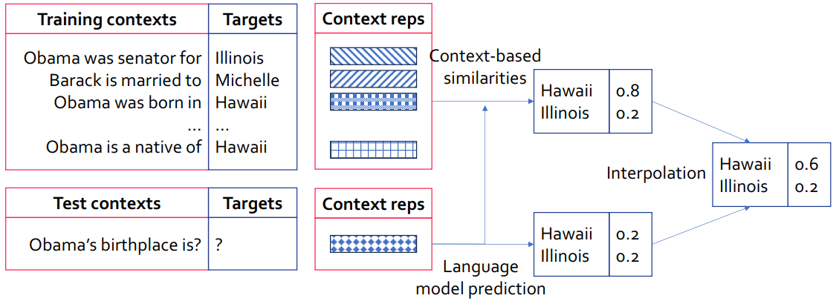
﻿RA-LLM Architecture: Output-layer Integration
﻿kNN-LM: Combining retrieved probabilities and predicted ones in generation
﻿Khandelwal el al. 2019. “Generalization through Memorization: Nearest Neighbor Language Models”
RAG meet LLMS: Towards Retrieval-Augmented LLMS Tutorial @ KDD 24 - https://advanced-recommender-systems.github.io/RAG-Meets-LLMs/

Slide 32
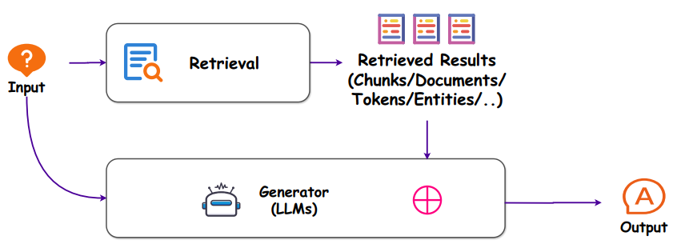
﻿Retrieved Results Integration: Intermediate-layer Integration
﻿Borgeaud et al. 2022. Improving Language Models by Retrieving from Trillions of Tokens
RAG meet LLMS: Towards Retrieval-Augmented LLMS Tutorial @ KDD 24 - https://advanced-recommender-systems.github.io/RAG-Meets-LLMs/

Slide 33
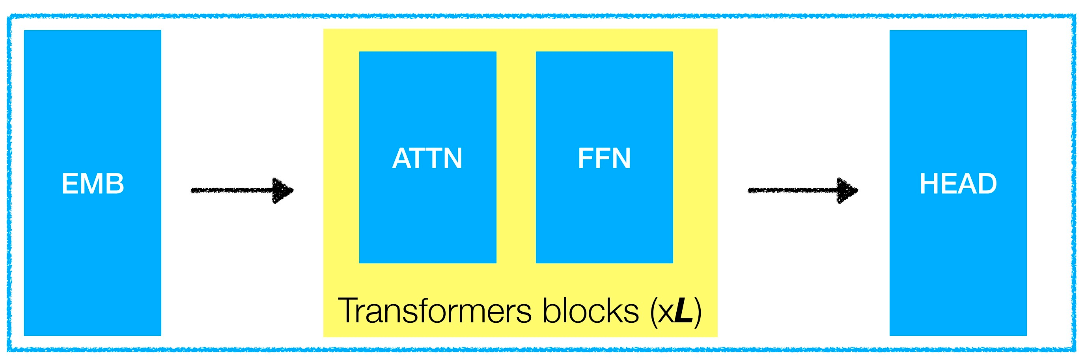
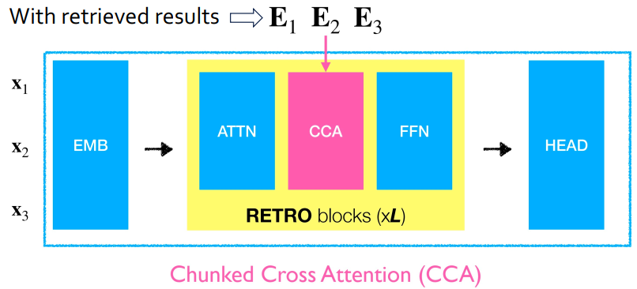
﻿Retrieved Results Integration: Intermediate-layer Integration
Regular Decoder
﻿Decoder to incorporate retrieved results (RETRO)
﻿Borgeaud et al. 2022. Improving Language Models by Retrieving from Trillions of Tokens
RAG meet LLMS: Towards Retrieval-Augmented LLMS Tutorial @ KDD 24 - https://advanced-recommender-systems.github.io/RAG-Meets-LLMs/

Slide 34
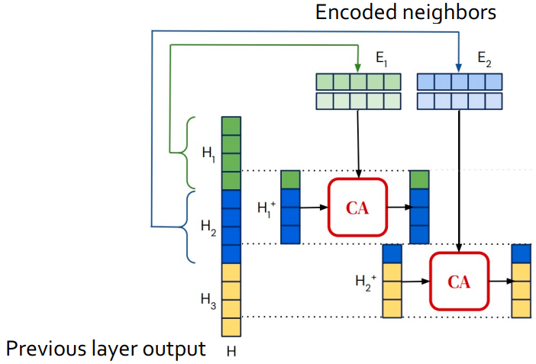
﻿Retrieved Results Integration: Intermediate-layer Integration
RAG meet LLMS: Towards Retrieval-Augmented LLMS Tutorial @ KDD 24 - https://advanced-recommender-systems.github.io/RAG-Meets-LLMs/

Slide 35
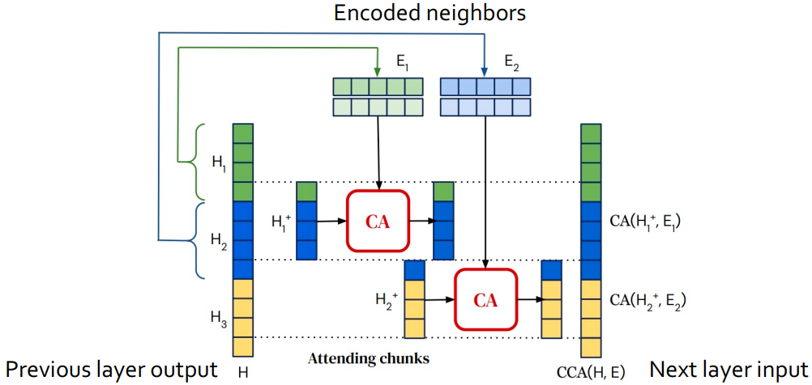
﻿Retrieved Results Integration: Intermediate-layer Integration
RAG meet LLMS: Towards Retrieval-Augmented LLMS Tutorial @ KDD 24 - https://advanced-recommender-systems.github.io/RAG-Meets-LLMs/

Slide 36
Plan for this lecture
RA-LLM architecture overview
Retriever in RA-LLMs
Retrieval results integration
Pre/Post-retrieval techniques
RAG meet LLMS: Towards Retrieval-Augmented LLMS Tutorial @ KDD 24 - https://advanced-recommender-systems.github.io/RAG-Meets-LLMs/

Slide 37
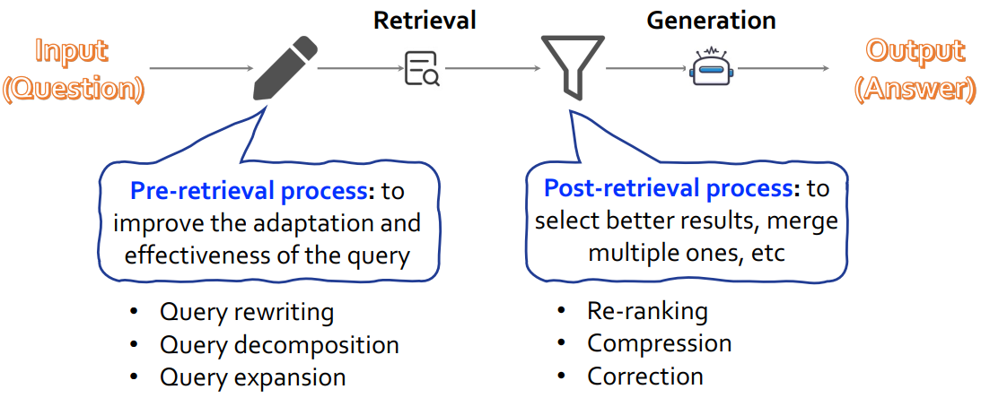
﻿Pre/Post-Retrieval Techniques
RAG meet LLMS: Towards Retrieval-Augmented LLMS Tutorial @ KDD 24 - https://advanced-recommender-systems.github.io/RAG-Meets-LLMs/

Slide 38
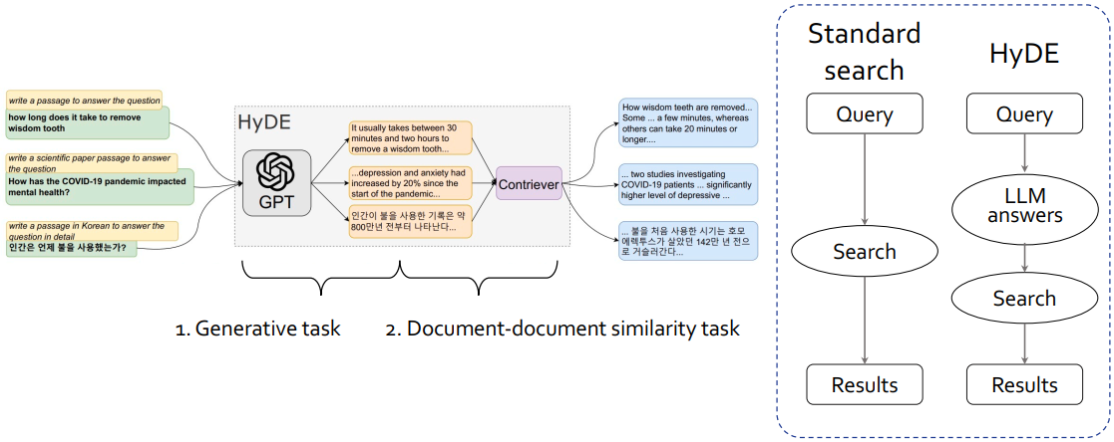
﻿Pre-Retrieval Techniques
﻿Query Rewriting: to improve the adaptation of the query
﻿Gao et al. 2022. “Precise zero-shot dense retrieval without relevance labels”
RAG meet LLMS: Towards Retrieval-Augmented LLMS Tutorial @ KDD 24 - https://advanced-recommender-systems.github.io/RAG-Meets-LLMs/

Slide 39
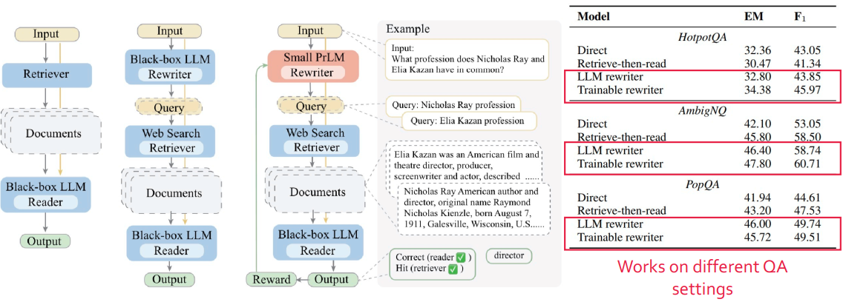
﻿Pre-Retrieval Techniques
﻿HyDE: Hypothetical Document Embeddings
﻿Wang et al. 2023. “Query rewriting for retrieval-augmented large language models”
RAG meet LLMS: Towards Retrieval-Augmented LLMS Tutorial @ KDD 24 - https://advanced-recommender-systems.github.io/RAG-Meets-LLMs/

Slide 40
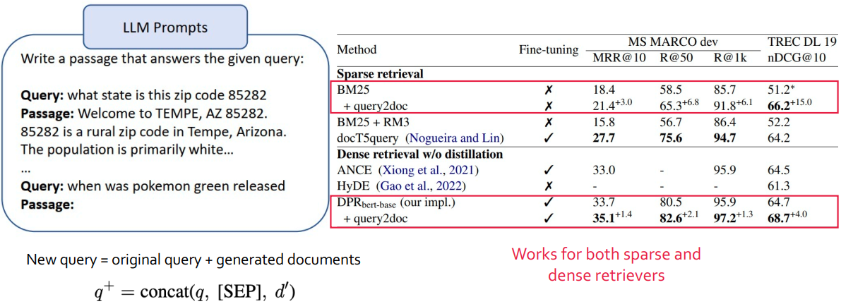
﻿Pre-Retrieval Techniques
﻿Query Expansion
﻿Wang et al. 2023. ”Query2doc: Query Expansion with Large Language Models”
RAG meet LLMS: Towards Retrieval-Augmented LLMS Tutorial @ KDD 24 - https://advanced-recommender-systems.github.io/RAG-Meets-LLMs/

Slide 41
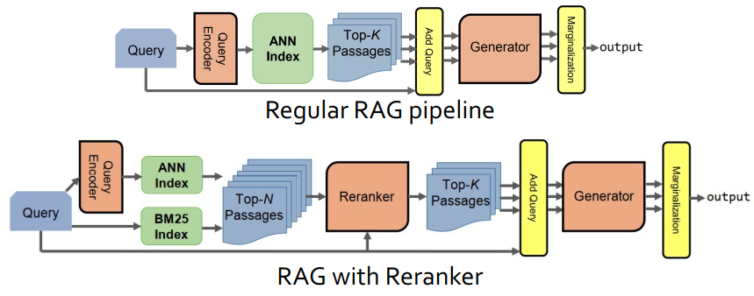
﻿Post-Retrieval Techniques
Retrieved Result Rerank (Re2G)
Results from initial retrieval can be greatly improved through the use of a reranker
Reranker allows merging retrieval results from sources with incomparable scores, e.g., BM25 and neural initial retrieval
﻿Glass et al. 2022. “Re2G: Retrieve, Rerank, Generate”
RAG meet LLMS: Towards Retrieval-Augmented LLMS Tutorial @ KDD 24 - https://advanced-recommender-systems.github.io/RAG-Meets-LLMs/

Slide 42
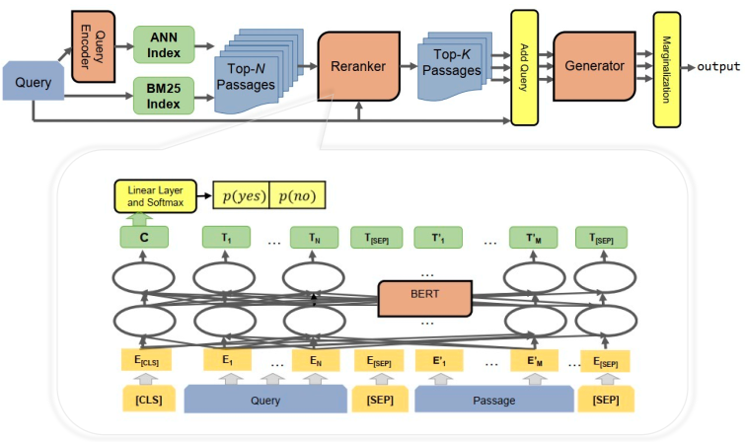
﻿Retrieved Result Rerank (Re2G) Model
﻿Reranker: interaction model based on the sequence-pair classification
﻿Nogueira and Cho, 2019, Passage Re-ranking with BERT
RAG meet LLMS: Towards Retrieval-Augmented LLMS Tutorial @ KDD 24 - https://advanced-recommender-systems.github.io/RAG-Meets-LLMs/

Slide 43
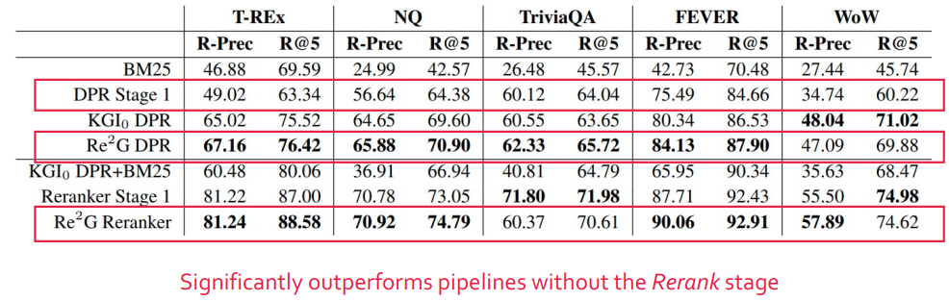
﻿Retrieved Result Rerank (Re2G) Performance
﻿Glass et al. 2022. “Re2G: Retrieve, Rerank, Generate”
RAG meet LLMS: Towards Retrieval-Augmented LLMS Tutorial @ KDD 24 - https://advanced-recommender-systems.github.io/RAG-Meets-LLMs/

Slide 44
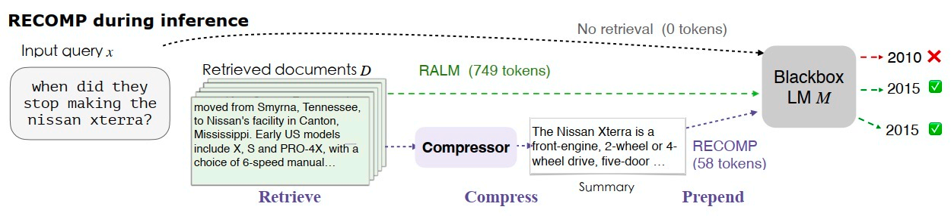
﻿Post-Retrieval Techniques
Retrieved Result Compression
To reduce the computational costs and also relieve the burden of LMs to identify relevant information in long retrieved documents.
Compressor Learning Objectives
Concise
Effective
Faithful
﻿Xu et al. 2023. “RECOMP: Improving retrieval- augmented LMs with context compression and selective augmentation”
RAG meet LLMS: Towards Retrieval-Augmented LLMS Tutorial @ KDD 24 - https://advanced-recommender-systems.github.io/RAG-Meets-LLMs/

Slide 45
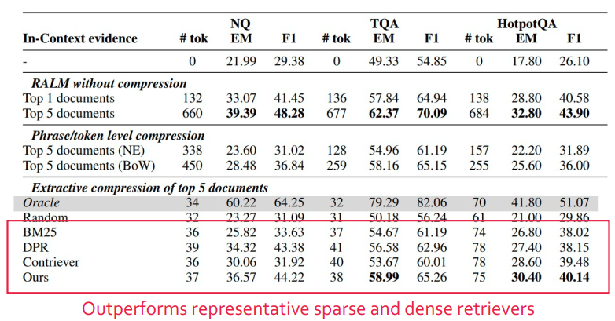
﻿Post-Retrieval Techniques
﻿QA tasks
﻿Xu et al. 2023. “RECOMP: Improving retrieval- augmented LMs with context compression and selective augmentation”
RAG meet LLMS: Towards Retrieval-Augmented LLMS Tutorial @ KDD 24 - https://advanced-recommender-systems.github.io/RAG-Meets-LLMs/

Slide 46
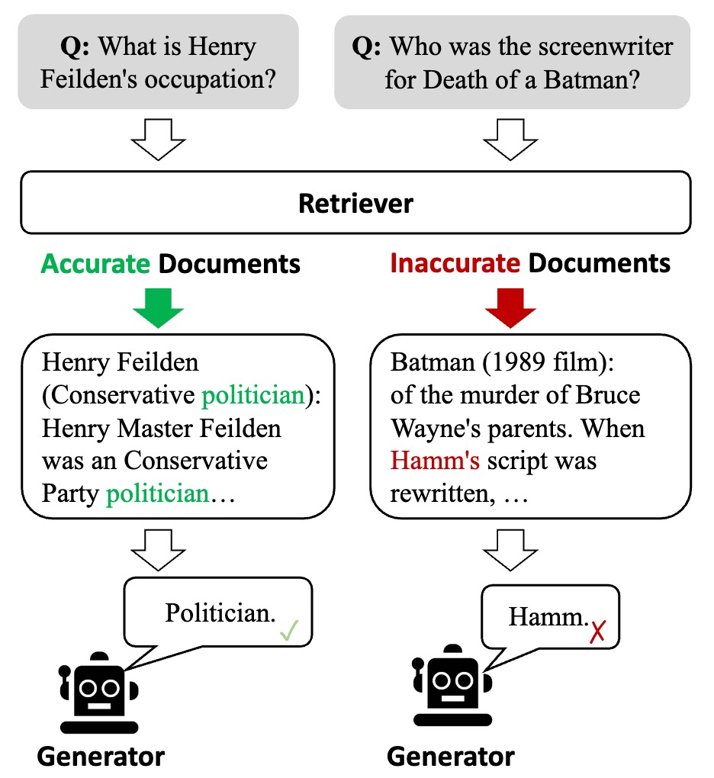
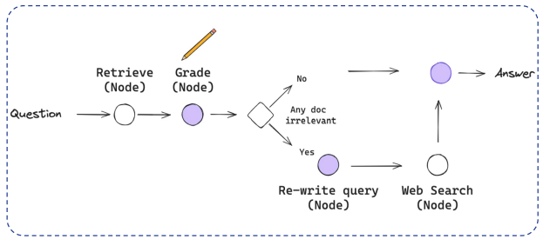
﻿Post-Retrieval Techniques: Corrective RAG
﻿Grading and correcting
﻿Yan et al., 2024, Corrective Retrieval Augmented Generation
RAG meet LLMS: Towards Retrieval-Augmented LLMS Tutorial @ KDD 24 - https://advanced-recommender-systems.github.io/RAG-Meets-LLMs/

Slide 47
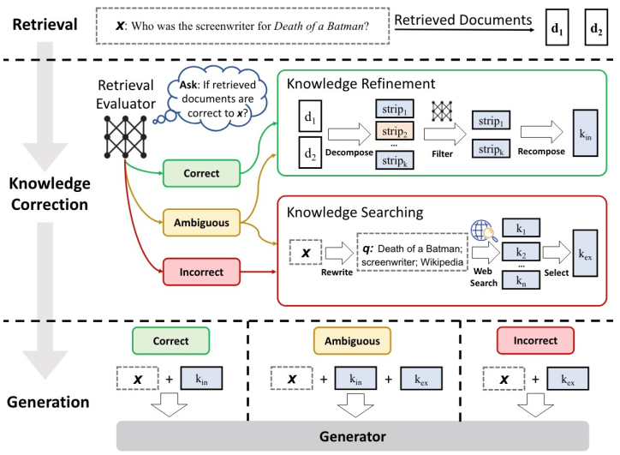
﻿Post-Retrieval Techniques: Corrective RAG
RAG meet LLMS: Towards Retrieval-Augmented LLMS Tutorial @ KDD 24 - https://advanced-recommender-systems.github.io/RAG-Meets-LLMs/

Slide 48
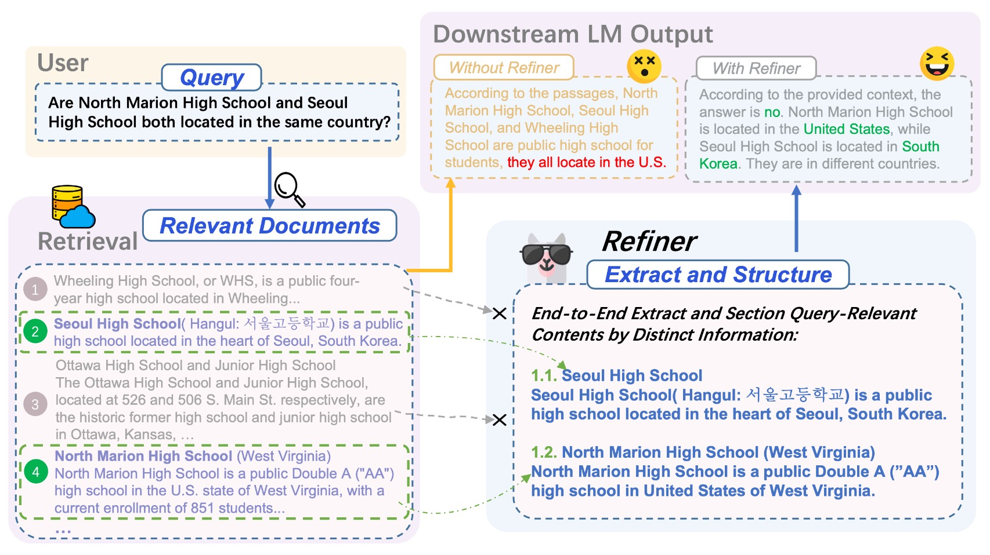
﻿Post-Retrieval Techniques: Refiner
﻿Refiner: leveraging a single decoder-only LLM to adaptively extract query relevant contents verbatim along with the necessary context
﻿Li et al., 2024, Refiner: Restructure Retrieval Content Efficiently to Advance Question-Answering Capabilities
RAG meet LLMS: Towards Retrieval-Augmented LLMS Tutorial @ KDD 24 - https://advanced-recommender-systems.github.io/RAG-Meets-LLMs/

Slide 49
Plan for this lecture
﻿Introduction of Retrieval Augmented Large Language Models (RA LLMs)
Architecture of RA-LLMs and Main Modules
Learning Approach of RA-LLMs
Challenges and Future Directions of RA-LLMs
RAG meet LLMS: Towards Retrieval-Augmented LLMS Tutorial @ KDD 24 - https://advanced-recommender-systems.github.io/RAG-Meets-LLMs/

Slide 50

﻿Learning Approach of RA-LLMs
﻿Training-free Methods
Training-based Methods
Independent Learning
Sequential Learning
Joint Learning
RAG meet LLMS: Towards Retrieval-Augmented LLMS Tutorial @ KDD 24 - https://advanced-recommender-systems.github.io/RAG-Meets-LLMs/

Slide 51
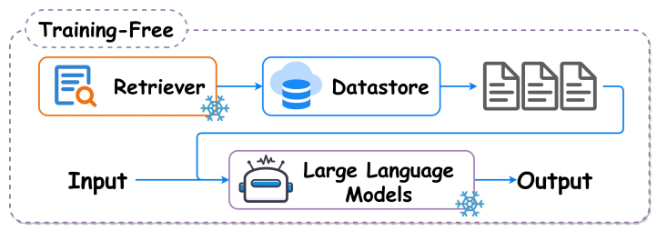
﻿RA-LLM Learning: Training-free
﻿Retrieval models and language models are both frozen.
RAG meet LLMS: Towards Retrieval-Augmented LLMS Tutorial @ KDD 24 - https://advanced-recommender-systems.github.io/RAG-Meets-LLMs/

Slide 52
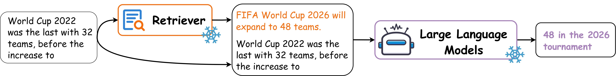
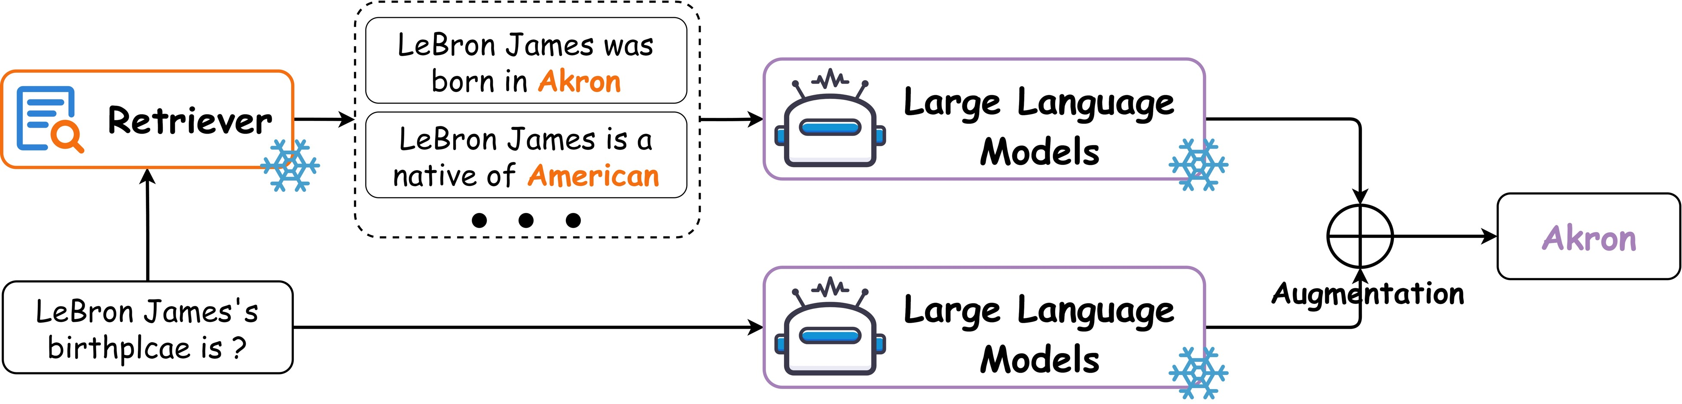
﻿RA-LLM Learning: Training-free
﻿Prompt Engineering-based Methods
﻿Retrieval-Guided Token Generation Methods
RAG meet LLMS: Towards Retrieval-Augmented LLMS Tutorial @ KDD 24 - https://advanced-recommender-systems.github.io/RAG-Meets-LLMs/

Slide 53
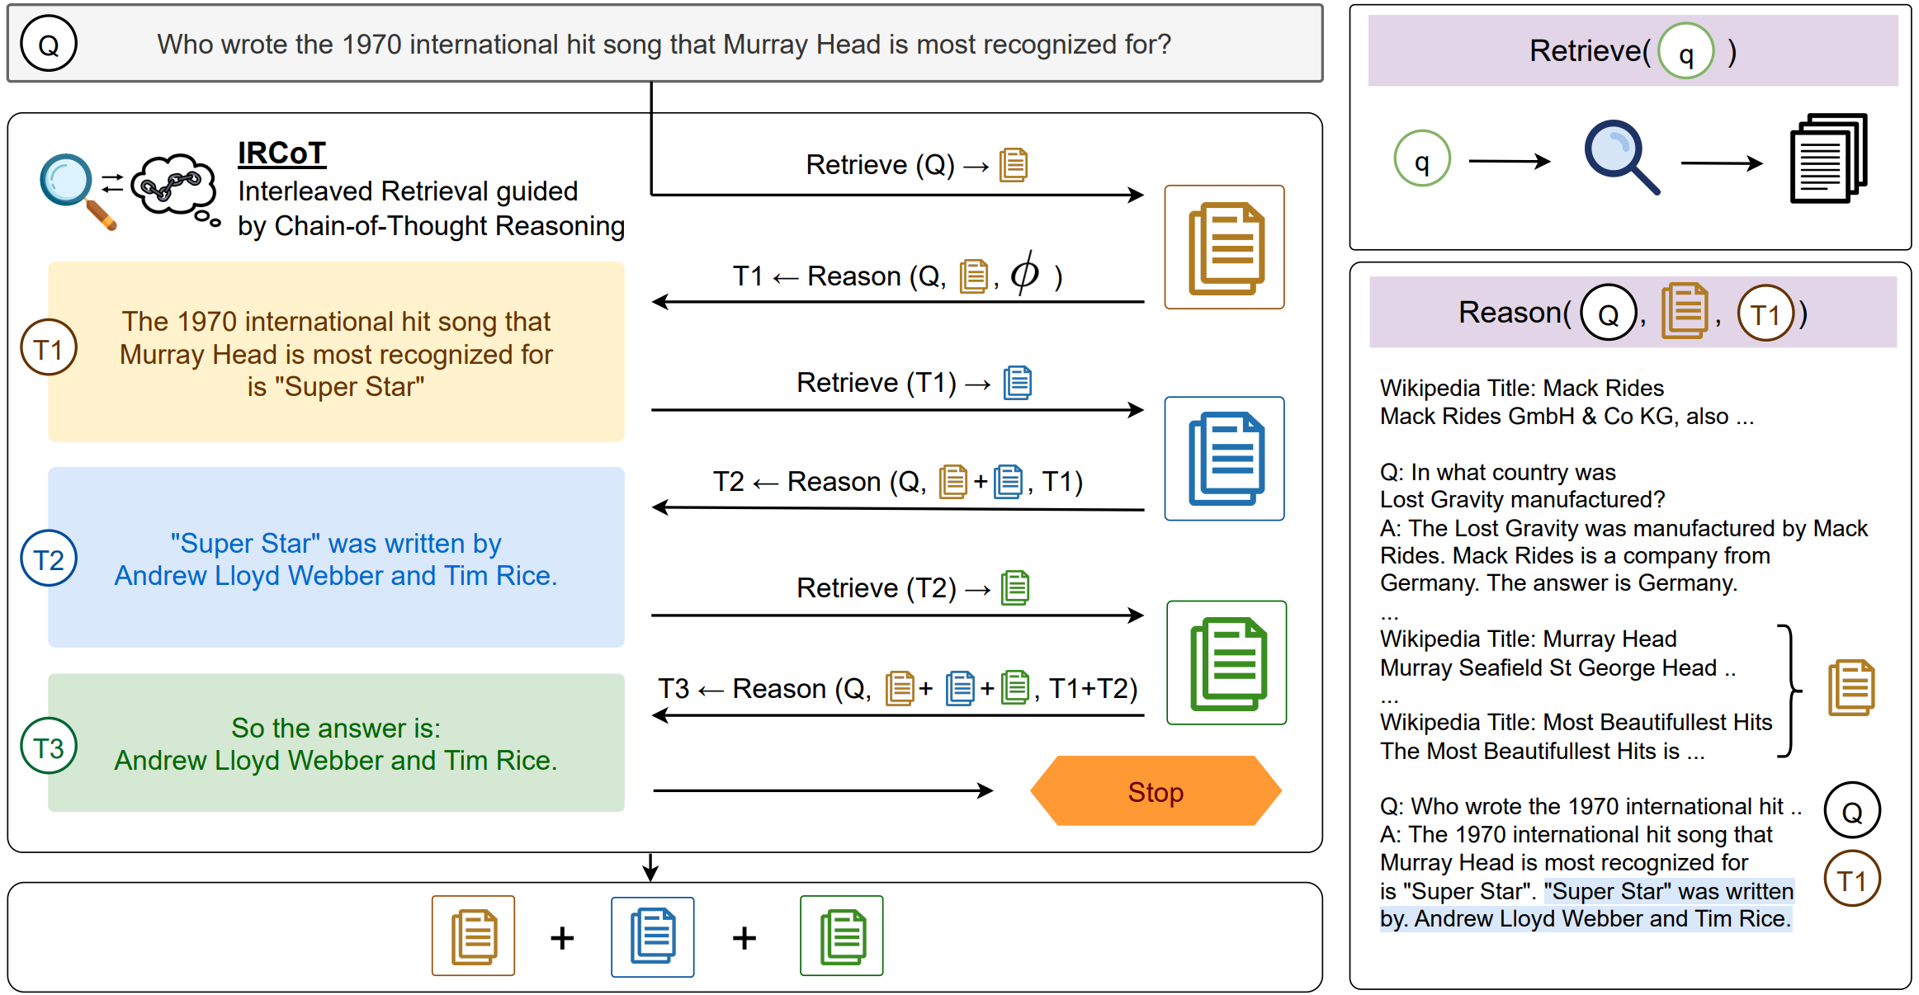
﻿RA-LLM Learning: Training-free
﻿ IRCoT
﻿Trivedi, Harsh, et al. "Interleaving Retrieval with Chain-of-Thought Reasoning for Knowledge-Intensive Multi-Step Questions." ACL. 2023
RAG meet LLMS: Towards Retrieval-Augmented LLMS Tutorial @ KDD 24 - https://advanced-recommender-systems.github.io/RAG-Meets-LLMs/

Slide 54
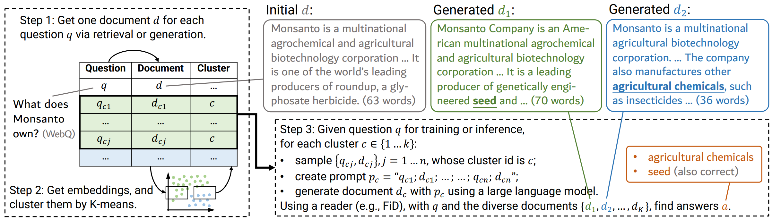
﻿RA-LLM Learning: Training-free
﻿GENREAD
﻿Yu, Wenhao, et al. "Generate rather than Retrieve: Large Language Models are Strong Context Generators." International Conference on Learning Representations. 2023
RAG meet LLMS: Towards Retrieval-Augmented LLMS Tutorial @ KDD 24 - https://advanced-recommender-systems.github.io/RAG-Meets-LLMs/

Slide 55
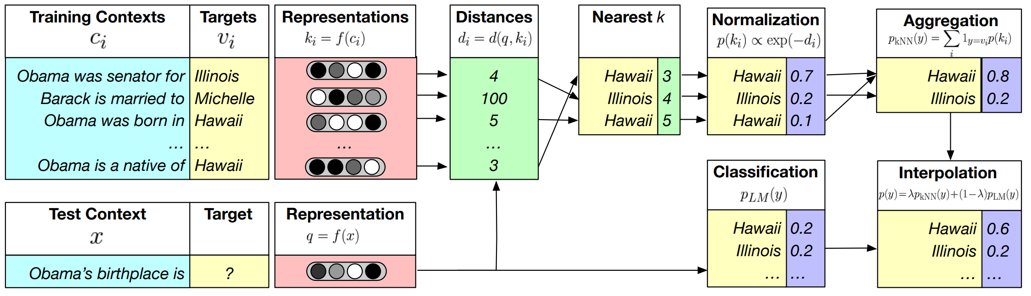
﻿RA-LLM Learning: Training-free
kNN-LM
﻿Khandelwal, Urvashi, et al. "Generalization through Memorization: Nearest Neighbor Language Models." International Conference on Learning Representations. 2019.
RAG meet LLMS: Towards Retrieval-Augmented LLMS Tutorial @ KDD 24 - https://advanced-recommender-systems.github.io/RAG-Meets-LLMs/

Slide 56

﻿RA-LLM Learning: Training-free
﻿REST
﻿He, Zhenyu, et al. "REST: Retrieval-Based Speculative Decoding." NAACL. 2024
RAG meet LLMS: Towards Retrieval-Augmented LLMS Tutorial @ KDD 24 - https://advanced-recommender-systems.github.io/RAG-Meets-LLMs/

Slide 57

﻿RA-LLM Learning: Training-free
RAG meet LLMS: Towards Retrieval-Augmented LLMS Tutorial @ KDD 24 - https://advanced-recommender-systems.github.io/RAG-Meets-LLMs/

Slide 58
﻿Learning Approach of RA-LLMs
﻿Training-free Methods
Training-based Methods
Independent Learning
Sequential Learning
Joint Learning
RAG meet LLMS: Towards Retrieval-Augmented LLMS Tutorial @ KDD 24 - https://advanced-recommender-systems.github.io/RAG-Meets-LLMs/

Slide 59


﻿RA-LLM Learning: Independent Training
﻿Retrieval models and language models are trained independently.
• Independent training of Retriever.
• Independent training of large language models
RAG meet LLMS: Towards Retrieval-Augmented LLMS Tutorial @ KDD 24 - https://advanced-recommender-systems.github.io/RAG-Meets-LLMs/

Slide 60

﻿RA-LLM Learning: Independent Training
﻿Independent training of large language models.
RAG meet LLMS: Towards Retrieval-Augmented LLMS Tutorial @ KDD 24 - https://advanced-recommender-systems.github.io/RAG-Meets-LLMs/

Slide 61
﻿RA-LLM Learning: Independent Training
﻿Retrieval models and language models are trained independently.
• Independent training of Retriever.
• Independent training of large language models
RAG meet LLMS: Towards Retrieval-Augmented LLMS Tutorial @ KDD 24 - https://advanced-recommender-systems.github.io/RAG-Meets-LLMs/

Slide 62

﻿RA-LLM Learning: Independent Training
﻿Sparse retrieval models: TF-IDF / BM25
﻿Ramos, Juan. "Using TF-IDF to determine word relevance in document queries." Proceedings of the first instructional conference on machine learning. 2003.
Robertson, Stephen, and Hugo Zaragoza. "The probabilistic relevance framework: BM25 and beyond." Foundations and Trends® in Information Retrieval. 2009
RAG meet LLMS: Towards Retrieval-Augmented LLMS Tutorial @ KDD 24 - https://advanced-recommender-systems.github.io/RAG-Meets-LLMs/

Slide 63

﻿RA-LLM Learning: Independent Training
﻿ Dense retrieval models: DPR
﻿Karpukhin, Vladimir, et al. "Dense passage retrieval for open-domain question answering." 2020 Conference on Empirical Methods in Natural Language Processing, 2020.
RAG meet LLMS: Towards Retrieval-Augmented LLMS Tutorial @ KDD 24 - https://advanced-recommender-systems.github.io/RAG-Meets-LLMs/

Slide 64

﻿RA-LLM Learning: Independent Training
﻿Dense retrieval models: CoG
﻿Tian Lan, et al. “Copy is All You Need.” In The Eleventh International Conference on Learning Representations, 2022.
RAG meet LLMS: Towards Retrieval-Augmented LLMS Tutorial @ KDD 24 - https://advanced-recommender-systems.github.io/RAG-Meets-LLMs/

Slide 65

﻿RA-LLM Learning: Independent Training
﻿Model Training:
﻿Tian Lan, et al. “Copy is All You Need.” In The Eleventh International Conference on Learning Representations, 2022.
RAG meet LLMS: Towards Retrieval-Augmented LLMS Tutorial @ KDD 24 - https://advanced-recommender-systems.github.io/RAG-Meets-LLMs/

Slide 66

﻿RA-LLM Learning: Independent Training
RAG meet LLMS: Towards Retrieval-Augmented LLMS Tutorial @ KDD 24 - https://advanced-recommender-systems.github.io/RAG-Meets-LLMs/

Slide 67
﻿Learning Approach of RA-LLMs
﻿Training-free Methods
Training-based Methods
Independent Learning
Sequential Learning
Joint Learning
RAG meet LLMS: Towards Retrieval-Augmented LLMS Tutorial @ KDD 24 - https://advanced-recommender-systems.github.io/RAG-Meets-LLMs/

Slide 68

﻿RA-LLM Learning: Sequential Training
﻿One component is first trained independently and then fixed.
The other component is trained with an objective that depends on the first one
RAG meet LLMS: Towards Retrieval-Augmented LLMS Tutorial @ KDD 24 - https://advanced-recommender-systems.github.io/RAG-Meets-LLMs/

Slide 69

﻿RA-LLM Learning: Sequential Training
﻿RETRO
﻿Borgeaud et al. 2022. Improving Language Models by Retrieving from Trillions of Tokens
RAG meet LLMS: Towards Retrieval-Augmented LLMS Tutorial @ KDD 24 - https://advanced-recommender-systems.github.io/RAG-Meets-LLMs/

Slide 70
﻿RA-LLM Learning: Sequential Training
﻿One component is first trained independently and then fixed.
The other component is trained with an objective that depends on the first one
RAG meet LLMS: Towards Retrieval-Augmented LLMS Tutorial @ KDD 24 - https://advanced-recommender-systems.github.io/RAG-Meets-LLMs/

Slide 71




﻿RA-LLM Learning: Sequential Training
﻿REPLUG (Retrieve and Plug)
﻿Shi, Weijia, et al. "REPLUG: Retrieval-Augmented Black-Box Language Models." NAACL. 2024.
RAG meet LLMS: Towards Retrieval-Augmented LLMS Tutorial @ KDD 24 - https://advanced-recommender-systems.github.io/RAG-Meets-LLMs/

Slide 72


﻿RA-LLM Learning: Sequential Training
﻿AAR (Augmentation-Adapted Retriever)
﻿Yu, Zichun, et al. "Augmentation-Adapted Retriever Improves Generalization of Language Models as Generic Plug-In." ACL. 2023.
RAG meet LLMS: Towards Retrieval-Augmented LLMS Tutorial @ KDD 24 - https://advanced-recommender-systems.github.io/RAG-Meets-LLMs/

Slide 73

﻿RA-LLM Learning: Sequential Training
RAG meet LLMS: Towards Retrieval-Augmented LLMS Tutorial @ KDD 24 - https://advanced-recommender-systems.github.io/RAG-Meets-LLMs/

Slide 74
﻿Learning Approach of RA-LLMs
﻿Training-free Methods
Training-based Methods
Independent Learning
Sequential Learning
Joint Learning
RAG meet LLMS: Towards Retrieval-Augmented LLMS Tutorial @ KDD 24 - https://advanced-recommender-systems.github.io/RAG-Meets-LLMs/

Slide 75

﻿RA-LLM Learning: Joint Training
﻿Retrieval models is and language models are trained jointly.
RAG meet LLMS: Towards Retrieval-Augmented LLMS Tutorial @ KDD 24 - https://advanced-recommender-systems.github.io/RAG-Meets-LLMs/

Slide 76

﻿RA-LLM Learning: Joint Training
RAG meet LLMS: Towards Retrieval-Augmented LLMS Tutorial @ KDD 24 - https://advanced-recommender-systems.github.io/RAG-Meets-LLMs/

Slide 77


﻿RA-LLM Learning: Sequential Training
﻿REALM
﻿Guu et al. 2020. “REALM: Retrieval-Augmented Language Model Pre-Training”
RAG meet LLMS: Towards Retrieval-Augmented LLMS Tutorial @ KDD 24 - https://advanced-recommender-systems.github.io/RAG-Meets-LLMs/

Slide 78

﻿RA-LLM Learning: Sequential Training
﻿REALM
﻿Guu et al. 2020. “REALM: Retrieval-Augmented Language Model Pre-Training”
RAG meet LLMS: Towards Retrieval-Augmented LLMS Tutorial @ KDD 24 - https://advanced-recommender-systems.github.io/RAG-Meets-LLMs/

Slide 79

﻿RA-LLM Learning: Sequential Training
﻿REALM
﻿Guu et al. 2020. “REALM: Retrieval-Augmented Language Model Pre-Training”
RAG meet LLMS: Towards Retrieval-Augmented LLMS Tutorial @ KDD 24 - https://advanced-recommender-systems.github.io/RAG-Meets-LLMs/

Slide 80

﻿RA-LLM Learning: Sequential Training
﻿REALM – Asynchronous Index Update
﻿Guu et al. 2020. “REALM: Retrieval-Augmented Language Model Pre-Training”
RAG meet LLMS: Towards Retrieval-Augmented LLMS Tutorial @ KDD 24 - https://advanced-recommender-systems.github.io/RAG-Meets-LLMs/

Slide 81

﻿RA-LLM Learning: Sequential Training
﻿TRIME – In-Batch Approximation
﻿Zhong et al., 2022. “Training Language Models with Memory Augmentation”
RAG meet LLMS: Towards Retrieval-Augmented LLMS Tutorial @ KDD 24 - https://advanced-recommender-systems.github.io/RAG-Meets-LLMs/

Slide 82

﻿RA-LLM Learning: Sequential Training
﻿TRIME
﻿Zhong et al., 2022. “Training Language Models with Memory Augmentation”
RAG meet LLMS: Towards Retrieval-Augmented LLMS Tutorial @ KDD 24 - https://advanced-recommender-systems.github.io/RAG-Meets-LLMs/

Slide 83

﻿RA-LLM Learning: Sequential Training
﻿TRIME Data Batching Strategy
﻿Zhong et al., 2022. “Training Language Models with Memory Augmentation”
RAG meet LLMS: Towards Retrieval-Augmented LLMS Tutorial @ KDD 24 - https://advanced-recommender-systems.github.io/RAG-Meets-LLMs/

Slide 84
Plan for this lecture
﻿Introduction of Retrieval Augmented Large Language Models (RA LLMs)
Architecture of RA-LLMs and Main Modules
Learning Approach of RA-LLMs
Challenges and Future Directions of RA-LLMs
RAG meet LLMS: Towards Retrieval-Augmented LLMS Tutorial @ KDD 24 - https://advanced-recommender-systems.github.io/RAG-Meets-LLMs/

Slide 85

﻿Trustworthy LLMs/RAG/RA-LLMs
﻿RA-LLMs bring benefits to humans, but
Unreliable output
Unequal treatment during the decision-making process
A lack of transparency and explainability
Privacy issues
……
RAG meet LLMS: Towards Retrieval-Augmented LLMS Tutorial @ KDD 24 - https://advanced-recommender-systems.github.io/RAG-Meets-LLMs/

Slide 86

﻿Trustworthy: ﻿Safety and Robustness
﻿External knowledge introduces new avenues for adversarial attacks.
﻿Deng, Gelei, et al. "Pandora: Jailbreak gpts by retrieval augmented generation poisoning." arXiv preprint arXiv:2402.08416 (2024).
RAG meet LLMS: Towards Retrieval-Augmented LLMS Tutorial @ KDD 24 - https://advanced-recommender-systems.github.io/RAG-Meets-LLMs/

Slide 87

﻿Trustworthy: ﻿Safety and Robustness
﻿CheatAgent is developed to harness the human-like capabilities of LLMs to generate perturbations and mislead the LLM-based RecSys
﻿Ning, Liangbo, et al."CheatAgent: Attacking LLM-Empowered Recommender Systems via LLM Agent." KDD (2024).
RAG meet LLMS: Towards Retrieval-Augmented LLMS Tutorial @ KDD 24 - https://advanced-recommender-systems.github.io/RAG-Meets-LLMs/

Slide 88

﻿Trustworthy: ﻿﻿Non-Discrimination and Fairness
﻿Can RAG be utilized to develop more fair LLMs?
﻿Shrestha, Robik, et al. "FairRAG: Fair human generation via fair retrieval augmentation." Proceedings of the IEEE/CVF Conference on Computer Vision and Pattern Recognition. 2024.
RAG meet LLMS: Towards Retrieval-Augmented LLMS Tutorial @ KDD 24 - https://advanced-recommender-systems.github.io/RAG-Meets-LLMs/

Slide 89

﻿Trustworthy: ﻿﻿﻿Explainability
﻿How to explain the generation process of the RA-LLMs?
RAG meet LLMS: Towards Retrieval-Augmented LLMS Tutorial @ KDD 24 - https://advanced-recommender-systems.github.io/RAG-Meets-LLMs/

Slide 90

﻿Trustworthy: ﻿﻿﻿﻿Privacy
﻿ External databases may contain private information, leading to privacy leaking risks.
﻿Zeng, Shenglai, et al. "The good and the bad: Exploring privacy issues in retrieval-augmented generation (rag)." arXiv preprint arXiv:2402.16893 (2024).
RAG meet LLMS: Towards Retrieval-Augmented LLMS Tutorial @ KDD 24 - https://advanced-recommender-systems.github.io/RAG-Meets-LLMs/

Slide 91

﻿Multi-Modal RA-LLMs
﻿Various modalities can provide richer contextual information.
﻿Cui, Wanqing, et al. "MORE: Multi-mOdal REtrieval Augmented Generative Commonsense Reasoning." arXiv preprint arXiv:2402.13625 (2024).
RAG meet LLMS: Towards Retrieval-Augmented LLMS Tutorial @ KDD 24 - https://advanced-recommender-systems.github.io/RAG-Meets-LLMs/

Slide 92

﻿Quality of External Knowledge
﻿The introduction of some texts that deviate from facts might even mislead the model’s generation process.
RAG meet LLMS: Towards Retrieval-Augmented LLMS Tutorial @ KDD 24 - https://advanced-recommender-systems.github.io/RAG-Meets-LLMs/

Slide 93

﻿Mamba-based RA-LLMs
﻿Transformer-based LLMs face computational efficiency challenges because of the quadratic complexity of attention mechanisms.
﻿“A Survey of Mamba”. https://arxiv.org/pdf/2408.01129, 2024
RAG meet LLMS: Towards Retrieval-Augmented LLMS Tutorial @ KDD 24 - https://advanced-recommender-systems.github.io/RAG-Meets-LLMs/

