Slide 1
CS 441: Infinite Cardinalities
PhD. Nils Murrugarra-Llerena
nem177@pitt.edu

Slide 2
Today's topics
Defining cardinality for infinite sets
How can sequences help?
Countability and proving sets countable
Proving a set uncountable

Slide 3
We can use the notion of sequences to analyze the cardinality of infinite sets
Definition: Two sets A and B have the same cardinality if and only if there is a one-to-one correspondence (a bijection) from A to B.
Definition: A finite set or a set that has the same cardinality as the natural numbers (or the positive integers) is called countable. A set that is not countable is called uncountable.
Implication: Any sequence {a_{n}} ranging over the natural numbers is countable.

Slide 4
Yes, the cardinalities of the natural numbers and positive integers are the same!
f: N → Z⁺, f(x) = x + 1
This maps natural numbers to positive integers
Every positive integer k (codomain) is mapped by natural number k-1 [surjection]
No two natural numbers have the same mapping [injection]
That is, if x+1 = y+1, then x = y
Thus, f is a bijection, and |N| = |Z⁺|
Both have cardinality countably infinite
Even though N contains 0 and Z⁺ does not, cardinality is equal
What about Z?
Seemingly twice as many elements as Z⁺
Exercise on the board
Notes:
---------------
| x | ( absolute value )
Surjection --> Every positive integer is mapped from +- number. Covers all co-domain
Injection --> No

Slide 5
Yes, the cardinalities of the natural numbers and positive integers are the same!
f: Z → Z⁺,
This maps integers to positive integers
Every positive integer k (codomain) is mapped by interleaved positive/negative integers [surjection]
No two integer numbers have the same mapping [injection]
That is, if f(x) = f(y), then x = y
Thus, f is a bijection, and |Z| = |Z⁺|
Both have cardinality countably infinite
Even though Z contains 0 and negative numbers, and Z⁺ does not, cardinality is equal
0
1
-1
2
-2
3
-3
4
-4
5
…
1
2
3
4
5
6
7
8
9
10
…
Notes:
---------------
| x | ( absolute value )
Surjection --> Every positive integer is mapped from +- number. Covers all co-domain
Injection --> No

Slide 6
Show that the set of even positive integers is countable
Proof #1 (Graphical): We have the following one-to-one correspondence between the positive integers and the even positive integers:
So, the even positive integers are countable. ❏
Proof #2: We can define the even positive integers as the sequence {2k} for all k ∈ Z⁺, so it has the same cardinality as Z⁺, and is thus countable. ❏
1
2
3
4
5
6
7
8
9
10
…
2
4
6
8
10
12
14
16
18
20
…

Slide 7
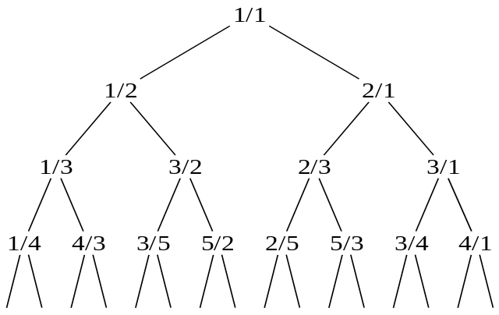
Surprisingly, the set of positive rationals is also countable
Consider a binary tree of rationals, with root node $\frac{1}{1}$
For each node containing $\frac{a}{b}$, let its children be $\frac{a}{a+b}$ and $\frac{a+b}{b}$
Traverse this tree in level-order fashion, assigning to the natural numbers in order
i.e., go across the first level, then second level, etc.
$\frac{1}{1}, \frac{1}{2}, \frac{2}{1}, \frac{1}{3}, \frac{3}{2}, \frac{2}{3}, \frac{3}{1}, …$
We just need to show that all positive rational numbers appear exactly once
Notes:
Note that left childs are always <1, right childs are always >1

Slide 8
Proof sketch that Calkin-Wilf tree contains every positive rational
First, note that every child has a larger sum of numerator + denominator than its parent
Consider an arbitrary positive rational, $\frac{a}{b}$, where $a$ and $b$ are positive integers
If $\frac{a}{b}=1$ and thus $a=b$:
This is the root, so it is in the tree
If $\frac{a}{b}<1$ and thus $a<b:$
This would be the left child of $\frac{a}{b−a}$, also a positive rational
If $\frac{a}{b}>1$ and thus $a>b$:
This would be the right child of $\frac{a−b}{b}$, also a positive rational
Since all non-root cases have a parent that is closer to $\frac{1}{1}$, repeatedly applying this logic will eventually reach the root
Analyze most to the left, and most to the right branches
Apply this logic for all intermediate node in the tree
Notes:
Note that this does not prove they’re reduced, but we could just ignore duplicates
See all nodes in left branches (left, left, left, … )
See all nodes in right branches (right, right, right, …)

Slide 9
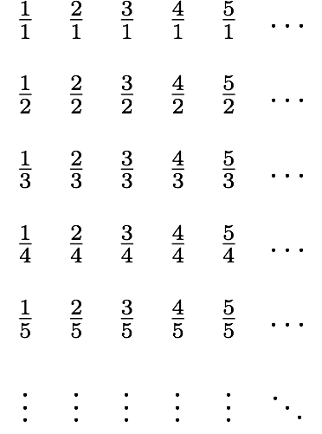
Another way to show the rationals are countable
This yields the sequence 1/1, 1/2, 2/1, 3/1, 1/3, …, so the set of rational numbers is countable. ❏
Notes:
List p+q = 2 first, then p+q = 3, p+q =4, …
Whenever we encounter a number p/q that is already listed, we do not list it again. For example, when we come to 2/2, we do not list it again
Uncircle number are those we leave out
----
Analyze be rows and columns, 1st row, 1st column

Slide 10
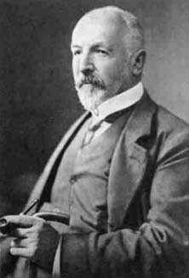
Is the set of real numbers countable?
No, it is not. We can prove this using a proof method called diagonalization, invented by Georg Cantor.
Proof: Assume that the set of real numbers is countable. Then the subset of real numbers between 0 and 1 is also countable, by definition. This implies that the real numbers can be listed in some order, say, r1, r2, r3 ….
Let the decimal representation these numbers be:
r1 = 0.d₁₁d₁₂d₁₃d₁₄…
r2 = 0.d₂₁d₂₂d₂₃d₂₄…
r3 = 0.d₃₁d₃₂d₃₃d₃₄…
…
Where d_{ij} ∈ {0,1,2,3,4,5,6,7,8,9} ∀i,j

Slide 11
Proof (continued)
Now, form a new decimal number r=0.d₁d₂d₃… where d_{i} = 0 if d_{ii} = 1, and d_{i}=1 otherwise.
Example:
r₁ = 0.123456…
r₂ = 0.234524…
r₃ = 0.631234…
…
r = 0.010…
Note that the i^{th} decimal place of r differs from the i^{th} decimal place of each r_{i}, by construction. Thus r is not included in the list of all real numbers between 0 and 1. This is a contradiction of the assumption that all real numbers between 0 and 1 could be listed. Thus, not all real numbers can be listed, and R is uncountable. ❏
Note: r can not be the same number as r₁, r₂, r₃, …. because it already has a different digit.
Notes:
r can not be the same number as r1, r2, or r3 because it already have a different digit.

Slide 12
Final thoughts
We can use sequences to help us compare the cardinality of infinite sets
Prove a set is countable by demonstrating a bijection to another countable set
Prove a set uncountable using diagonalization
Next time:
Algorithms (Section 3.1)

