Slide 1
Retrieval Effectiveness of an Ontology-based Model for Information Selection
Khan, L., McLeod, D. & Hovy, E.
Presented by Danielle Lee

Slide 2
Agenda
Study Purpose
Target Data Processing
Ontology Development
Metadata
Query Mechanism
Experiment
Results
Discussion

Slide 3
Study Purpose
Keyword based search retrieves documents containing user’s specified keyword.
To find the documents containing the desired semantic information, even though they don’t have the user-specific keywords
To develop and evaluate disambiguation algorithm pruning irrelevant concepts and expand information selection using ontology.
Extraction of the semantic concepts from the keywords.
Document Indexing.

Slide 4
Target Data Processing
Sports news audio clip from CNN and FOX.
Segmentation of audio
Identify entry points/jump location as the boundaries of news items of interest.
Content extraction
Closed captions from CNN Web site and Fox Sports rather than labor intensive speech recognition
Definition of an audio object
To specify the content of segments.
A sequence of contiguous segments is defined as an audio objects
Each object specified as metadata such as object ID, starting time, ending time, description.
Notes:
Within a broadcast audio stream, some items are of interest to the user and some are not.
<entry points>
Change of speaker
Long pauses ➔ Short-time energy measurements were used.

Slide 5
Ontology Development (1)
Sport news domain dependent ontology
Each concept has unique name and synonyms list
The synonyms list is used for disambiguation of keyword.
Interrelationships
Specialization /concept inclusion (IS-A)
Exclusive and non-exclusive
Generalized concept (super concept) in exclusive relation is called as nonparticipant concept (NPC), which is not utilized in metadata generation and SQL query generation
ex) “NFL” is a kind of “Professional” league. “Professional” is NPC.
Instantiation (Instance-Of)
ex) All players and teams are instances of the concepts “Player” and “Team.”
Component membership (Part-Of)
ex) “NFL” is part-of the concept “football.”
Notes:
Exclusive means that the union of specialized concepts (or sub concepts) is equal to the generalized concept.
On the other hand, for non-exclusive relation, the union of specialized concepts is not equal to the generalized concept.

Slide 6
Ontology Development (2)
Disjunct concepts
A number of concepts associated with a parent concept through IS-A interrelationships.
Object having a disjunct concept as the metadata cannot associated with another object having another disjunct concept. ➔ this is helpful for disambiguation of concepts.
ex) Object having “NBA” and object having “NFL”.
This grouping makes regions.
Creating an ontology
All possible concepts are listed, concepts are grouped using Yahoo’s hierarchy (Team, player, manager, etc.)
Max depth of concept is six, and max no. of branching factor is 28.

Slide 7
Test for Ontology Coverage
Aim : to select concepts from ontologies for the annotated text of audio clips from CNN and Fox sports news.
90.5% of the clips are associated with concepts of ontologies.
9.5% of the clips failed to find the relevant concepts.
It is due to the incompleteness of ontology.

Slide 8
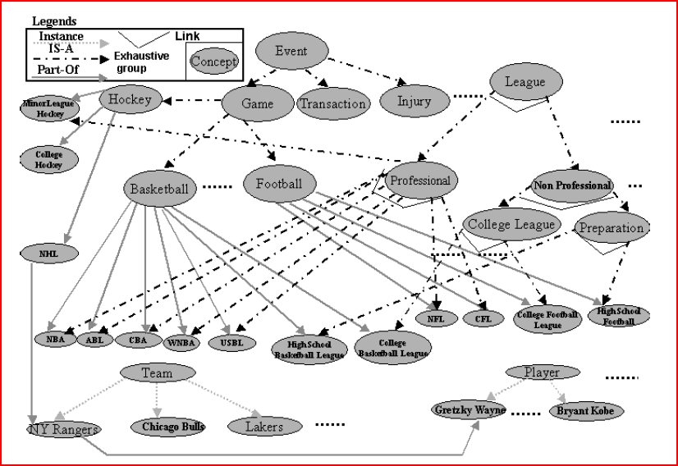
Developed Ontology

Slide 9
Metadata
To name the concepts of audio objects.
Using a descriptive keywords acquired by content extraction, they made a connection the description with terms in ontology
Descriptive keywords : concept = 1 : many
Disambiguation algorithm is needed.
Co-occurrence
Semantic closeness
Notes:
If base, bat or gloves take together the intent, the meaning can be obvious. That is the cooccurence.

Slide 10
Query Mechanism (1)
After keywords in the user request are matched to concepts, the generation of a DB query takes place.
Through the list of synonyms of each keyword, the related concepts are found.
1) Pruning irrelevant concepts
2) Query expansion and SQL query generation

Slide 11
Query Mechanism (2)
1) Pruning irrelevant concepts
Element-score and Concept score : to choose the most appropriate concept.
Semantic distance : the shortest path between two concepts in ontology
Propagated-score
Notes:
Among several synonym lists, they try to choose the list having the largest match with user’ keywords

Slide 12
Partial Ontology of Selected Concepts
NBA
Vancouver Grizzlies
Cleveland
Cavaliers
Los Angeles
Lakers
New Jersey
Nets
Score = 0.5
Propagated Score = 1.5
Bryant
Reeves
Mark
Bryant
Kobe Bryant
Score = 0.5
P-Score = 0.5
Score = 0.5
P-Score = 0.5
Score = 1.0
P-Score = 1.5

Slide 13
Query Mechanism (3)
2) Query expansion and SQL query generation
If the selected concept is not NPC type nor leaf node concept, no further progress.
Otherwise each concept is added in disjunctive form.
ex) Tell me about Los Angeles Lakers
SELECT Time_start, Time_end
FROM Audio_news a, Meta_news m
WHERE a.Id = m.Id
AND (Label = “NBATeam 11”
OR Label = “NBAPlayer9” OR Label = “NBAPlayer10” …)
Notes:
NPC concepts are expressed exhaustively as a collection of more specific concepts and non-leaf node concept has also the child concept.

Slide 14
Experiment
Independent Variables
Search mechanism (Keyword based search vs. Query expansion using ontology)
Vector space model based keyword search
The kind of queries
Broader/generic queries (ex. “tell me about basketball”)
Narrow/specific queries (ex. “tell me about Los Angeles Lakers”)
Context query formation (ex. “Tell me Laker’s Kobe/Boxer Mike Tyson”)
Dependent variables
Precision
Recall
F value (the combined value of precision and recall)
2481 Audio clips (usually less than 5 min .wav or .ram files with closed captions) and around 7000 concepts in ontology.

Slide 15
Analytical Results Equation
The higher Only BOTH precision and recall are, the higher F score is
When no relevant documents have been retrieved, the F score is 0.
When all retrieved documents are relevant, the F score is 1.

Slide 16
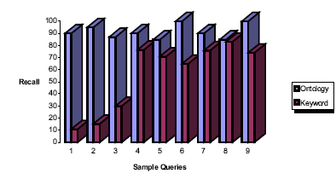
Result (Recall)
Generic/Broader
Queries
Specific/Narrow
Queries
Context
Queries

Slide 17
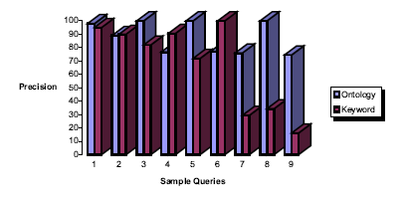
Result (Precision)
Generic/Broader
Queries
Specific/Narrow
Queries
Context
Queries

Slide 18
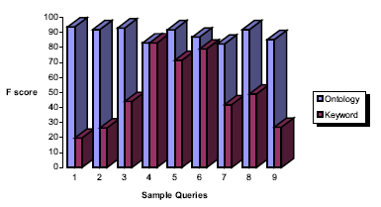
Result (F Score)
Generic/Broader
Queries
Specific/Narrow
Queries
Context
Queries

Slide 19
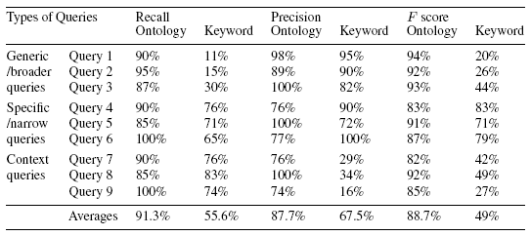
Results (Total)

Slide 20
Conclusion & Discussion
Ontology-based query expansion outperformed over keyword based search in three kinds of query
Fully automatic and applicable in some systems using ontology such as job recommender system.
Precondition of this research is to have well defined ontology hierarchy.

