Slide 1
Transitions
The Biography of a North American Family
An Illustrated History
The Photos and Plates
Louis A. Picard
Note: This is a draft document and should not be cited or quoted in any way. All statements should be considered provisional at this point.

Slide 2
Chapter One Overview
For the last five years, I have been working on a biographical history of my family and what brought the family to North America and eventually to the United States. Though there is much that remains to be done on this e-book, I now have defined its major parameters and wish to share them with selected readers. What follows is tentative and incomplete illustrated history but is intended to define the parameters of this project.

Slide 3
Overview- 2
This book focuses on France and Francophone North America and French Canadian immigration to the United States and is tentatively entitled Transitions: The Biography of a North American Family. The book will be a cross between genealogy, memoir and cultural history focusing on the clash between Anglo-Saxon and French cultures and on the nature of North America as a settler society. It differs from genealogy since it will include much speculation on origins, descriptions and motives.

Slide 4
Overview-3
The first section of the book will focus on the French origins and culture of the Picard family which eventually settled in Saginaw in Eastern Michigan. Only ten people (generations) separate my generation from Northern France. I’ve been able to confirm that the genealogy in my possession of the Eastern Michigan Picard Family, founded by Alfred Picard (my great grandfather) is accurate as far back as circa 1598 and Nantes, France and one Hugues Picard dit LaFortune who migrated to Quebec from Nantes in 1653. His father, Gabriel, who remained in France, is our oldest family link thus far. The second section of this book places the Picard family within the context of the history of New France and Canada between 1653 and the present. The third section of the book (and a focal point of this research) is on the descendents of Alfred, my immediate family who migrated from Beauharnois County, Quebec in the nineteenth century to Eastern Michigan (Saginaw).

Slide 5
Overview- 4
The Male Lineage I am following is as follows:
France: Gabriel Picard (c. 1597-1660)
Hugues Picard (c. 1618-1707 Emigrated to New France/Canada)
Note: Though the approach is Patrilineal it is not Patriarchal. Tracing through sons is easier particularly since I am interested in the Picard family legacy.

Slide 6
Overview- 5
LaChine/
Dorval Jean-Gabriel Picard (c. 1669-1723)
Antoine Picard (c. 1700-1777)
Antoine Picard (c. 1735-c. 1795?)
Paul Picard (c. 1770-1845?)

Slide 7
Overview- 6
Chateauguay-
St Louis de Gonzague/
Beauharnois Isaac Picard (1817-1881)

Slide 8
Overview- 7
St. Louis de Gonzague Alfred Picard (1846-1909 Emigrated to Eastern Michigan)
Louis A. Picard (1883-1952)
Frank A. Picard (1889-1963
Joseph Picard (1892-1975)
And the Families of Frank and Alex Picard
Vincent Picard (1904-1988)

Slide 9
Overview- 8
This work has been influenced by two short books by Frank A. Picard, Dear Marie” and Dear Marie Again (Privately Published) and his related work.
A most important source of information is Ellen Picard’s web page, The Picard Surname Homepage http://freepages.genealogy.rootsweb.ancestry.com/~picard/Index.html and
PicardLouisA_Ancestors_1106.rtf by Ellen Picard November 25, 2006 (Corrections/modifications by Louis A. Picard (2007)
The interpretations and errors contained here are those of the author alone.

Slide 10
Chapter Two Gabriel Picard
Gabriel Picard was likely born about 1597 and lived and died in the small village of St. Colombin (en-Marche) du Pont James, near Nantes, which was then the capital of Brittany (Bretagne) and is now in the Loire-Atlantique region of France.

Slide 11
“The Wanderer Who Stayed Behind”
I know little of Gabriel Picard at this point other than that he lived and worked in Nantes, France. He was probably a skilled artisan and most likely worked with wood as did his son Hugues. Gabriel married Michelle Clavier c. 1631. He likely died before 1660. His wife, Michelle died in June of 1660.

Slide 12
Gabriel Picard- A Mental Image
I imagine that Gabriel wore a black or brown floppy hat and a white blouse, somewhat worn, and a red waist shirt. He often appeared unkempt with his white hair and his beard windblown. To keep away the cold he often wore or carried a brown tunic or cape. His white collar was plain and slightly frayed. His pants were often baggy and loose. He wore his beard full. It was dark gray and sometimes unkempt. His hair was thinning around the temples. Gabriel was stout, fond of cheap red wine and ale. He was a skilled worker who aspired upward to the gentler classes but lacked the money for the fur lining or the soft cloth. In an austere sort of way, he often attracted children to him.
Note: This description is based upon paintings and images of the Eighteenth Century.

Slide 13
From Normandy to Nantes
I do not believe that Gabriel was native to Nantes but that is a guess. Either Gabriel’s father or one of his ancestors probably moved to Nantes from Normandy or Picardie, the historical lands of the Picard clan. It was not uncommon for artisans to move around during the sixteenth century. Nantes was of course a major city and port then as it is today. Michelle may also have come from the far north of France (Picardie) and it is not clear that Gabriel was born in Brittany since there continued to be much movement among the artisan classes[i] by young men in search of work in seventeenth century Europe.
[i] Leslie Choquette, Frenchmen into Peasants: Modernity and Tradition in the Peopling of French Canada (Cambridge, MA: Harvard University Press, 1997), pp. 184-185.

Slide 14
The Picard Tribe
My own belief then is that Gabriel’s branch of the Picard family was originally either from Normandy or Picardy (Picardie) or perhaps Wallonia in what is now Belgium. We are part of a French “tribe” which spoke one of the Oil languages, regional dialects related to French. Many people in Northern France and Southern Belgium still speak a dialect or patois self-styled as chti, chtimi or rouche or labeled informally as “Picard” after the ancient French province of Picardy.

Slide 15
French Artisan Family- mid-17th Century
The work of Louis Le Nain and his family, who were painters from Laon in Normandy, was essentially unparalleled anywhere in the seventeenth century for its portrayal of ordinary life. Louis Le Nain most often painted family life around meagerly furnished tables, peasant life without plenty, occasionally outdoors, on the way back from the fields.

Slide 16
Images of Northern France
Images in this painting suggest to me that of how Gabriel Picard and part of his family might look some eighteen years before Hughes Picard emigrated to Quebec for the first time.

Slide 17
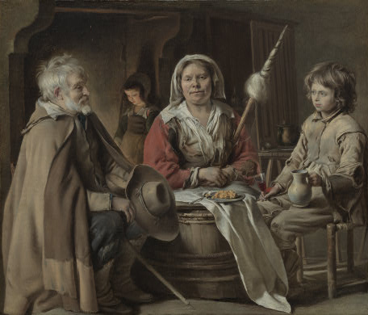
A French Interior, c. 1645, oil on canvas, Louis Le Nain

Slide 18
Picard: A Patois or a Language
This Northern dialect of French came to influence the patois that characterized Quebec French prior to their move back to standard French at the beginning of the twentieth century and more importantly after World War II. In the 16th century, the natives of what is now Canada called the settlers, “Normans.”[i] It is not unfair to say that French Canadian culture has been strongly influenced by the peoples of Northern France.
[i] See the Preface to Brian Moore’s fine, if bleak novel of sixteenth century Quebec, The Black Robe (New York: Plume Books, 1997 edition), p. viii.

Slide 19
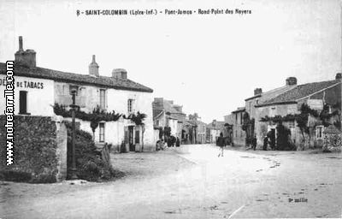
Village of St. Colombin (en-Marche) du Pont James, near Nantes, c. 1910
The Main Street

Slide 20
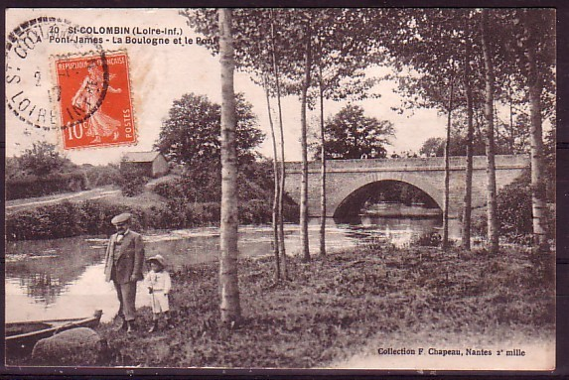
Pont James c. 1910

Slide 21
Nantes, 2007

Slide 22
Chapter Three New France
The Descendents of Gabriel Picard family lived in New France and Canada between 1653 and the present. Gabriel’s son, Jaques Hugues Picard dit LaFortune, was born about 1618 in Nantes.

Slide 23
A Mental Picture from New France
Hugues Picard apprenticed as a wood worker, most likely working with his father for the better part of ten years. He was likely short, muscular, corpulent later in life. He often wore a dark brown cape, used a walking stick and favored his left foot, which was slightly shorter than his right leg. His hat was round with a thin rope above the brim and he often wore a feather in it. His workpants were made of heavy brown cotton.
One pictures his wife in a white head scarf, a red jacket, a long brown dress with a white full blouse. Her hair was triple braided. In the kitchen she wore a yellow and brown apron. In the evenings she wore a white laced shawl with a red bow-neck.

Slide 24
Emigration to Canada
In 1653, our ancestor, Jacques Hugues Picard, left Nantes, France as part of the “Great Recruitment” on a three year contract to go to Villa Marie (now Montreal).

Slide 25
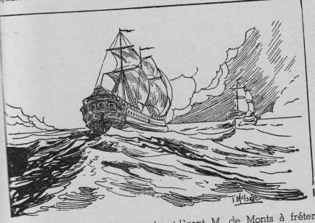
The Saint-Nicolas du Nantes

Slide 26
The Great Recruitment
Artisans, particularly carpenters and wood workers were in particularly high demand in New France. In 1653, our ancestor, Jacques Hugues Picard, left Nantes, France as part of the “Great Recruitment” on a three year contract to go to Villa Marie (now Montreal). According to Ellen Picard, "Hugues Picard hired to clear land and as a sawyer in the spring of 1653 at 75 french [livre symbol] a year. He returned to France at the end of his contract but returned to Ville Marie (Montreal) in 1659 as a carpenter fo the Supician Fathers.“[i] Hugues left his father Gabriel and his mother Michelle Clavier behind in France and set off on a harrowing journey to the new world. Hugues and his fellow immigrants “must have been an unusually adventurous, enterprising, even innovative group….”[ii]
[i]http://freepages.genealogy.rootsweb.ancestry.com/~picard/HuguesPicardditLaFortune.html
[ii] Choquette, Frenchmen, p. 159.

Slide 27
Departure
The Voyage of the Saint-Nicolas:
“The departure from Saint-Nazaire takes place on June 20, 1653. It is the beginning of a harsh and tragic crossing. As soon as they leave the shore, the passengers find out that the Saint-Nicolas is nothing but an old tub.”

Slide 28
“The Saint-Nicolas”
Marguerite Bourgeoys writes of the Situation: “I was most
distressed to see us in this dangerous situation… Our people
were ill prepared to die… Monsieur de Maisonneuve left all
of his soldiers on an island from which it was impossible to
escape. Otherwise none would have stayed with us. A few of
them try to escape by throwing themselves into the water.
They became crazy and accused us of leading them to their
perdition.”
Note both quotes from : “Near 350 years ago: THE GREAT RECRUITEMENT OF 1653” http://www.lesarchambaultdamerique.com/documents/recrue1653A.pdf. Downloaded May 18, 2008.

Slide 29
The Sawyer
Hugues Picard was a Sawyer (he cut logs into planks) a skill no doubt needed to clear the forests in New France. He likely worked on the construction of the wooden Fort at Ville Marie. At the end of his three year contract he returned to Nantes where he stayed for three years and then for reasons that are not clear (though his father’s death about that time may have been a factor) he returned to Montreal in 1659 to work for the Sulpician Fathers who were the feudal lords of Montreal.
In the census of 1666 Hugues is listed as 48 years old, as a farmer and plowman (habitant) and one of 627 Europeans living in Montreal that year. He was granted land by the Sulpicians and purchased additional acreage which he cleared and farmed.

Slide 30
Marriage
Hugues married Anne Antoinette de Liercourt on Jun 30, 1660 at Notre Dame de Montreal, Quebec. Sir Paul de Chomedey the Governor of Montreal stood up for the couple. Hugues had two sons, Jean Gabriel and Jacques Picard who were born in Ville Marie in 1669 and 1672 respectively.
As a reward for his service, Hugues received a land grant from the Sulpician Fathers on April 4, 1667 on the shores of the Lake St. Louis rapids in the LaChine/Dorval area. On April 26, 1693, Hugues sold the land to his sons Jean-Gabriel and Jacques Picard. Hugues died Dec 22, 1707 in Notre Dame de Montreal, Quebec.

Slide 31
From Ville Marie to LaChine/Dorval
Both Jean-Gabriel and Jacques lived in in LaChine/ Dorval in what is now western Montreal. They both farmed but also were “engaged in the west” as fur traders (Voyagers), travelling to Michilimakinac to trade furs with the Indians. Their descendents lived in LaChine/Dorval and later Pointe St. Claire on Lake St. Louis for more than 150 years.

Slide 32
Quebec Picards
In 1697 Jacques brought back a ten year old Indian boy with him from Michilimakinac, had him baptized and presumably raised him. The story that there was “Indian” blood in the family (a legend confirmed by Richard Picard) may go back to this incident.[i]
[i] In a telephone conversation with the present author, November, 2007.

Slide 33
Jean-Gabriel
Mental images of Jean Gabriel show him in Black work boots, blue work pants, a pull over light brown shirt and a red felt cap. His pipe was long and thin. He liked his tobacco strong and pungent.

Slide 34
Maison Jean-Gabriel Picard
5430 boulevard Saint-Joseph, Dorval
This remains a private residence. Built in 1719-1720, it is a typical 18th century Montréal farm house. It is recognizable by the pitch of its roof (over 45 degrees), its chimneys centered symmetrically on the crest of the roof and the four openings in its facade. It is one of Lachine’s two oldest houses.

Slide 35
Maison Jean-Gabriel Picard

Slide 36
Maison Jean-Gabriel Picard
"The one [house] that still stands, was built in 1719-1720 by your ancestor Jean Gabriel Picard. It is situated at 5430 St. Joseph St. ... The house is situated on lot #885-8 of the Parish of Lachine." [my NOTE: old cadaster # given as 431 or 432.]
Source: Ellen Picard Website
http://freepages.genealogy.rootsweb.ancestry.com/~picard/HuguesPicardditLaFortune.html

Slide 37
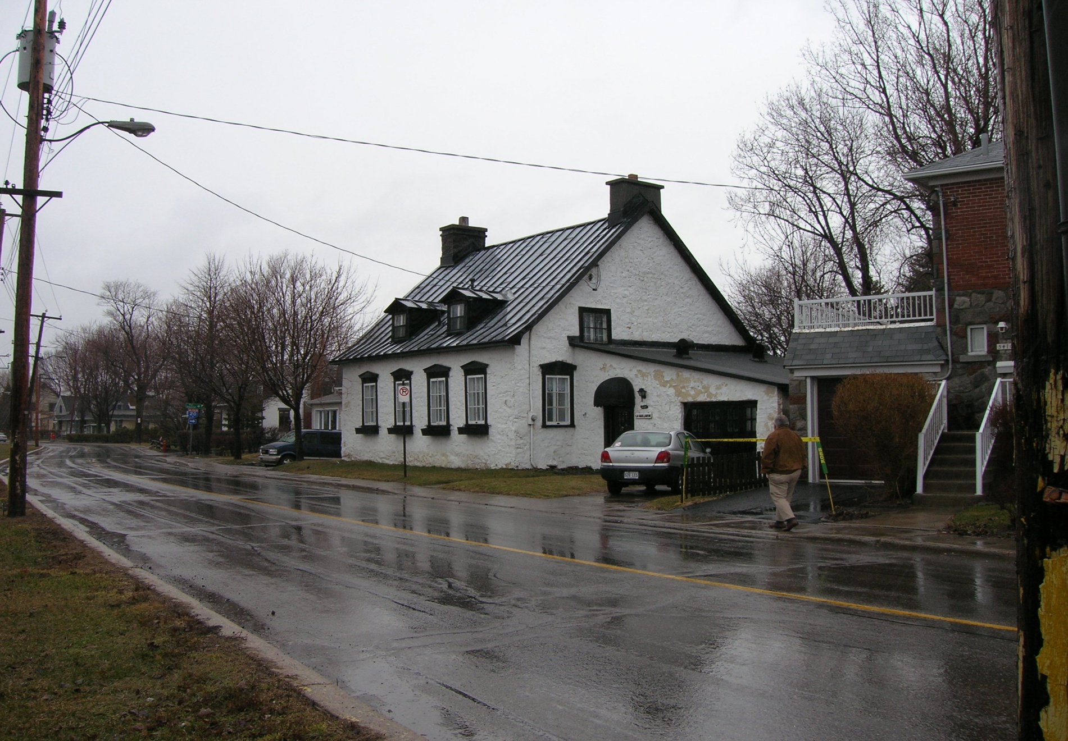
Maison Jean-Gabriel Picard, 2007

Slide 38
Dorval, Quebec
Jean Gabriel Picard’s descendents included his son Antoine Picard born in St. Agnes Church in La Chine/Dorval. Antoine had a son Antoine Picard (also born in La Chine) but was married to Marie Angelique Duquet on November 4, 1760 in Chateauguay south of the St. Lawrence River. Antoine (father and sons) were farmers (Habitant)
The son appears to have lived in Chateuguay. Jean Gabriel, his brothers and sons were founding fathers of the borough of Dorval near Montreal. Several of their houses still stand in the Dorval/LaChine area.[i]
[i] Andre Duval, Dorval: Three Hundred Years of History (Dorval: City of Dorval,Quebec 1989), pp. 155-163-165.

Slide 39
The Dorval Picards
No traces currently remain of the early wooden houses built on what is now Pointe Picard in Dorval by either Jacques Morin (1685), Jean-Baptiste Bouchard Dorval (1691) or Antoine Picard (1732). The first stone house was built by Antoine's son, Jean-Baptiste Picard, in 1803. From 1874 on, it was enlarged by the latter's grandson Désiré Girouard, lawyer, historian, M.P., first Mayor of Dorval in 1892 and Supreme Court Judge. What is left of this stone manor, “The Anchorage,” is now included in the southern part of the modern convent which serves as a tranquil retirement home for members of Marguerite Bourgeoys' Congregation of Notre-Dame.
Source: Richard Picard, “The Picards: A Family of Pioneers,” in Heritage Dorval, vol. 12, no. 1 (2001) pp.39-43 and “2 Martin Avenue,” Heritage Dorval, vol. 11, no. 1 (2000), pp. 72-76. Publication of the Dorval Historical Society.

Slide 40
Martin Avenue, Maison Paul Picard “The Anchorage” (1802)

Slide 41
2 Martin Avenue, Maison Paul Picard “The Anchorage” (1802)
This attractive fieldstone house, hardly visible from the street, is typical of early 19th Century rural architecture. Built in 1802 by Paul Picard on a broad piece of land granted to his ancestor, Antoine Picard, in 1732, there are several other houses built around it now but the area is still known as Pointe Picard.

Slide 42
Chapter Four Paul Picard
Antoine and Angelique had had a son Paul Picard who was born and lived in Pointe Claire (Point Picard) on Lake St. Louis near Montreal. Paul married Veronique Theoret on September 23, 1805, at Pointe Claire, Quebec, the LaChine/Dorval area. Antoine most likely built the house that is now known as ‘The Anchorage’ in 1802.
Paul and Veronique Picard had four sons, Joseph Abraham, Paul, Jean Baptiste Picard and Isaac Picard, who was born 1817 in approximately 1881. Isaac married Emelie Legault Feb 02, 1841 in Pointe Claire, Quebec. Paul Picard left his house to his two sons, Paul Junior and Jean Baptiste (brothers of Isaac). The house was later purchased by Désiré Girouard known locally as the Father of Dorval, a Conservative MP and later Justice of the Canadian Supreme Court.

Slide 43
The Nineteenth Century: South of the River
The Picard family played a prominent role in the founding of Pointe Claire, La Chine and Dorval and the family lived there from 1703 to 1800 and after 1760 a branch of the family was among those who opened up the South bank of the St. Lawrence River. The family moved first to Chateauguay County and then to Beuharnois County. Chateauguay is located south of the LaChine/Dorval area of greater Montreal and is near to the Kahnawake Mohawk Reserve.

Slide 44
South of the St. Lawrence
Paul’s Picard’s son Isaac was born in Pointe Claire in about 1817 and married Emelie Legault on February 2, 1841 (the Picard and Legault families intermarried frequently in the eighteenth and nineteenth centuries).
Alfred Picard was born in St. Timothee, Quebec
Canada. May 22 1846.

Slide 45
Isaac Picard
In the early 1800s the branch of the family, headed by Paul’s son Isaac Picard had moved back again south of the St. Lawrence River near Valleyfield (first to Chauteguay then to St. Louis de Gonzague, where Isaac purchased land, cleared it and farmed. My great grandfather, Alfred one of nine children of Isaac, then immigrated to the United States in 1864 three months before he was to graduate from law school for reasons not entirely clear. Alfred founded the Eastern Michigan Picard Family which lived in Saginaw Michigan for over a hundred years.

Slide 46
Beauharnois
Beauharnois County is Southeast of Montreal and next to Chateauguay. The largest city in the county is Salaberry De Valleyfield. Parishes connected to the Eastern Michigan Picards include St. Louis De-Gonzague, Beauharnois, St. Etienne De Beau-Harnois, and St. Timothee. The County Borders the St. Laurence River, close to Lake St. Louis. The Beuharnois Canal, which is linked to the St. Laurence Canal System, passes through The county.

Slide 47
Migration
From the end of the nineteenth century focus is on the descendents of Alfred, my immediate family who migrated from Beauharnois County, Quebec in the nineteenth century to Eastern Michigan (Saginaw). In the process, the United States branch of the family, through marriage and the “melting pot” philosophy U.S. nationalism became Anglophone in culture and language.[i] My great grandparents were Alfred Picard and Zephirine Legault (Zephirine Legault Lachapelle Picard). Though Alfred moved to the U.S. during the American civil war (1864), and risked being drafted in the Union army he would revisit Beauharnois periodically.
[i] John Higham, Strangers in the Land: Patterns of American Nativism, 1860-1925 (New York: Athenium, 1963), p. 15-17.

Slide 48
The Family Alfred Left Behind
In addition to his parents, according to Alfred Picard’s Obituary and genealogy records Alfred left behind five brothers and three sisters in Canada. They were:
1. Calixte Picard
2. Napoleon Picard
3.Joseph Picard
4. Leon Picard
5. Isaac Picard
The three sisters were:
1. Melee
2. Elise and
3. Armida

Slide 49
The Hotel Keeper
“Alfred Picard “followed various occupations in the early days of his Saginaw life but he was best known as a hotel keeper. He was for many years the proprietor of the old Central House, at that time one of the important hotels of the city, which was situated at the corner of Water and Thompson Streets.”[i]
[i] “Death Comes to Alfred Picard,” Saginaw Courier-Herald (February 10, 1909), p. 1 (Section Two)

Slide 50
Zepherine Legault
Alfred first married Amelia Poquet in Saginaw Michigan July 24, 1868. She died during childbirth in 1874 and shortly after that Alfred and Zepherine Legault (who was widowed) married in Notre Dame Cathedral in Montreal. The Legualt and the Picard families continued to have had close linkages in Beauharnois, and appeared to have inter-married more than once, a practice not uncommon as I understand it. It is worth reiterating that Alfred’s mother’s maiden name was Legault

Slide 51
The Picards and the Legaults
I now have been able to tentatively locate a number of descendents of Isaac and Alfred’s five brothers who stayed behind in Quebec and have begun to work on tracing back the Legault family (Zepherine’s side) who are also resident in Beauharnois County, South of Montreal. The Legaults are a huge family in Quebec and there are descendents of Hugues Picard in both Dorval/LaChine and south of the St. Lawrence in the Valleyfield/Beauharnois area.

Slide 52
Alfred’s Tragedy
I am now beginning to piece together what might have happened to Alfred in the last years of his life. He has been listed variously as a saloon keeper and an hotelier, a grocer, patent medicine dealer and Canadian agent. For several years, he owned and managed the Central Hotel on the corner of Water and Johnson in Saginaw later described as a “mecca for picturesque longshoremen.”

Slide 53
When he went back to Quebec to marry Zepherine in 1874 after the death of his first wife, I believe he was a wealthy man, a prominent citizen of East Saginaw according to his obituary and of course one of the founders of the French speaking Holy Family Church in Saginaw, Michigan. During the 1870s and 1880s, Alfred continued to have links with his family in Quebec and Alfred and Zephirine lived in Beauharnois for several years (betweem 1880-1883). They eventually moved back to Eastern Michigan. (Alfred traveled back and forth to Quebec a number of times- train service was probably better then than it is today).

Slide 54
Isaac Picard Died in 1881 (probably while Alfred was back home). Alfred and Zepherine were both picked up in the 1881 Canadian census as living in Beauharnois, Quebec. Several of their children were born in Beauharnois (St. Louis de Gonzogue). However, Alfred and Zepherine are also both identified in the U.S. 1980 census in Michigan where he took out citizenship in the 1880s. I believe Alfred lost all of his money in the Panic of 1887 and I think he may also have lost some of his brothers’ money as well. I’ve found evidence of two of his brothers having to sell property in Canada during the 1880s perhaps either to invest with Alfred or to pay back loans. (This is a bit of speculation I realize).

Slide 55
Chapter Five The Eastern Michigan Picards
Alfred died in 1909 and Zepherine died in 1931 both in Eastern Michigan. Alex and Frank Picard, two of Alfred’s sons lived their whole lives in Saginaw Michigan. A third son Joseph lived in Jackson Michigan.

Slide 56
CARL HAGENBECK and GREAT WALLACE SHOWS September 28, 1907

Slide 57
The Circus
Alex, three of his brothers and his son Vincent all joined the circus performing as aerialists. The Flying Picards performed for about ten years from the mid-1990s. Vincent was in show business from about 1918 (he was fourteen) until 1927.

Slide 58
YESTERDAY'S TOWNS Wednesday, August 08, 2007
Many famous performers were from Saginaw, but it was the circus life that attracted many Saginaw residents. Some Saginawians of circus fame included:
FRED JENKS
PHIL CHEVETTE
JAMES MURPHY known as JAMES DUVAL
THE BROTHERS PICARD FRENCH GYMNASTS THE THOMAS FAMILY known as THE FLYING MELZORAS GEORGE VOISE and sons HAROLD and JACK

Slide 59
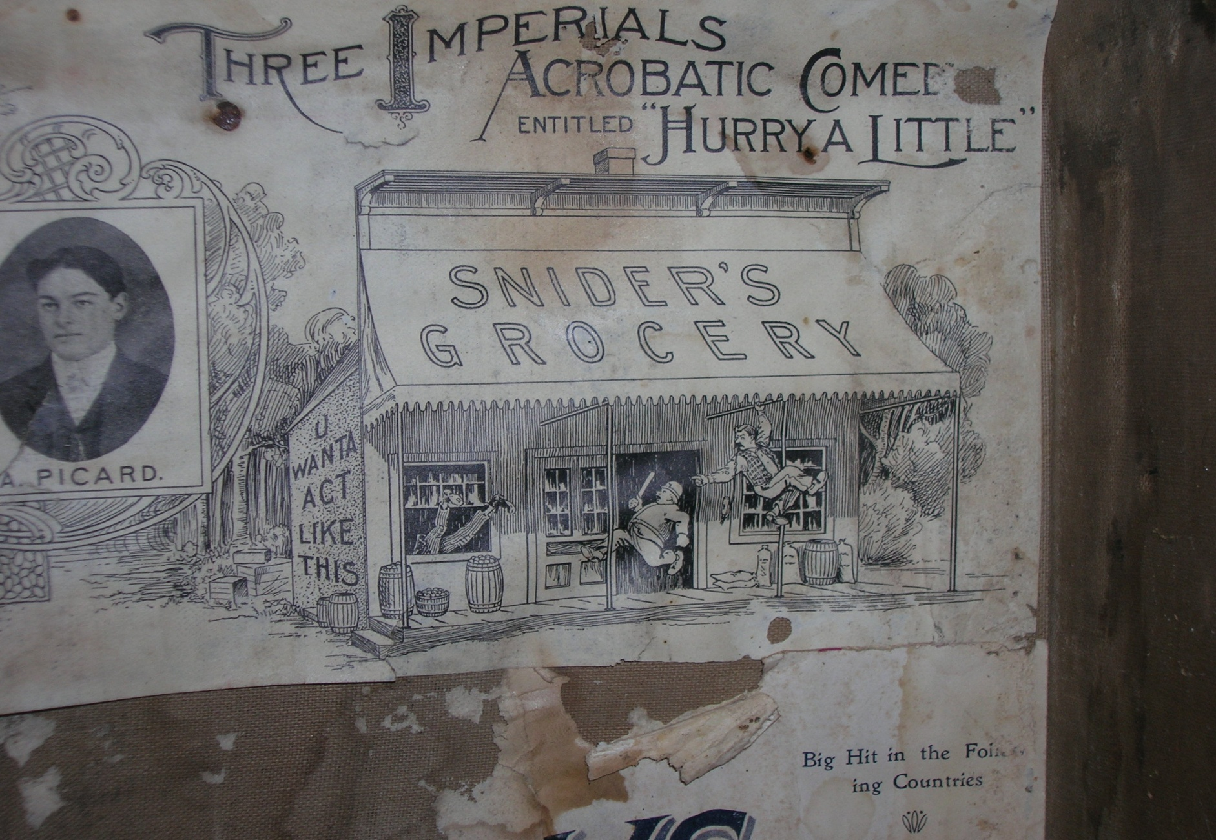
Alex Picard, Ringling Brothers Circus, c. 1903

Slide 60
Ringling Brothers Route Book, Centralia, Washington, Saturday, August 22 1903
“Prince, the clown dog, dislocated his neck by running into Jack Rooney. He was attempting to reach his master and seize him by the seat of the trousers. With his neck out of gear the little animal tore around in a circle. Alex Picard caught him, gave his neck a twist, sent it into position again, and Prince, none the worse for his experience, darted into the ring and performed his part to perfection.”

Slide 61
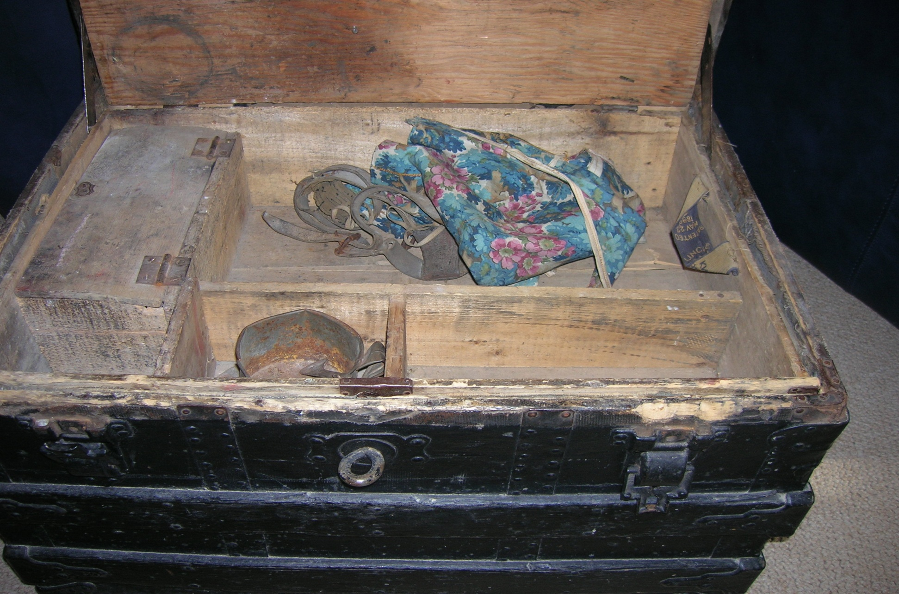
Circus Trunk, Alex and Vincent Picard, built, c. 1896

Slide 62
1911 University of Michigan Football Team- Quarterback Frank Picard, seated left side.

Slide 63
Chapter Six The Law
Frank (like his father) read law, became a political activist and a federal judge. Joe, the youngest brother, was long time Postmaster of Jackson Michigan, nominated by President Franklin D. Roosevelt, at the recommendation of his elder brother Frank.

Slide 64
Delegates to Michigan Convention to Ratify 21st Amendment Election held April 3, 1933 Convention held April 10, 1933
Saginaw County 1st District
Albert S. Harvey (wet) Frank A. Picard (wet)
Fred M. Bullock (dry) William R. Longstreet (dry)

Slide 65
Frank A. Picard, 1934 Senate Campaign Picture

Slide 66
Frank Albert Picard (1889-1963)
Eastern District of Michigan (1939-1963)
Nominated: February 9, 1939 Confirmed: February 16, 1939 Appointed: February 23, 1939 Entered on Duty: March 30, 1939 Chief Judge: August 6, 1959-October 18, 1959 Senior Status: March 31, 1961 Died: February 28, 1963

Slide 67
Source of Information on Frank Picard
The following material is taken from John H. Dise, Jr., “Frank A. Picard, An Introduction,” The Court Legacy, vol. XIII, no. 2 (Detroit: Historical Society of the United States District Court for the Eastern District of Michigan, September 2005), pp. 1-12.
Pictures taken from the above.

Slide 68
Left to right: Lloyd W. Bartlett, Archie Katcher, Walter I. McKenzie, Frank H. Boos, State Bar President, Chief Justice Edward M. Sharpe, Judge Frank A. Picard, and B. J. Tally, March, 1949.

Slide 69
Frank Albert Picard (1889-1963)
On October 19, 1889, Frank Albert Picard was born in Saginaw, Michigan, to Alfred and Zepherine (Lagault) Picard. At an early age he had hopes of becoming an aerial acrobat and joining his brothers who were known to circus audiences as the "Flying Picards." His father, a hotelkeeper having twelve children to support, quickly put an end to his circus dreams. Frank A. Picard attended Saginaw High School where he was a member of the student council and captain of the football team. After graduating from high school he worked as a journalist on the Saginaw Dailey News, the Courier Herald and was managing editor of the Saginaw Exponent.1 Picard studied law at the University of Michigan where he received his LL. B. degree in 1912. He was admitted to the bar in the same year. He was assistant prosecutor for Saginaw County thereafter for one year and engaged in private practice for the next four years.In May, 1917, Picard left his law practice and entered the United States Army. He held the rank of captain and saw action in France. After the war Picard returned home and resumed private law practice. In 1920 he ran for the lieutenant governorship of Michigan but was defeated. He also served as the first chairman of the Liquor Control Commission from 1932 until 1934.

Slide 70
Judge Picard as a new Federal Judge and his family.Standing (left to right) are Frank A. Picard II, Ruth Mary, Patricia Eve and John Alfred. Seated is his wife Ruth. February, 1939.

Slide 71
Frank A. Picard
In 1934 he was the Democratic nominee for the United States Senate but lost to the incumbent, Arthur H. Vandenberg, by a slim margin. In 1936 he was elected as a delegate from the Eighth Congressional District to the Democratic National Convention in Philadelphia. President Franklin D. Roosevelt appointed Picard to the bench of the United States District Court for the Eastern District of Michigan on April 3, 1939. He became Chief Judge on August 6, 1959. His most famous decision involved the workers at the Mount Clemens Pottery Company, the "portal-to-portal overtime case", dealing with pay for the time workers spent in preparing for work and also for cleanup time. Judge Picard was a member of the Knights of Columbus, Kiwanis International, National Conference of Christians and Jews, and was the first chairman of the Michigan Chapter of the Christian-American Palestine Committee, which helped promote the establishment of the State of Israel. On June 8, 1921, Picard married Ruth Caroline Doersan of Saginaw, Michigan, and they had four children, two boys and two girls. He died in Saginaw, Michigan on February 28, 1963 and was interred at the Oakwood Mausoleum.

Slide 72
Portal to Portal
“The law is a ass, a idiot.”
Mr. Bumble in Oliver Twist
“In Detroit last week, Federal Judge Frank A. Picard did his best to make the law look less like "a ass." He threw clear out of court the famed Mt. Clemens Pottery Co. case for portal-to-portal pay. If the Supreme Court—to which the case is quickly headed—should sustain him, there would be lifted from industry the threat of $5 billion in back-pay claims filed by scores of unions. If it should reverse him, the law would look more like "a ass" than ever.”
Time Magazine, Monday, Feb. 17, 1947

Slide 73
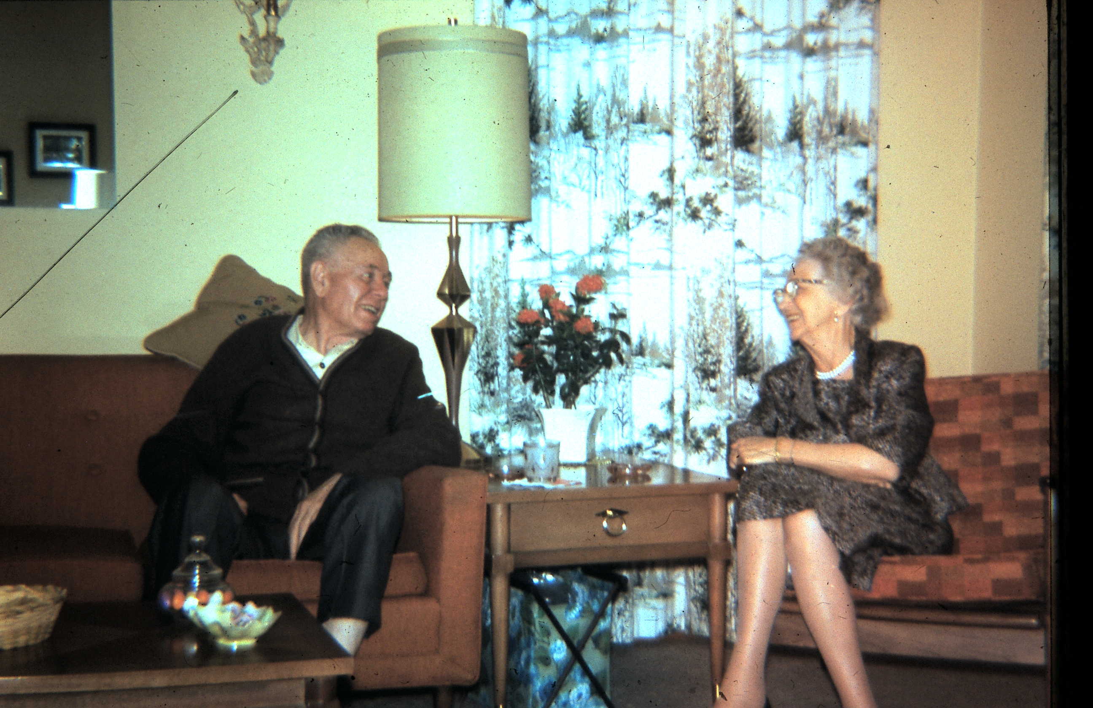
Joseph Picard and Marie Picard, 1965

Slide 74
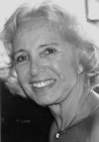
Helen Picard Kretschmer, Northwood University National Women’s Board

