Slide 1
Emergency Treatment for the Woman
Module 1
Session 2

Slide 2
Objectives
At the end of this session participants will be able to discuss best practices for:
Emergency treatment to patients identified during RAM before referral
Basic and general management of emergency situations

Slide 7
Video Clip IV line Insertion

Slide 8
Rate of Infusion is Determined by the Condition & Findings
RAPID RATE
Systolic BP less than 90 or pulse more than 110 ml or heavy vaginal bleeding
Infuse 1 litre in 15-20 min. repeat if necessary
Monitor BP every 15 min
MODERATE RATE
Severe abdominal pain, obstructed labour, ectopic pregnancy, high grade fever or dehydration
Infuse 1 litre in 2-3 hours
SLOW RATE
Severe anaemia, severe pre eclampsia, or eclampsia infuse 1 litre in 6 to 8 hrs

Slide 9
If I/V Access Not Possible
Give ORS by mouth if able to drink
Or give by N/G tube
Give 300-500 mls in one hour
DO NOT give ORS to unconscious or woman with convulsions

Slide 10
If placenta not delivered
Controlled cord traction-D12
Mannual removal of placenta-B11
If hours or days have passed since delivery or if placenta is retained due to close cervix it may not be possible to put the hand into the uterus.
If unable to remove placenta refer urgently to hospital-B17

Slide 11
If placenta delivered
Repeat bolus dose of oxytocics-B10
Bimannual compression of uterus-B10
Mannual compression of aorta-B-10
Insert P/R misoprostol-B10
Prevention of PPH-(600 mcg orally or sublingually)
Treatment of PPH(800mcg rectally)

Slide 13
Case Study 1
Gulpari 37 years old has delivered her 8th baby. She is brought in the labour room in emergency. She delivered at home. Deliver was unattended by skilled birth attended. She is bleeding excessively since delivery one hour ago. Routine examination reveals that she is very pale, pulse rapid and weak. Feels cold to touch. Clothing soaked in blood and blood pressure records 90/50mm Hg. Placenta is not delivered completely.
Q: How will you treat her?

Slide 16
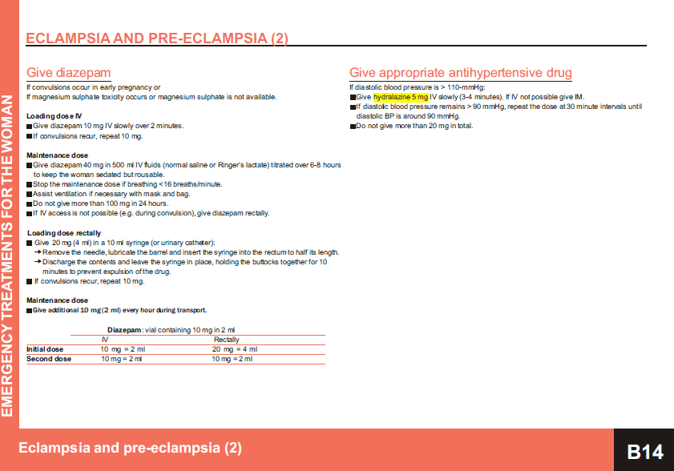

Slide 21
Group activity
Case (1)
Mrs. Rukhsana has presented at 31 weeks of gestation with complaint of painless bleeding vaginally. On examination she is looking pale. B.P is 90/60 pulse is 110/min?
Q: What is your assessment and how will your manage?
Case (2)
Mrs. Tayyaba Khalid is in her first pregnancy at 34 weeks & has presented with swelling of hands and feet and is unconscious. B.P is 180 / 110.
Q: What is your assessment and how will you manage her ?
Case (3)
Mrs. Asma has presented at 32 weeks of pregnancy, she c/o fever with chills and body aches since 3 days. Her temperature is 101 ◦ F and is lethargic.
Q: What is your assessment and how will you manage her?

Slide 22
Thanks

