Slide 1
Session 5. Human rights approach to Health and its link to health equity discourse
HUMAN RIGHTS AND HEALTH EQUITY: IMPLICATIONS FOR ADVOCACY, ACTION AND GOVERNANCE
Abdul Rehman Pirzado MBBS,DCH.MSPH

Slide 2
Human Rights based Approach to Health (HRBA)
Underlying determinants
Health-care
water, sanitation, food, nutrition, housing, healthy occupational and environmental conditions, education, information, Gender & Social Norms etc.
AAAAQ
Availability, Accessibility, Affordability Acceptability, Quality

Slide 3
Human Rights based Approach to Health
Right to health principles and values:
Effective participation and inclusion
Equality and non-discrimination
Equity
Transparency
Accountability
Rule of law
Dignity and respect
6 building blocks of a health system:
Leadership/governance
Financing
Health workforce
Information and evidence
Medical products, vaccines and technologies
Care delivery
Availability
Accessibility
(incl. affordability)
Acceptability
Quality
(AAAQ)
Health equity
Underlying determinants of health:
Access to minimum essential food, which is nutritionally adequate and safe, basic shelter/housing, safe and potable drinking water, adequate sanitation, education and access to information concerning the main health problems in the community, including methods of preventing and controlling them, address socio-cultural barriers and gender norms

Slide 4
Human Rights based Approach to Health
Right to health principles and values
Effective participation and inclusion
Equality and non-discrimination
Equity
Transparency
Accountability
Rule of law
Dignity and respect

Slide 5
Application of HRBA: Right to Health in practice
The Right to Health
principles and elements
in combination with HRBA
principles
International commitments and agreements (treaties, charters, declarations, meeting documents, etc.)
National constitutions
National Policies & Public health laws and policies
Rules and regulations
Implementation and health outcomes
Public health response monitoring & evaluation

Slide 6
Added value of the human rights based approach
to health response
The Right to Health
principles and elements
in combination with HRBA
principles
Vulnerability assessment
Disaggregated data
Health legislation review and improvement
Health in all policies
Whole-of-government approach
Whole-of-society approach
Availability, physical and economic accessibility, acceptability and quality of comprehensive health care
Advocacy and partnerships
Monitoring & Evaluation
Improved population health outcomes (level and equity)
Better people-centered responsiveness
Greater social protection

Slide 7
Added value of the right to health
to health systems strengthening
The Right to Health
principles and elements
in combination with HRBA
principles
Leadership/Governance (multisectoral)
Medical products, vaccines and technologies
Care delivery
Health workforce
Financing
Improved health outcomes (level and equity)
Better responsiveness
Information and disaggregated data
Greater social protection
Financial efficiency
Improved system’s efficiency

Slide 8
Added value of the rights-based approach to public health response
Promoting the Right to Health principles and elements are vital to improving the performance of public health sector response
The approach focuses on actual outcomes and analyzes all general policy declarations and health system commitments from the perspective of “what people actually receive in terms of real entitlements and state obligations”
The approach puts the most disadvantaged and vulnerable communities at the center of health sector response;
Rights-based approach is crucial to improve health sector performance through promotion of availability, accessibility, acceptability and good quality of the services with people centered focus;
Furthermore, promoting right-based approach principles in health system functions (accountability, transparency, effective participation, respect, equity and ethics) with priority being given to disadvantaged, marginalized and vulnerable populations is a prerequisite towards achieving universal health coverage, securing social protection in line with international, regional and national commitments.

Slide 9
Overview
Block 2.
How to assess the realization of right to health and health inequities to guide policies and actions?
Block 3.
How to move from health policies and actions to inter-sectoral policies and actions for public health?

Slide 10
Overview
1
2
Application of Right to Health and Equity Framework in Assessment
3
Practical: Role Plays & Group work exercises
Social Determinants of Health, Health in All Policies & Inter-sectoral Action for Health
Notes:
This is another option for an Overview slide.

Slide 11
Role Play: Power walk Exercise

Slide 12
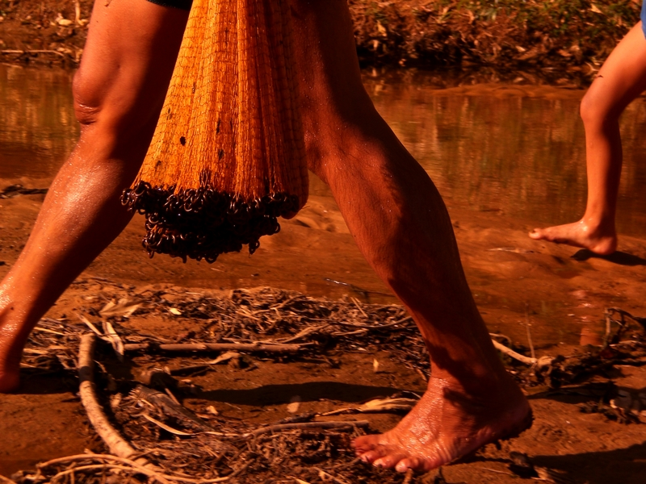
Was empowerment an obstacle for your character?
Empowerment
…a process that helps people gain and/or strengthen control of their lives
…about putting power in the hands of women and men of all groups
Notes:
Copyright: Amir Esmann at https://www.flickr.com/photos/viennacameraman/3212346560/in/photolist-5TS7Hw-7AXLXt-2m7jUU-5WiDUx-XhXS-oft3my-9kcAj4-nY8Hez-6Lf9as-ofqyEW-ofAx1G-ofsGzE-ohq7Gv-ofAvVA-oaoMYH-bctoU6-ohpkDK-7G7n6e-o8vWyW-nY8BhJ-odAPAw-nR84uX-o8AM6k-nR8hZT-nYay8f-nR8H3H-nR7nYK-o8isUa-At4om-odSbWW-At4xD-agpd8P-AATAS-nY9Cev-nYb7ho-AAT63-nY8a2j-nY7YUp-nWxCFj-ofr1Ns-nYbcwS-ofuk2q-nWxwA4-ofEDhz-nYaYou-ofo7B4-AAUkR-AAQRH-AKEAu-7cfeC7

Slide 13
Did gender matter?
Notes:
Copyright (creative commons license): Samnang Danou at https://www.flickr.com/photos/danou_info/4880930201/in/photolist-8rj3uZ-7aFEHS-cSXkY3-7ACaHB-7p55TH-5mkz86-dC2Q8j-6fyogb-7bemry-4tHQ7H-cuXSG5-7aFER3-DkyfD-9aiX5R-dwQo92-kAzNkt-68MZE3-95SFMj-68N2gS-7rkbNX-7w9Cta-4nTEEq-jADc83-kAs5oK-7ACaAv-5ahdu4-58mZCz-q5kFEd-8qVq8E-jAB5y6-bcu5DD-a1uZDA-8qt2KY-6Z8rRJ-68Cpse-6YHmyd-7oEYnw-7cgFKJ-p8rXEL-q4iWxW-4oW4PN-aptST7-7CfEzt-5Tk56P-qQFCUw-4FXeDd-jEwKWQ-aebbTY-4nPxA6-odFsnX [image modified]

Slide 14
Gender matters because…
Biological differences are not enough to explain different disease patterns.
Due to gender norms, roles and relations, there are differences between different groups of men and women in:
exposure to risk factors
household-level investment in nutrition, care and education
access to and use of services
their experiences in care settings
social impact of ill-health
Many differences in health can be mitigated or prevented altogether.

Slide 15
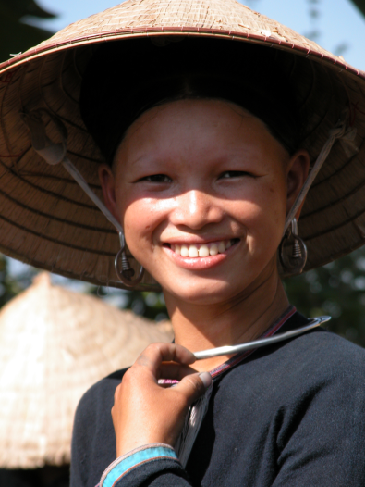
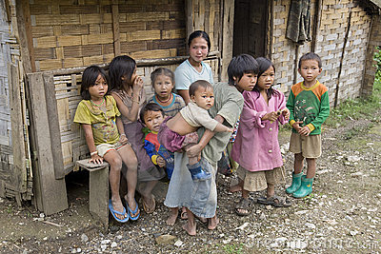
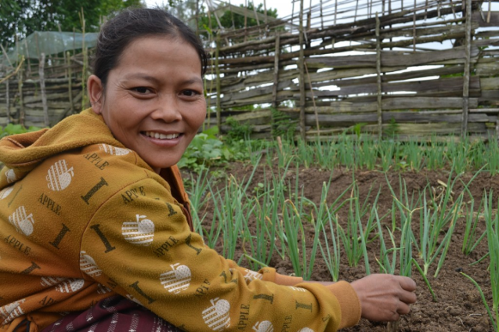
How did your access to or control over resources affect your ability to move forward?
UHC and health equity cannot be achieved without action on social determinants of health and coherent recognition of health across other sectors.
Notes:
Copyright (creative commons license): : Amir Esmann at https://www.flickr.com/photos/viennacameraman/3212346560/in/photolist-5TS7Hw-7AXLXt-2m7jUU-5WiDUx-XhXS-oft3my-9kcAj4-nY8Hez-6Lf9as-ofqyEW-ofAx1G-ofsGzE-ohq7Gv-ofAvVA-oaoMYH-bctoU6-ohpkDK-7G7n6e-o8vWyW-nY8BhJ-odAPAw-nR84uX-o8AM6k-nR8hZT-nYay8f-nR8H3H-nR7nYK-o8isUa-At4om-odSbWW-At4xD-agpd8P-AATAS-nY9Cev-nYb7ho-AAT63-nY8a2j-nY7YUp-nWxCFj-ofr1Ns-nYbcwS-ofuk2q-nWxwA4-ofEDhz-nYaYou-ofo7B4-AAUkR-AAQRH-AKEAu-7cfeC7

Slide 16
Session 4. Group Work : Provincial Case Studies
HUMAN RIGHTS AND HEALTH EQUITY: IMPLICATIONS FOR ADVOCACY, ACTION AND GOVERNANCE

Slide 17
Application of HRBA on Health Challenges: Case Studies
Balochistan Group: Maternal Mortality
Sindh Group: Malnutrition
Format of Presentation:
Overview of Problem
Analysis with HRBA
Actions

Slide 18
Integrating equity, gender and human rights
Answer 4 critical questions:
Who has been left behind?
Why?
Which rights are at stake?
How have gender norms, roles and relations affected risk/exposure, household investments in care, nutrition and education, access to and use of health services or the social impact of ill-health?
→ Who has to do something about it?
→ What do they need, to take action?
Process and outcome are equally important

Slide 19
Thanks

