Slide 1
Introduction to Labs
Wenchao Cao, Teaching Assistant
Department of EECS
University of Tennessee

Slide 2
Outline
Software
Xilinx ISE Design Suite 13.2 WebPACK
Digilent Adept 2.0
Hardware
Digilent BASYS Board (Xilinx Spartan 3E FPGA)
Digilent BASYS 2 Board (Xilinx Spartan 3E FPGA)
Example
Demo
Lab Report Requirements

Slide 3
Outline
Software
Xilinx ISE Design Suite 13.2 WebPACK
Digilent Adept 2.0
Hardware
Digilent BASYS Board (Xilinx Spartan 3E FPGA)
Digilent BASYS 2 Board (Xilinx Spartan 3E FPGA)
Example
Demo
Lab Report Requirements

Slide 4
Xilinx ISE Design Suite 13.2 WebPACK
Logic design software including GUI, schematics editor and files for logic symbols, VHDL compiler, “PlanAhead” package to assign I/O pins, utilities to create to a *.bit file to send to the BASYS or BASYS2 board to program the Xilinx Spartan3e FPGA on the board, and TestBench simulator.
We’re using release 13.2, not a later release.
Free
Download link: http://www.xilinx.com/support/download/index.html/content/xilinx/en/downloadNav/design-tools/v13_2.html
Select: Full installer for windows
Need registration

Slide 5
Digilent Adept 2.0
The software interface to the board that downloads a completed *.bit file via USB connector.
Free
Download link: http://www.digilentinc.com/Products/Detail.cfm?Prod=ADEPT2
Select: Adept 2.13.1 System, 32/64-bit Windows

Slide 6
Outline
Software
Xilinx ISE Design Suite 13.2 WebPACK
Digilent Adept 2.0
Hardware
Digilent BASYS Board (Xilinx Spartan 3E FPGA)
Digilent BASYS 2 Board (Xilinx Spartan 3E FPGA)
Example
Demo
Lab Report Requirements

Slide 7
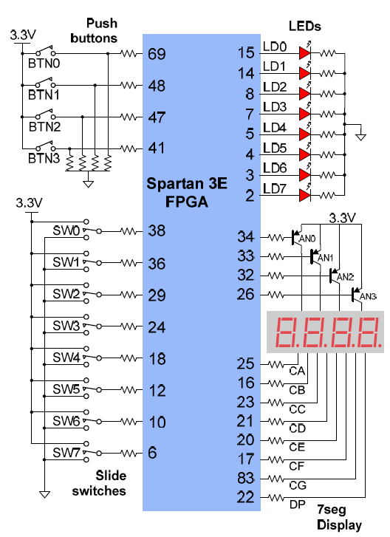
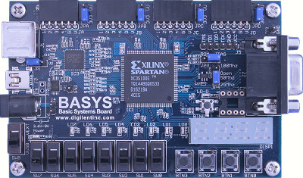
Digilent BASYS Board (Xilinx Spartan 3E FPGA)
Old version, not preferred.
Description: http://www.digilentinc.com/Products/Detail.cfm?Prod=BASYS
Download “BASYS reference manual” and “BASYS schematic” for references.
Family: Spartan 3E
Device: XC3S100E
Package: TQ144
I/O pins

Slide 8
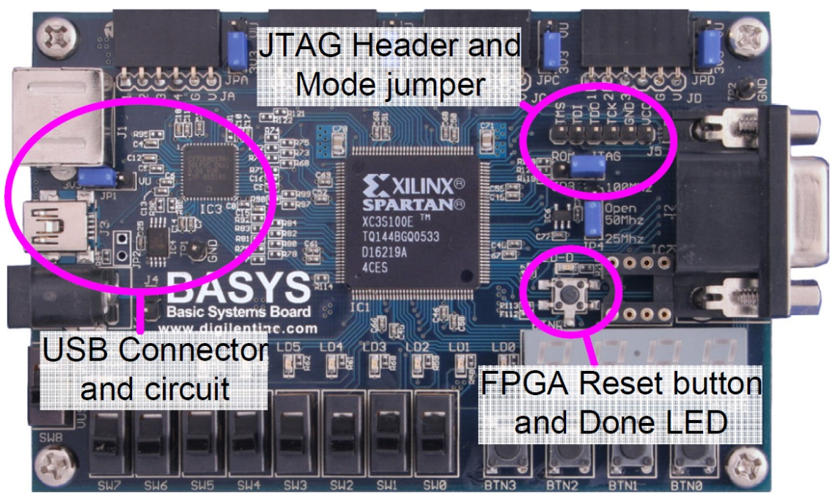
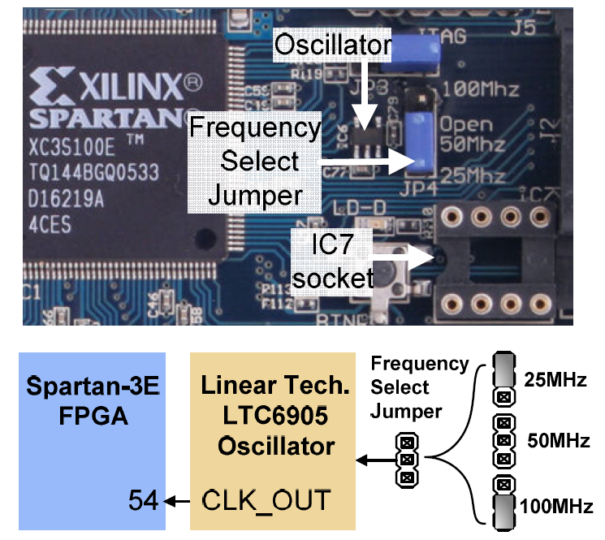
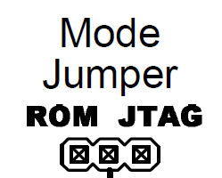
Digilent BASYS Board (Xilinx Spartan 3E FPGA)
Please read “BASYS reference manual” (Page 1 to Page 5) very carefully!
Basys programming circuit locations
Basys oscillator circuits
Select
JTAG
Select
The required input clock frequency

Slide 9
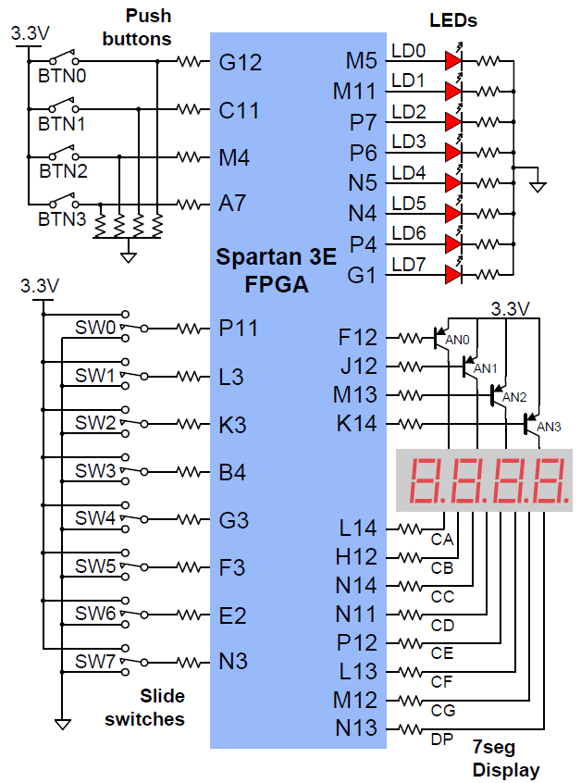
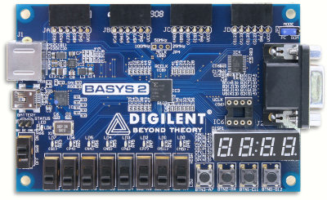
Digilent BASYS 2 Board (Xilinx Spartan 3E FPGA)
New version, preferred.
Description: http://www.digilentinc.com/Products/Detail.cfm?Prod=BASYS2
Download “BASYS 2 reference manual” and “BASYS 2 schematic” for references.
Family: Spartan 3E
Device: XC3S100E
Package: CP132
I/O pins

Slide 10
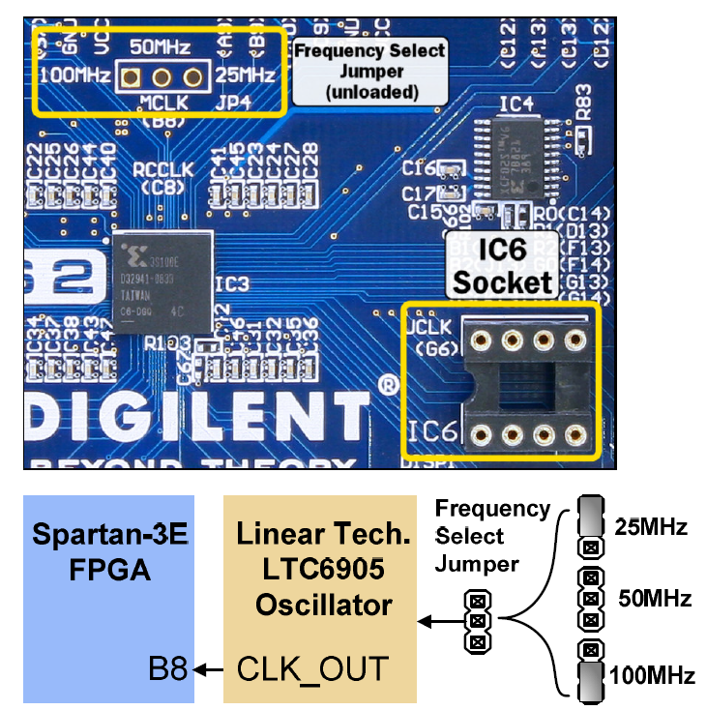
Digilent BASYS 2 Board (Xilinx Spartan 3E FPGA)
Please read “BASYS 2 reference manual” (Page 1 to Page 5) very carefully!
Basys 2 programming circuit locations
Basys 2 oscillator circuits
Select
PC
Can only select
50 MHz as the input clock frequency

Slide 11
Outline
Software
Xilinx ISE Design Suite 13.2 WebPACK
Digilent Adept 2.0
Hardware
Digilent BASYS Board (Xilinx Spartan 3E FPGA)
Digilent BASYS 2 Board (Xilinx Spartan 3E FPGA)
Example
Demo
Lab Report Requirements

Slide 12
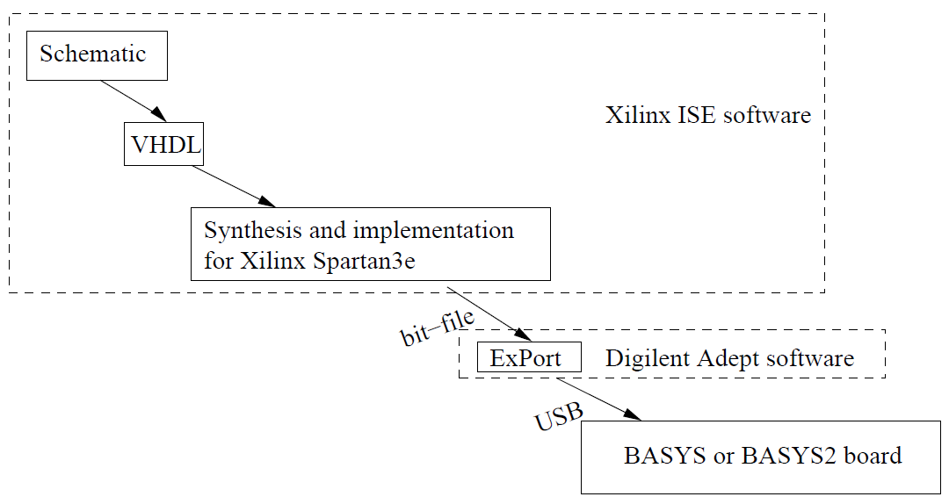
Example
Work Flow
The figure shows the software tools in a logic design project from schematic to VHDL code to *.bit file for download to BASYS or BASYS2 board.

Slide 13
Xilinx ISE Design Suite 13.2
Double Click

Slide 14
Create A New Project

Slide 15
Project Settings
Choose TQ144 if you are using a BASYS board

Slide 16
Create New Source Files

Slide 17
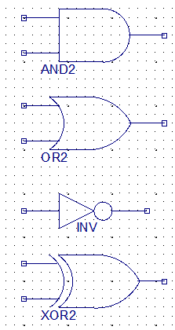
Draw the Schematics
Add wire
Add I/O marker
Add symbol
AND: AND2
OR: OR2
Quick search of the symbols
NOT: INV
XOR: XOR2

Slide 18
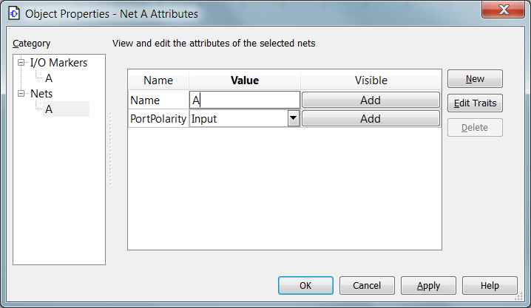
Draw the Schematics
Rename the Ports by right-clicking on them

Slide 19
Pin Placement & Assignment
Select the file
Expand the Folder here
Assign pins here
Find “Design”

Slide 20
PlanAhead 13.2

Slide 21
PlanAhead 13.2

Slide 22
PlanAhead 13.2
Expand the Folder here
Save your work and exit

Slide 23
Generate “*.bit file”

Slide 24
Download the program

Slide 25
Download the program

Slide 26
Program the Board

Slide 27
Results
ABCD = 0000 ABCD = 0001

Slide 28
Results
ABCD = 0011 ABCD = 0111

Slide 29
Results
ABCD = 1001 ABCD = 1101

Slide 30
Results
ABCD = 1100 ABCD = 1111

Slide 31
Outline
Software
Xilinx ISE Design Suite 13.2 WebPACK
Digilent Adept 2.0
Hardware
Digilent BASYS Board (Xilinx Spartan 3E FPGA)
Digilent BASYS 2 Board (Xilinx Spartan 3E FPGA)
Example
Demo
Lab Report Requirements

Slide 32
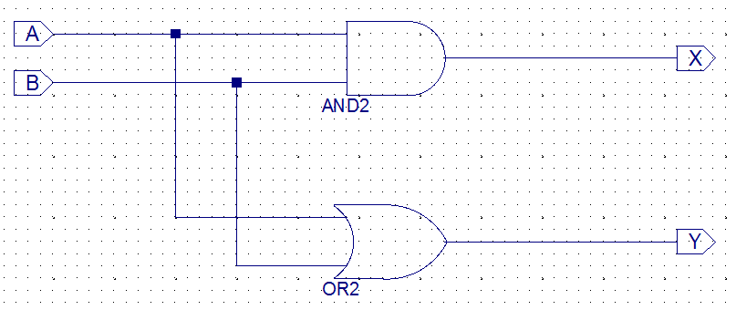
Demo
Demo
X=AB
Y=A+B

Slide 33
Outline
Software
Xilinx ISE Design Suite 13.2 WebPACK
Digilent Adept 2.0
Hardware
Digilent BASYS Board (Xilinx Spartan 3E FPGA)
Digilent BASYS 2 Board (Xilinx Spartan 3E FPGA)
Example
Demo
Lab Report Requirements

Slide 34
Lab Report Requirements
Completing a lab means demo-ing your work to a GTA and turning in a short written report at the same time.
You are free to work on labs on your own schedule, but each lab must be demo-ed to a GTA sometime during the open lab hours in the week stated on the lab handout.
Return the boards when demo-ing the final lab.

Slide 35
Lab Report Requirements
Each report must be in this format:
an introductory page with your name and signature, the lab number, a very short description of the goals or objectives of the lab, and a place for the GTA to date and sign off your work;
summaries of your work on each major part of the lab—be sure to tell how you solved any problems you encountered and to refer if necessary to the appendix for schematics, VHDL code, etc;
a concluding statement, short and explicit, of what you learned in the lab and what skill(s) you acquired or improved;
an appendix containing all additional documentation such as
any schematics,
any VHDL code,
any timing diagrams (including simulations),
all clearly labeled and identified.
Make your reports short and to-the-point. Conciseness and accuracy are your objectives in your reports, not wordiness.

Slide 36
Beyond the Labs
If you are interested in electronics design,
what else can you do with the BASYS or BASYS 2 board?
Please refer to the “BASYS (2) reference manual”
Be safe! Do not injure yourself or damage the board!
LED Clock
* Pictures are from google.com

Slide 37
Beyond the Labs
Expansion connectors
* Need to buy the expansion boards from Digilent inc
PS/2 port
VGA port
Mini Computer
* Pictures are from google.com

