Slide 1
Introduction to VHDL Coding
Wenchao Cao, Teaching Assistant
Department of EECS
University of Tennessee

Slide 2
Outline
Example of VHDL Coding in Xilinx ISE Design Suite
Basic Knowledge of VHDL

Slide 3
Outline
Example of VHDL Coding in Xilinx ISE Design Suite
Basic Knowledge of VHDL

Slide 4
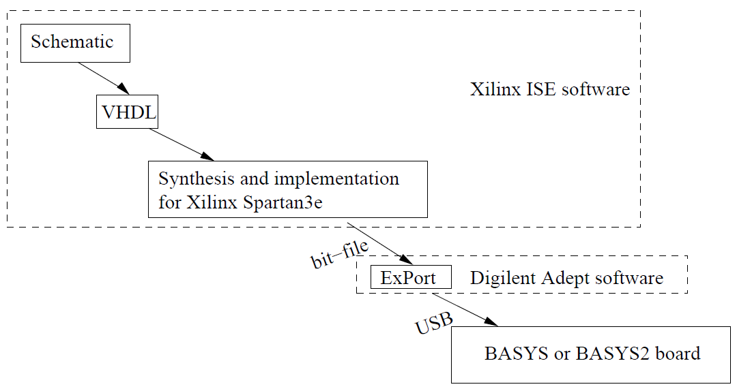
Example of VHDL Coding in Xilinx ISE Design Suite
Work Flow
The figure shows the software tools in a logic design project from schematic to VHDL code to *.bit file for download to BASYS or BASYS2 board.

Slide 5
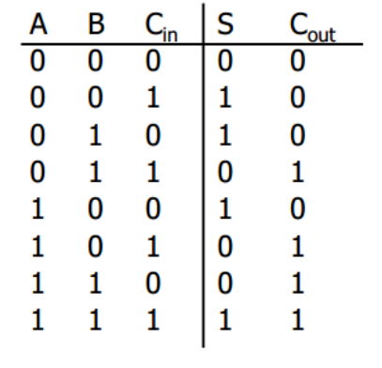
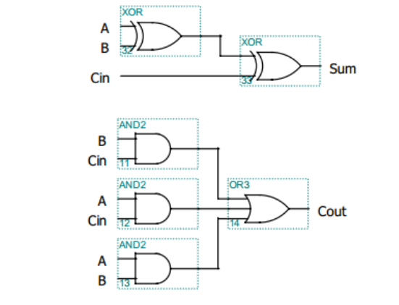
Implementation of a Full Adder

Slide 6
Create A New Project

Slide 7
Project Settings
Choose TQ144 if you are using a BASYS board

Slide 8
Create New Sauce Files

Slide 9
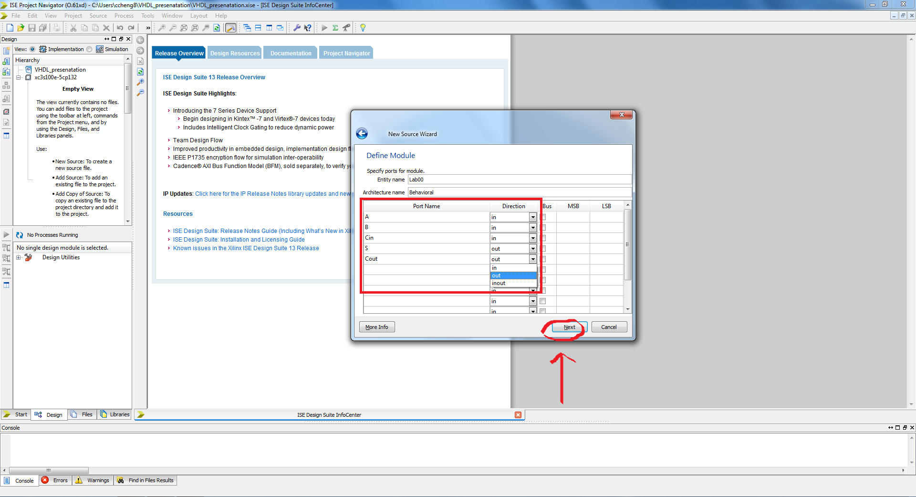

Slide 10
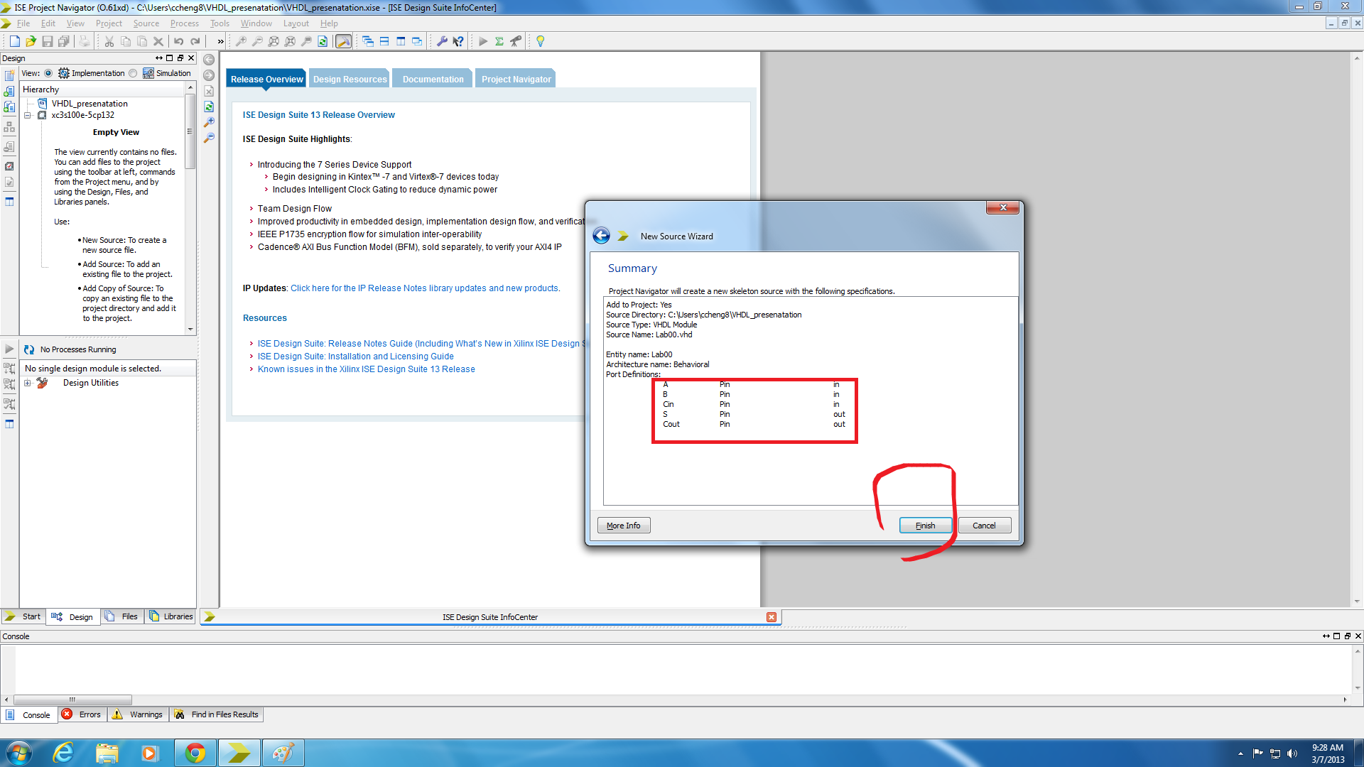

Slide 11
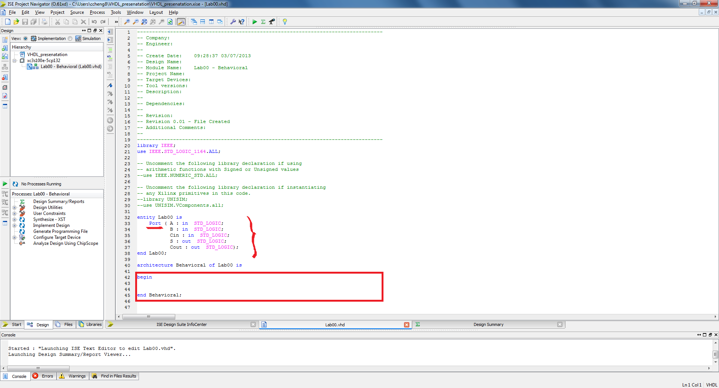
Generated VHDL file template by the software:
Entity declaration
(Entity name)
Port definition
(Port name and direction)
Architecture body
(Write the functions here!)

Slide 12
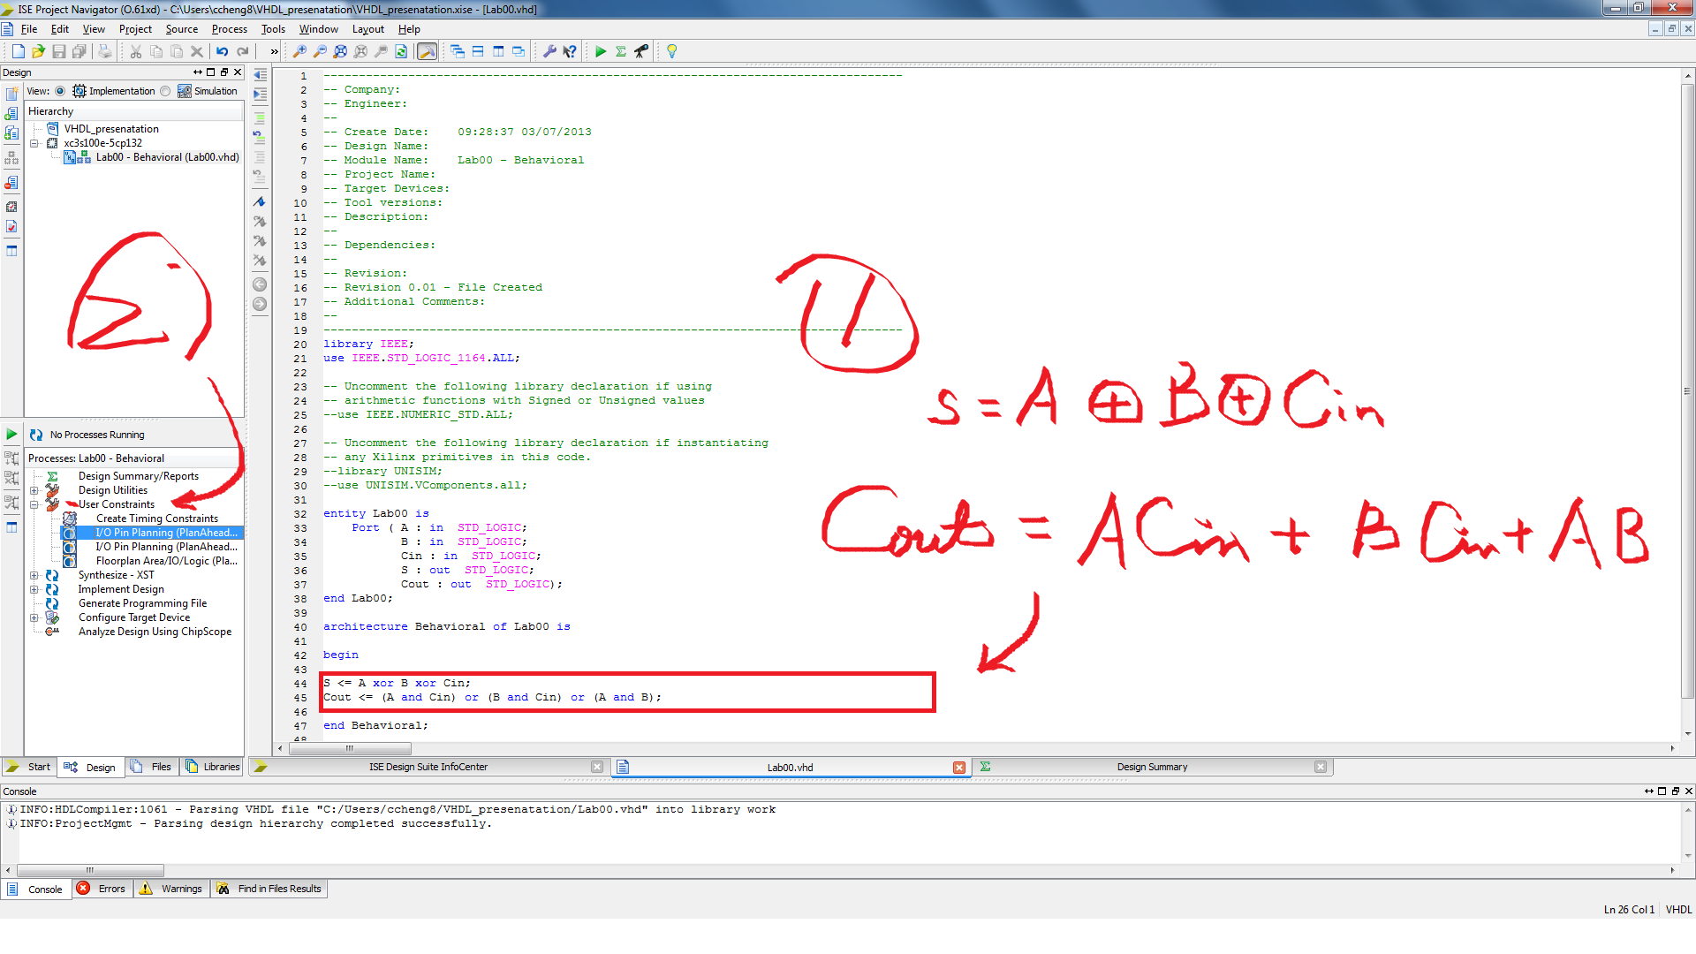

Slide 13
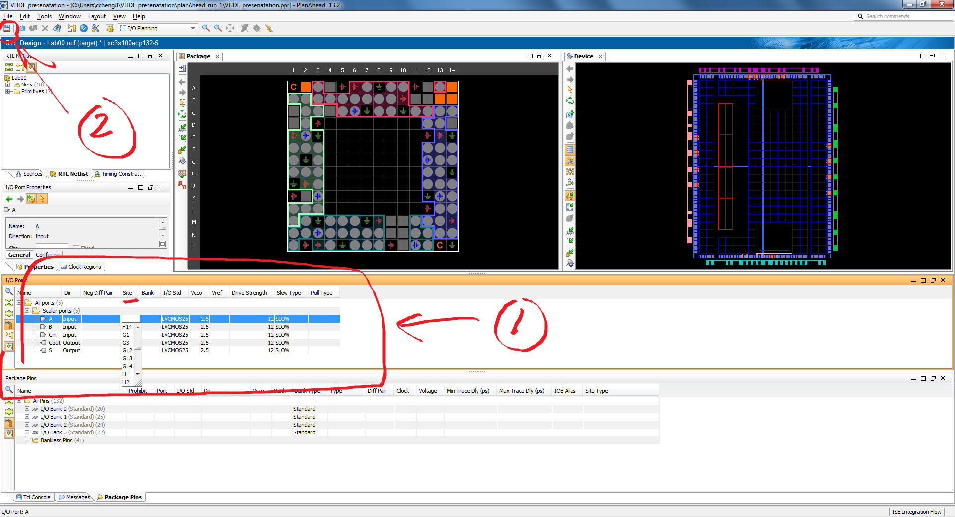

Slide 14
Outline
Example of VHDL Coding in Xilinx ISE Design Suite
Basic Knowledge of VHDL

Slide 15
Basic Modeling Constructs
Entity declarations
Entity identifier: Lab00
Ports definition
Port names: A, B, Cin, S, Cout
Port directions
“in” for input ports, “out” for output ports.
Architecture body
Architecture identifier: Behavioral
Behavioral descriptions
Signal assignment statement
S <= A xor B xor Cin;
Logical operators
and, or, not, xor, nand, nor, xnor
(No difference between upper case and lower case.)
Use ( ) to make the statement clearly expressed.

Slide 16
Signal Assignment Statement
Example
Logical operators in lower case
Logical operators in upper case
Less parentheses ( )

Slide 17
Assign Logic ‘1’ and Logic ‘0’
Example
Assign value of ‘1’
Assign value of ‘0’

Slide 18
Introduction to VHDL Coding
QUESTIONS
?

