Slide 1
Introduction to VHDL for Moore Machine
Teaching Assistants:
Wenchao Cao, Yin Lei, Cale Nelson
Department of EECS
University of Tennessee

Slide 2
Moore Machine and Mealy Machine
Moore machine:
Each node (state) is labeled with an output value.
Mealy machine:
Each arc (transition) is labeled with an output value.

Slide 3
Example of Moore Machine
Example of Moore machine
Three inputs: Reset, CLK, w
One outpu: z
Four states: S0, S1, S2, S3

Slide 4
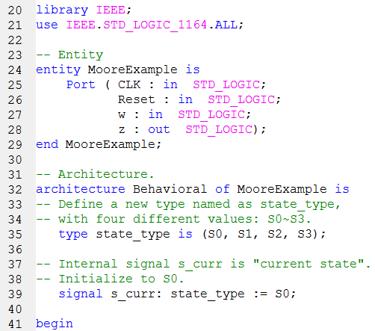
Example of VHDL for Moore Machine
VHDL Syntax :
Entity
entity <entity_name> is port( port assignments ... ); end [entity | <entity_name>];

Slide 5
Example of VHDL for Moore Machine
VHDL Syntax : Architecture
architecure <architecture_name> of <entity_name> is [ component declarations
function declarations
signal declarations
constant declarations
variable declarations
type declarations
... ] begin [ combinatorial statements sequential statements ... ] end architecture;

Slide 6
Example of VHDL for Moore Machine
VHDL Syntax :
Type declarations
type <type_name> is (<values>); -- where values is a list of acceptable values
-- array types can be defined as follows: type <type_name> is array (<low> to <high>) of <data_type>;
type <type_name> is array (<high> downto <low>) of <data_type>;

Slide 7
Example of VHDL for Moore Machine
VHDL Syntax :
Signal declarations
Signals are declared outside the process using the following statement:
signal list_of_signal_names: type [ := initial value] ;
signal SUM, CARRY: std_logic;
signal CLOCK: bit;
signal TRIGGER: integer :=0;
signal DATA_BUS: bit_vector (0 to 7);
signal VALUE: integer range 0 to 100;

Slide 8
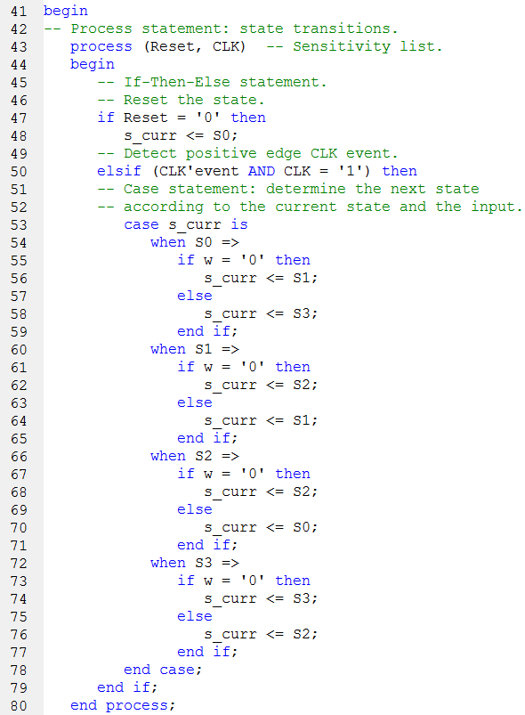
Example of VHDL for Moore Machine
VHDL Syntax :
Processes
[<process_name>:] process (<sensitive signals>) variable declarations constant declarations ... begin statements ... end process;

Slide 9
Example of VHDL for Moore Machine
VHDL Syntax :
If-Then-Else statement
if <condition> then statements ... [ elsif <condition> then statements ... else statements ... ] endif;

Slide 10
Example of VHDL for Moore Machine
VHDL Syntax : Signal attributes
One of the signal attributes:
signal_name’event
Function:
returns the Boolean value True if an event on the signal occurred, otherwise gives a False
Example:
if (CLOCK’event and CLOCK=’1’) then …
This expression checks for the arrival of a positive clock edge.

Slide 11
Example of VHDL for Moore Machine
VHDL Syntax : Case statement
case <expression> is when <choice(s)> => <expression>; ... when ... [when others => ... ] end case;

Slide 12
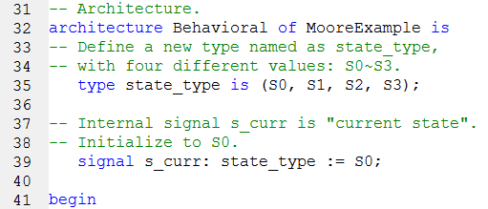
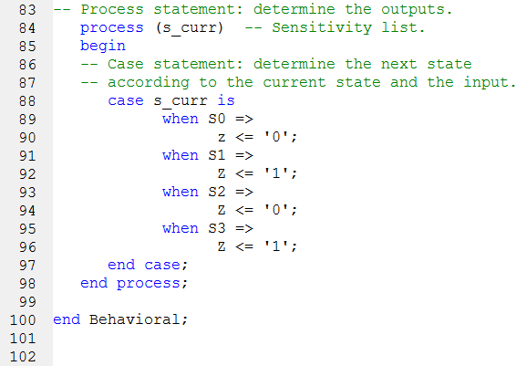
Example of VHDL for Moore Machine

Slide 13
References
http://webdocs.cs.ualberta.ca/~amaral/courses/329/labs/VHDL_Reference.html#signal_dec
http://www.seas.upenn.edu/~ese171/vhdl/vhdl_primer.html#_Toc526061362
http://www.ics.uci.edu/~jmoorkan/vhdlref/cases.html
http://web.engr.oregonstate.edu/~traylor/ece474/vhdl_lectures/essential_vhdl_pdfs/essential_vhdl107-127.pdf
http://www.gmvhdl.com/process.htm
http://www.gmvhdl.com/signals.htm

Slide 14
Introduction to VHDL for Moore Machine
QUESTIONS
?

