Slide 1
More on Basys board
Wenchao Cao, Teaching Assistant
Department of EECS
University of Tennessee

Slide 2
Reference Manuals
Digilent BASYS Board (Xilinx Spartan 3E FPGA)
Description: http://www.digilentinc.com/Products/Detail.cfm?Prod=BASYS
Download “BASYS reference manual” for references.
Read Pages 4-5 about “seven-segment display”.
Digilent BASYS 2 Board (Xilinx Spartan 3E FPGA)
Description: http://www.digilentinc.com/Products/Detail.cfm?Prod=BASYS2
Download “BASYS 2 reference manual” for references.
Read Pages 4-5 about “seven-segment display”.

Slide 3
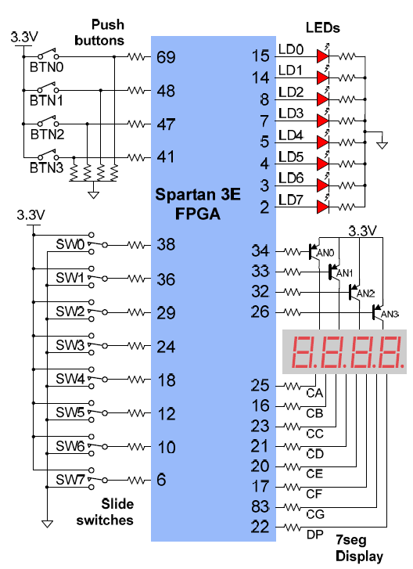
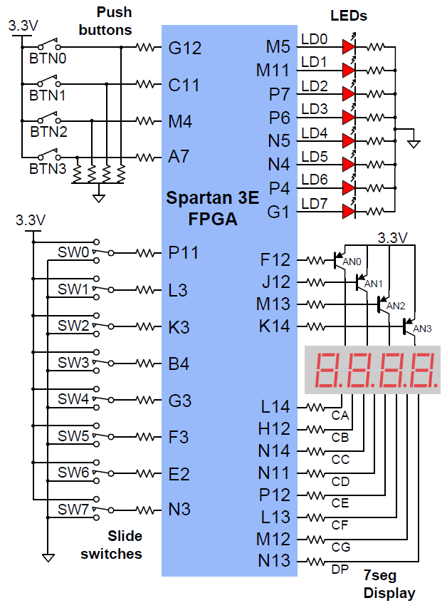
I/O Circuits
Digilent BASYS Board
Pins for
display selection (anode signals)
Logic 0: enable display
Logic 1: disable display
(Labels on boards are wrong!!)
From left to right:
BASYS board:
BASYS2 board:
Digilent BASYS 2 Board
AN3 | AN2 | AN1 | AN0
P26 | P32 | P33 | P34
AN3 | AN2 | AN1 | AN0
K14 | M13 | J12 | F12
Pins for
each bar of the 7-segment display
(cathode signals)
Logic 0: LED on
Logic 1: LED off

Slide 4
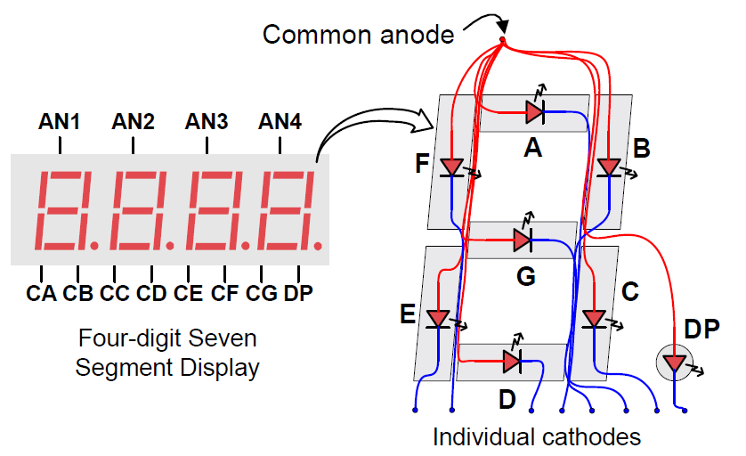
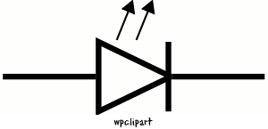
7-Segment Display
LED
7-segment display
AN3 AN2 AN1 AN0
Anode
Cathode
Anode | Cathode | State
Logic 1 | Logic 0 | ON
Logic 0 | Logic 0 | OFF
Logic 0 | Logic 1 | OFF
Logic 1 | Logic 1 | OFF
To light up the A-bar (CA) on the rightmost (AN0) display
AN0 | CA | Anode | Cathode | State
Logic 0 | Logic 0 | Logic 1 | Logic 0 | ON
Logic 0 | Logic 1 | Logic 1 | Logic 1 | OFF
Logic 1 | Logic 0 | Logic 0 | Logic 0 | OFF
Logic 1 | Logic 1 | Logic 0 | Logic 1 | OFF

Slide 5
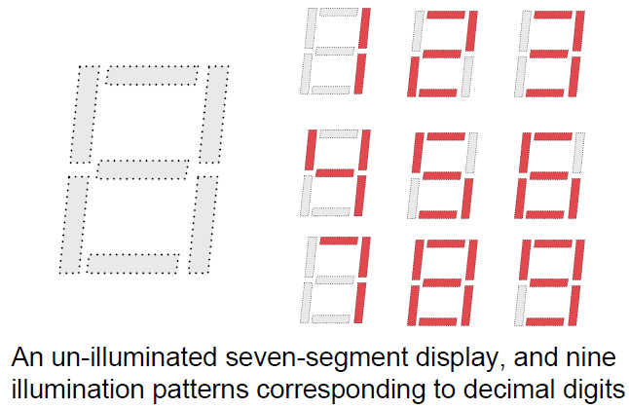
7-Segment Display
AN3 AN2 AN1 AN0
Truth table
Hex digit | SW3 | SW2 | SW1 | SW0 | CA | CB | CC | CD | CE | CF | CG
‘1’ | 0 | 0 | 0 | 1 | 1 | 0 | 0 | 1 | 1 | 1 | 1
‘9’ | 1 | 0 | 0 | 1 | 0 | 0 | 0 | 0 | 1 | 0 | 0
‘F’ | 1 | 1 | 1 | 1 | 0 | 1 | 1 | 1 | 0 | 0 | 0
Inputs
Outputs

Slide 6
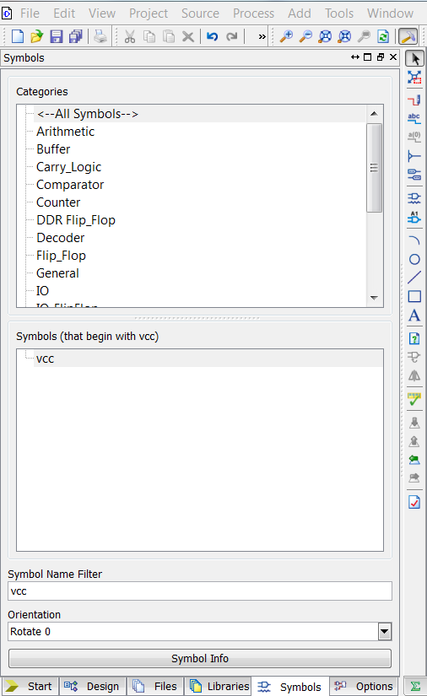
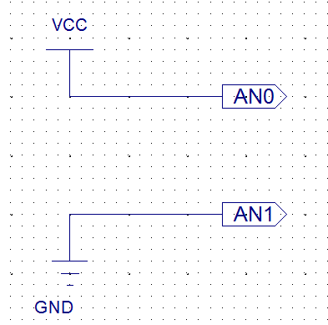
Assign Logic ‘1’ and Logic ‘0’
Logic ‘1’:
Symbol “VCC”
Logic ‘0’:
Symbol “GND”
Quick search of the symbols

Slide 7
Guide to Lab 2
QUESTIONS
?

