Slide 1
Supporting Cooperative Caching in Disruption Tolerant Networks
Wei Gao and Guohong Cao
Dept. of Computer Science and Engineering
Pennsylvania State University
Arun Iyengar and Mudhakar Srivatsa
IBM T. J. Watson Research Center

Slide 2
Outline
Introduction
Network Central Locations (NCLs)
Caching Scheme
Performance Evaluation
Summary & Future Work
Notes:
First of all, I would like to give you an overview about our motivation and the major challenges of supporting cooperative caching in DTNs, and also give you a big picture about our proposed caching scheme.

Slide 3
Disruption Tolerant Networks (DTNs)
Consist of hand-held personal mobile devices
Laptops, PDAs, Smartphones
Opportunistic and intermittent network connectivity
Result of node mobility, device power outage or malicious attacks
Hard to maintain end-to-end communication links
Data transmission via opportunistic contacts

Slide 4
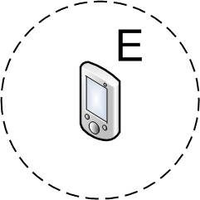
Data Transmission in DTNs
Carry-and-Forward
Mobile nodes physically carry data as relays
Forwarding data opportunistically upon contacts
Major problem: appropriate relay selection
0.7
0.5
Notes:
Based on this basic methodology, a lot of work has been done on developing effective relay selection methods for forwarding data to a pre-specified set of destinations in DTNs. However, in this paper, we target a different, more general but also more challenging problem: data dissemination in DTNs.

Slide 5
Providing Data Access in DTNs
Active data dissemination
Data source actively push data to users being interested in the data
Publish/Subscribe
Brokers forward data to users according to their subscriptions
Caching
Notes:
Based on such opportunistic communication paradigm, our focus in this paper is to provide effective data access to users. i.e., there are some data in the networks, and we make it easy and prompt for the users to have access to them. Actually, there are several ways of providing data access.
Active dissemination: in this case, nodes are used as relays to carry and forward data to the nodes interested in the data
The first one is expensive, and second one needs to additionally maintain network structure, which is expensive in DTNs without end-to-end network connectivity.
So, we focus on caching.

Slide 6
Our Focus
Cooperative caching in DTNs
Cache data at appropriate network locations
Queries in the future are responded faster
Major challenges
Where to cache
Hard to monitor the network query pattern and determine the caching location for minimizing data access delay
How many to cache
Uncertainty of opportunistic data transmission
Tradeoff between data accessibility and caching overhead
Notes:
Cache data at appropriate network locations based on the query history, so that queries in the future can be responded with less delay.
The caching location should minimize the data access delay: delay minimization is the basic goal of caching.
In general, when designing a caching scheme, we need to solve the problems of “where to cache”. But in DTNs, due to the opportunistic network connectvitiy, this is more challenging.
Uncertainty of transmission: you cannot ensure that a data copy can be transmitted to the request on time, so you need multiple data copies to ensure delivery.
due to the uncertainty of data transmission, multiple data copies need to be cached at different locations
to ensure data accessibility. The difficulty in coordinating multiple caching nodes makes it hard to optimize the tradeoff between data accessibility and caching overhead.

Slide 7
Challenges
Wireless ad-hoc network with end-to-end network connectivity
Incidentally cache pass-by data
Notes:
More specifically, let me use the difference of caching schemes in traditional wireless ad-hoc networks and DTNs to furthermore illustrate these challenges.
In traditional caching schemes, because we always have end-to-end network connectivity, the query and response will take the same way. So any node on the path is able to monitor the complete query history, and make decision on caching the “pass-by”data. Such caching is “incidental” because any node can cache the pass-by data.

Slide 8
Challenges
Disruption-Tolerant Networks (DTNs)
Notes:
Due to the opportunistic network connectivity, the query and response for a data item may take different ways. Hence, it is difficult to collect the global information about complete query history, and furthermore determine caching locations.
For example, the queries from D and F take the same way back, but the response to E will take node H instead of C, because C is disconnected from G by then. In this case, C cannot cache d1, H cannot cache d1 either because it has not received the query q2 so consider d1 is less popular. and d1 can only be cached at G which is further from the requesters.

Slide 9
Basic Ideas
Intentionally cache data at a set of Network Central Locations (NCLs)
A group of mobile nodes represented by a central node
Being easily accessed by other nodes in the network
Utility-based cache replacement
Popular data is cached near central nodes
Coordinate multiple caching nodes
Tradeoff between data accessibility and caching overhead
Notes:
These challenges show that it is infeasible to cache data incidentally at random network places in DTNs according to the query history.
Our way to solve the aforementioned challenges is: instead of incidentally cache data at dynamic locations, we intentionally cache data at a set of NCLs, i.e., fixed network locations.
Note that: here a NCL does not correspond to some geographical location because the nodes in DTNs are keep moving. They just indicate some good locations for the data to be cached.

Slide 10
The Big Picture
NCL 2
NCL 1
Notes:
We have two NCLs, each of which corresponds to a set of nodes, and indicated by central nodes c1 and c2.
Data source S multicasts data to the central nodes
Central nodes are prioritized for caching data. Buffer of C1 is full, so cached at A near C1.
A requester R sends queries to central nodes, and central nodes are responsible for searching data if it is not cached locally. If C2 is too far, the query may not be able to reach C2 before it expires. So finally only A at NCL 1 replies the data to R.

Slide 11
Outline
Introduction
Network Central Locations (NCLs)
Caching Scheme
Performance Evaluation
Summary & Future Work

Slide 12
Network Modeling
Contacts in DTNs are described by network contact graph G(V, E)
Contact process between nodes i and j is modeled as an edge e_{ij} on network contact graph
The contacts between nodes i and j are modeled as a Poisson process with contact rate

Slide 13
NCL Selection
Central nodes representing NCLs are selected based on a probabilistic metric
Central nodes can be easily accessed by other nodes
Number (K) of NCLs is a pre-defined parameter
Central nodes are selected in a centralized manner based on global network knowledge
Notes:
NCL selection means to choose the central nodes representing the NCLs

Slide 14
NCL Selection Metric
Metric of node i to be selected as central node
Opportunistic path:
Average probability that data can be transmitted from a random non-central node to i within time T
Set of existing central nodes
Notes:
Opportunistic path is the path from node I to j on the network contact graph, and its weight evaluates the data transmission delay between the two nodes.

Slide 15
Trace-based Validation
The applicability of NCL selection in realistic DTN traces
Only few nodes have high metric values
Our metric reflects the heterogeneity of node contact pattern
Notes:
In this case, we validate the existence of heterogeneity of node metric values in practice, which is necessary for our selection scheme to work. We ensure that the few selected central nodes have much better contact capability than the other nodes in the network, so that we ensure that they can be effectively used for caching.

Slide 16
Outline
Introduction
Network Central Locations (NCLs)
Caching Scheme
Performance Evaluation
Summary & Future Work

Slide 17
Caching Scheme Overview
Initial caching locations
Data source pushes data to NCLs
Querying data
Requesters pulls data from NCLs by multicasting queries to NCLs
Utility-based cache replacement
When caching nodes contact each other
More popular data is cached nearer to central nodes
Notes:
The caching scheme consists of three components:
Initial caching locations are determined during pushing process
Queries: how queries are forwarded to the caching nodes and
Cache replacement. The data access pattern in the network is dynamic and ever changing. Therefore, we perform real-time cache replacement, to ensure that popular data are always cached near the central nodes, so as the minimize the cumulative delay.

Slide 18
Initial Caching Locations
Central nodes are prioritized to cache data
Data is cached at nodes near central nodes if their buffer are full
Notes:
Push the data to the central nodes by initiating a multicast process
C2: cache is full, so cached at R4_2
C3: even R4_3 is full, so cached at R3_3

Slide 19
Querying Data
Requester multicasts query to central nodes
If data is cached at central nodes
Respond directly
Otherwise
Forward query
to caching nodes

Slide 20
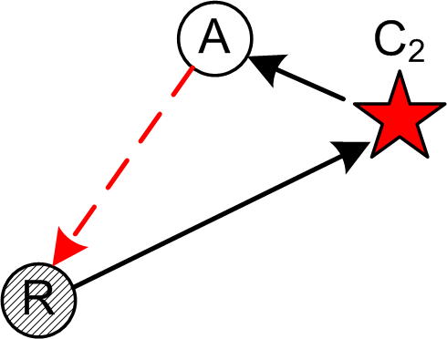
Analyzing Data Access Delay
Related to the number (K) of NCLs
K is small
1./3.: Data transmission delay between requester and NCLs is longer
2.: Data can be cached nearer
to the central node
K is large
Metric values of some central
nodes may not be high
2.
3.
1.
Notes:
In general, you have only one data copy at each NCL. So when K is small, the amount of data being cached is also smaller, so you have higher chance to cache data nearer to the central node.

Slide 21
Utility-based Cache Replacement
Two caching nodes exchange their cached data when they contact each other
Cache popular data near central nodes to minimize the cumulative data access delay
Data utility
The popularity of data in the network
The distance from the caching node to the corresponding central node
Notes:
This replacement is necessary because the network query pattern is dynamic, and the popularity of different data items in the network is also changing. SO that, we have to adaptively adjust the caching locations, to ensure that popular data is always cached near central nodes to minimize the delay
When two nodes A and B contact each other, we put the data they cache into a common selection pool S, and formulate their cache replacement decision as a knapsack problem.
Note that, a data item has different utility at different caching nodes.

Slide 22
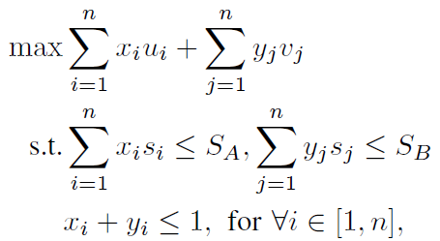
Utility-based Cache Replacement
Knapsack formulation
Data at nodes A and B:
Data utilities
Data sizes
Each data is only cached at one node

Slide 23
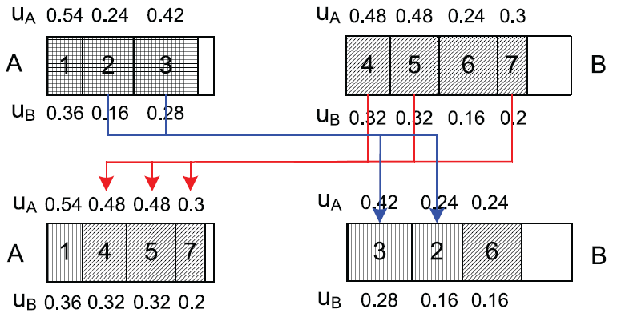
Utility-based Cache Replacement
Example: A is nearer to the central node

Slide 24
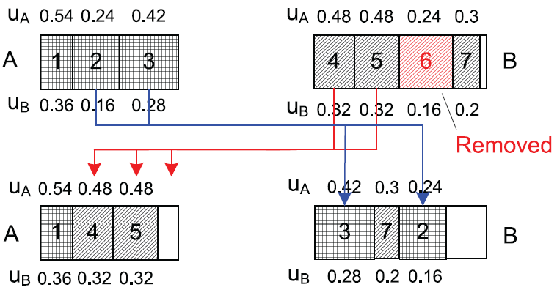
Utility-based Cache Replacement
Less popular data may be removed from cache if caching buffer is very limited
Notes:
The data 2 and 3 was moved from A to B. since both 2 and 3 have higher utility than 6, 6 was removed from B’s buffer.
In this case, our scheme prioritize to cache popular data in the network, so that the cumulative data access delay is minimized.

Slide 25
Outline
Introduction
Network Central Locations (NCLs)
Caching Scheme
Performance Evaluation
Summary & Future Work

Slide 26
Experimental Settings
Data generation
Each node periodically determines whether to generate new data with a fixed probability p_{G}=0.2
Data lifetime is uniformly distributed in [0.5T, 1.5T]
Query pattern
Randomly generated at all nodes periodically
Query pattern follows Zipf distribution
Time constraint of query: T/2

Slide 27
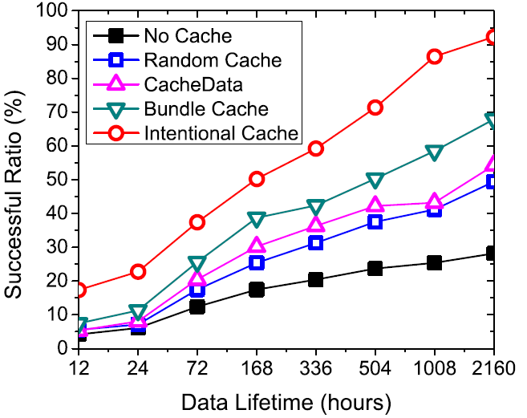
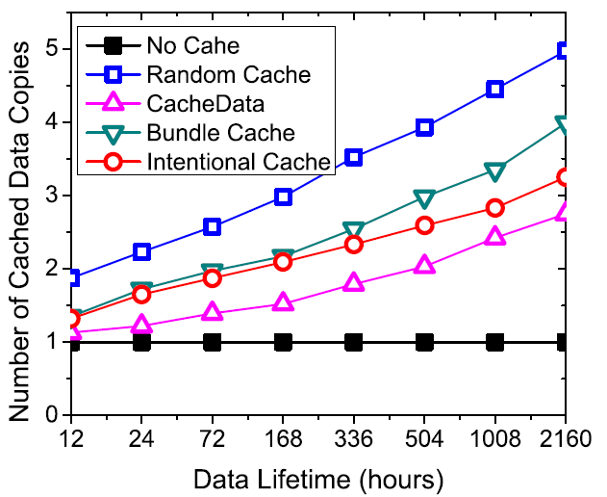
Caching Performance
On the MIT Reality trace with different data lifetime (T)
Higher successful ratio
Lower caching overhead

Slide 28
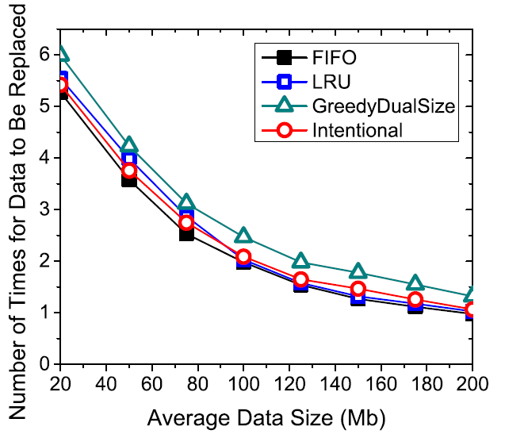
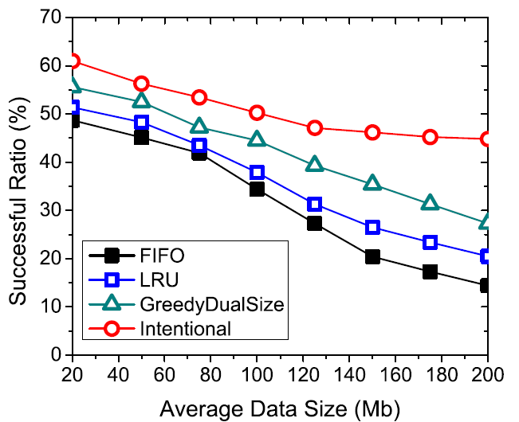
Effectiveness of Cache Replacement
Different replacement strategies on MIT Reality trace
Improves successful ratio
Similar replacement overhead

Slide 29
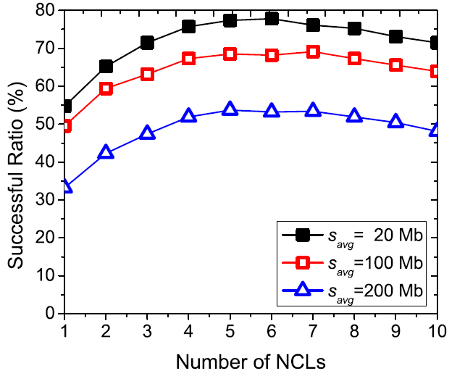
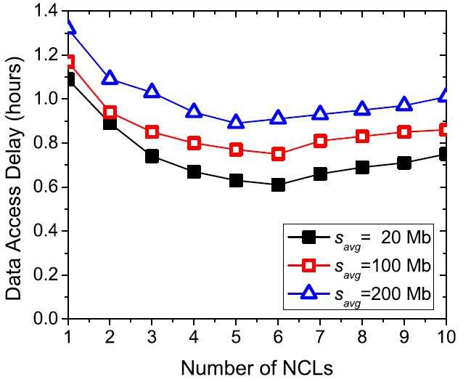
Impact of the Number of NCLs
On Infocom06 trace with T=3 hours
Optimal: K=5
Notes:
When K=5: highest successful ratio
K=5:

Slide 30
Summary
Cooperative caching in DTNs
Intentionally cache data at a pre-specified set of NCLs which can be easily accessed by other nodes
NCL selection based on a probabilistic metric
Utility-based cache replacement to maximize the cumulative caching performance
Future work
Distributed NCL selection
Load balancing on NCLs

Slide 31
Thank you!
http://mcn.cse.psu.edu
The paper and slides are also available at:
http://www.cse.psu.edu/~wxg139

Slide 32
Traces
Record user contacts at university campus
Various wireless interfaces
Bluetooth: periodically detect nearby peers
WiFi: associate to the best Access Point (AP)
Notes:
The two traces differ in their scale, contact detection period, as well as the contact density and duration.
Note that the average contact duration in the MIT Reality trace is much shorter than that in the UCSD trace, and this difference will lead to significant difference in the later pattern formulation.

Slide 33
Opportunistic Path
Each hop corresponds to stochastic contact process with pairwise contact rates
X_{k}: inter-contact time between nodes N_{k} and N_{k+1}
Exponentially distributed
Y: the time needed to transmit data from A to B along the path
follows hypoexponential distribution

Slide 34
Probabilistic Data Selection in Cache Replacement
Fairness of caching
Every node caches popular data
Caching effectiveness is only locally maximized
Probabilistic data selection
Every caching node probabilistically determine whether to cache the data
Data utility is used as the probability
Notes:
It is possible that popular data is cached at every node, but other data is simply ignored.

Slide 35
Comparisons
NoCache, where caching is not used for data access
RandomCache, where each requester caches the received data randomly
CacheData, which is proposed for cooperative caching in wireless ad-hoc networks
BundleCache, which caches network data as bundles

