Slide 1
On Exploiting Dynamic Execution Patterns for Workload Offloading in Mobile Cloud Applications
Wei Gao, Yong Li, and Haoyang Lu
The University of Tennessee, Knoxville
Ting Wang
IBM T. J. Watson Research Center
Cong Liu
University of Texas at Dallas

Slide 2
Cloud Computing for Mobile Devices
Contradiction between limited battery and complex mobile applications
Mobile Cloud Computing (MCC)
Offloading local computations to remote execution
Virtual Machine (VM) synthesis and migration

Slide 3
Cloud Computing for Mobile Devices
Wireless communication is expensive!
Partitioning workloads at the method level
A
3G/4G, WiFi
B
Application process
B
Local execution > wireless data transmission

Slide 4
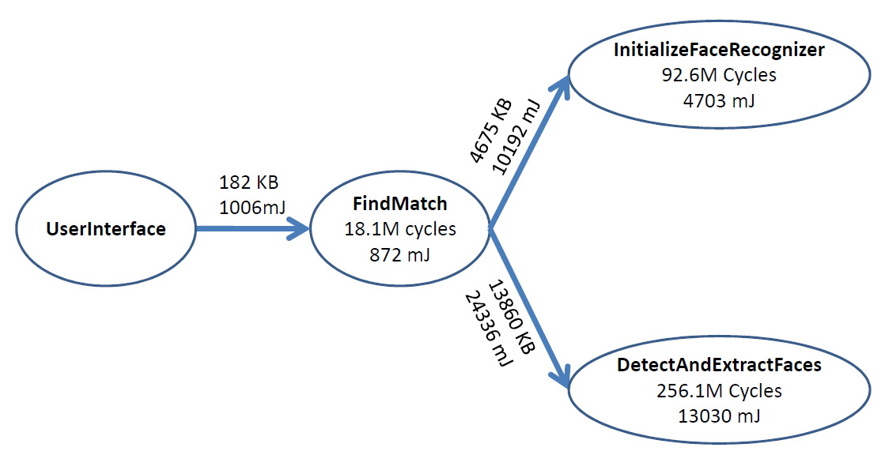
Existing Work
Assuming stationary and fixed program
execution paths
Fixed partitioning decisions based on
Online/offline profiling data
Empirical heuristics
Deterministic optimization problems

Slide 5
Should the Partitioning Be Fixed?
Dynamics of execution patterns at run-time
Different input datasets,
user operations,
and system contexts
We explore such run-time dynamics via real-world experiments
Run-time execution patterns of mobile applications
Open-source Android apps: Firefox, Chess game, Barcode scanner
Multiple application runs with different data and user inputs
Online profiling every time

Slide 6
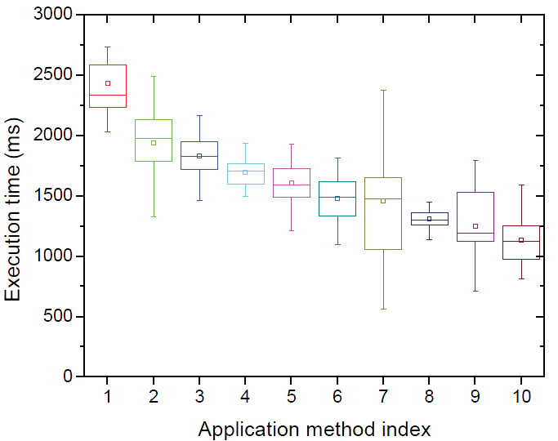
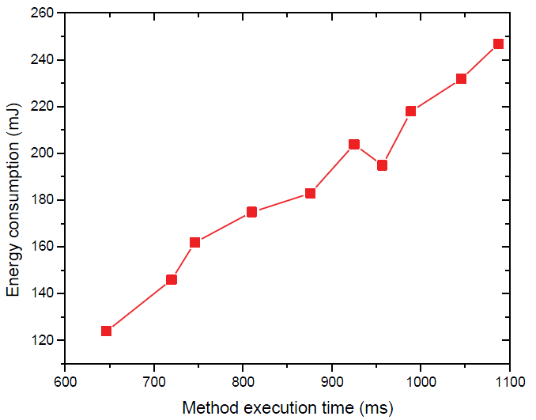
Run-time Dynamics of Execution Patterns
Dynamics of application execution paths
Method execution times and energy consumption
More than 40% difference
Execution times of a method could vary up to 50%
Energy consumption of a method is application-specific

Slide 7
Insights
Ignorance of run-time execution dynamics
Inaccurate estimation of application execution cost
Inappropriate partitioning decisions
Incorporation of run-time execution dynamics
Formulating method transitions as a continuous-time stochastic process
An ordinary Markov model is insufficient
Complicated invocation interdependency
Heterogeneous system and network conditions

Slide 8
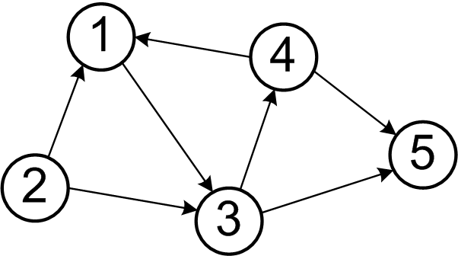
Our Solution
A stochastic workload offloading framework
Formulating method transitions as an order-k semi-Markov model
Semi-Markov: arbitrary sojourn times
between method transitions
Heterogeneous method execution times
Order-k: precise prediction of method
invocation
k-step interdependency
Incorporation of system dynamics
Method execution times
Energy consumption of computation and data transmission
Method execution times

Slide 9
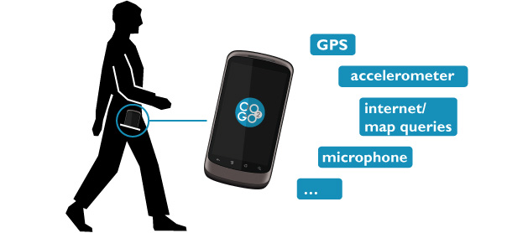
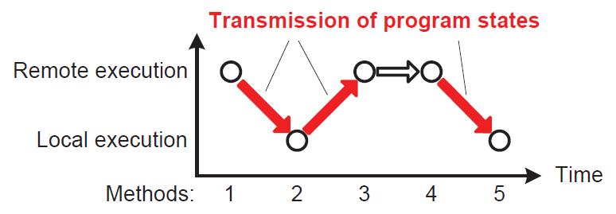
System Model
Decisions among remoteable app methods
Non-remoteable: User display,
sensor access, etc
Programmer’s annotations
Transmission of program states
Only when the working
location is changed
Assumption
Independence among multiple mobile apps

Slide 10
Semi-Markov-Based Formulation
A Markov renewal process {(M_{n}, T_{n}), n=1,…N}
M_{n}: the n-th app method being executed
T_{n}: the time when M_{n} is invoked
T_{n+1}-T_{n}: the execution time of M_{n}
Invocation interdependency
Invocation of is M_{n} determined by its previous k methods
Composite state
Extended state transition probability matrix T= { p_{ij} }
Sojourn time distribution: the holding time of a state

Slide 11
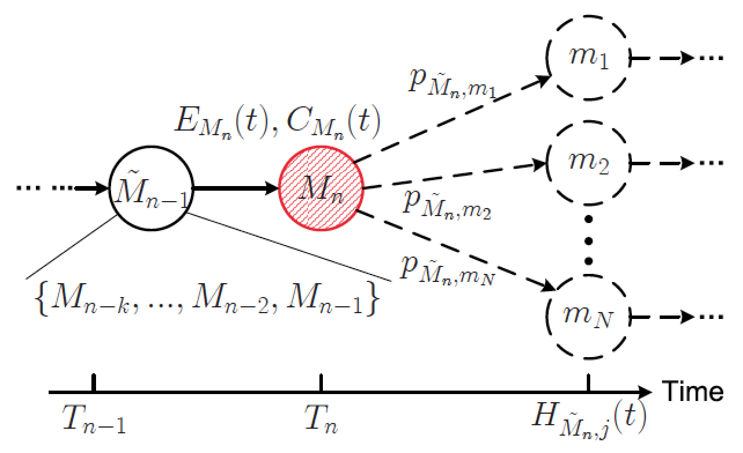
Workload Offloading Decisions
Criteria: whether M_{n}’s remote execution could save local energy
What methods are executed before and after M_{n}
Affecting M_{n}’s execution time and energy consumption
Approach: Local Invocation Graph (LIG) of M_{n}
Not predicting too far
into the future
Aim to avoid the
“ping-pong”
phenomenon

Slide 12
Workload Offloading Decisions
G_{Mn}: amount of energy saved by M_{n}’s remote execution
E_{Mn}(t): energy consumed
by M_{n}’s local execution
C_{Mn}(t): energy consumed
by transmitting M_{n}’s
program states
Prob to invoke m_{j}
M_{n}’s execution time
If j is executed locally
Prob for m_{j} to be
Executed locally

Slide 13
Exploiting Execution Dynamics
G_{Mn} highly depends on the characteristics of E_{Mn}(t) and C_{Mn}(t)
Sojourn time distributions indicating method execution times
Characteristics of energy consumption
Exploiting execution dynamics
Run-time parameter estimation with profiled information
Quantified operations of workload offloading

Slide 14
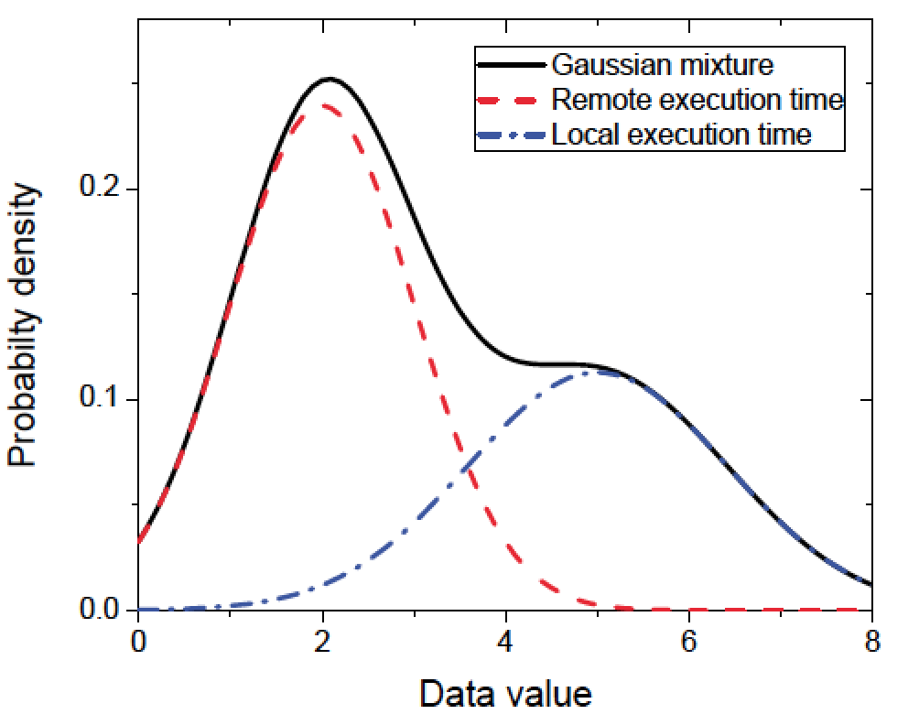
Sojourn Time Distribution
Formulated as a Gaussian mixture
Parameter re-estimation
EM algorithm over the profiled
information about past method
executions
Maximum A Posteriori (MAP)
method for the limited training
data
Local execution
Remote execution

Slide 15
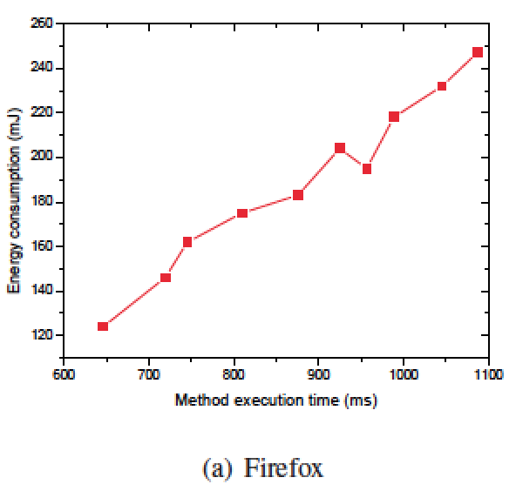
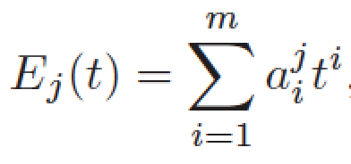
Addressing the Energy Consumption
Energy consumed by method
execution depends on method
execution time
Formulate the relationship
as a m-order polynomial
Coefficients a_{i}^{j}: real-time linear regression analysis
E_{j}(t): chi-square distribution with m degrees of freedom
t: normally distributed random variable as the method execution time

Slide 16
Quantified Operations of Offloading
Formulations of these system dynamics allow further quantification of offloading decisions:

Slide 17
Performance Evaluations
Comparisons
MAUI: offloading by solving integer optimizations
AlfredO: offloading by finding the optimal graph cut
FuzzyLogic: offloading with a fuzzy logic engine
Evaluation metrics:
Method execution time
Amount of energy saved
Computational overhead
Energy consumed by making decisions of workload offloading

Slide 18
Evaluation Setup
Evaluation against open-source Android mobile apps
Firefox, Chess game, Barcode scanner
Implementing the offloading framework into app codes
Offloading operations
Adopt the approach of CloneCloud
A clone VM is maintained at the cloud server for each app
A Dalvik VM instance compiled for the x86 architecture
Experiments
10-min app session with different human inputs and operations

Slide 19
Offloading Effectiveness
An order-3 semi-Markov model is used
25% shorter execution time
40% more energy saved
Less than 5% overhead

Slide 20
Impact of System Workload
System workload is simulated by articulated dumb computations
Better performance with higher system workload
Slower increase of
execution time
30% of energy saving
Similar overhead

Slide 21
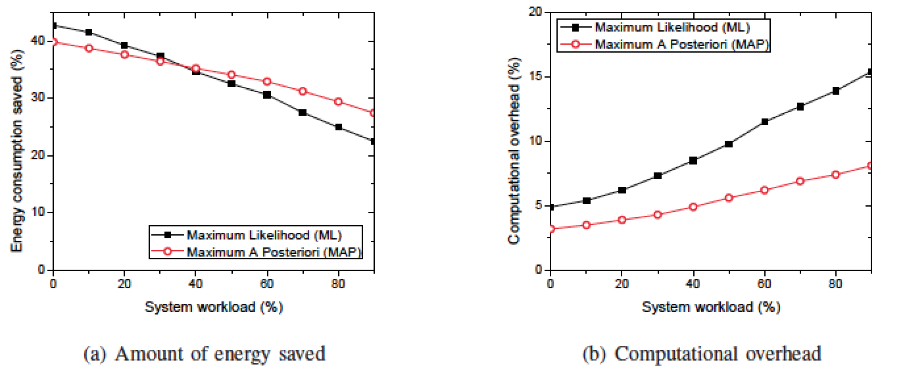
Parameter Estimation of Sojourn Time Distribution
MAP performs better only when the system workload is high
Higher overhead is incurred

Slide 22
The Order of Semi-Markov Model
Using higher value of k
Smaller performance improvement when k increases
Significant overhead increase
Carefully choose k according to the application scenario!

Slide 23
Summary
Mobile cloud computing (MCC) is critical to
Augment mobile devices’ local capabilities
Energy saving
MCC efficiency is determined by application partitioning
Our insight: exploiting the dynamic execution patterns of mobile apps is the key
A stochastic offloading framework based on order-k semi-Markov model
Exploiting the system dynamics of application executions

Slide 24
Thank you!
Questions?
The paper and slides are also available at:
http://web.eecs.utk.edu/~weigao/

