Slide 1
Wakeup Scheduling for Energy-Efficient Communication in Opportunistic Mobile Networks
Wei Gao¹ and Qinghua Li²
¹The University of Tennessee, Knoxville
²The Pennsylvania State University

Slide 2
Outline
Introduction
Big picture: energy saving through wakeup scheduling
Pairwise wakeup scheduling
Cumulative wakeup scheduling
Performance evaluation
Conclusion

Slide 3
Opportunistic Mobile Networks
Consist of hand-held personal mobile devices
  Laptops, PDAs, Smartphones
Opportunistic and intermittent network connectivity
  Result of node mobility, device power outage, or malicious attacks
  Hard to maintain end-to-end communication links
Data transmission via opportunistic contacts
  Communication opportunity upon physical proximity

Slide 4
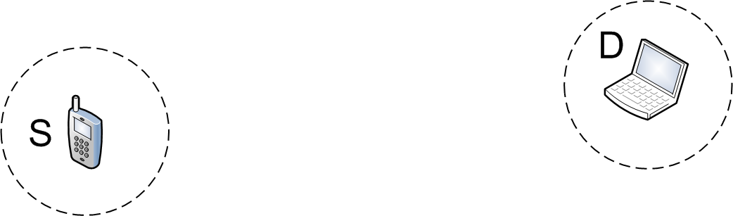
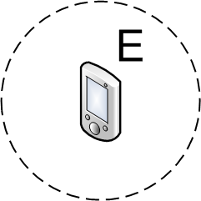
Methodology of Data Transmission
Carry-and-Forward
  Mobile nodes physically carry data as relays
  Forwarding data opportunistically upon contacts
  Major problem: appropriate relay selection
0.7
0.5
Notes:
As you can see from this example, S want to send data to D but does not have end-to-end links to D, so S has to determine whether to use A or B as relay. Suppose we know that B’s probability to contact D (0.7) is higher than that of A (0.5), than S is able to make the correct relay selection decision as B, and B will carry and forward data to the destination. In general, such relay selection may take multiple hops, as A may further select C as relay.

Slide 5
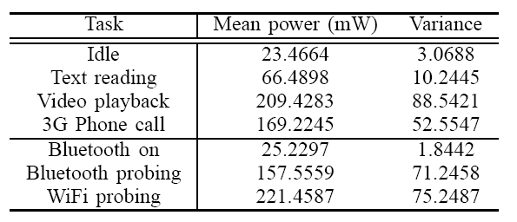
Contact Probing
A node periodically probes contacts nearby
  Bluetooth: discoverable mode
  Prerequisite for opportunistic communication
Major source of energy consumption
Notes:
From the above example we can see that, in order to ensure efficient opportunistic communication, a node has to periodically detect its nearby environment and look for opportunistic contacts. The key factor here is the probing interval, which has to be short enough so that no contact is missed, but is rather energy consuming. We have done experiments using Samsung Nexus S smartphones to evaluate the energy consumption of contact probing, and it shows that one probing action costs as much energy as 3G phone call or video playback. Considering that such contact probing is performed periodically, it becomes the major source for energy consumption in opportunistic communication.

Slide 6
Outline
Introduction
Big picture: energy saving through wakeup scheduling
Pairwise wakeup scheduling
Cumulative wakeup scheduling
Performance evaluation
Conclusion

Slide 7
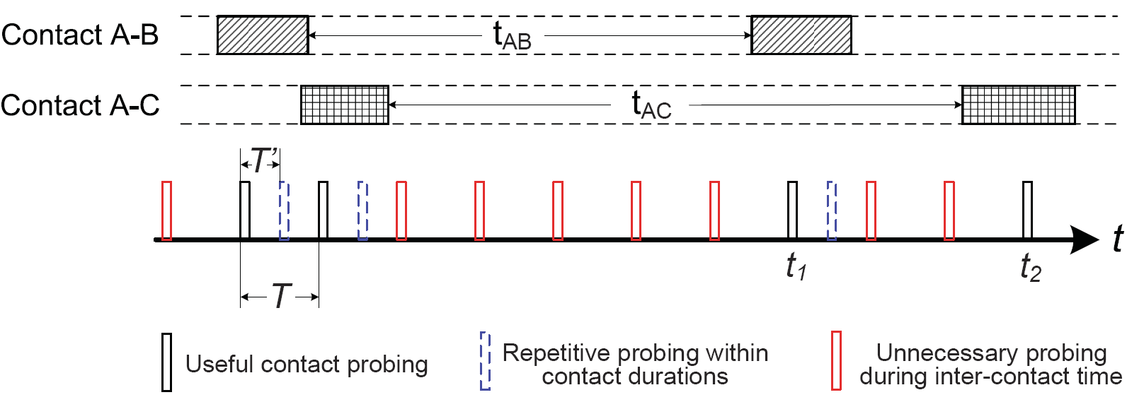
Our Focus
Reduce the energy consumption of contact probing
  Optimizing the probing interval is insufficient
    Only avoid repetitive probing within contact duration
  Energy consumption during inter-contact times
    Inter-contact time is much longer than contact duration
    Users only need to wake up when a contact will happen
Notes:
Therefore, the major focus of this paper is to reduce the energy consumption of contact probing, which is vital to energy-efficient opportunistic communication. Existing work only focuses on optimizing the contact probing interval, but leave the majority of energy consumption during inter-contact time untackled. Users waste the majority of their energy on uselessly contact probing during inter-contact times which is much longer than the contact duration, but actually probes nothing. Instead, they only need to wake up when a predicted contact is likely to happen.
As shown in this figure, existing work can only avoid repetitive contact probing within contact durations, but users are uselessly probing for contact during inter-contact times. Our approach aims to only reserve useful contact probing, and avoid any other unnecessary contact probing actions.

Slide 8
Network Model
Node contacts are described by the network contact graph G(V,E)
  Contact process between nodes is described by
  Pairwise inter-contact time is assumed to be exponentially distributed
  Nodes i and j are contacted neighbors if
  The node set is called the contacted neighborhood of node i

Slide 9
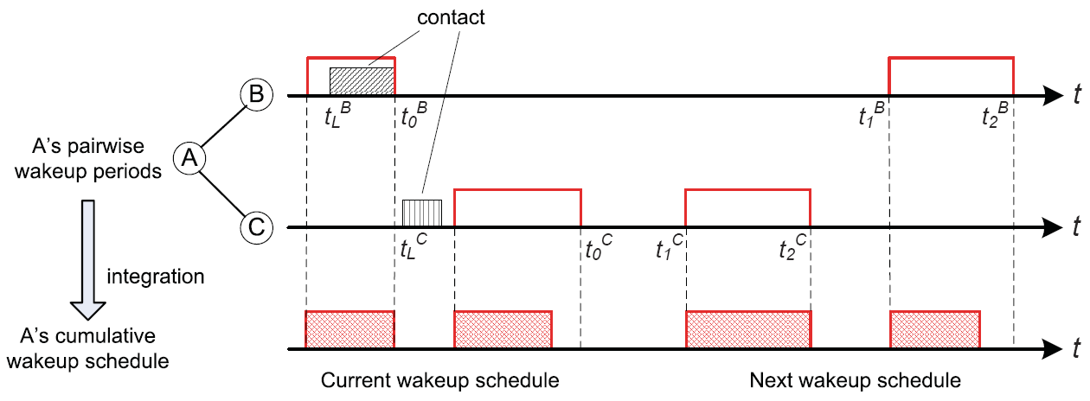
The Big Picture
Basic idea: Wakeup scheduling
  A user only wakes up when a predicted contact happens
    Probabilistic contact prediction
  Pairwise scheduling cumulative scheduling
Notes:
Our basic idea is to schedule a user’s wakeup periods, so that a user only needs to wake up when a predicted contact with other users is likely to happen. This is based on probabilistic contact prediction. As shown in this figure, A independently schedules its pairwise wakeup periods with its contacted neighbors B and C separately, and then integrates these pairwise periods together to generate its cumulative wakeup schedule. As a result, A can sleep during most of the time, and saves energy. When the current contact between A and B ends, this pairwise wakeup scheduling is performed. If the contact prediction is inaccurate like A and C, the contact did not happen during the wakeup period, we also have proposed techniques to handle such prediction inaccuracy.

Slide 10
Outline
Introduction
Big picture: energy saving through wakeup scheduling
Pairwise wakeup scheduling
Cumulative wakeup scheduling
Performance evaluation
Conclusion

Slide 11
Pairwise Wakeup Scheduling
Focus: a pair of nodes A and B stay awake each time they contact each other
Tradeoff between energy saving and communication performance
  A and B schedule their next wakeup period [t₁, t₂] at t₀
  Minimize the energy consumption during [t₁, t₂] measured
  by the active ratio
  Satisfy the performance requirement
Last contact between A and B
Notes:
Scheduling happens when i) the contact between A and B ends, ii) data transmission between A and B finishes.
When you want to save energy and let a node sleep, you have the chance to miss contacts (a contact happens when a node sleeps) and degrade communication performance. We want to optimize this tradeoff: minimize the energy consumption subjective to the performance requirement.
The performance requirement is defined as the maximally allowed performance degradation due to wakeup scheduling, which is controlled by the parameter p. If A and B has a specific probability to contact each other during [t1,t2] without sleeping (l.h.s. of inequation), then their contact probability after wakeup scheduling should not be too low.

Slide 12
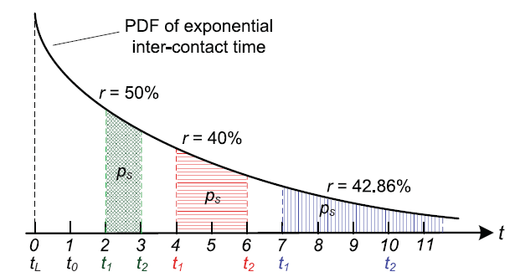
Minimizing the Active Ratio
Contact prediction
  Choose t₁ and to minimize r
  Larger t₁, larger
  r increases with t₁
  when is fixed
Notes:
Since we assume that the pairwise inter-contact time is exponentially distributed, we can derive the contact probability within a specific time period. Therefore, the performance requirement can be transformed to the first formula.
The cornerstone for such minimization is the decreasing PDF of exponential inter-contact time. The larger t1 you choose, the smaller probability density you have, and longer wakeup period you need to satisfy the performance requirement. Since r increases with t1 when \Delta is fixed, we need to first find out the correlation between t1 and \Delta, then find out the optimal value of t1. as shown in this figure, t1 must be carefully chosen.
Due to the time limit we will not talk about the details about how to derive t1 and \Delta here. You can refer to the paper.

Slide 13
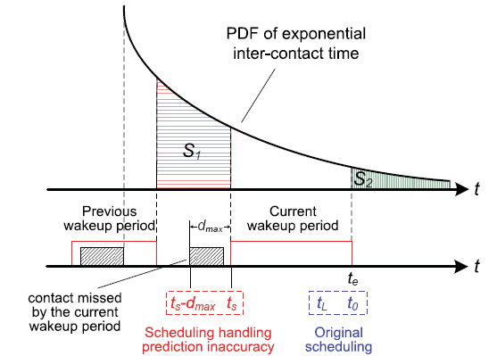
Handling Inaccuracy of Contact Prediction
Contact prediction cannot be 100% accurate
  A scheduled wakeup period may miss the contact
  Assume that the missed contact
  actually happened earlier
  Schedule the next wakeup
  period to be earlier and
  longer
  [t₀, t_{L}] [t_{s}, t_{s}-d_{max}]
The last known contact
Maximum contact duration
Notes:
The missed contact can happen either before or after the scheduled wakeup period. Due to the decreasing PDF of inter-contact time, we assume that it happens before, where the majority of probability mass exists. Therefore, our solution is to schedule the next wakeup period to be earlier and longer, so as to avoid missing contact again. To do this, we replace the quantity t0 and tL in our scheduling algorithm with tS and tS-dmax.
The key challenge is that we don’t know when this missed contact happens, so it is difficult to schedule the next wakeup period. Therefore, we instead use the information we have about the last known contact instead. This is essentially a conservative approximation.

Slide 14
Outline
Introduction
Big picture: energy saving through wakeup scheduling
Pairwise wakeup scheduling
Cumulative wakeup scheduling
Performance evaluation
Conclusion

Slide 15
Cumulative Wakeup Scheduling
A node may have multiple contacted neighbors
Cascaded integration of pairwise wakeup periods
  Energy efficiency can be further optimized by integration
Preserving scheduling consistency

Slide 16
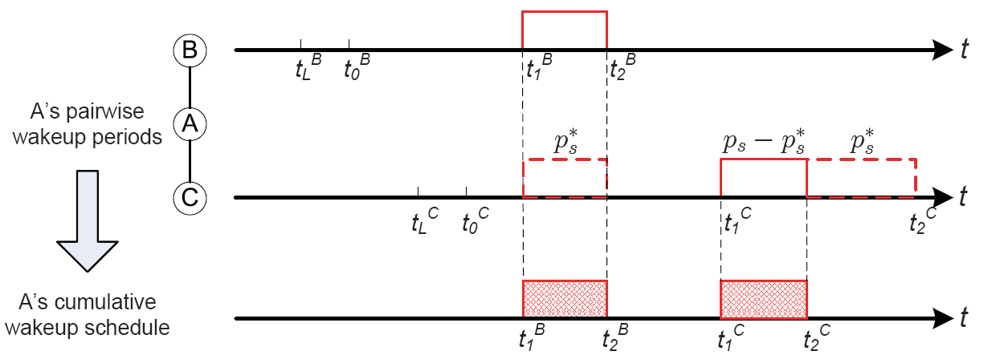
Cascaded Integration
Further optimization of energy efficiency
  A node may contact more than one contacted neighbors during one pairwise wakeup period
    E.g., A may contact C during [t₁^{B}, t₂^{B}] p_{s}*
    A’s pairwise wakeup period with C can be shortened due to an earlier wakeup period [t₁^{B}, t₂^{B}]
Notes:
A has the probability p_{s}* to contact C during its pairwise wakeup period with B. therefore, we can remove the corresponding length of A’s scheduled wakeup period with C, but still satisfy the performance requirement of contact probability. In the paper, we proposed analytical methods to calculate the remaining length of A’s wakeup period with C.

Slide 17
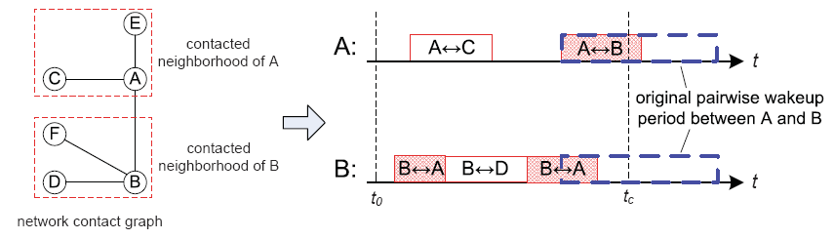
Preserving Scheduling Consistency
A and B may have different contacted neighborhood
  Pairwise wakeup scheduling is independent
Inconsistency when integrating pairwise wakeup periods
Notes:
When A and B integrates their pairwise wakup periods with their other contacted neighbors, they may integrate them in different ways. A->C, B->D. as a result, when the contact between A and B actually happens at t_{c}, B goes into sleep and miss the contact.

Slide 18
Preserving Scheduling Consistency
Solution: A and B communicate with each other before cascaded integration
  Exchange information about pairwise wakeup periods
  Ensure that the pairwise wakeup period between A and B is consistent at both A and B
Relaxation is needed between A and B
  Follows the one with lower contact probability
Notes:
If B has lower probability to contact its contacted neighbors, B will be prioritized to ensure its performance requirement can be satisfied. We prove that in this case, A’s performance requirement must also be satisfied.

Slide 19
Outline
Introduction
Big picture: energy saving through wakeup scheduling
Pairwise wakeup scheduling
Cumulative wakeup scheduling
Performance evaluation
Conclusion

Slide 20
Simulation Setup
Energy efficiency of unicast
Randomization
  Data generation time, TTL, data source and destinations
Data forwarding strategies
  Compare-and-Forward
    Forward data to a relay with higher metric
  Delegation
    Forward data to a relay with the highest metric
  Spray-and-Focus
Metric for energy efficiency: avg. number of contact probing per node during data TTL

Slide 21
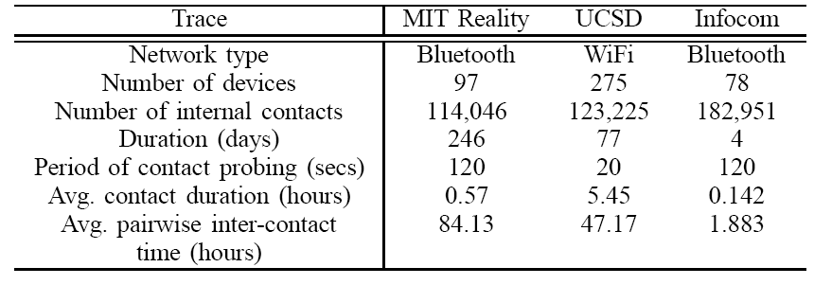
Traces
Realistic opportunistic mobile networks
Record contacts among mobile devices when they contact each other

Slide 22
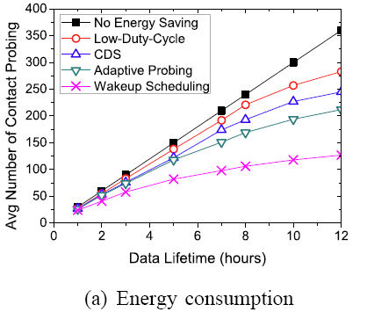
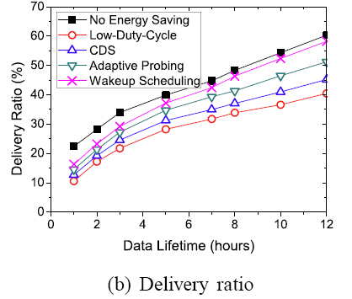
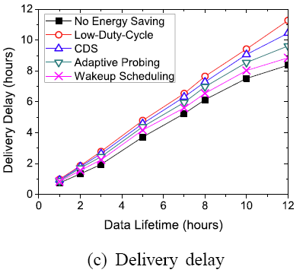
Energy Efficiency
Compare-and-forward strategy
Reduces energy consumption by up to 65%
  Better energy efficiency when data forwarding lasts longer
Slight performance degradation

Slide 23
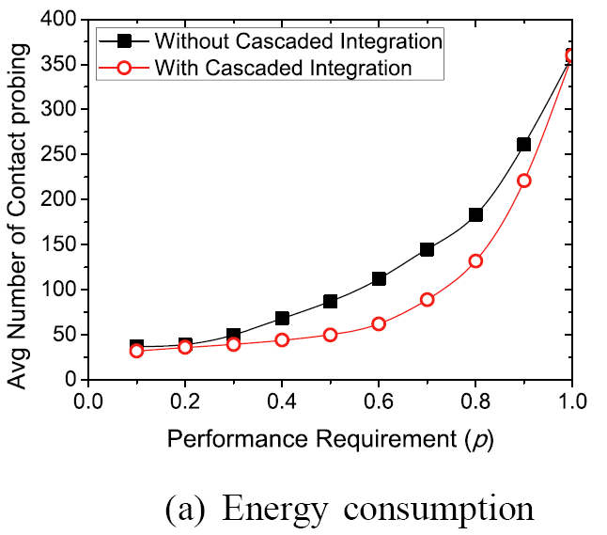
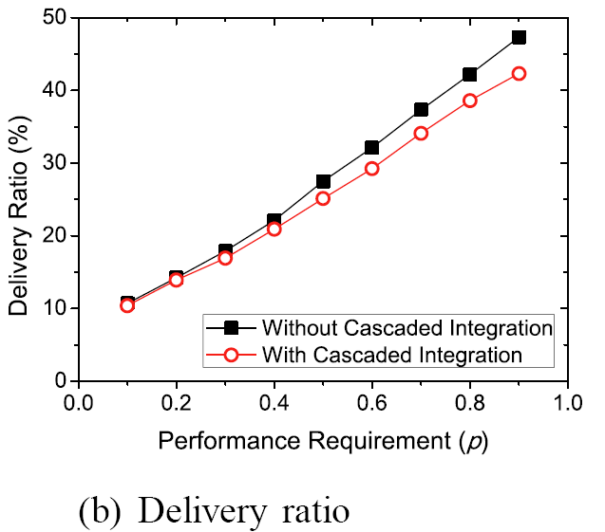
Impact of Cumulative Wakeup Scheduling
Cascaded integration helps further reduce energy consumption by up to another 40%

Slide 24
Conclusion
Reduce energy consumption of opportunistic communication while preserving communication performance
  Nodes only wake up when a predicted contact is likely to happen
Minimize the active ratio based on probabilistic contact prediction
  Efficient handling of prediction inaccuracy
Integration of independent pairwise wakeup periods
  Further reduction of energy consumption

Slide 25
Thank you!
Questions?
The paper and slides are also available at:
http://web.eecs.utk.edu/~weigao

