Slide 1
Multicasting in Delay Tolerant Networks: A Social Network Perspective
Wei Gao
Joint work with Qinghua Li, Bo Zhao and Guohong Cao
Department of Computer Science and Engineering
The Pennsylvania State University

Slide 2
Data forwarding in DTNs
Carry-and-forward methods
Mobile nodes are used as relays to carry data
Main problem: appropriate relay selection strategy and forwarding criteria
Difference between multicast and unicast
A relay is chosen for multiple destinations
We need to calculate the cumulative probability to forward data to multiple destinations
Difficult in DTNs

Slide 3
Our focus
Multicast: improve cost-effectiveness by effective relay selections
Minimize the number of used relays
Satisfy the required delivery ratio and delay

Slide 4
Social Network Perspective
Social network concepts
Social communities
Centrality
Another perspective
Contacts vs. mobility
Social relations: stable, long-term characteristics
Another form of mobility regularity
Social-based approaches
SimBet, BUBBLE Rap

Slide 5
Major Contributions
Analytical models for relay selections
Single-Data Multicast
Multiple-Data Multicast
Unified knapsack formulation for DTN multicast problems

Slide 6
Problem Formulation
Single-Data Multicast (SDM)
Deliver a data item to a set of destinations
Multiple-Data Multicast (MDM)
Deliver a set of data items to destination sets , respectively
Data items has sizes
Choose the minimum number of relays
Achieve the delivery ratio p within the time constraint T

Slide 7
Problem Formulation
Node buffer constraints
Assume each node N_{k} has a buffer size B_{k}
Trivial for SDM
Necessary for MDM
The node buffer may be only enough to carry a part of the data items
Which data item to carry?
Key difference between SDM and MDM!

Slide 8
Basic Approach
Basic idea: social-based relay selection metrics
Assume the contacts of each node pair as a Poisson process
Unified knapsack formulation
w_{k}: social-based metric values for mobile nodes
W: the totally required metric value determined by the required delivery ratio p and delay T

Slide 9
Basic Approach
SDM
Local knowledge is enough for relay selection
No node buffer constraint
The data source does not need to distinguish the data forwarding probabilities to different destinations
Centrality-based approach
The data source selects relays based on their centrality values

Slide 10
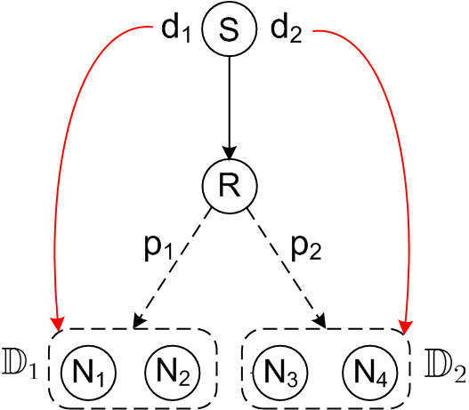
Basic Approach
MDM
Node buffer constraints: which data items to carry?
Compare p₁ with p₂
Relays should know the probabilities for forwarding data to different destinations
Destination-awareness
Community-based approach

Slide 11
Single-Data Multicast (SDM)
Localized centrality-based heuristic
Centrality metric for weighted social network
Relay selection
Ensure that all the nodes are contacted by the data source or the selected relays within time T

Slide 12
Centrality metric
Betweenness does not work well for weighted social network
Our solution: cumulative contact probability (CCP)
Suppose there are totally N nodes in the network
Average probability a random node is contacted by N_{i} within time T
CCP is more effective to evaluate nodes’ capabilities as relays

Slide 13
Relay selection
All the nodes are contacted by the data source or the selected relays within time T
Define p_{k}
The probability that a random node is not contacted by relay R_{k} within T
p_{k} can be calculated at individual nodes based on their centrality values
The delivery ratio is higher than p

Slide 14
Relay selection
Corresponding to the unified knapsack formulation

Slide 15
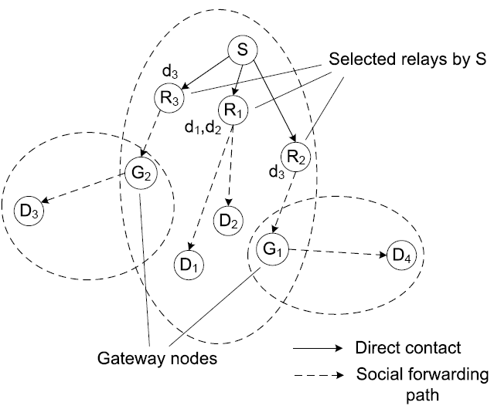
Multiple-Data Multicast (MDM)
A community-based approach is used
Each node maintains its destination-awareness about the other nodes in the same community
Inter-community data forwarding is done via the “gateway” nodes

Slide 16
Social Forwarding Path
Weight: the probability that a data item is forwarded from A to B within time T
PDF:

Slide 17
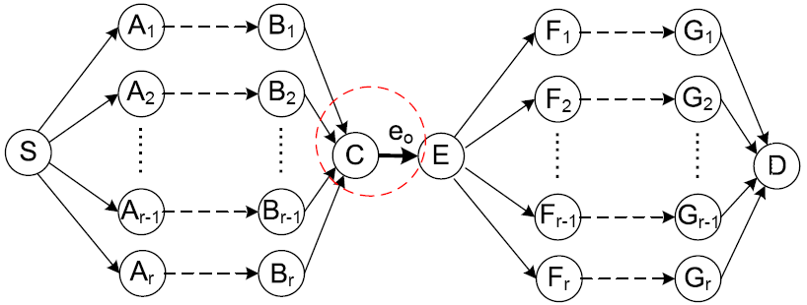
Edge-splitting process
Social forwarding paths may be overlapping
The probability that S sends data to D within time T is not
No analytical form!

Slide 18
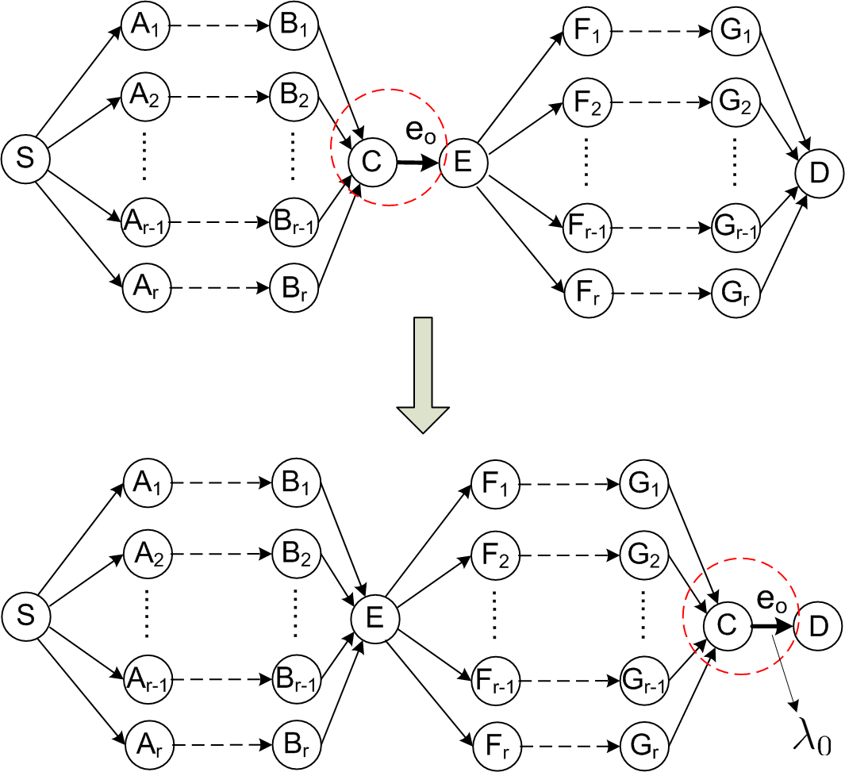
Edge-splitting process
Step 1: “Move” e₀ to the end of paths
Commutativity of convolution

Slide 19
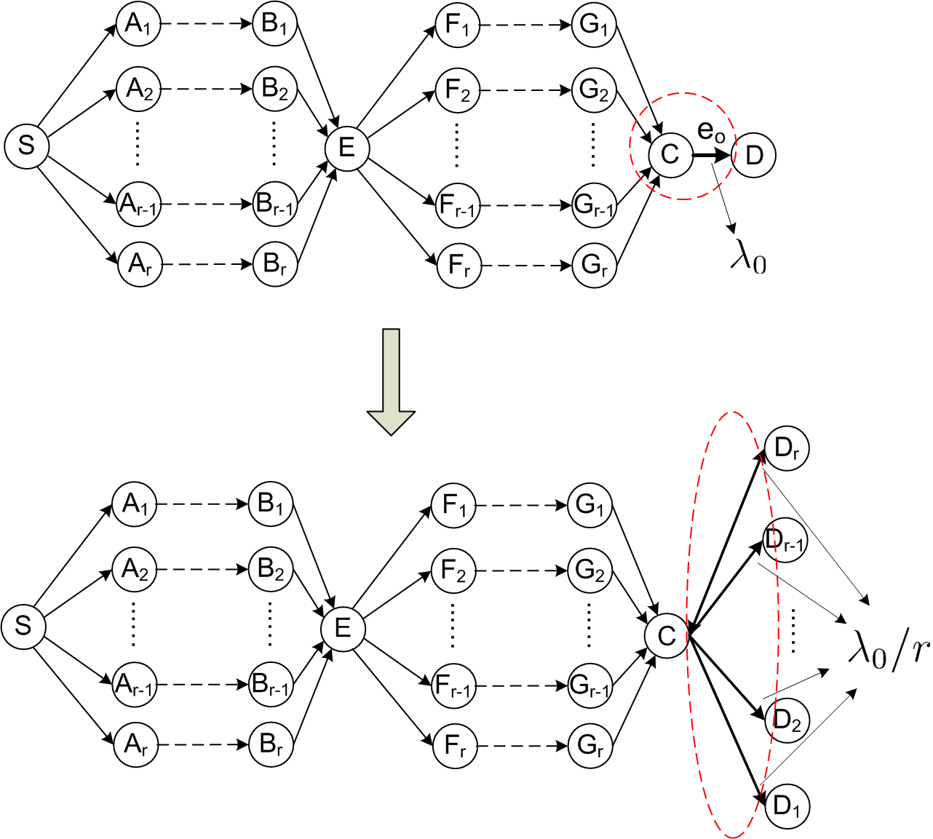
Edge-splitting process
Step 2: The overlapping edge is split to r edges
The contact rate is also split
Cumulative probability

Slide 20
Two-Stage Relay Selection
1. Data item selection
For each relay, which data items should it carry
2. Relay selection
Relay selection metric:
Used in relay selection:
(Similar form with that of SDM)

Slide 21
Performance Evaluations
Traces: Infocom and MIT Reality
Comparisons:
Epidemic routing & PROPHET
SimBet and BUBBLE Rap

Slide 22
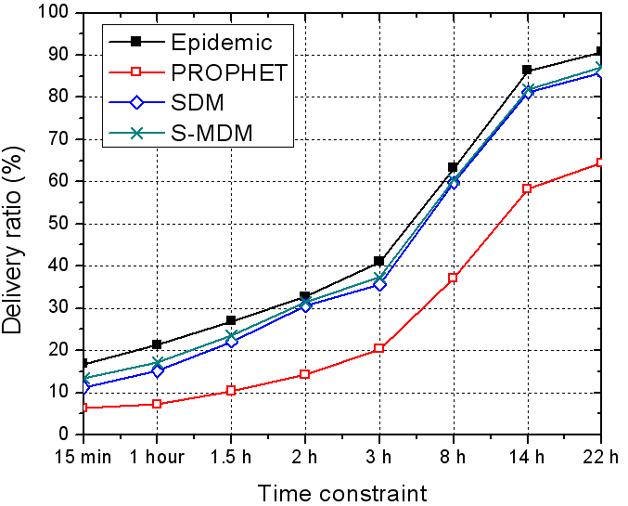
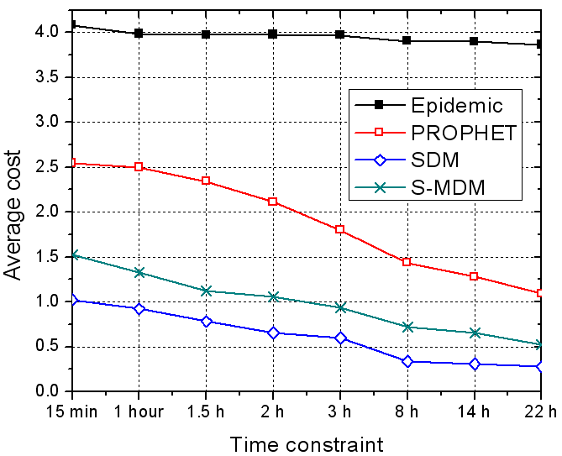
Performance of SDM
S-MDM: apply community-based MDM scheme to SDM problem
Similar performance, higher cost

Slide 23
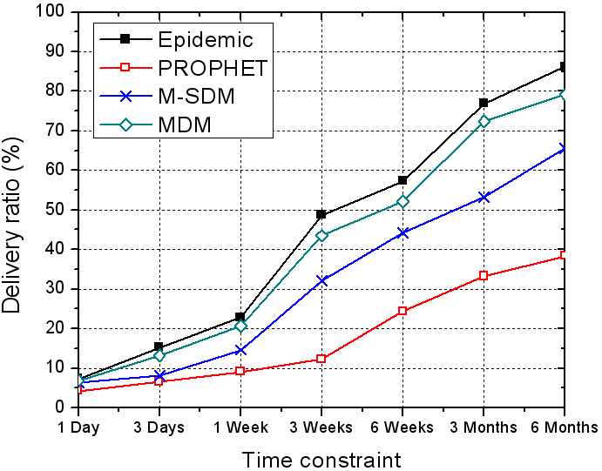
Performance of MDM
M-SDM: apply localized SDM scheme to MDM problem
Considerable performance degradation

Slide 24
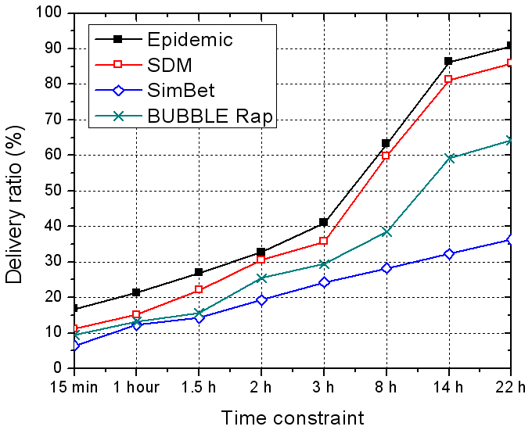
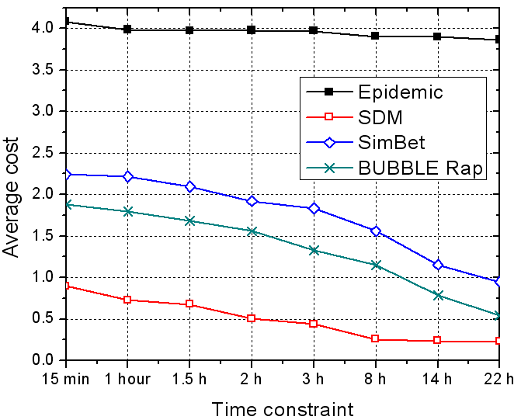
Compare with SimBet and BUBBLE Rap
Multicast is treated as separate unicast processes
Unicast approaches do not perform well for multicast

Slide 25
Conclusions
Multicast in DTNs from the social network perspective
Centrality-based localized heuristic for SDM
Community-based approach for MDM
The essential difference between multicast and unicast in DTNs
Data forwarding probability of a relay for multiple destinations
Our approach improves the cost-effectiveness of multicast

Slide 26
Thank you!
http://mcn.cse.psu.edu
The paper and slides are also available at:
http://www.cse.psu.edu/~wxg139

Slide 27
Delivery ratio
Average ratio of data items being delivered to destinations
For MDM,
The average probability that a destination node receives the data item within time T is higher than p
Different from the strict definition
For each destination node, the probability that it receives the data item within T is higher than p
Back

Slide 28
Social Network Concepts
Social communities
A natural outcome from the “small-world” phenomenon
“Six-degree” separation
Centrality
Some nodes in a community are the common acquaintances of other nodes
Various centrality metrics
Degree-based closeness
Betweenness
Socio-centric vs. ego-centric
Back

Slide 29
Community Detection
K-clique method
A k-clique community is defined as a union of all k-cliques that can be reached from each other
A k-clique is a complete sub-graph of size k
Can be implemented in a distributed manner
Pairwise contact rates are used as the admission criterion to a community
Back

Slide 30
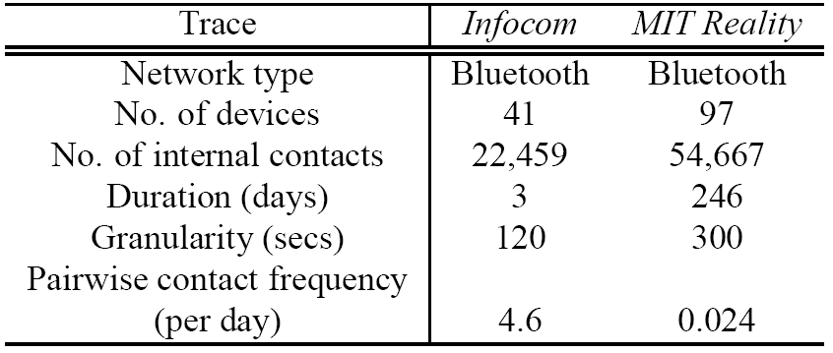
Traces
Record contacts among users carrying Bluetooth devices
Trace summary
Back

